Slide 1

Real-Time Social Media Sentiment Analysis Pipeline
Presented
1---Midhun
2---Rohith
3---Surya
4---Swetha

Slide 2

ABSTRACT
This project builds a real-time social media sentiment analysis pipeline using Amazon Kinesis for data streaming, PySpark with NLP for processing, and Delta Lake (Bronze → Silver → Gold) for storage. It provides aggregated sentiment insights and triggers Slack alerts for anomalies, enabling timely brand monitoring.

Slide 3

TECHNOLOGIES USED
• Amazon Kinesis – Real-time ingestion
• Logistic Regression – ML sentiment classification
• TextBlob – Sentiment scoring
• Python UDFs – Data enrichment
• Slack – Real-time alerts
• SQL Tables – Bronze, Silver, Gold, Log layers

Slide 4

Bronze Layer – Raw Data Storage
Purpose: Collect & Store Raw Data
Input: tweet.json (tweets + ML sentiment from Logistic Regression)
Ingestion: Amazon Kinesis (Producer sends data stream)
Storage: tweet_data table
Fields: id, user_id, tweet, timestamp, label, ml_sentiment
Acts as the foundation, keeping raw + ML predictions safe.

Slide 5

Silver Layer (Clean & Enrich)
Ensures data completeness & consistency
Enhances sentiment with score + human-readable class
Flags mismatches between ML prediction & sentiment
Produces enriched valid_tweets table for analysis

Slide 6
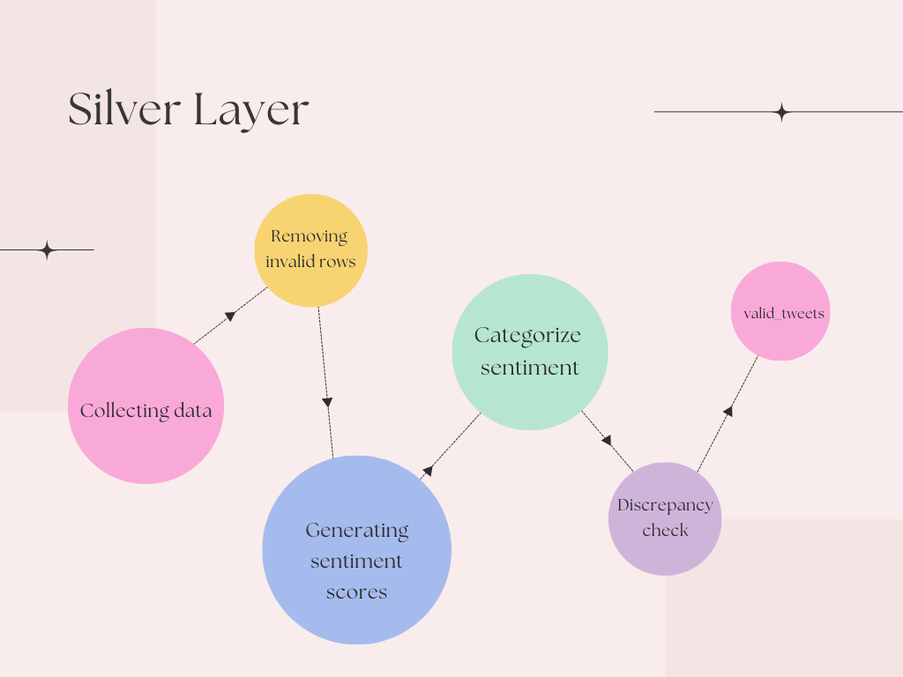

Slide 7
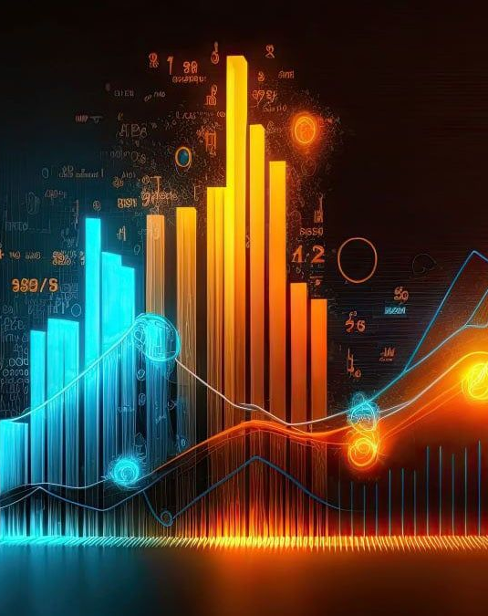
Gold Layer ( Business Insights )
Purpose: Generate Business Insights Tables created:
Hourly Sentiment Trend
Discrepant Tweets
Negative Word Frequency
Positive Word Frequency
Neutral Word Frequency
Top hashtags

Slide 8
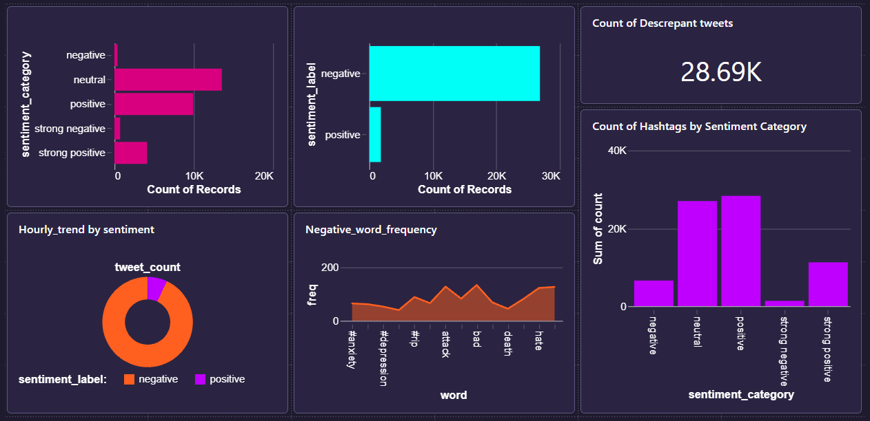
TWITTER SENTIMENT ANALYSIS DASHBOARD
The Twitter Emotional Pulse in Real-time

Slide 9

Logging, Monitoring & Alerts
Reads from valid_tweets
Captures discrepancies (label ≠ sentiment_category)
Stores anomalies in anomaly_log table
Sends real-time Slack alerts
Ensures trust & quality of the pipeline

Slide 10
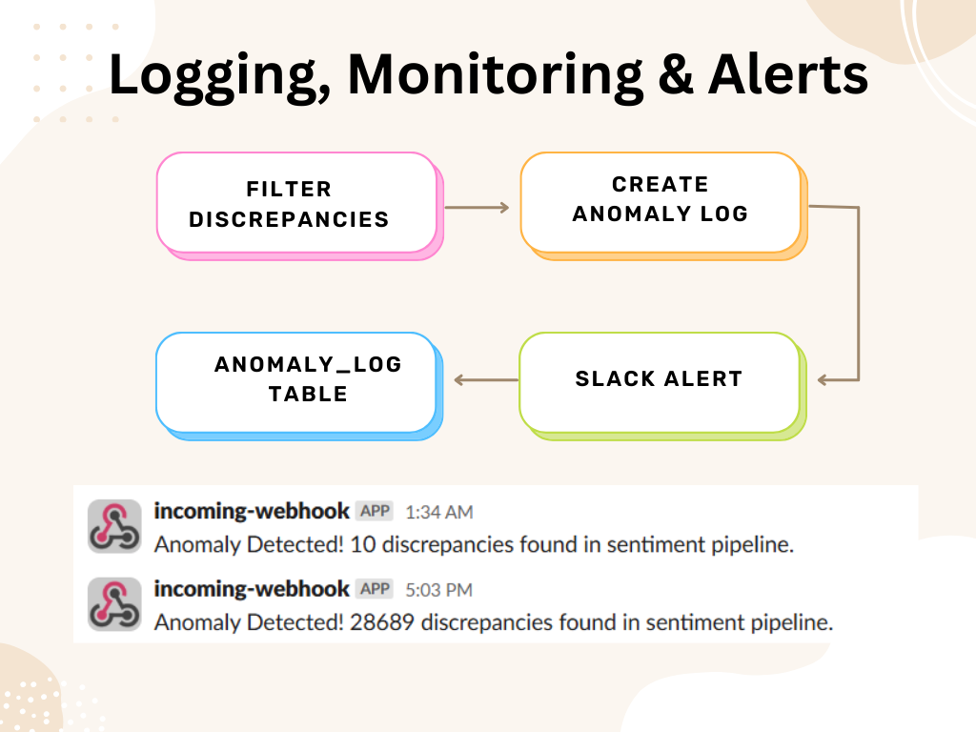

Slide 11

The real-time Twitter sentiment analysis pipeline successfully demonstrates how raw social media data can be ingested, processed, enriched, and analyzed to deliver actionable business insights. With the Bronze, Silver, Gold, and Logs, the pipeline ensures scalability, accuracy, and real-time monitoring, making it valuable for proactive brand monitoring and decision-making.

