Slide 1
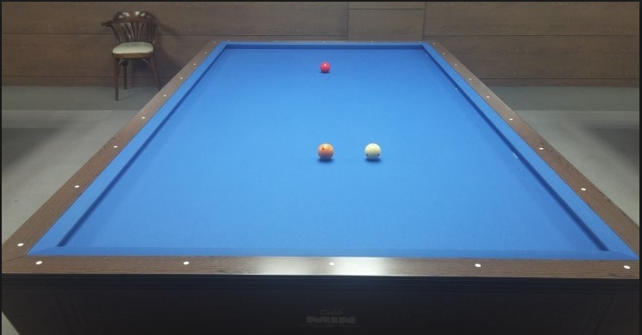
377,78
567,112
166, 137
628, 173
90, 217
433,176
378,177

Slide 2
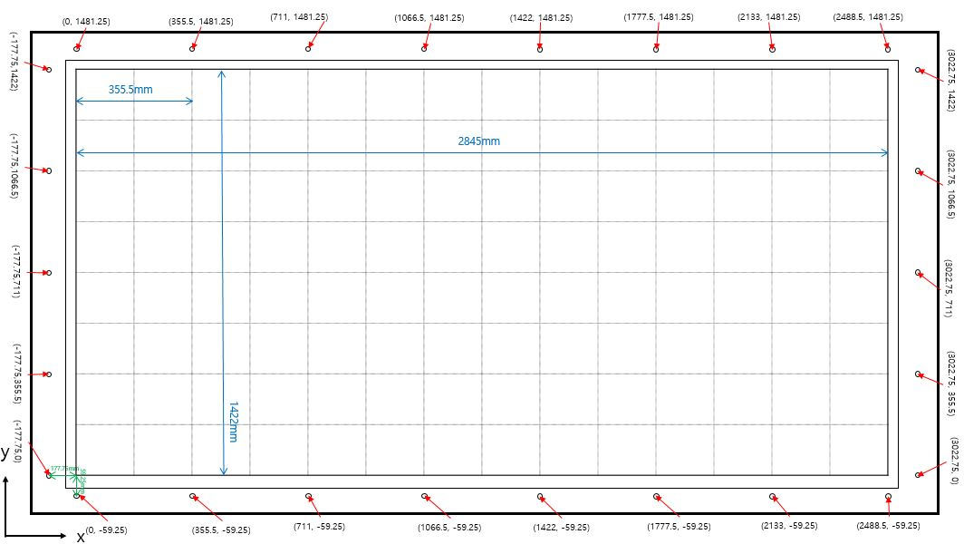
666.012, 713.312
676.871, 544.669
2051.17, 709.8

Slide 3
