Slide 1
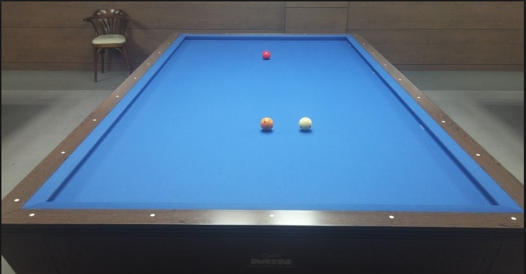
377,78
377.021,91.0558
567,112
166, 137
628, 173
b
b
90, 217
435.784,172.148
378.653, 171.895
433,176
378,177

Slide 2
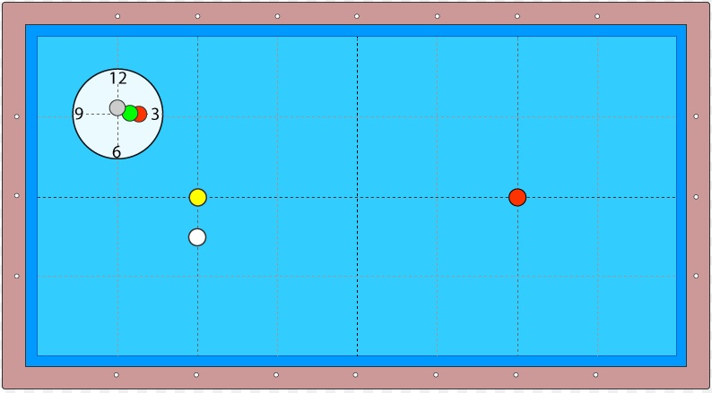

Slide 3
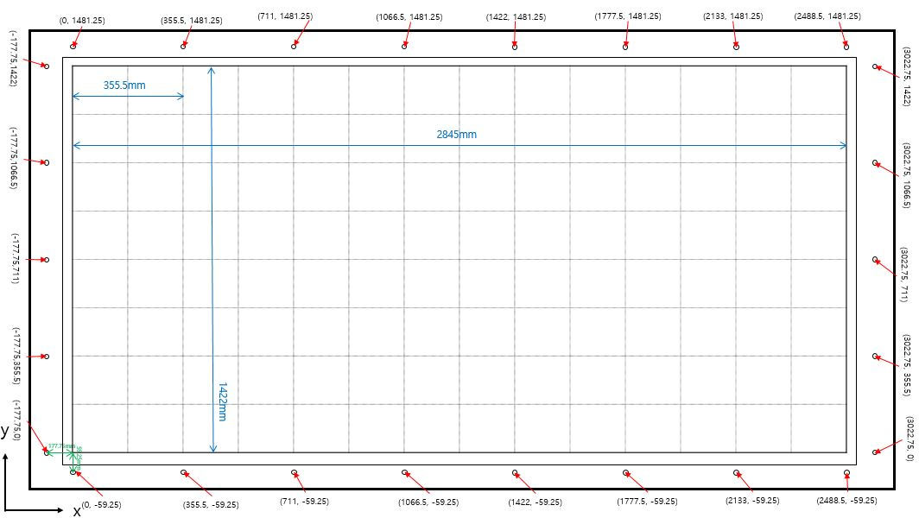
666.012, 713.312
676.871, 544.669
2051.17, 709.8

