Slide 1
TEST 1

Slide 2
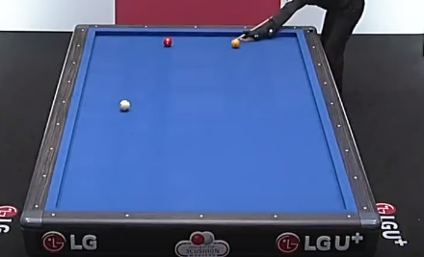
(7)99, 28
(8)150, 27
172, 43
(3)334, 85
(2)65, 105
(4)347, 130
(1)52, 153
(6)45, 182
242, 44
(5)38, 212
(12)374, 214
128,108
(9)54, 221
(10)131, 222
(11)358, 223

Slide 3
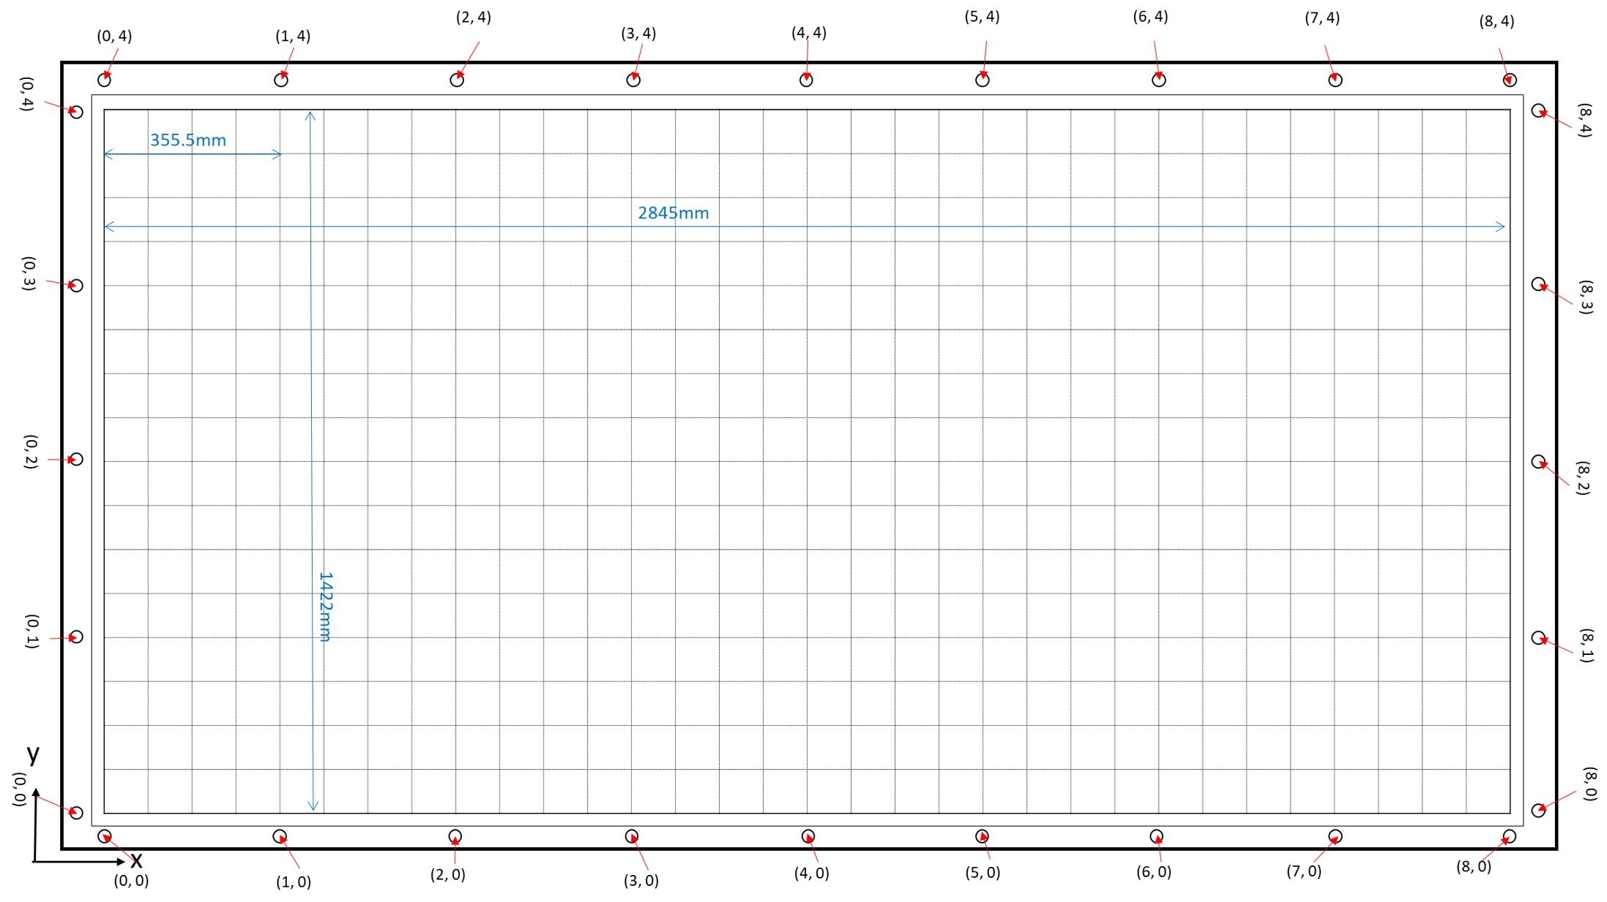
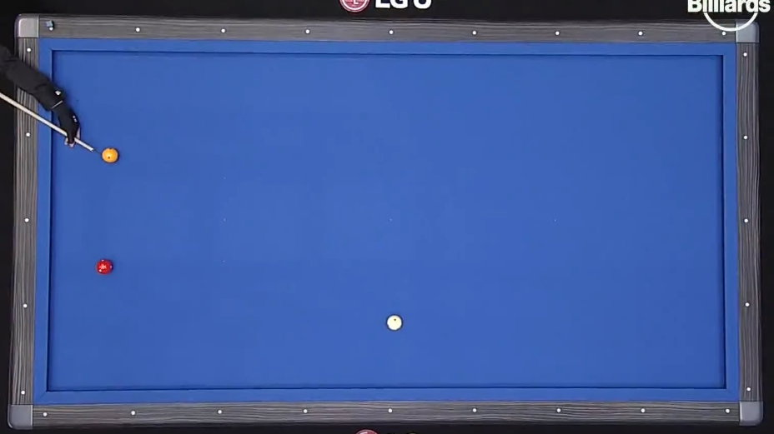
3.87971, 3.06195
7.24564, 2.47755
7.18652, 1.3141

Slide 4
TEST 2

Slide 5
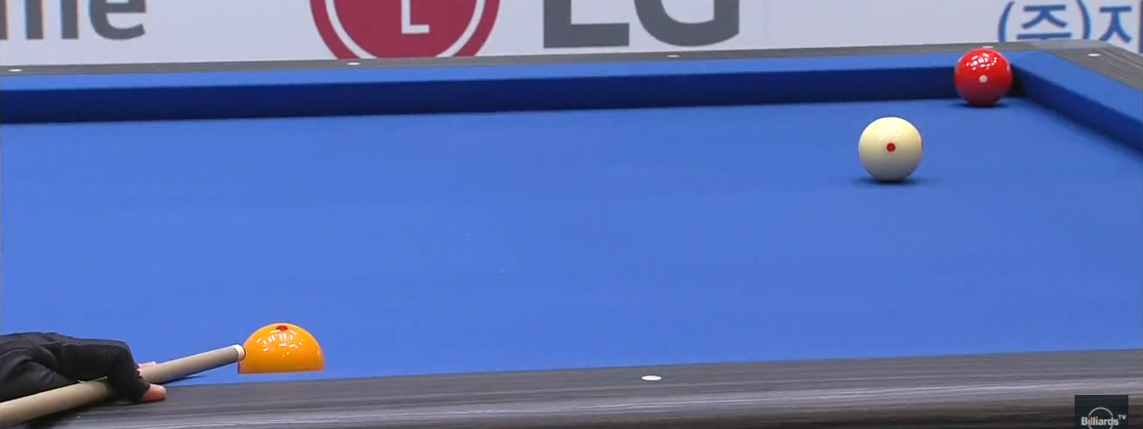
1008, 81
689, 57
1122, 56
362, 65
667, 387
913, 151
293, 378

Slide 6
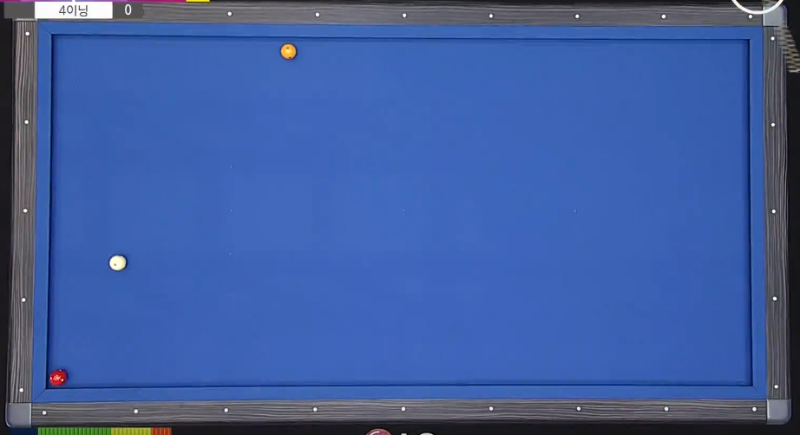
2834.86, 1292.48
2623.53, 926.28
1828.92, 99.4836

Slide 7
TEST 3

Slide 8
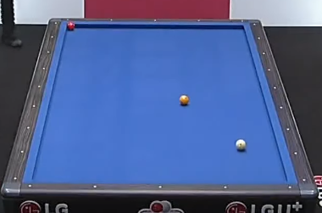
85, 31
133, 24
335, 128
363, 215
113, 222
220, 119
287,172

Slide 9
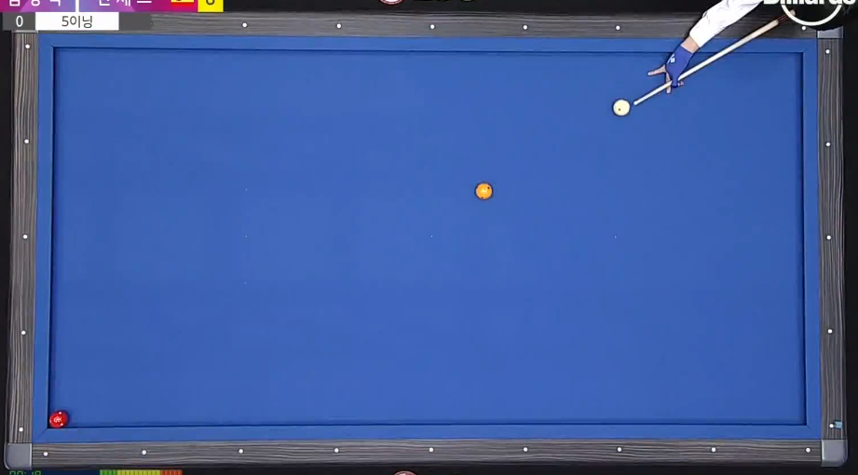
2874.47, 1400.36
1181.76, 529.604
465.83, 231.195

Slide 10
TEST 4

Slide 11
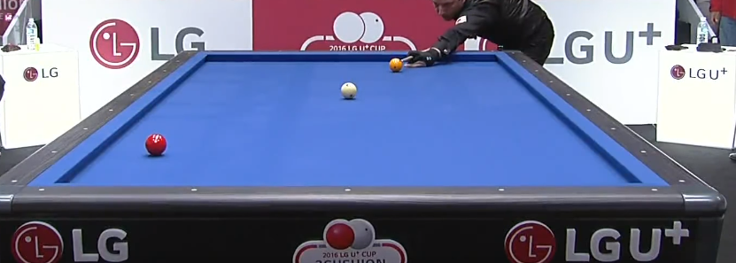
450, 73
170, 93
609, 80
669, 125
97, 146
396, 103
177, 165

Slide 12
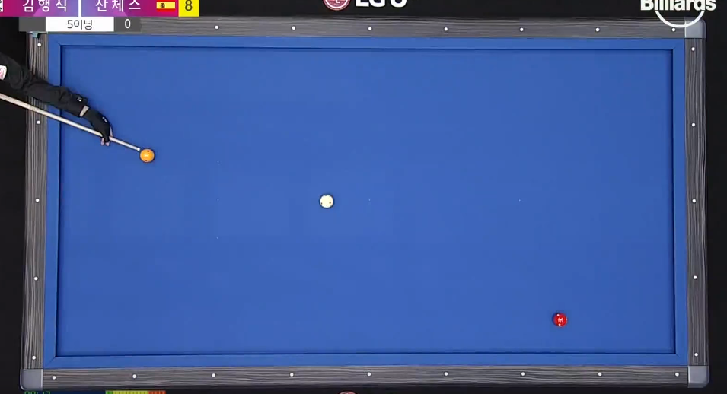
444.949, 1226.74
1524.21, 710.88
2364.77, 508.218

