Slide 1
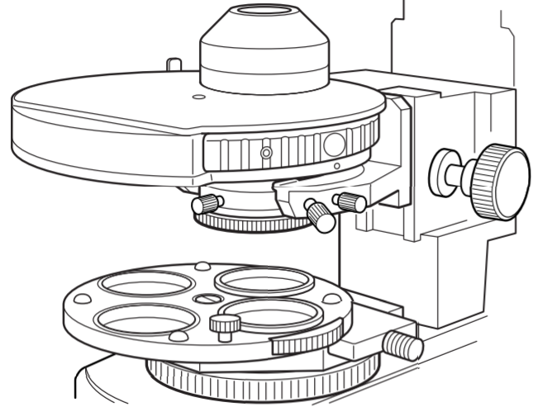
Condenser iris
Condenser turret
Condenser
Compensator lock
Condenser focus
Compensator rotation
Condenser lock
Polarizer
Condenser alignment
IR filter
Aperture iris
Polarizer rotation
Polarizer lock

Slide 2
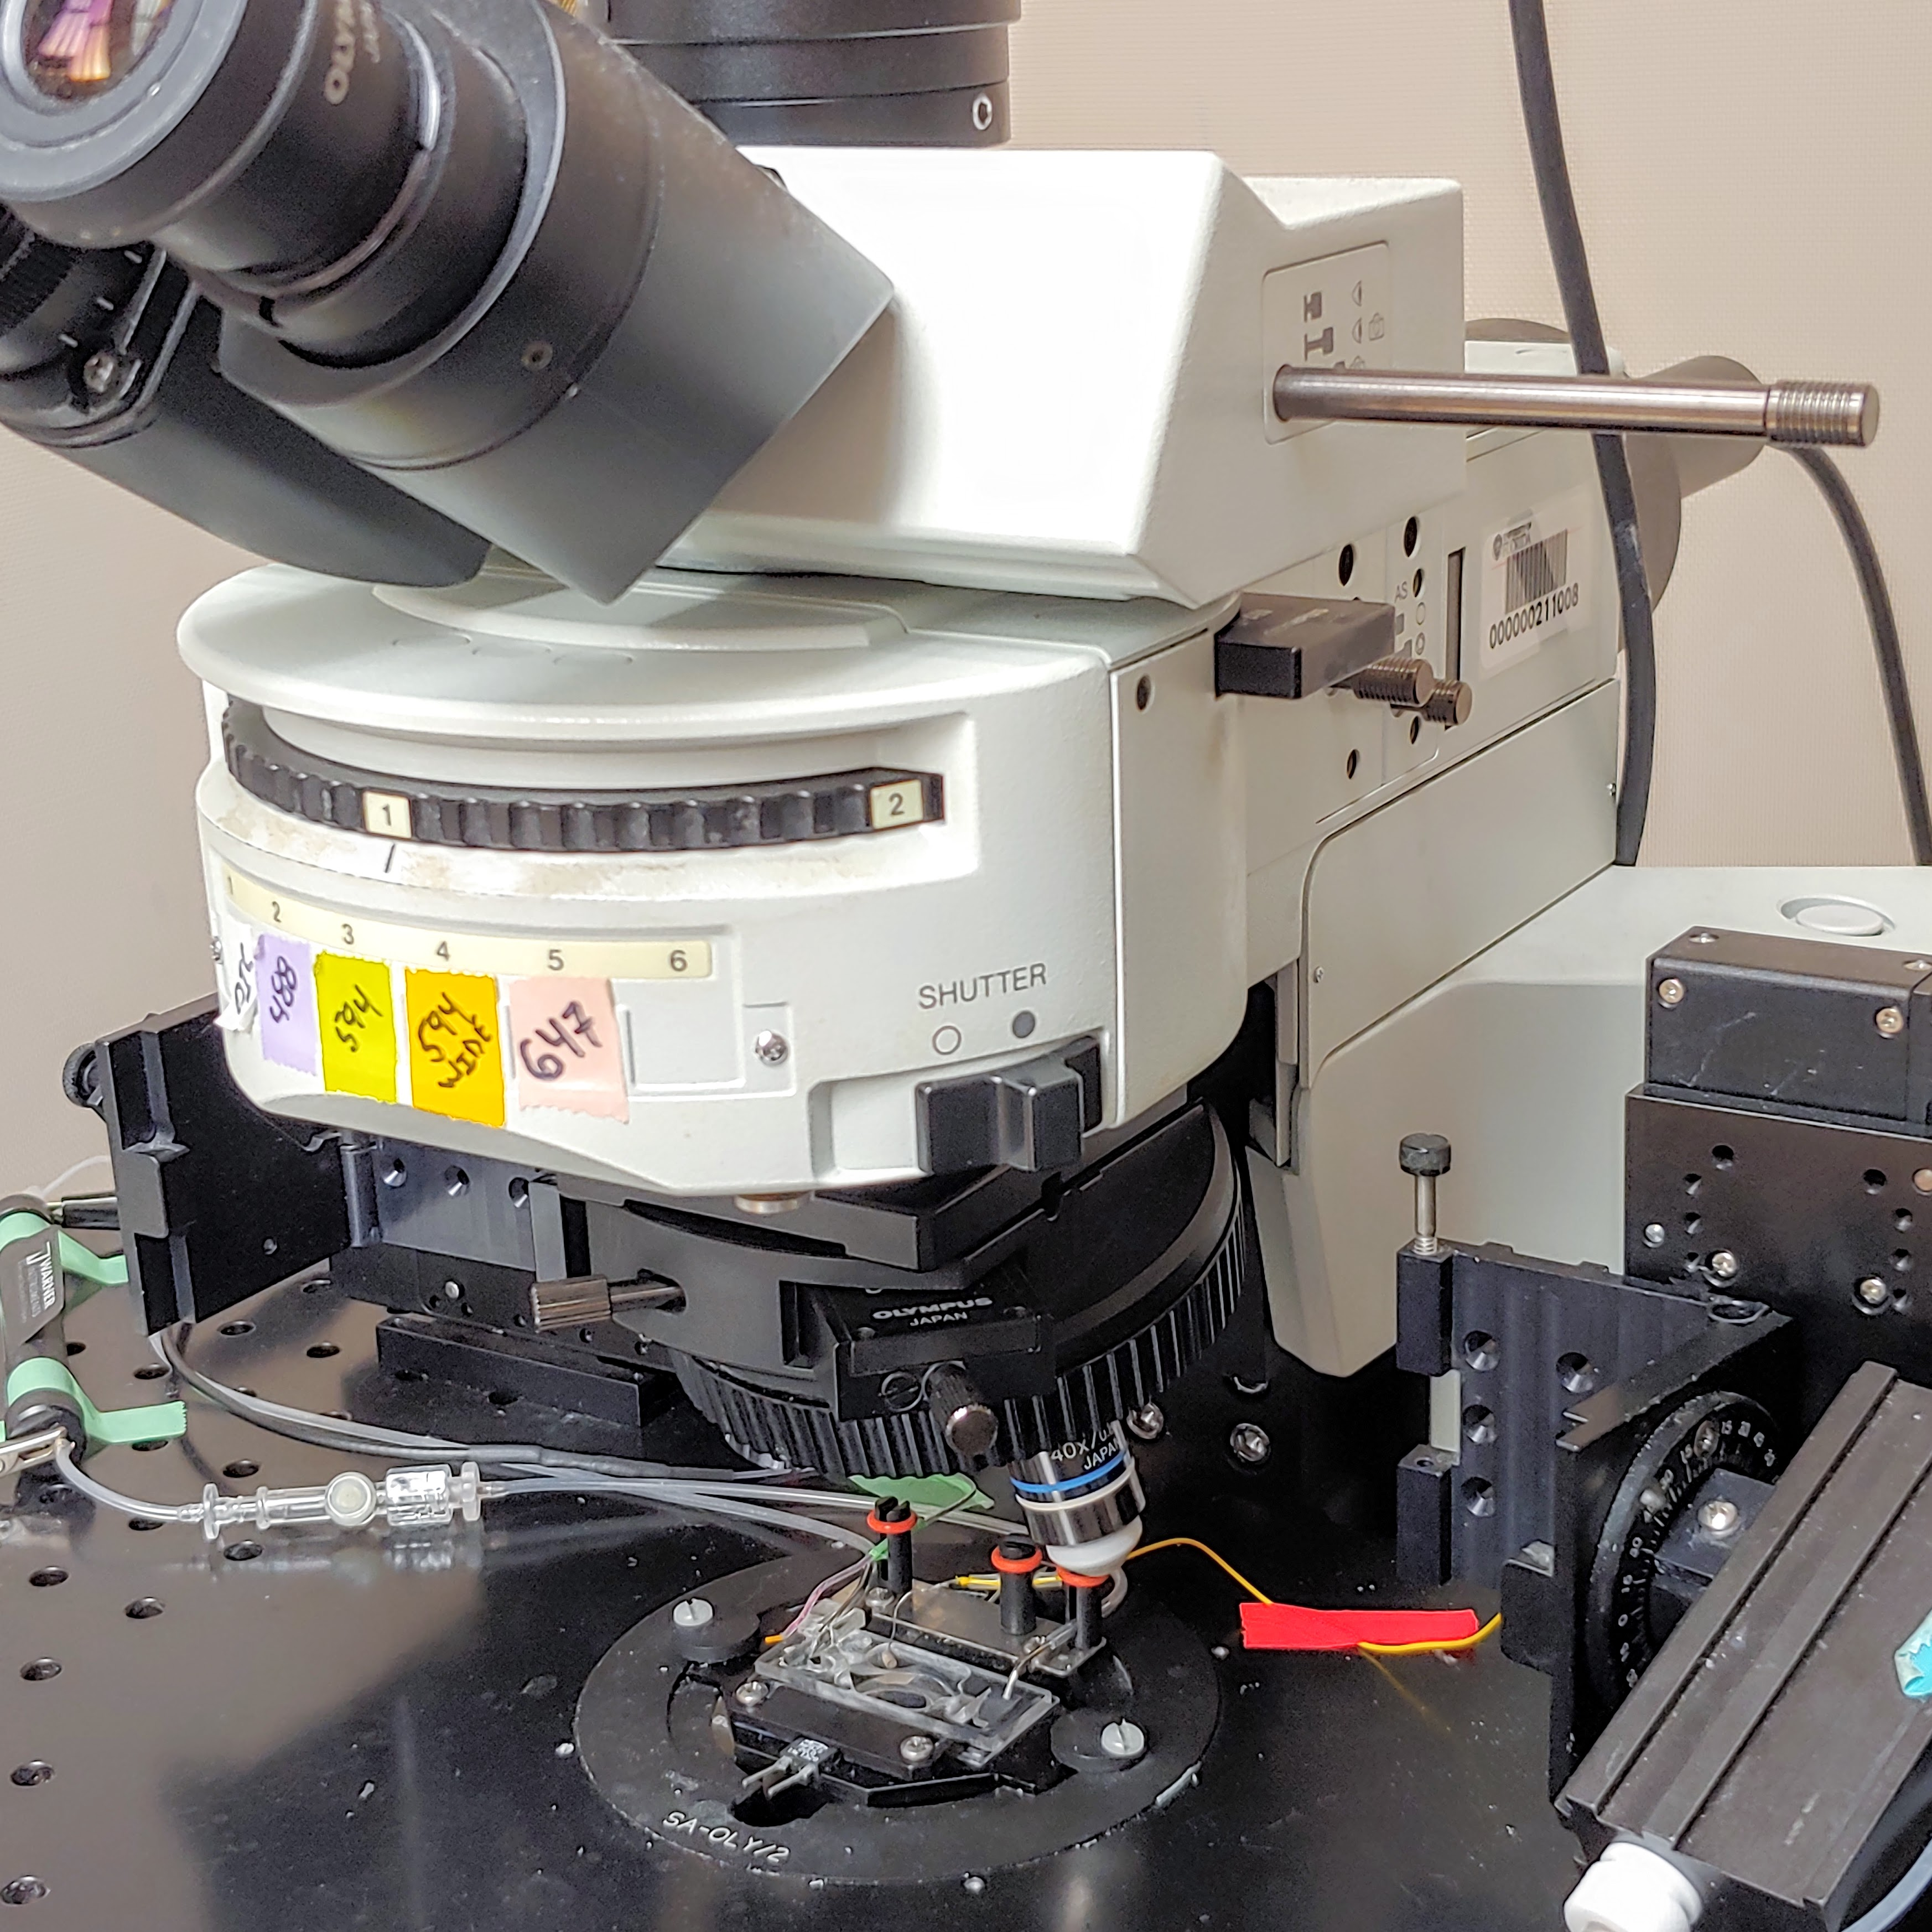
Path selector
Analyzer
Adjustable DIC prism

