Slide 1
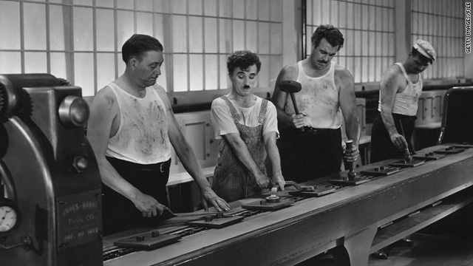




Many cores
Pipeline
Instructions devided in stepsMultiple instructions in the pipeline but at different steps
Importance of the order of the instructions
Memory hierarchy

