Slide 1
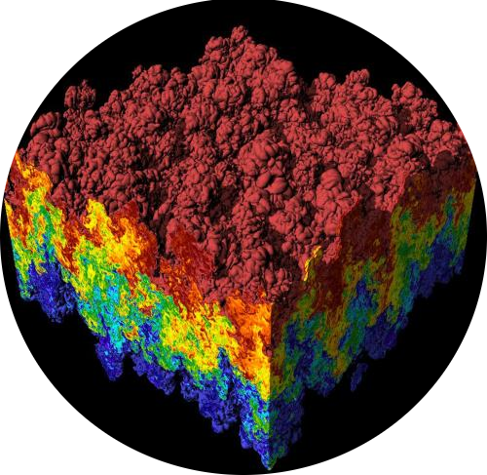
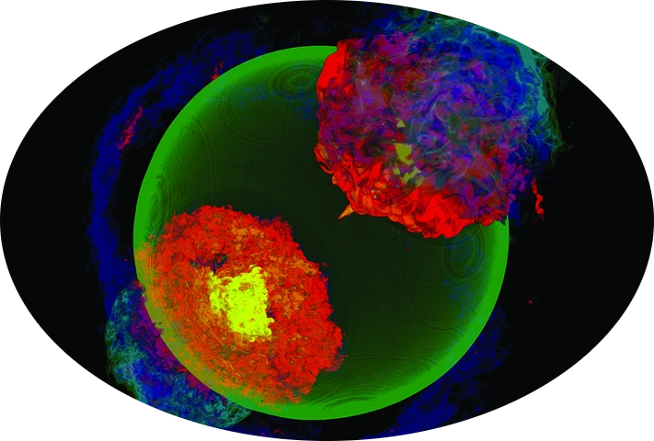

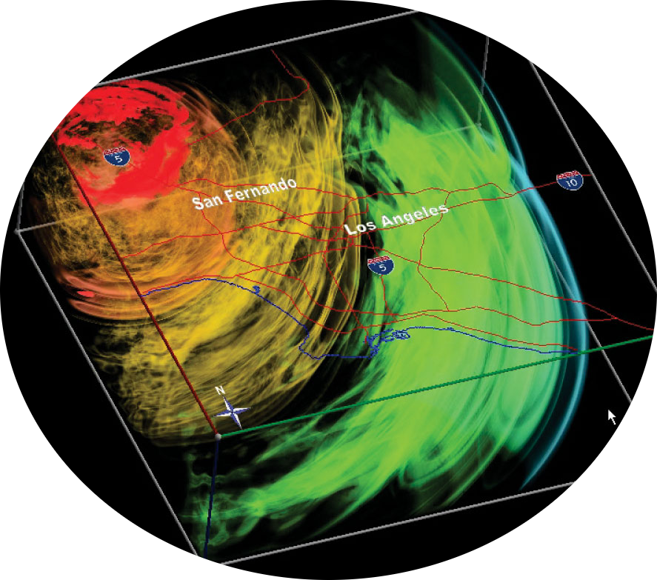
Scientific applications
High computational power need

Slide 2

Many cores
Tianhe-2 = 3,120,000 cores
Need to exploit parallelism
Efficiency is difficult to achieve

Slide 3

Many cores
Memory hierarchy
Circumvent memory wall
Data locality
Memory access pattern

Slide 4

Many cores
Pipeline
Instructions devided in steps
Memory hierarchy

Slide 5
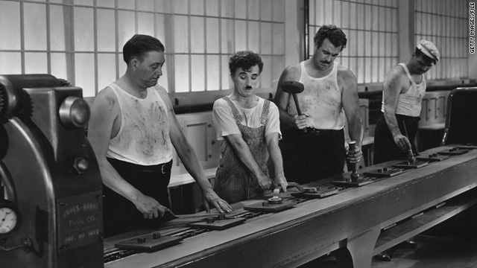
Many cores
Pipeline
Instructions devided in steps
Memory hierarchy

Slide 6
Many cores
Pipeline
Instructions devided in steps
Multiple instructions in the pipeline but at different steps
Importance of the order of the instructions
Memory hierarchy

Slide 7

Pipeline
Many cores
Vector support
Same Instruction Multiple Data
Save decoding phase
Memory hierarchy

Slide 8

Pipeline
Many cores
GPUs
Powerfull for scientific computation
Mapping computation on on pipeline suited to graphics
Different cache size and organization.
Memory hierarchy
Vector support

Slide 9
Pipeline
Many cores
GPUs
Memory hierarchy
Vector support

