Slide 1
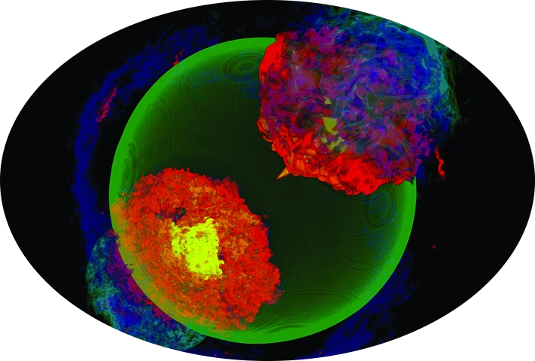

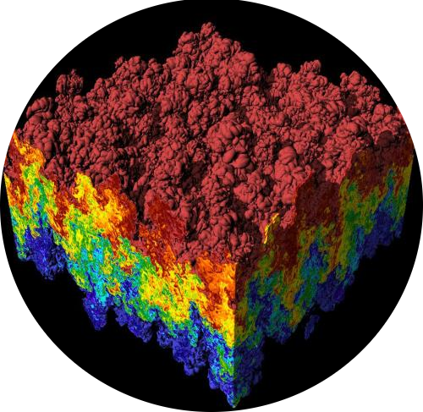






GPUs
Many cores
Memory hierarchy
Instruction set specific
Pipeline

