Slide 1
Conducting Longitudinal Data Analysis: Knowing What to Do and Learning How to Do It
SRCD 2019 Professional Development Workshop Daniel J. Bauer & Patrick J. Curran

Slide 2
Part I
Knowing What To Do: Survey of Techniques

Slide 3
Objectives
Distinguish between different longitudinal data structures
Clarify the analysis approaches that are associated with each type of data structure and the questions they can answer

Slide 4
Longitudinal Data
The term “longitudinal data” and hence also “longitudinal data analysis” is often used to describe different kinds of data structures.
It is helpful to differentiate these structures because they address different research questions and call for different analysis approaches.

Slide 5
Types of Longitudinal Analyses
Can first split by research focus into two distinct research questions that lead to very different data structures and analytic methods…
Longitudinal Data Analysis
Whether/When
Change
Time to Event Data
Repeated Measures Data

Slide 6
Time to Event Data
Time to event data is used to evaluate whether and when an event occurs.
Examples:
Does the age of menarche depend on the stability of the family configuration?
Do boys use marijuana more often and at earlier ages than girls?

Slide 7
Time to Event Data
Sometimes time to event data is obtained based on a single assessment
Sample individuals at age 40
Ask when first obtained a job, graduated from college, got married, became a parent, etc.
Such data are subject to retrospective recall bias
Better time to event data can be obtained using a prospective longitudinal design.
Sample individuals every 5 years from 15 to 40
At each occasion ask when first obtained a job, graduated from college, got married, became a parent, etc.

Slide 8
Survival Analysis
Time to event data is best analyzed using survival analysis
a.k.a. hazard models, event history analysis, life table analysis
Two flavors
Continuous time survival analysis:
Event times are measured in continuous time, such that the timing of the event is known with high precision (e.g., seconds or days) and it is uncommon for events to occur at exactly the same time for any two people.
Discrete time survival analysis:
Event times are measured on discrete time, that is, the timing of the event is measured coarsely (e.g., months or years), and it is common for events to occur at the same time for multiple people.
Allison (2010); Lee & Wang (2003); Singer & Willett (2003)

Slide 9
Longitudinal Data Analysis
Whether/When
Change
Time to Event Data
Repeated Measures Data
Precise
Intervals
Continuous-Time Survival Models
Discrete-Time Survival Models

Slide 10
Discrete Time Hazard Models
In the social and behavioral sciences time is usually measured coarsely and hence discrete time models are most useful.
Predict the hazard of event occurrence
Hazard at time t is probability of event occurrence at time t given the event did not already occur at a prior time
Based on the model for the hazard, one can also compute the lifetime distribution function and the survival function
LDF is cumulative probability of event occurrence over time
Survival function is complement of LDF; gives probability of not experiencing the event by time t

Slide 11
Hazard Functions
Most commonly, the hazard function is non-parametric (unstructured)
Hazards are uniquely estimated at every time point
Sometimes can be advantageous to utilize a parametric hazard function (structured)
Hazards are constrained to change according to some function

Slide 12
Longitudinal Data Analysis
Whether/When
Change
Time to Event Data
Repeated Measures Data
Precise
Intervals
Continuous-Time Survival Models
Discrete-Time Survival Models
N:interval ratio, irregular function,
frequency of events, value on parsimony, etc.
Nonparametric Hazard Function
Parametric Hazard Function

Slide 13
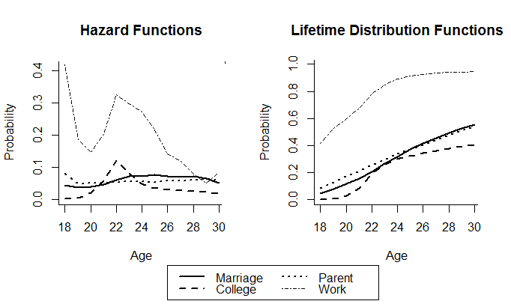
A Nonparametric Discrete-Time Model
Examining the timing of role status transitions
Dean, Bauer & Shanahan (2014)

Slide 14
A Parametric Discrete-Time Model
Hazard for developing an alcohol disorder as a quadratic function of years elapsed since onset of alcohol use
Hussong, Bauer & Chassin (2008)

Slide 15
Survival Functions
Probability of not being diagnosed with an alcohol disorder as a function of years from onset of alcohol use
Hussong, Bauer & Chassin (2008)

Slide 16
Longitudinal Data Analysis
Switching Branches…
Whether/When
Change
Time to Event Data
Repeated Measures Data
Intensive,
1 or a few units
Not Intensive,
More units
Time Series Analysis
Panel Data
Intensive,
More units
Intensive Longitudinal Data (ILD)

Slide 17
Time Series
Another type of longitudinal data structure is time series data
Time series data typically consists of a very long sequence of measurements on a single unit

Slide 18
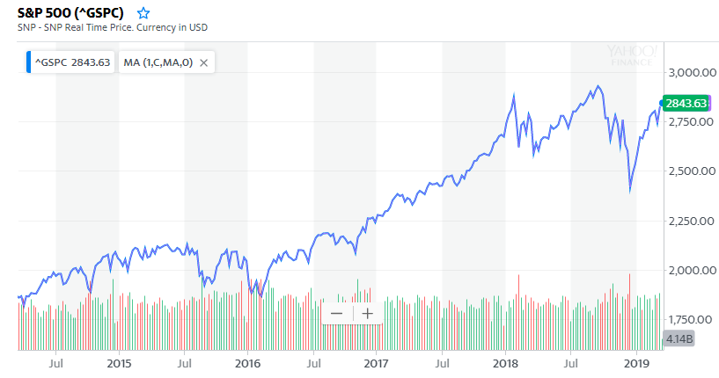
Example Time Series Data
S&P 500 index over the past 5 years
finance.yahoo.com

Slide 19
Goals of Time Series Analysis
In building a time series model, the primary goal is prediction / forecasting
What do we expect to happen to the S&P 500 tomorrow? Next week? Next month?
Prior observations are used to predict future observations
Common models are autoregressive, moving average, ARMA, ARIMA, etc.
These models vary in their assumptions and complexity
Sometimes interest is also in extracting other information
cyclical trend information like seasonal and/or weekly trends, although often try to de-trend data when doing time-series analysis
overall amount of variability (volatility)

Slide 20
Longitudinal Data Analysis
Whether/When
Change
Time to Event Data
Repeated Measures Data
Intensive,
1 or a few units
Not Intensive,
More units
Time Series Analysis
Panel Data
Intensive,
More units
Intensive Longitudinal Data (ILD)

Slide 21
Intensive Longitudinal Data Analysis
In the behavioral and health sciences, now common to use experience sampling to obtain time series on many individuals
Daily positive and negative affect ratings over 2 months for older adults
Daily pain ratings for one month for patients with rheumatic disease
A time series model sometimes fit to each individual’s data, and the parameter estimates then become individual difference variables
Standard deviation of a time series indicates intra-individual variability, instability
Magnitude of autoregression parameter has been interpreted as “inertia” in emotion research: larger values indicate it takes longer to return to equilibrium
Jahng, Wood & Trull (2008); Wang, Hamaker & Bergeman (2012)

Slide 22
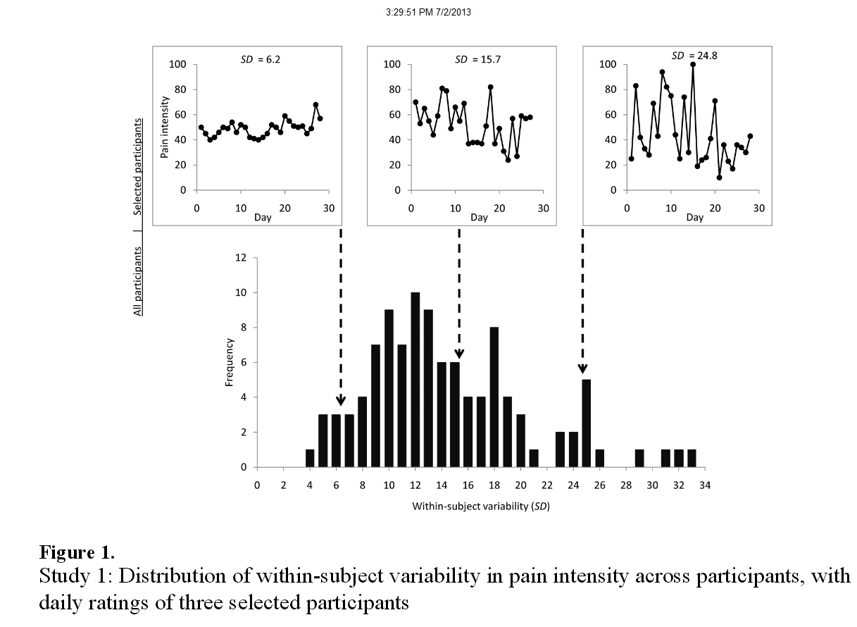
Individual Differences in Time Series
Pain ratings for patients with rheumatic disease
Schneider et al. (2012)

Slide 23
Longitudinal Data Analysis
Whether/When
Change
Time to Event Data
Repeated Measures Data
Intensive,
1 or a few units
Not Intensive,
More units
Time Series Analysis
Panel Data
Intensive,
More units
Intensive Longitudinal Data (ILD)

Slide 24
Panel Data
Most often, what we mean by longitudinal data is panel data
Panel data is data collected over a relatively small number of time points on a relatively large number of units
Examples:
Biennial assessments of alcohol and substance use in adolescents and young adults from ages 14 to 30.
Monthly assessments of vocabulary production by infants/toddlers from 8 to 24 months of age
Other similar data structures arise from
Randomized clinical trials
Accelerated longitudinal designs

Slide 25
Analysis Goals
A common goal when collecting panel data is to evaluate change over time
One can distinguish between mean-level change…
On average, how much more quickly does the vocabulary production of girls increase relative to the vocabulary production of boys?
and individual-level (within person) change…
What do individual trajectories of vocabulary production look like?
How great are the individual differences in these trajectories?

Slide 26
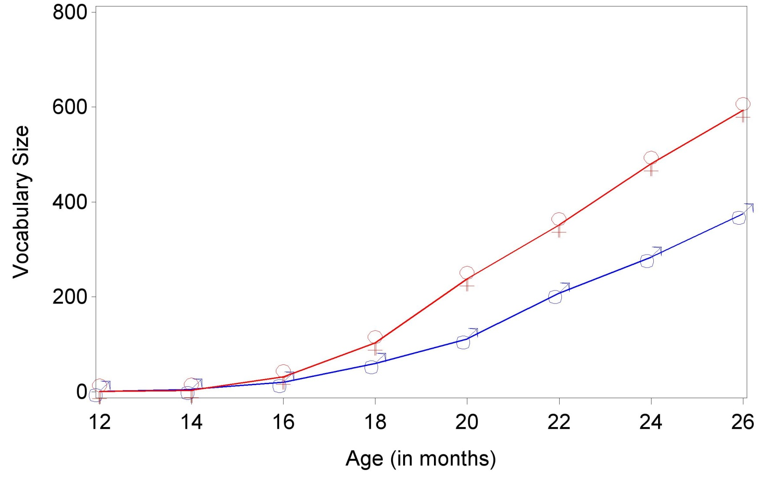
Example: Vocabulary Development
Mean-level differences in developmental change
Huttenlocher et al. (1991)

Slide 27
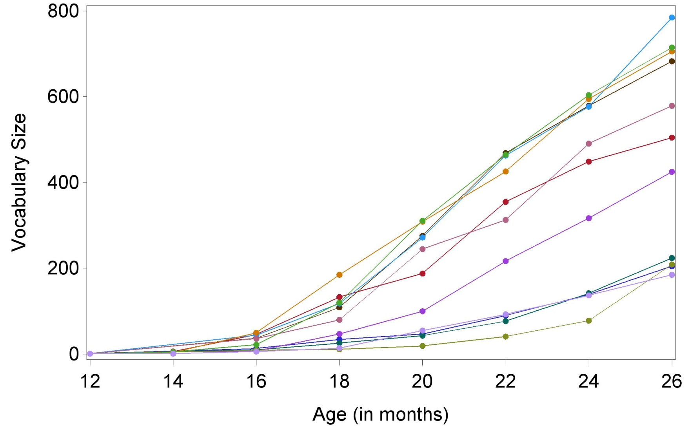
Example: Vocabulary Development
Individual differences in developmental change
Huttenlocher et al. (1991)

Slide 28
Analytic Techniques
Models that focus exclusively on mean-level change sometimes called Marginal Models
Those that emphasize individual change often do so through inclusion of Random Effects
often called “growth models”

Slide 29
Panel Data
Mean Change
Individual Change
Marginal Models
Random Effect Growth Models

Slide 30
Marginal Models
Modeling approaches that focus on mean change:
Repeated measures ANOVA and MANOVA
ANCOVA (especially with pre/post data)
Generalized Estimating Equations

Slide 31
Panel Data
Mean Change
Individual Change
Marginal Models
Random Effect Growth Models
Linear
Non-Linear
RM-ANOVA
ANCOVA
Generalized Estimating Equations

Slide 32
Example: Treatment of Schizophrenia
GEE model fit to evaluate efficacy of drug treatment for symptoms of schizophrenia
Observed v. Predicted: Model Scale
Observed v. Predicted: Outcome Scale
8
1.0
7
6
5
0.8
4
3
0.6
2
log-odds of severe sx
probability of severe sx
1
0
0.4
-1
-2
Condition
Condition
-3
0.2
-4
Control
Control
-5
Treatment
Treatment
-6
0.0
0
1
2
3
0
1
2
3
4
5
6
square root of weeks on treatment
weeks on treatment
Hedeker & Gibbons (2004)

Slide 33
Modeling Mean Change
GEE particularly popular in longitudinal health research because it provides robust inferences without making strong assumptions about individual differences
Particularly useful when working with discrete outcomes
Repeated measures ANOVA and ANCOVA remain popular for within-subjects experimental designs but less so for over-time longitudinal data
Except when limited to 2 waves of data…

Slide 34
Limitations of Two Time Points
Having only two time points makes it difficult to study anything but mean change
Problem is it is difficult to parse individual change from error
Two waves of data are better than one, but maybe not much better
Rogosa, Brandt, Zimowski (1982)
Obvious measure of individual change is difference score between two time points, but this is often unreliable

Slide 35
The Trouble with Difference Scores
True and observed difference for a hypothetical case
y
Time 1
Time 2

Slide 36
Switching Branches…
Panel Data
Mean Change
Individual Change
Marginal Models
Random Effect Growth Models

Slide 37
Modeling Individual Change
Random effects models start by focusing on individual or within-person change
One person’s data
With 3 or more time points, can separate true change from error
depression
Underlying indiv. trajectory
time

Slide 38
A Growth Curve for One Person
Can summarize line by two pieces of information
the intercept and the slope unique to individual i
intercept
slope
depression
time

Slide 39
Random Effects
Intercept and slope coefficient values permitted to vary over individuals
Variation in growth coefficients described by a distribution
Growth coefficients are random effects in statistical sense that they come from a probability distribution
We usually don’t literally estimate the coefficients for each person, but rather the parameters of the distribution from which they came
This allows us to make inferences to full population of people from which our sample was drawn

Slide 40
Differences by Degree or Kind?
Key question is how to define the distribution of the random effects
Modeling approaches differentiate based on assumptions about how individuals are thought to differ from one another
Quantitative variation on a continuum: differences of degree
Qualitative differences between types of trajectories: differences in kind

Slide 41
Panel Data
Mean Change
Individual Change
Marginal Models
Random Effect Models
Differ by Degrees
Differ in Kind
Multilevel Model
Latent Curve Model
Mixed Effects Model
Semi-Parametric Groups-Based Approach
Latent Class Growth Analysis
Both
General Growth Mixture Models

Slide 42
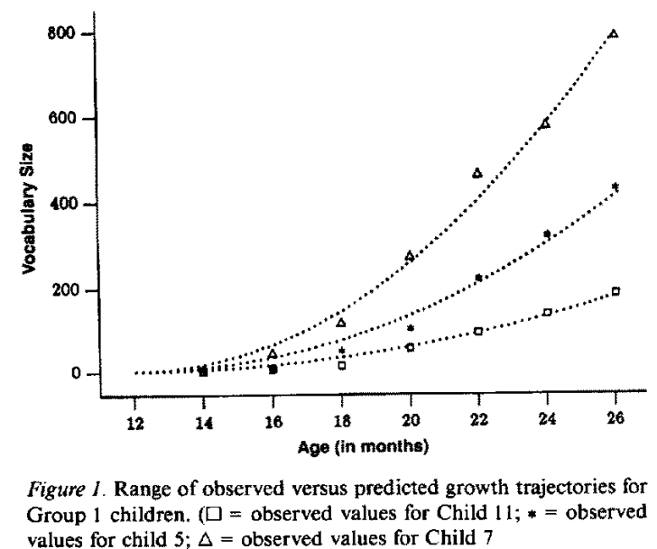
Example: Modeling Vocabulary Growth
Huttenlocher et al. (1991)

Slide 43
Example: Ambulatory HR Over 24 Hrs
Richman, Pek, Pascoe & Bauer (2010)

Slide 44
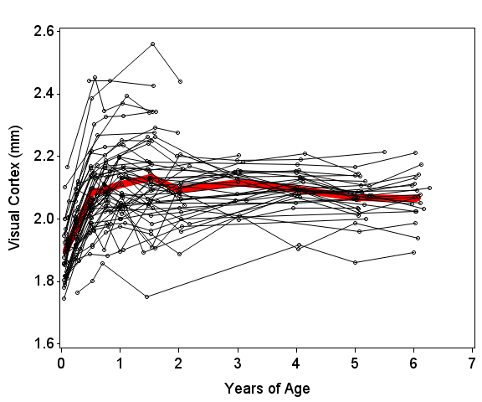
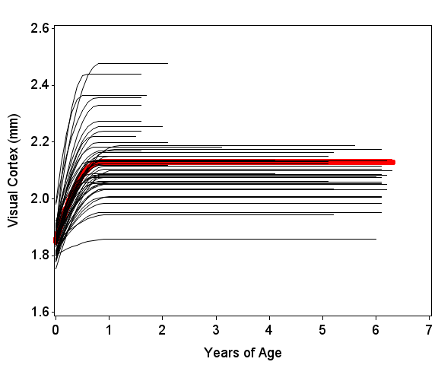
Example: Cortical Development
Observed Data
Predicted Trajectories
Sheridan, Cohen, Bauer & Lin (in progress)

Slide 45
Conditional Models
Often goal is not only to see individual differences in change but also to examine differences as a function of a predictor
Predictor could be known grouping variable (boys/girls vocabulary)
Predictor could be continuous (stress)
Plot expected trajectories by levels of predictors to visualize differences in change over time
But what if trajectories might differ as a function of some unknown grouping?

Slide 46
Panel Data
Mean Change
Individual Change
Marginal Models
Random Effect Models
Differ by Degrees
Differ in Kind
Multilevel Model
Latent Curve Model
Mixed Effects Model
Semi-Parametric Groups-Based Approach
Latent Class Growth Analysis
Both
General Growth Mixture Models

Slide 47
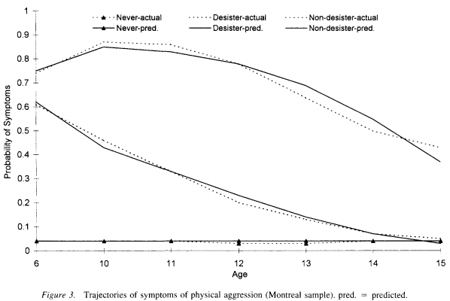
Example: Physical Aggression
Nagin (1999)

Slide 48
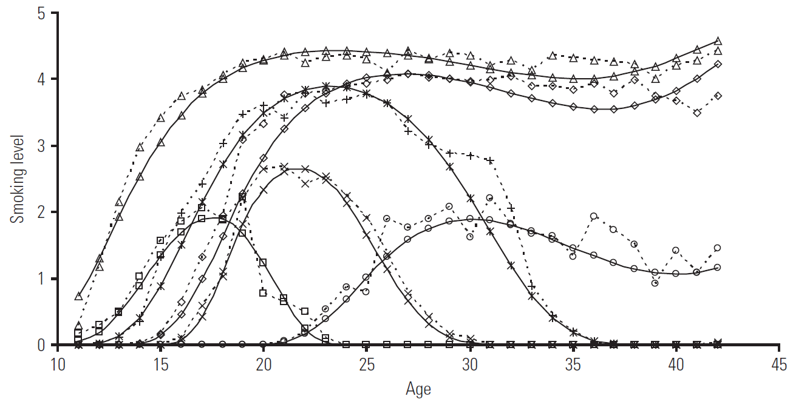
Example: Tobacco Use Trajectories
Chassin, Curran, Wirth, Presson & Sherman (2009)

Slide 49
Panel Data
Mean Change
Individual Change
Marginal Models
Random Effect Models
Differ by Degrees
Differ in Kind
Multilevel Model
Latent Curve Model
Mixed Effects Model
Semi-Parametric Groups-Based Approach
Latent Class Growth Analysis
Both
General Growth Mixture Models

Slide 50
Archetypal Case: Antisocial Behavior
Moffitt (1993) posited a developmental taxonomy for antisocial behavior, but can imagine variation within each “theme”
Hypothetical patterns
Antisocial Behavior
1
Life-course persistent
Adolescent limited
age
Moffitt (1993)

Slide 51
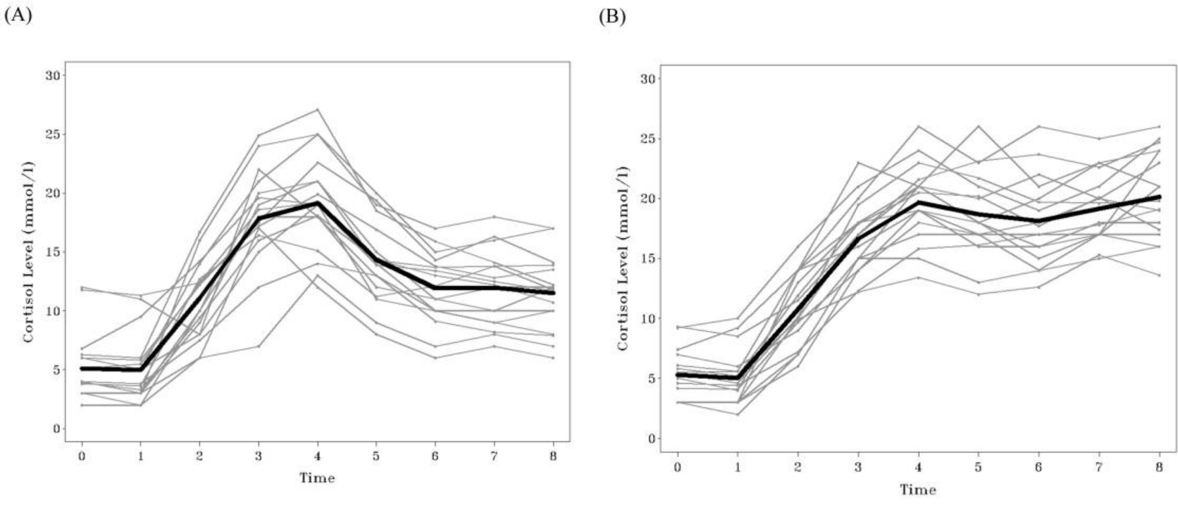
Example: Cortisol Response to Stress
Down-regulation group (Typical)
Chronic stress group
Ram & Grimm (2013)

Slide 52
Other Panel Data Models
There are many, many other panel data models that are useful in a variety of other circumstances
We’ll briefly look at some of these here…
Not a comprehensive listing

Slide 53
Autoregressive Cross-Lag (ARCL) models
Evaluate bidirectional effects as they unfold over time

Slide 54
Multivariate Growth Models
Examine how trajectory coefficients are related across processes
Int_{y}
Slp_{y}
Int_{z}
Slp_{z}

Slide 55
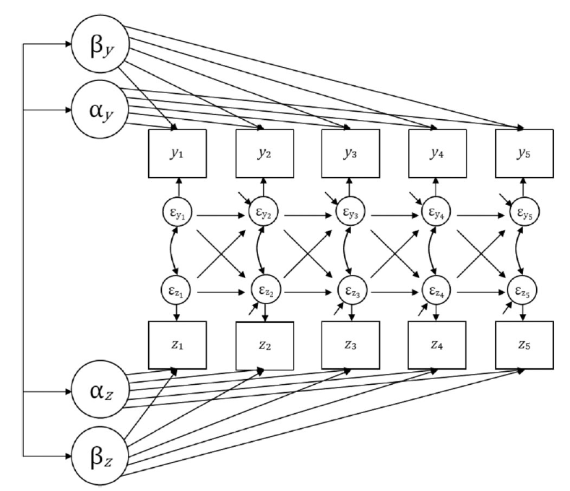
Models that Combine Growth and ARCL
LCM-SR to separate within and between person relationships
Curran et al. (2013)

Slide 56
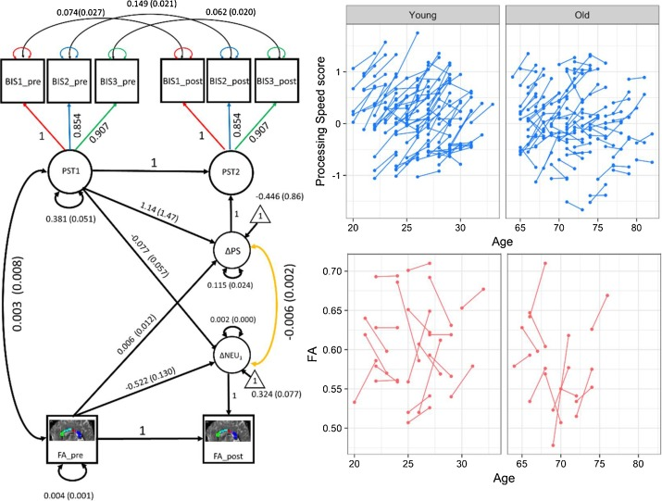
Latent Change Score Models
Examine relationships between time-adjacent changes
Kievit et al. (2018)

Slide 57
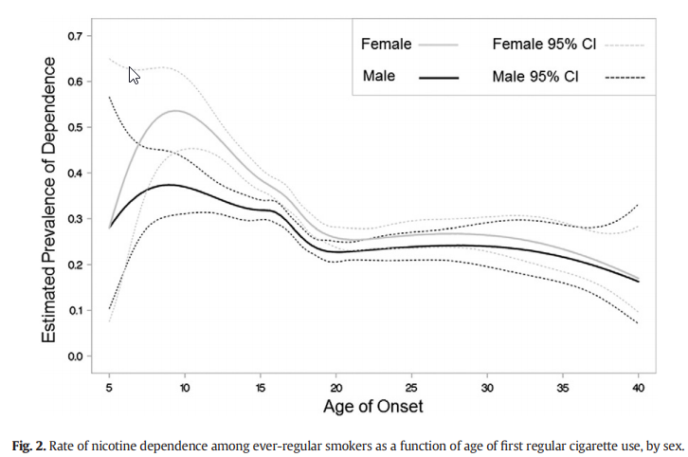
Time Varying Effects Models
Evaluate how effect of predictor varies over time
Lanza & Vasilenko (2015)

Slide 58
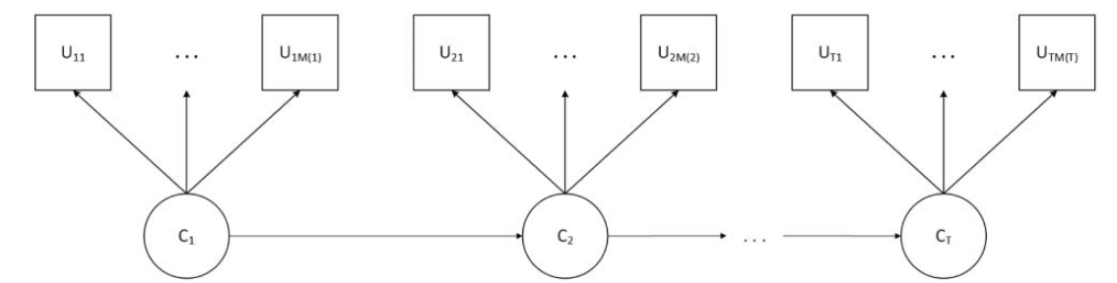
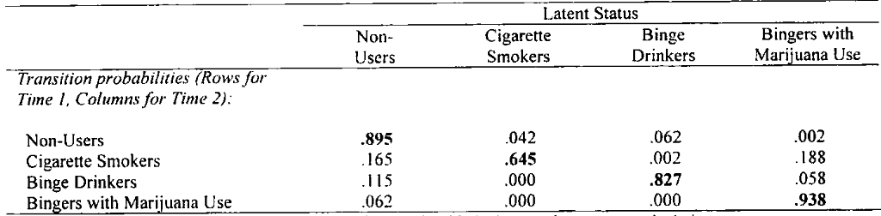
Latent Transition Analysis
Evaluate stage-like change
Lanza et al. (2010); Scorza et al. (2015)

Slide 59
Summary by Research Focus / Data Type
Research Focus | Data Type | Model
Whether/when event occurs | Time to event | Precise times: Continuous-time survival analysis Coarse intervals: Discrete-time survival analysis
Predict future observation | Time series | AR, MA, ARMA, etc
Individual differences in volatility, inertia | Intensive longitudinal | Multiple time series analyses
Mean differences in change | Panel (2+ waves) | RM-ANOVA, ANCOVA, GEE
Within-person change | Panel (3+waves) | Quantitative Ind. Differences: Multilevel, mixed effects, latent curve Qualitative Ind. Differences: Latent class growth analysis, Semiparametric groups-based approach Qual Themes + Quant Variations: General growth mixture model

Slide 60
Summary by Research Focus / Data Type
Research Focus | Data Type | Model
Bidirectional effects over time | Panel data | Auto-regressive Cross Lag
Change in one process related to change in another | Panel data | Trajectories: Multivariate growth model Pairs of time points: Latent change score model
Change + bidirectional | Panel data | Latent curve model with structured residuals
Timing of predictor effects | Intensive longitudinal Long-term panel | Time-varying effects models
Progression through stages/sequence | Panel data | Latent transition analysis

Slide 61
Summary
“Longitudinal data” may refer to a variety of different data structures
Analytic techniques vary by data structure and are designed to answer different questions
Surveyed many commonly used techniques, when they are typically applied, and to what ends
Many exceptions to generalities noted here, and many techniques not covered
A large and growing literature to keep up with
So how do you keep up with it?

Slide 62
Part II
Learning How to Do It: Options for Additional Training

Slide 63
Objectives
Describe training options available for learning how to conduct longitudinal data analyses of various kinds

Slide 64
Range of Options
Training options range in level of formality and scaffolding
Formal in-person coursework
Scaffolding

Slide 65
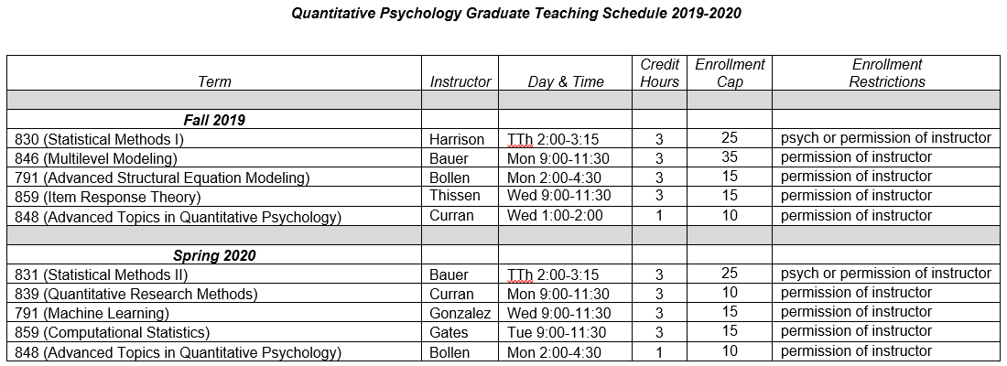
Coursework
Large, research focused universities will tend to have some graduate-level coursework
Example: UNC has a quantitative psychology graduate program with six faculty who regularly teach graduate level courses…

Slide 66
Advantages of Coursework
In depth treatment of topic over a semester
Hands on examples
Opportunities to complete assignments and obtain feedback

Slide 67
Disadvantages of Coursework
Accessibility can be limited
Are you at a university that offers these classes?
Are you eligible to take them?
Still a student? If not, does instructor allow others to sit in?
Restrictions on enrollment
Can you find them?
Sprinkled over departments
Are they being offered when you need them and can take them?
Time involvement
A semester is a long time to wait if you have an analysis you need/want to do now
Homework assignments may not bear much similarity to your situation

Slide 68
Range of Options
Training options range in level of formality and scaffolding
Formal in-person coursework
Workshops
Scaffolding

Slide 69
Workshops
Many different groups offer training seminars on longitudinal data analysis techniques
Curran-Bauer Analytics
ICPSR
APA Advanced Training Institute
Statistical Horizons
Stats Camp
Many more…
Nice listing of these here…
http://reifmanintrostats.blogspot.com/2019/02/2019-list-of-summer-statistics-and.html

Slide 70


Slide 71
Advantages of Workshops
In depth treatment of topic
5-day workshop approximately equivalent to a semester-length class
Training obtained quickly through intensive coverage
Can take when you need it

Slide 72
Disadvantages of Coursework
Cost, although can sometimes be offset
Institutional travel awards
Awards made by professional organizations
SMEP award for students from under-represented groups: https://smep.org/resources/underrepresented-fellowships
Write into grants (e.g., K and R awards)
Travel
Can avoid if do online workshop, but remote participation less engaging and effective (in our opinion)
Assignments/feedback often limited
But may be able to obtain individualized consulting on your specific project while in attendance

Slide 73
Range of Options
Training options range in level of formality and scaffolding
Formal in-person coursework
Online courses
(variable)
Workshops
Scaffolding

Slide 74
Advantages of Online Courses
Often low cost or free
Can do whenever you want and in as much depth as you like

Slide 75


Slide 76

Disadvantages of Online Courses
Can be hard to find
Little/no contact with instructors
Requires a lot of self-discipline

Slide 77
Range of Options
Training options range in level of formality and scaffolding
Formal in-person coursework
Online courses
(variable)
Workshops
Online tutorials
(variable)
Scaffolding

Slide 78
Advantages of Online Tutorials
To the point
15-minute YouTube video tells you exactly what you needed to know
Can do whenever you want
May be able to find multiple tutorials on the same topic
Obtain diversity of perspectives, see taught different ways

Slide 79
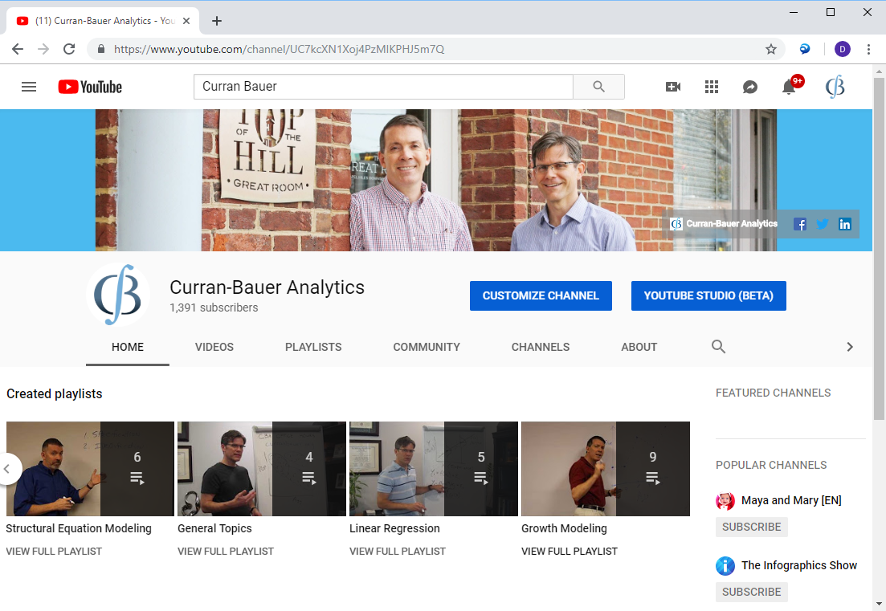

Slide 80
Disadvantages of Online Tutorials
Coverage typically less in depth
Little or no contact with instructors
Often no assignments or opportunities for feedback on application of models
May focus on concepts or may focus on implementation but often not both

Slide 81
Range of Options
Training options range in level of formality and scaffolding
Formal in-person coursework
Online courses
(variable)
Workshops
Online tutorials
(variable)
Self Study
Scaffolding

Slide 82
Self Study
Can always read about techniques on your own
Textbooks
Tutorial articles
Applications in the research literature you might emulate

Slide 83
Advantages of Self Study
Do on your own time, to the extent you want
Resources generally low-cost
Can often obtain from university library
Pursue whatever topics interest you as you go

Slide 84
Disadvantages of Independent Study
Textbooks sometimes challenging to navigate on one’s own
Tutorial papers often focus on simplest cases
May not match your situation well
Application papers seldom tell you how to do it or what to watch out for
Little opportunity to seek clarification when confused
Requires much discipline to stick to it

Slide 85
Our Opinion
An all-of-the-above strategy can be useful
Often a good idea to try to get a sense of what you want to learn from exploring low-cost resources
Articles, on-line tutorials/videos, pre-conference workshops
Then often useful to obtain more formal training
Coursework, workshops
Build confidence and skills
Can then engage in self-study activities as needed with greater confidence

Slide 86
Summary
There are many options for pursuing additional training in quantitative methods
Coursework, workshops, online classes and tutorials, textbooks and articles
These vary considerably in level of formality
Available resources within each category also vary considerably in quality
Ask around before investing time/money
Thanks for your time and attention

