Slide 1
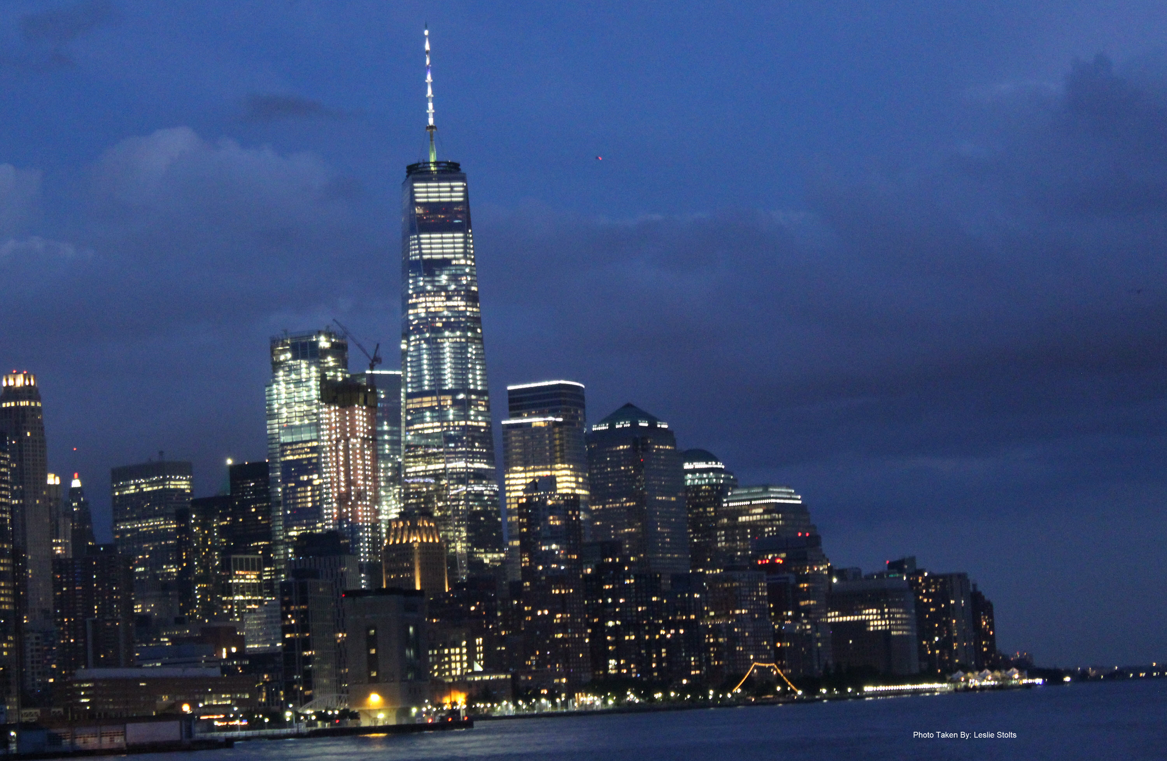
Welcome to New York
Azure Certification Jump Start 70-534 Architecting Microsoft Azure Solutions
8:30 AM |  | Registration, Breakfast and Networking
 |  | Presentation followed by 15 min Lab and Q & A
 | Dur (Min) | Speaker
9:00 | 10 | Laura Clayton McDonnell | Executive Welcome
9:10 | 10 | Dan | What to Expect; Q&A; Labs; Simulcast
9:20 | 45 | Ben Day Dan Stolts | Design an application storage and data access strategy (5-10%)
Content Location:
https://github.com/dstolts/70-534
Notes:
Greetings all and Welcome To New York City,
I am Dan Stolts, I will be your MC for the day. We have two rooms here in NYC so speakers are splitting their time between the two
We are thrilled to have you join us for this important topic. We hope to be able to do more of these shows in the future. I would like to encourage you to go back to your organizations and teach others some of what you learned. If others in your organization would like a similar event, please have them contact your Microsoft Account Team.
Let’s start things off with a

Slide 2
Welcome to New York
Azure Certification Jump Start 70-534 Architecting Microsoft Azure Solutions
8:30 AM |  | Registration, Breakfast and Networking
 |  | Presentation followed by 15 min Lab and Q & A
 | Dur (Min) | Speaker
8:50 | 10 | Laura Clayton McDonnell | Executive Welcome
9:00 | 20 | Peter | What to Expect; Q&A; Labs
9:20 | 45 | Ben Day Dan Stolts | Design an application storage and data access strategy (5-10%)
Content Location:
https://github.com/dstolts/70-534
Notes:
Greetings all and Welcome To New York City,
I am Dan Stolts, I will be your MC for the day. We have two rooms here in NYC so speakers are splitting their time between the two
We are thrilled to have you join us for this important topic. We hope to be able to do more of these shows in the future. I would like to encourage you to go back to your organizations and teach others some of what you learned. If others in your organization would like a similar event, please have them contact your Microsoft Account Team.
Let’s start things off with a

Slide 3
Executive Welcome!
Please Welcome
Laura Clayton McDonnell

Slide 4
Welcome to New York
Azure Certification Jump Start 70-534 Architecting Microsoft Azure Solutions
8:30 AM |  | Registration, Breakfast and Networking
 |  | Presentation followed by 15 min Lab and Q & A
 | Dur (Min) | Speaker
9:00 | 10 | Laura Clayton McDonnell | Executive Welcome
9:10 | 10 | Dan | What to Expect; Q&A; Labs; Simulcast
9:20 | 45 | Ben Day Dan Stolts | Design an application storage and data access strategy (5-10%)
Content Location:
https://github.com/dstolts/70-534
Notes:
We have two rooms here in NYC so speakers are splitting their time between the two. This means the speaker of your topic may have to leave immediately to go to the other room, and there is a chance he/she will be a min or two late as they may be wrapping up in the other room.
Most sessions will be followed by a short lab time. This time can be used for breaks but we hope you will start working on one of the labs for that session. We do not expect you to finish the lab in this allocated time. There will be more lab time during lunch and at the end of each event day. Any labs not finished during the two days will simply be homework … Homework that is not graded but will certainly help you pass the exam. Lets go a bit deeper…

Slide 5
Welcome to New York
Azure Certification Jump Start 70-534 Architecting Microsoft Azure Solutions
8:30 AM |  | Registration, Breakfast and Networking
 |  | Presentation followed by 15 min Lab and Q & A
 | Dur (Min) | Speaker
8:50 | 10 | Laura Clayton McDonnell | Executive Welcome
9:00 | 20 | Peter | What to Expect; Q&A; Labs
9:20 | 45 | Ben Day Dan Stolts | Design an application storage and data access strategy (5-10%)
Content Location:
https://github.com/dstolts/70-534
Notes:
Greetings all and Welcome To New York City,
I am Dan Stolts, I will be your MC for the day. We have two rooms here in NYC so speakers are splitting their time between the two
We are thrilled to have you join us for this important topic. We hope to be able to do more of these shows in the future. I would like to encourage you to go back to your organizations and teach others some of what you learned. If others in your organization would like a similar event, please have them contact your Microsoft Account Team.
Let’s start things off with a

Slide 6
Please Socialize! #70-534 @ITProGuru
Please tell the world about what is going on here this week.
What you like
What you learned ☺ every time you learn something new ☺
How this knowledge can be leveraged at work

Slide 7
Voting: Show of Hands
How deep is your knowledge of Azure Cloud Solutions?
1. I know Azure and its offerings really well
2. I know some of Azure
3. I’m just getting started with Azure

Slide 8
Voting: Show of Hands
Are you planning on taking the Azure Certification Exam related to this content?
1. Yes
2. Maybe, I’m interested in finding out more
3. No, please elaborate?

Slide 9
Voting: Show of Hands
Do you feel you are educationally ready to deliver Azure Solutions?
1. Yes, Ready to go
2. Maybe, after doing homework, I will be ready
3. No, please elaborate?

Slide 10
Voting: Show of Hands
Do you have ability and subscription access to practice what you learned; to continue to growing your skills in Azure?
Yes
No
Explain

Slide 11
Exam 70-534 Architecting Microsoft Azure Solutions
#1 Design Azure Resource Manager (ARM) networking (5–10%)
Design Azure virtual networks - Extend on-premises
Describe Azure VPN and Express Route architecture and design
#2 Secure resources (20–25%)
Secure resources by using managed identities
Secure resources by using managed identities
Secure resources by using identity providers
Identify an appropriate data security solution
Design a role-based access control (RBAC) strategy
Manage security risks by using an appropriate security solution
#3 Design an application storage and data access strategy (5–10%)
Design data storage
Select the appropriate storage option
#4 Design advanced applications (20–25%)
Create compute-intensive applications
Create long-running applications
Integrate Azure services in a solution
Implement messaging applications
Implement applications for background processing
Design connectivity for hybrid applications
#5 Design Azure Web and Mobile Apps (5–10%)
Design Web Applications
Design Mobile Applications
#6 Design a management, monitoring, and business continuity strategy (20–25%)
Design a monitoring strategy
Describe Azure business continuity/disaster recovery (BC/DR) capabilities
Design a disaster recovery strategy
Design Azure Automation and PowerShell workflows
Describe the use cases for Azure Automation configuration
#7 Architect an Azure Compute infrastructure (10–15%)
Design ARM Virtual Machines (VMs)
Design ARM template deployment
Design for availability
+ Bonus: Containers
https://www.microsoft.com/learning/en-us/exam-70-534.aspx
Notes:
We have 7 primary sections called Objective Domains (OD) to cover. Each one has sub categories. Each has a percentage range. This percentage is the value of that portion on the exam. Note, some are 5-10 while others are 20-25. The sections that are 20-25 means that up to 25% of the points you can get on the exam will be in the topic area. You can see additional information on each section at the link on the bottom of the page.

Slide 12
Questions Post Event…
Yammer Group
http://aka.ms/AzureExamPrep
Notes:
Exam tips are slides to pay close attention to. You will very likely see many questions that are related to the various Exam Tips.
This Yammer Group will NOT be on the exam. We just wanted to highlight it is very important so you know where to turn after the event is finished.

Slide 13
6.1.2 What size or type of company can benefit from System Center and hybrid scenarios?
Small: less than 10 servers
Medium: greater than 10 servers but less than 100
Large: greater than 100 servers
Extra Large or multisite: greater than 1,000 servers or greater than 100 locations
All of the above (this is the BEST answer)
Small: less than 10 servers
Medium: greater than 10 servers but less than 100
Large: greater than 100 servers
Extra Large or multisite: greater than 1,000 servers or greater than 100 locations
All of the above
Notes:
You will likely see some sample questions like this through the various presentations. The content creators are not authorized to see the actual exam questions or to share what was on the exam when we took it. However, we wanted to give you some sample questions to get you into the Q&A mode of the exam.

Slide 14

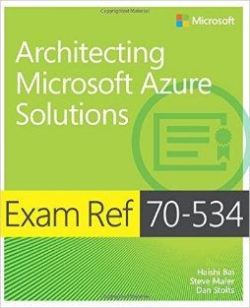
Azure Certification Jump Start – Free Event 70-534 Architecting Microsoft Azure Solutions
Day 1 Tuesday June 13th
8:30 AM |  | Registration, Breakfast and Networking
 |  | Presentation followed by 15 min Lab and Q & A
 | Dur (Min) | Speaker | Room 1 Name {Room #}
9:00 | 10 | Laura Clayton McDonnell | Executive Welcome
9:10 | 10 | Dan | What to Expect; Q&A; Labs; Simulcast
9:20 | 45 | Ben Day Dan Stolts | Design an application storage and data access strategy (5-10%)
10:05 | 15 | Break {No Lab Time / Confirm Open Lab Guides & Env}
10:20 | 60 | Mike Richter Mark Grimes | Design Azure Resource Manager (ARM) networking (5-10%)
11:20 | 60 | Jason Haley | Design Azure Web and Mobile Apps (5-10%)
12:20 | 60 | Labs/Lunch & Networking
1:20 | 75 | Steve Porter Bill Wilder | Secure resources (20-25%)
2:35 | 75 | Praveen Jim O'Neil | Design advanced applications (20-25%)
3:50 | 40 | Hands-On Labs
16:30 | 30 | Networking and Social
5:00 PM |  | Safe Journey Home :)
Day 2 Wednesday June 14th
8:30 AM |  | Registration, Breakfast and Networking
 |  | Presentation followed by 15 min Lab and Q & A
 | Dur (Min) | Speaker | Room 1 Name {Room #}
9:00 | 20 | Michael Corkery | Exam Tips & Tricks
9:20 | 75 | Mike Richter | Architect an Azure Compute infrastructure + Containers (10-15%)
10:35 | 15 | Break/Labs
10:50 | 75 | Dan Stolts Ian Philpot | Design a management, monitoring, and business continuity strategy (20-25%)
12:05 | 60 | Lunch & Networking
13:05 | 20 | Dan Stolts | DevOps and Next Steps
13:25 | 20 | Audience | Feedback & Tips Presentation Prep
13:45 | 20 | Audience | Presentations / Q & A
14:05 | 155 | Hands-On Labs
16:30 | 30 | Networking and Social
5:00 PM |  | Safe Journey Home :)
Brought to you By:
Dan Stolts @ITProGuru
http://aka.ms/70-534
June 13-14 2017 – Microsoft – 11 Times Square NYC
Notes:
Objective: Learn what you need to know to become a certified Azure Solutions Architect. We will go through the lessons found in the book 70-534 Architecting Microsoft Azure Solutions.
The Topics, though they are numbered in the book, will not be presented in that order. Also, the current book has been retired; the new book is in the works so it will likely be out in a few months.
If you are with us Live in NYC you should have been given a schedule and there is a schedule posted on the wall outside the rooms.

Slide 15
Azure Certification Jump Start – Free Event 70-534 Architecting Microsoft Azure Solutions
8:30 AM |  | Registration, Breakfast and Networking
 |  | Presentation includes 15 min Lab and Q & A
 | Dur (Min) | Speaker | Winter Garden 5412
8:45 | 10 | Laura Clayton McDonnell | Welcome
9:00 | 20 | Peter | What to Expect; Q&A; Labs
9:20 | 45 | Mike Richter Mark Grimes | Design Azure Resource Manager (ARM) networking (5-10%)
10:05 | 15 | Break {No Lab Time / Confirm Open Lab Guides & Env}
10:20 | 60 | Ben Day | Design an application storage and data access strategy (5-10%)
11:20 | 60 | Praveen Jim O'Neil | Design advanced applications (20-25%)
12:20 | 60 | Labs / Lunch & Networking
1:20 | 75 | Mike Richter | Architect an Azure Compute infrastructure + Containers (10-15%)
2:35 | 75 | Steve Porter Bill Wilder | Secure resources (20-25%)
3:50 | 40 | Hands-On Labs
16:30 | 30 | Networking and Social
5:00 PM |  | Safe Journey Home :)
Content: https://github.com/dstolts/70-534 Socialize: #70-534 @ITProGuru
 |  | Day 2 Wednesday June 14th
8:30 AM |  | Registration, Breakfast and Networking
 |  | Presentation includes 15 min Lab and Q & A
 | Dur (Min) | Speaker | Winter Garden 5412
9:00 | 20 | Dan Stolts | DevOps and Next Steps
9:20 | 75 | Dan Stolts Ian Philpot | Design a management, monitoring, and business continuity strategy (20-25%)
10:35 | 15 | Break/Labs
10:50 | 75 | Jason Haley | Design Azure Web and Mobile Apps (5-10%)
12:05 | 60 | Labs / Lunch & Networking
13:05 | 20 | Michael Corkery | Exam Tips & Tricks
13:25 | 20 | Audience | Feedback & Tips Presentation Prep
13:45 | 20 | Audience | Presentations / Q & A
14:05 | 155 | Hands-On Labs
16:30 | 30 | Networking and Social
5:00 PM |  | Safe Journey Home :)
Content: https://github.com/dstolts/70-534 Socialize: #70-534 @ITProGuru
 |  | Evaluation Link: Please text MICROSOFT AZURE to 878787 to take part in a brief survey. Survey Link: http://t.validar.com/1/VBV7Q
Brought to you By:
Dan Stolts @ITProGuru
http://aka.ms/70-534
June 13-14 2017 – Microsoft – 11 Times Square NYC
Notes:
Objective: Learn what you need to know to become a certified Azure Solutions Architect. We will go through the lessons found in the book 70-534 Architecting Microsoft Azure Solutions.
The Topics, though they are numbered in the book, will not be presented in that order. Also, the current book has been retired; the new book is in the works so it will likely be out in a few months.
If you are with us Live in NYC you should have been given a schedule and there is a schedule posted on the wall outside the rooms.

