Slide 1


Design Application Storage and Data Access Strategy
Design Data Storage Options
Design Data Storage Security
Security Options For Perf
Storage for Cloud & Hybrid
Benjamin Day
Benjamin Day Consulting, Inc.
www.benday.com
@benday

Slide 2




Benjamin Day
Brookline, MA
Consultant & Trainer
Scrum, DevOps, Team Foundation Server, Software Architecture & Testing
Microsoft MVP
Pluralsight Author
Scrum.org Trainer
@benday

Slide 3
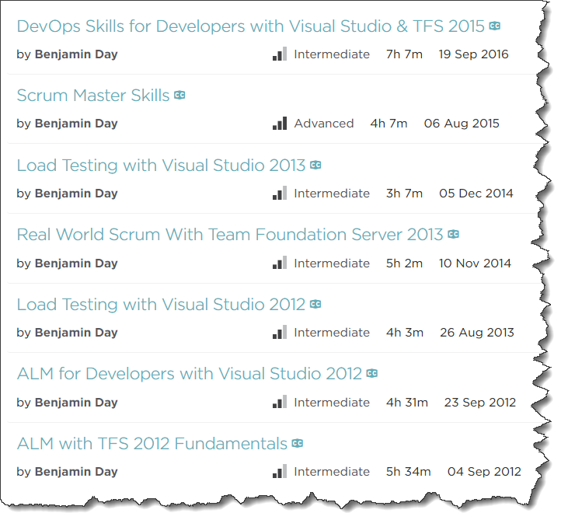
Pluralsight.com
Online courses
Scrum Master Skills
DevOps with TFS2015
DevOps with TFS2017 (soon)

Slide 4
On with the show.

Slide 5
Exam 70-534 Architecting Microsoft Azure Solutions
#1 Design Azure Resource Manager (ARM) networking (5–10%)
Design Azure virtual networks - Extend on-premises
Describe Azure VPN and Express Route architecture and design
#2 Secure resources (20–25%)
Secure resources by using managed identities
Secure resources by using managed identities
Secure resources by using identity providers
Identify an appropriate data security solution
Design a role-based access control (RBAC) strategy
Manage security risks by using an appropriate security solution
#3 Design an application storage and data access strategy (5–10%)
Design data storage
Select the appropriate storage option
#4 Design advanced applications (20–25%)
Create compute-intensive applications
Create long-running applications
Integrate Azure services in a solution
Implement messaging applications
Implement applications for background processing
Design connectivity for hybrid applications
#5 Design Azure Web and Mobile Apps (5–10%)
Design Web Applications
Design Mobile Applications
#6 Design a management, monitoring, and business continuity strategy (20–25%)
Design a monitoring strategy
Describe Azure business continuity/disaster recovery (BC/DR) capabilities
Design a disaster recovery strategy
Design Azure Automation and PowerShell workflows
Describe the use cases for Azure Automation configuration
#7 Architect an Azure Compute infrastructure (10–15%)
Design ARM Virtual Machines (VMs)
Design ARM template deployment
Design for availability
+ Bonus: Containers
https://www.microsoft.com/learning/en-us/exam-70-534.aspx

Slide 6
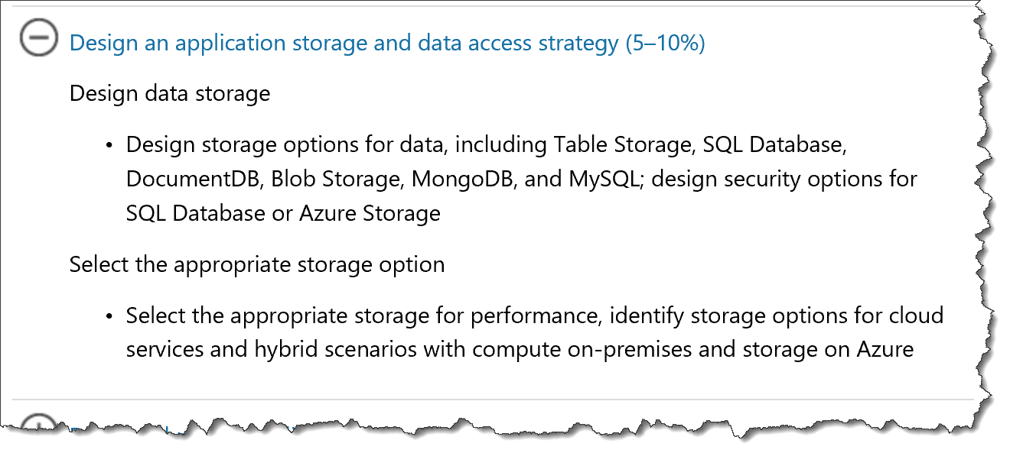
Storage in 70-534
https://www.microsoft.com/en-us/learning/exam-70-534.aspx

Slide 7
Storage in 70-534
Products
Table Storage
Blob Storage
SQL Database
DocumentDB
MongoDB
MySQL
Security Options
SQL Database
Azure Storage
Performance
Hybrid scenarios

Slide 8
Design Data Storage Options
Table Storage
NoSQL
SQL Database
Relational
Tables
MySQL
Relational
Fast DB
Key/attribute
Schemaless
Fast Data Access
Relatively inexpensive
FK, PK, Indexes, etc.
Open Source
DocumentDB
NoSQL
JSON / JavaScript
Blob Storage
Unstructured data
Disks, Images, Logs
MongoDB
NoSQL
JSON-like
Dynamic schemas
High performance
Data Security Options
Azure Storage | Share Access Signature - SAS
SQL Database – same model as on-premises
See aka.ms/azure/storage for a complete introduction
Microsoft Azure Storage Explorer (Preview) is a standalone app from Microsoft that allows you to easily work with Azure Storage data on Windows, macOS and Linux. http://storageexplorer.com/
Source: Mark Grimes https://mva.microsoft.com/en-US/training-courses/certification-exam-overview-70534-architecting-microsoft-azure-solutions-17406?l=olgrYVmjD_6006218965
Notes:
Design an application storage and data access strategy (15–20%)
Design data storage
Table Storage
With a schemaless data store, it's easy to adapt your data as the needs of your application evolve. Table storage is easy to use, so developers can create applications quickly. Access to data is fast and cost-effective for all kinds of applications.
Table storage is typically significantly lower in cost than traditional SQL for similar volumes of data.
SQL Database, DocumentDB, Blob Storage, MongoDB, and MySQL
design security options for SQL Database or Azure Storage; identify the appropriate VM type and size for a solution
MySQL” is “My Ess Que Ell” (not “my sequel”),
http://azure.microsoft.com/en-us/documentation/articles/storage-introduction/
http://azure.microsoft.com/en-us/marketplace/partners/mongodb/mongodb-inc/
DocumentDB Azure DocumentDB is a NoSQL document database service designed from the ground up to natively support JSON and JavaScript directly inside the database engine. It’s the right solution for web and mobile applications when predictable throughput, low latency, and flexible query are key. Microsoft consumer applications like OneNote already use DocumentDB in production to support millions of users. http://azure.microsoft.com/en-us/services/documentdb/
4 NoSQL options…
Graph Database
Cp;umn-Family?????????
Document
Key/Value
http://www.asp.net/aspnet/overview/developing-apps-with-windows-azure/building-real-world-cloud-apps-with-windows-azure/data-storage-options
Compared to relational databases, the NoSQL options offer far greater scalability and cost-effectiveness for storage and analysis of unstructured data. The tradeoff is that they don't provide the rich queryability and robust data integrity capabilities of relational databases. NoSQL would work well for IIS log data, which
h involves high volume with no need for join queries. NoSQL would not work so well for banking transactions, which requires absolute data integrity and involves many relationships to other account-related data.
There is also a newer category of database platform called NewSQL that combines the scalability of a NoSQL database with the queryability and transactional integrity of a relational database. NewSQL databases are designed for distributed storage and query processing, which is often hard to implement in "OldSQL" databases. NuoDB is an example of a NewSQL database that can be used on Azure.
A shared access signature provides delegated access to resources in your storage account. This means that you can grant a client limited permissions to your blobs, queues, or tables for a specified period of time and with a specified set of permissions, without having to share your account access keys. The SAS is a URI that encompasses in its query parameters all of the information necessary for authenticated access to a storage resource. To access storage resources with the SAS, the client only needs to pass in the SAS to the appropriate constructor or method.
You can use a SAS when you want to provide access to resources in your storage account to a client that can't be trusted with the account key. Your storage account keys include both a primary and secondary key, both of which grant administrative access to your account and all of the resources in it. Exposing either of your account keys opens your account to the possibility of malicious or negligent use. Shared access signatures provide a safe alternative that allows other clients to read, write, and delete
Security administration in Microsoft Azure SQL Database is similar to security administration for an on-premises instance of SQL Server. Managing security at the database-level is almost identical, with differences only in the parameters available. Because Azure SQL Databases can scale to one or more physical computers, Microsoft Azure SQL Database uses a different strategy for server-level administration.

Slide 9
Design Data Storage Options
Table Storage
NoSQL
SQL Database
Relational
Tables
MySQL
Relational
Fast DB
Key/attribute
Schemaless
Fast Data Access
Relatively inexpensive
FK, PK, Indexes, etc.
Open Source
DocumentDB
NoSQL
JSON / JavaScript
Blob Storage
Unstructured data
Disks, Images, Logs
MongoDB
NoSQL
JSON-like
Dynamic schemas
High performance

Slide 10
3.1.1
Know the various storage types and their uses. For example, many times you can use Queues to decouple components of a system.
aka.ms/azure/storage, how they are alike & how they are different

Slide 11
3.1.2
Read
Azure Storage | Share Access Signature - SAS
SQL Database – same model as on-premises
Download and Use:
Microsoft Azure Storage Explorer (Preview) is a standalone app from Microsoft that allows you to easily work with Azure Storage data on Windows, macOS and Linux. http://storageexplorer.com/

Slide 12
Table Storage & Blob Storage

Slide 13
Azure Table Storage
NoSQL
Key-value
Structured, not schema’d
Queries
OData
API
Data is consistent for other client reads after insert/update
Store lots of data for cheap
Geo-redundant options
Stored 3x in a region
3x in another region

Slide 14
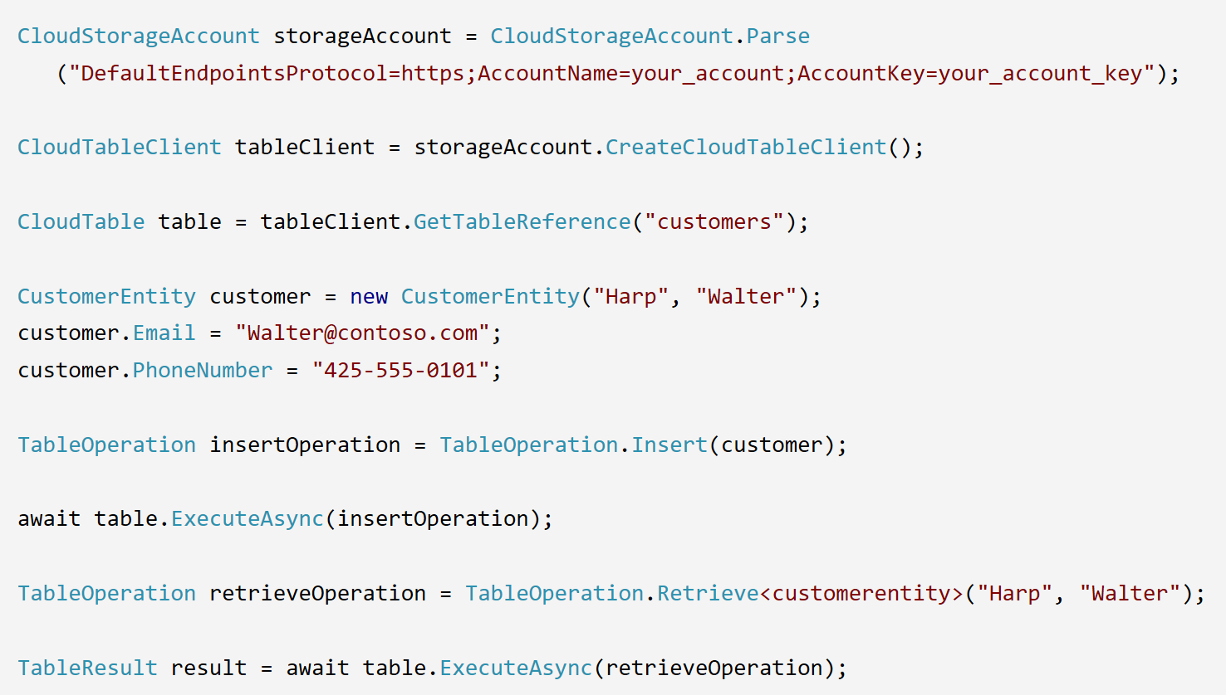
Table Storage via API

Slide 15
Azure Blob Storage
Unstructured storage
Queries
OData
API
All blobs start from a Container
Block Blobs, Append Blobs, & Page Blobs
Store lots of data for cheap
Geo-redundant options
Stored 3x in a region
3x in another region

Slide 16
Storage Options
Standard
Max total request rate of 20k IOPS
Premium
Designed for Azure VMs
High performance
Low latency
Azure VM disks are implemented as “Page Blobs”

Slide 17
Block Blobs
Blob is broken into pieces
Block Id for each piece
Max block size = 100MB
Up to 50k blocks per blob
Efficient upload of large blobs
Blocks upload can be multithreaded
Streaming
Storing documents, media files, backups

Slide 18
Append Blobs
Similar to Block Blobs
Optimized for append operations
Only can add to the end

Slide 19
Page Blob
Optimized for IaaS disks
Supports random writes
Collection of 512 byte pages
Max size = 1TB
Storage Options
Premium Storage
Standard Storage

Slide 20
Replication for Table & Blob Storage
Locally redundant storage (LRS)
3 copies in a single data center
Zone-redundant storage (ZRS)
3 copies across 2 or 3 facilities in 1 or 2 regions
Geo-redundant storage (GRS)
3 copies in primary region, 3 in secondary region
Auto failover
Read-access geo-redundant storage (RA-GRS)

Slide 21
Blob Access
Anonymous Access
Public access for containers or individual blobs
Shared Access Signatures (SAS)
Delegated access without sharing account key
Containers & blobs
File shares & files
Queues
Tables & ranges of table entities

Slide 22
Shared Access Signatures (SAS)
Time interval
Start & end time for permissions
Permissions
Read, Write, and/or Delete
(Optional) IP address or address range
Allowed protocols
Example: only https

Slide 23
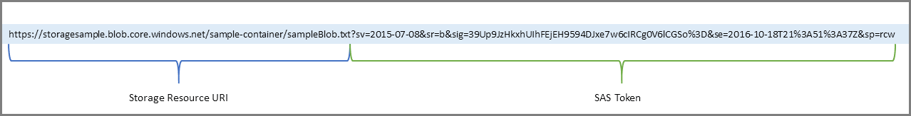
Example of SAS token
3.1.3 Exam Tip!

Slide 24
Blob Encryption
Client-side
Storage Client Library for .NET
Server-side
“Data at Rest”

Slide 25
Table & Blob: Performance, Storage Limits, etc.
https://docs.microsoft.com/en-us/azure/storage/storage-scalability-targets

Slide 26
Resource | Default Limit
Number of storage accounts per subscription | 200
TB per storage account | 500 TB
Max number of blob containers, blobs, file shares, tables, queues, entities, or messages per storage account | Only limit is the 500 TB storage account capacity
Max size of a single blob container, table, or queue | 500 TB
Max number of blocks in a block blob or append blob | 50,000
Max size of a block in a block blob | 100 MB
Max size of a block blob | 50,000 X 100 MB (approx. 4.75 TB)
Max size of a block in an append blob | 4 MB
Max size of an append blob | 50,000 X 4 MB (approx. 195 GB)
Max size of a page blob | 1 TB
Max size of a table entity | 1 MB

Slide 27
Resource | Default Limit
Maximum Request Rate per storage account | Blobs: 20,000 requests per second for blobs of any valid size (capped only by the account's ingress/egress limits)
 | Files: 1000 IOPS (8 KB in size) per file share
 | Queues: 20,000 messages per second (assuming 1 KB message size)
 | Tables: 20,000 transactions per second (assuming 1 KB entity size)
Target throughput for single blob | Up to 60 MB per second, or up to 500 requests per second
Target throughput for single queue (1 KB messages) | Up to 2000 messages per second
Target throughput for single table partition (1 KB entities) | Up to 2000 entities per second
Target throughput for single file share | Up to 60 MB per second
Max ingress per storage account (US Regions) | 10 Gbps if GRS/ZRS enabled, 20 Gbps for LRS
Max egress per storage account (US Regions) | 20 Gbps if RA-GRS/GRS/ZRS enabled, 30 Gbps for LRS
Max ingress per storage account (Non-US regions) | 5 Gbps if GRS/ZRS enabled, 10 Gbps for LRS
Max egress per storage account (Non-US regions) | 10 Gbps if RA-GRS/GRS/ZRS enabled, 15 Gbps for LRS

Slide 28
Sufficient bandwidth on VM
Make sure sufficient bandwidth is available on your VM to drive disk traffic, as described in Premium Storage-supported VMs. Otherwise, your disk throughput and IOPS is constrained to lower values. Maximum throughput and IOPS are based on the VM limits, not on the disk limits described in the preceding table.
https://docs.microsoft.com/en-us/azure/storage/storage-premium-storage#scalability-and-performance-targets

Slide 29
Premium storage accounts Scalability
… have the following scalability targets:+
Total account capacity | Total bandwidth Locally redundant storage account
Disk capacity: 35 TB Snapshot capacity: 10 TB | Up to 50 gigabits per second for inbound¹ + outbound² ¹ All data (requests) that are sent to a storage account+ ² All data (responses) that are received from a storage account
https://docs.microsoft.com/en-us/azure/storage/storage-premium-storage#scalability-and-performance-targets

Slide 30
If Using Storage Spaces Striping
If you stripe premium storage data disks by using Storage Spaces, set up Storage Spaces with 1 column for each disk that you use. Otherwise, overall performance of the striped volume might be lower than expected because of uneven distribution of traffic across the disks. By default, in Server Manager, you can set up columns for up to 8 disks. If you have more than 8 disks, use PowerShell to create the volume. Specify the number of columns manually. Otherwise, the Server Manager UI continues to use 8 columns, even if you have more disks. For example, if you have 32 disks in a single stripe set, specify 32 columns. To specify the number of columns the virtual disk uses, in the New-VirtualDisk PowerShell cmdlet, use the NumberOfColumns parameter. For more information, see Storage Spaces Overview and Storage Spaces FAQs.
https://docs.microsoft.com/en-us/azure/storage/storage-premium-storage#scalability-and-performance-targets

Slide 31
Pay Attention to I/O vs IOPs
If your disk traffic mostly consists of small I/O sizes, your application likely will hit the IOPS limit before the throughput limit. However, if the disk traffic mostly consists of large I/O sizes, your application likely will hit the throughput limit first, instead of the IOPS limit. You can maximize your application's IOPS and throughput capacity by using optimal I/O sizes. Also, you can limit the number of pending I/O requests for a disk.
https://docs.microsoft.com/en-us/azure/storage/storage-premium-storage#scalability-and-performance-targets

Slide 32
Azure Storage Samples
https://azure.microsoft.com/en-us/resources/samples/?service=storage

Slide 33
Table Labs for .NET
https://github.com/Azure-Samples/storage-table-dotnet-getting-started

Slide 34
Blob Labs for .NET
https://azure.microsoft.com/en-us/resources/samples/storage-blob-dotnet-getting-started/
https://github.com/Azure-Samples/storage-blob-dotnet-getting-started

Slide 35
SAS Labs
https://azure.microsoft.com/en-us/resources/samples/storage-dotnet-sas-getting-started/

Slide 36
SQL Database

Slide 37
Azure SQL Database
Think “SQL Server in the cloud”
Relational database
Service tiers:
Basic
Standard
Premium
Premium RS

Slide 38
Service Tiers
Basic
Small size
Low traffic
Single active operation
Standard
Low to medium IO performance requirements
Multiple current queries
Premium
High transaction volume
High IO performance requirements
Many concurrent users
High availability
For mission critical apps
Premium RS
IO-intensive apps
Does not require high availability
Analytical workloads

Slide 39
Service Tier Attributes
Service tier features | Basic | Standard | Premium | Premium RS
Maximum single database size | 2 GB | 250 GB | 4 TB* | 500 GB
Maximum elastic pool size | 156 GB | 2.9 TB | 4 TB* | 750 GB
Maximum database size in an elastic pool | 2 GB | 250 GB | 500 GB | 500 GB
Maximum number of databases per pool | 500 | 500 | 100 | 100
Maximum single database DTUs | 5 | 100 | 4000 | 1000
Maximum DTUs per database in an elastic pool | 5 | 3000 | 4000 | 1000
Database backup retention period | 7 days | 35 days | 35 days | 35 days
https://docs.microsoft.com/en-us/azure/sql-database/sql-database-service-tiers

Slide 40
Basic
Performance level | Basic
Max DTUs | 5
Max database size* | 2 GB
Max in-memory OLTP storage | N/A
Max concurrent workers (requests) | 30
Max concurrent logins | 30
Max concurrent sessions | 300

Slide 41
Standard
Performance level | S0 | S1 | S2 | S3
Max DTUs | 10 | 20 | 50 | 100
Max database size* | 250 GB | 250 GB | 250 GB | 250 GB
Max in-memory OLTP storage | N/A | N/A | N/A | N/A
Max concurrent workers (requests) | 60 | 90 | 120 | 200
Max concurrent logins | 60 | 90 | 120 | 200
Max concurrent sessions | 600 | 900 | 1200 | 2400

Slide 42
Premium
Performance level | P1 | P2 | P4 | P6 | P11 | P15
Max DTUs | 125 | 250 | 500 | 1000 | 1750 | 4000
Max database size* | 500 GB | 500 GB | 500 GB | 500 GB | 4 TB | 4 TB
Max in-memory OLTP storage | 1 GB | 2 GB | 4 GB | 8 GB | 14 GB | 32 GB
Max concurrent workers (requests) | 200 | 400 | 800 | 1600 | 2400 | 6400
Max concurrent logins | 200 | 400 | 800 | 1600 | 2400 | 6400
Max concurrent sessions | 30000 | 30000 | 30000 | 30000 | 30000 | 30000

Slide 43
Premium RS
Performance level | PRS1 | PRS2 | PRS4 | PRS6
Max DTUs | 125 | 250 | 500 | 1000
Max database size* | 500 GB | 500 GB | 500 GB | 500 GB
Max in-memory OLTP storage | 1 GB | 2 GB | 4 GB | 8 GB
Max concurrent workers (requests) | 200 | 400 | 800 | 1600
Max concurrent logins | 200 | 400 | 800 | 1600
Max concurrent sessions | 30000 | 30000 | 30000 | 30000

Slide 44
SQL Database Security
Firewall & Firewall Rules
Authentication
“Who are you?”
SQL Authentication
Azure Active Directory (AAD) Authentication
Authorization
“What can you do?”

Slide 45
Authorization
Row-level
Data masking
Hide sensitive data from non-privileged users

Slide 46
SQL Database Videos
https://azure.microsoft.com/en-us/resources/videos/index/?services=sql-database

Slide 47
DocumentDB

Slide 48
DocumentDB
Now part of Cosmos DB
“one of the supported APIs and data models”
https://docs.microsoft.com/en-us/azure/cosmos-db/faq
Document != *.docx
Document == JSON
NoSQL database
Stores flexible-schema documents in JSON format
Similar to MongoDB
DocumentDB SQL for queries
PaaS

Slide 49
DocumentDB Programming Options
Server-side programming options
Stored procs, triggers, & user-defined functions
Written in JavaScript
https://docs.microsoft.com/en-us/azure/cosmos-db/programming

Slide 50
DocumentDB Resources
Stored Proc Programming Video
https://docs.microsoft.com/en-us/azure/cosmos-db/programming
DocumentDB vs MongoDB
https://medium.com/@th0maswe1ss/azure-documentdb-vs-mongodb-6d5806c16239
Getting Started
https://docs.microsoft.com/en-us/azure/cosmos-db/documentdb-get-started

Slide 51
MySQL

Slide 52
MySQL
Relational database
~3 Azure Options
Run it in a VM
Hosted by ClearDb
Azure Database for MySQL (preview)
https://azure.microsoft.com/en-us/services/mysql/

Slide 53
MySQL Resources
https://docs.microsoft.com/en-us/azure/mysql/

Slide 54
MongoDB

Slide 55
MongoDB
“humongous"
NoSQL
JSON-like documents with schemas
Two options:
One of the offerings under Cosmos DB
Install on VM https://docs.microsoft.com/en-us/azure/virtual-machines/windows/classic/install-mongodb

Slide 56
3.1.1 Exam Tip!
Know the various storage types and their uses. For example, many times you can use Queues to decouple components of a system.

Slide 57
3.1.1: A title company needs to provide access to storage for people to upload scans of documents that they signed. There are time limits to when the documents are needed. Which approach should be used to provide access?
Create a service and set up the valid dates in a database that will be read
Use an SAS and set the expiration time and date for the user.
Set up Azure AD with permissions for the user that limit the time in which she can upload documents.
Open up the Blob storage container to public access so that the user can add the document even if she is late.

Slide 58
3.1.3: A company is looking to move its existing system from on-premises to Azure and it is using MySQL. Which of the following are valid statements?
MySQL is not a Microsoft product, so it cannot be used in Azure.
MySQL can be set up in its own VM.
Convert all of the data to SQL Azure to save time and money.
There is a MySQL option in the Azure Marketplace.

Slide 59
3.1.2
Azure might update to change feature availability. The exam is updated over time, as well, to reflect these changes. However, because of the way Azure is steadily being updated, the newest features might not be on the exams.

Slide 60
3.1.3
Performance levels of the database are important to a company, and the ability to change this at times is equally important. For example, the limits of each level of SQL Database can help the architect to determine the minimum level needed to satisfy those needs.

Slide 61
Videos
Mark Grimes @ MSFT
Certification Exam Overview 70-534
https://mva.microsoft.com/en-US/training-courses/certification-exam-overview-70534-architecting-microsoft-azure-solutions-17406

Slide 62
Summary
Table storage supports structured data that uses a partition key and a row key for searches.
Blob storage supports unstructured data files such as text or binary data (document files, pictures, whatever).
DocumentDB is a NoSQL, JSON document–based storage system that by default has every field indexed.
MongoDB and MySQL databases are supported through the Azure Marketplace.
Copyright MICROSOFT Not for public disclosure

