Slide 1


Say Hay React Native App
Say Hay (acronym for How Are You?) is an iOS application developed to help you keep in touch with friends, family and associates. In this fast paced world we often do not have time to chat with all the friends that we have stored in our phones. At one time, long ago, it was the goal of social media to help solve this problem. However, it seems that social media has become more media and less social. Say Hay is intended to get back to the roots of using technology to improve our social interactions and help us connect with the people that we want to communicate with.
Created By Sean, Matt, Brian, Devin

Slide 2
The Process
We Did:
Hours of research on React–Native, React–Native–Elements,
React-Navigation, Mongo, iOS, Expo and AuthO
We Installed:
React, React-Native, React-Native-Elements, Expo, Mongo, Mongoose, Ngrok,
We Built:
A custom logo and color theme
An AuthO page for signing up and logging in
A database
Buttons, routes and overlays
A IOS App that will be deployed to the App Store (pending approval)

Slide 3
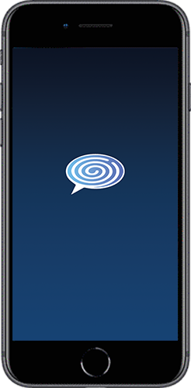
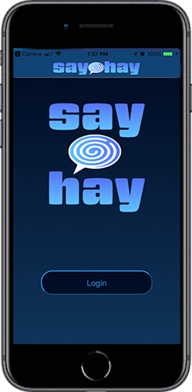
Loading and Login Screens
Animated .gif of logo for Loading Screen
Navbar, Logo, Login button
StyleSheets for customized CSS

Slide 4
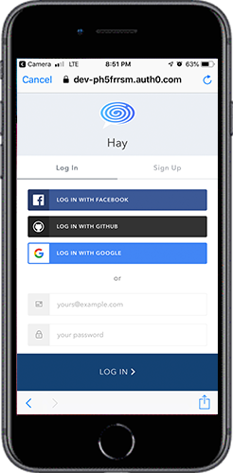
AuthO Screen
Log in with Google, Facebook or Github
Or create an account
Button links to contact page

Slide 5
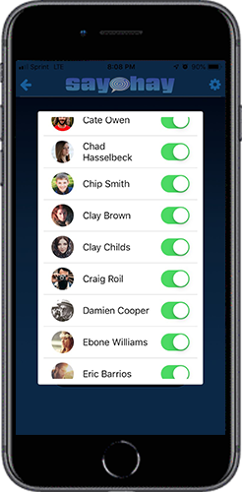
Contacts Screen
Contacts Overlay
Contacts List
Selection slider
Button Links to Randomly Chosen Friend

Slide 6
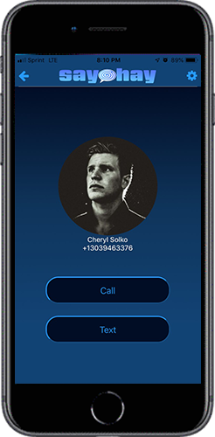
Friends Screen
Header with sign out and settings
Friend image or Icon
Buttons Link to Call or Text

Slide 7





New Technology /
Future Development
Future Development:
Custom Fonts and Animated elements
Deployment and availability via Apple App Store and Google Play
Store info from contact lists
Have contacts in categories i.e.: Family, Friends, Business, Other
Shake event (React-Native)
Employ our own server (other than expo)

Slide 8
Summary
Since social media has become more focused on media than being social, and the fast pace in everyday life, We developed Say Hay so that it would be easier to stay in contact with the people in our lives. It simply reminds you to keep in touch with your contacts. So call your long lost cousin and
Say Hay!
(Soon to be available on the App Store)

