Slide 1
De-noising a chaotic dynamical system
Igor Świerlikowski

Slide 2
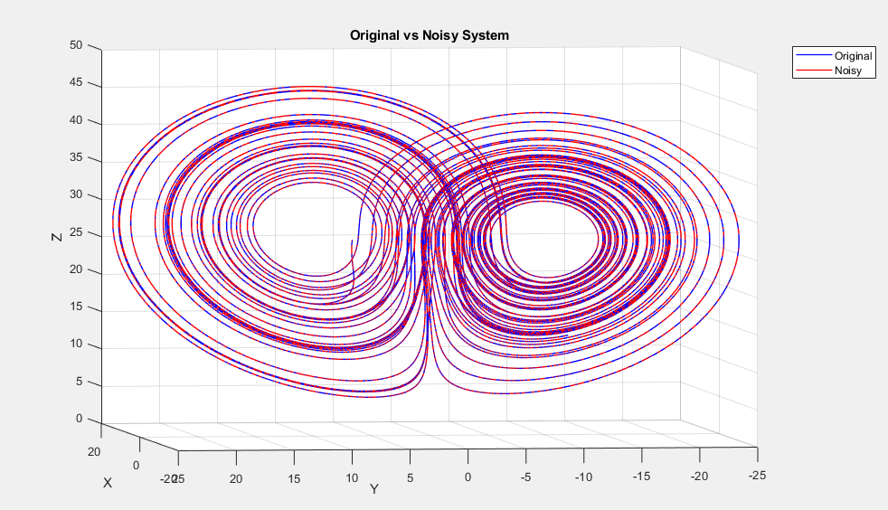
A noisy system
Noise:
Gaussian noise with sd=0.01
Added as measurement error at the end (doesn’t influence how the system evolves)

Slide 3
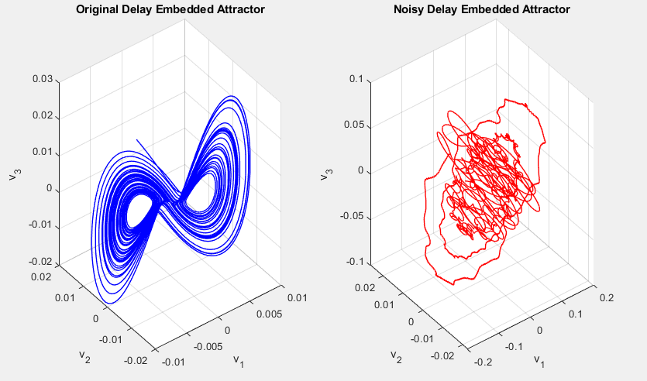
Reconstruction

Slide 4

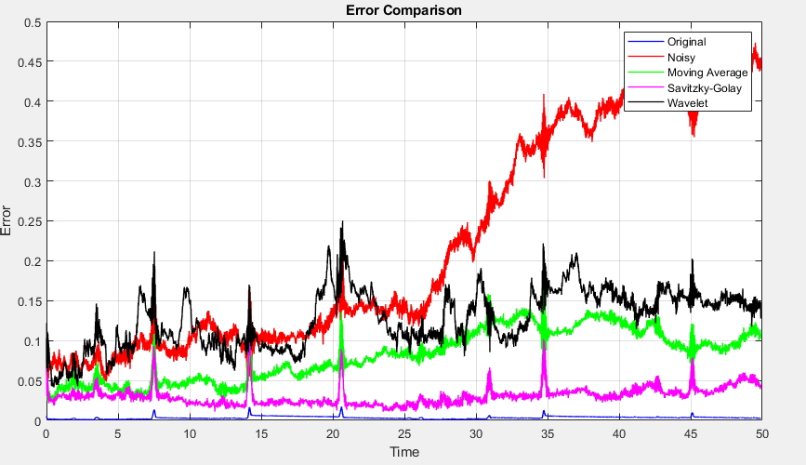
Results:

Slide 5
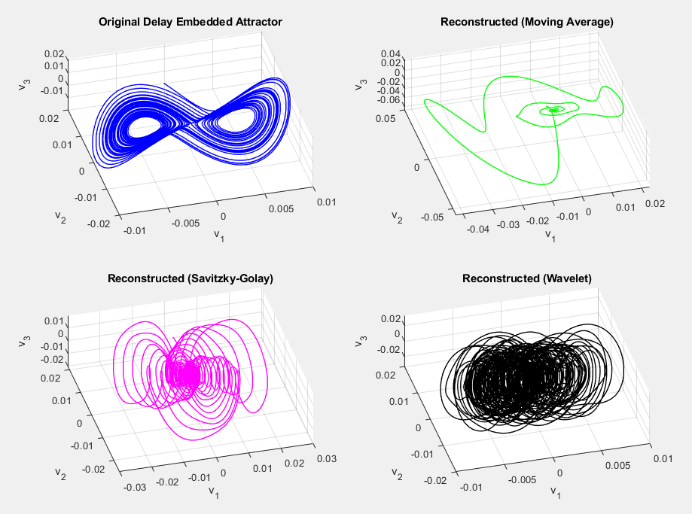
Results

Slide 6
Future Research Plans:

Slide 7
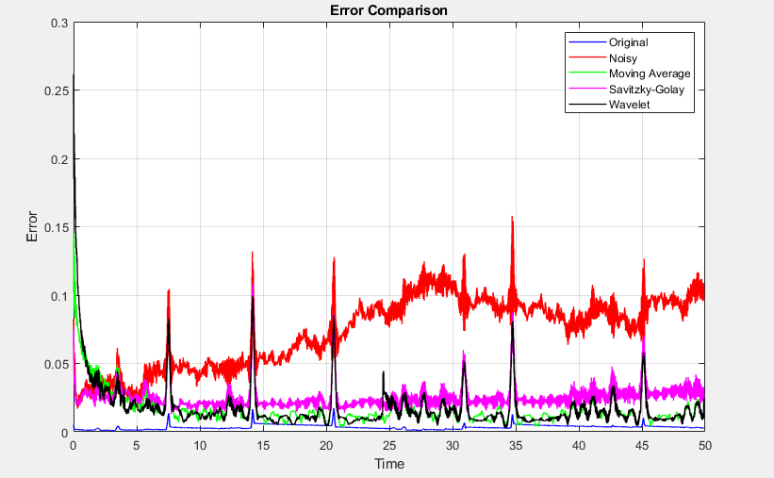
Continue Work On Denoising
Again, gaussian noise but this time with sd=0.03

Slide 8
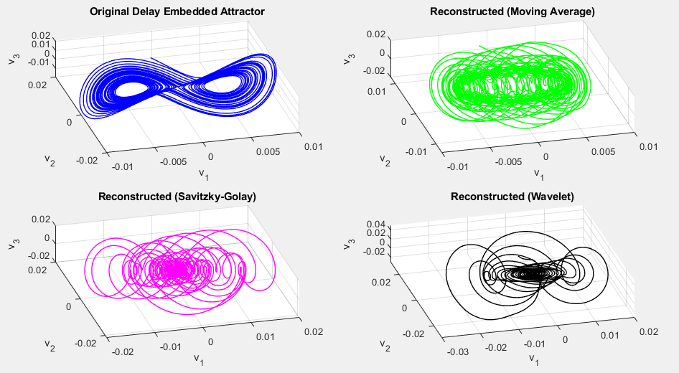
Results

Slide 9
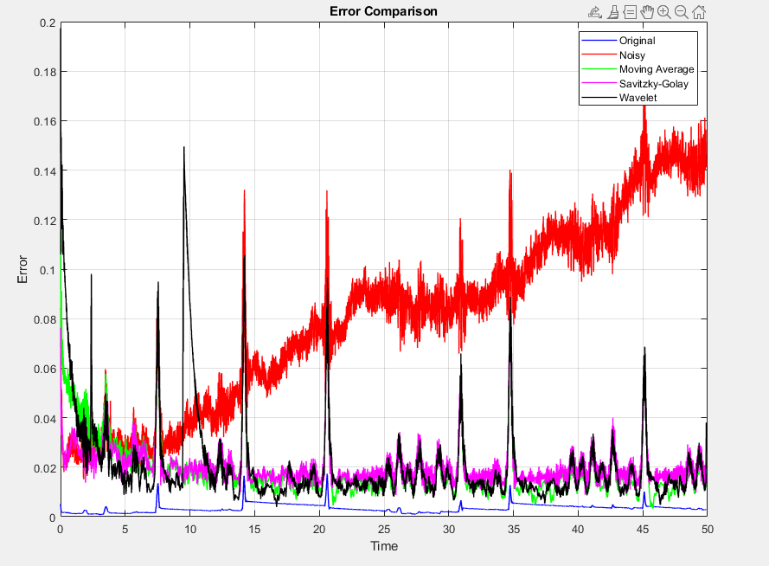
Continue Work On Denoising
Again, random gaussian noise but sd = 0.05

Slide 10
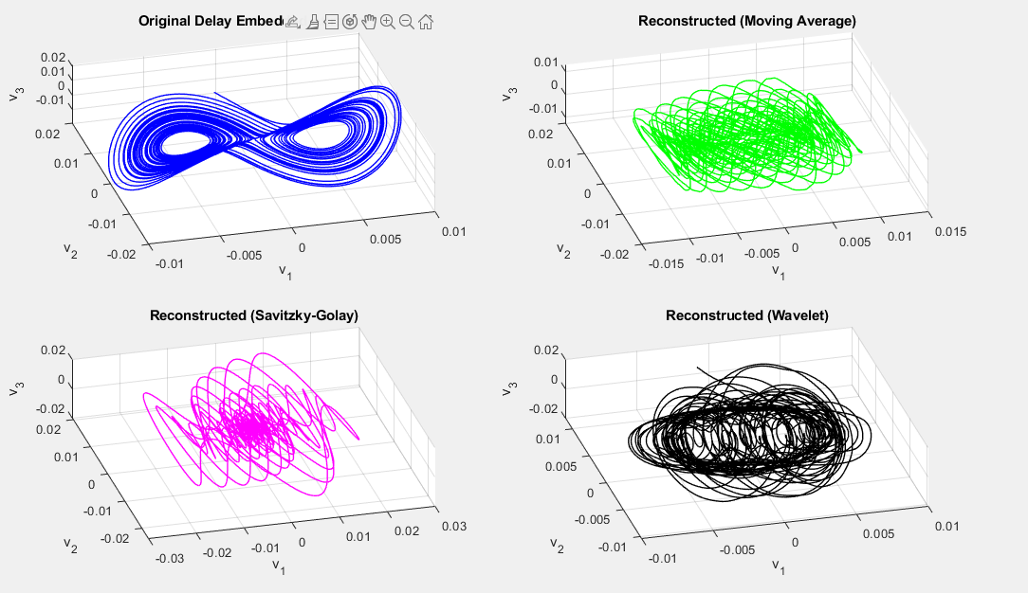
Results

Slide 11
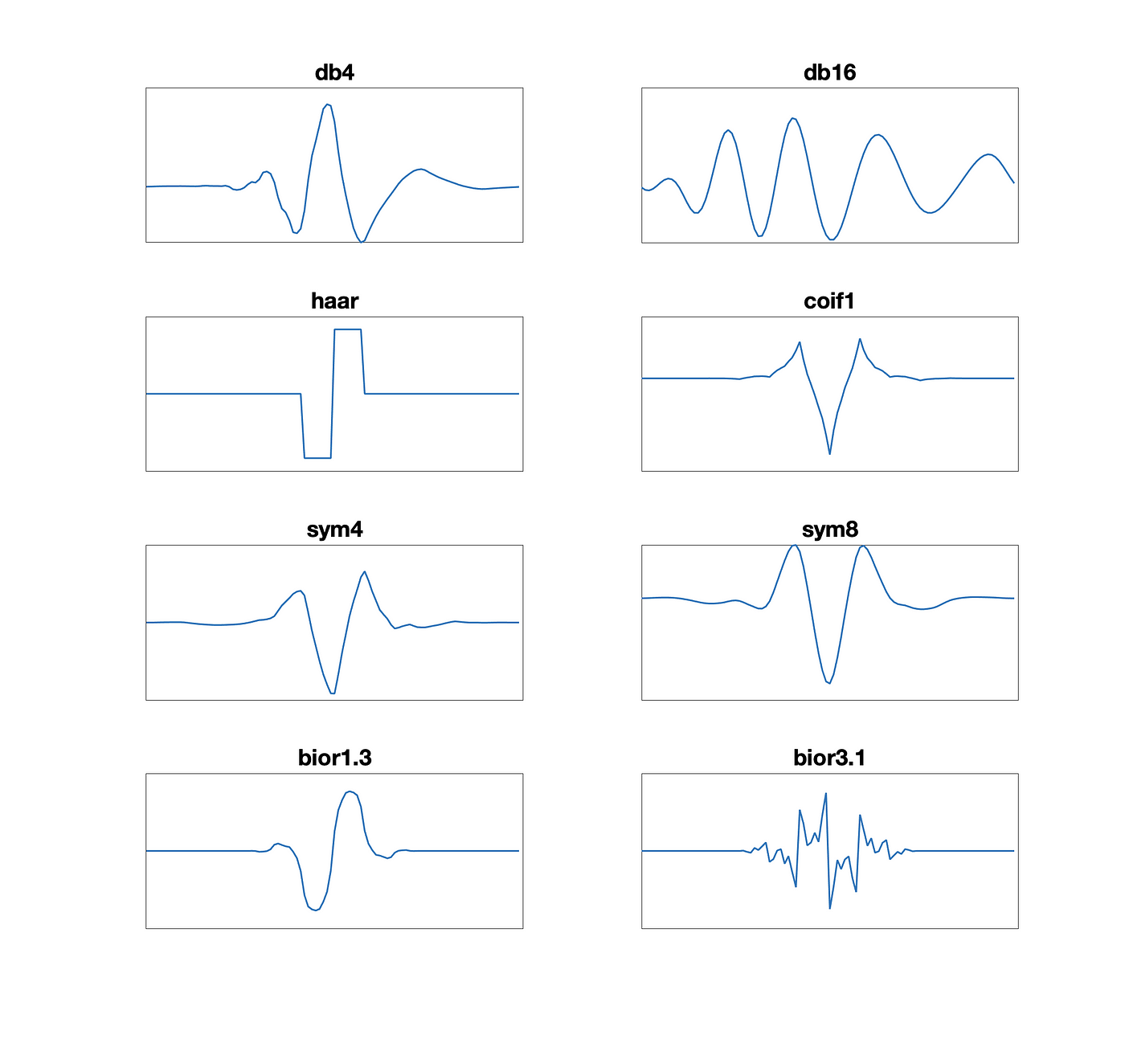


What are wavelets?
Admissibility Condition - 0 average
Finite Energy
Localization in time and frequency - compact support
Oscillatory Nature
Scalability and Translatability – dilating/compressing in time and shifting in time
Frequency Band-Pass Nature – captures information in a specific frequency band, determined by its scale

Slide 12
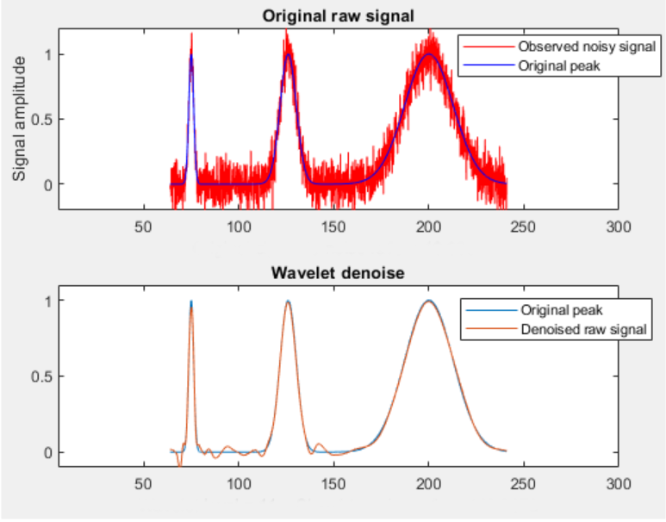
Wavelet Denoising

Slide 13
Research Questions
Can we apply wavelet denoising to improve HAVOK’s accuracy in noisy environments?
Figuring out a better error measure
Creating a method from scratch
Using different wavelets
Predict future states/lobe switches with the forcing vector

