Slide 1

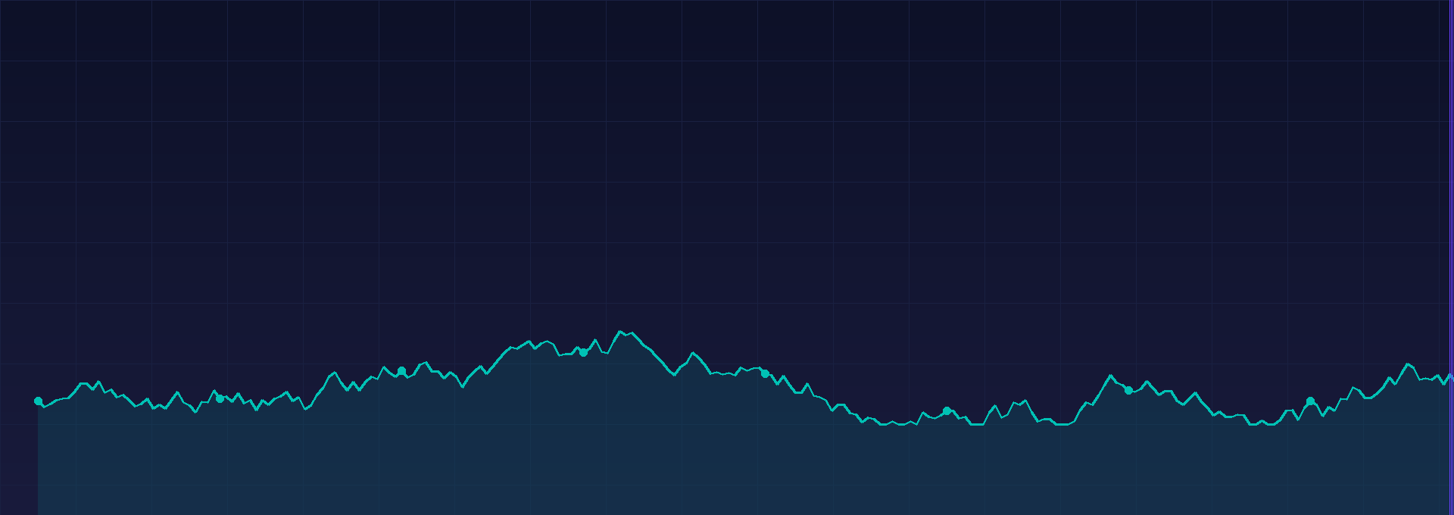
Final Case Study · Fintech Seminar · June 2026
Democratizing Investing in Latin America
Access the US market from just US$5 · 500K+ users · 20+ countries
Daniel Taboada · Benjamin Pereyra · Luis Sanchez Jorge Ramirez · Santiago Wiesse
Universidad del Pacífico · Fanny Mariana Díaz Galindo

Slide 2
Agenda
01
Product & Technology
02
Market Opportunity
Hapi · Case Study 2026
03
Competitive Landscape
04
Business Model & Revenue
05
Customer Segments
06
Key Metrics & Funding
07
SWOT Analysis
08
Strategic Outlook

Slide 3
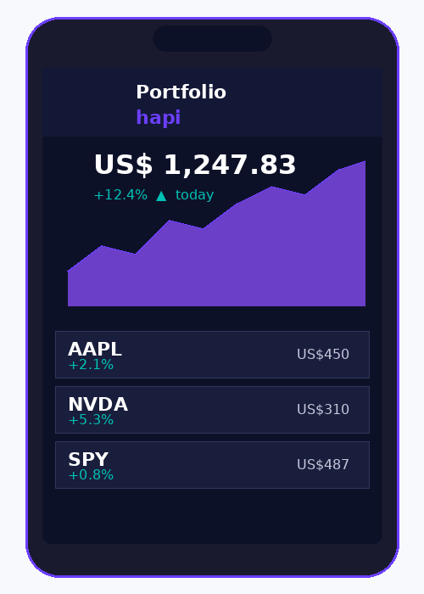
01 · Product & Technology
Built by investors, for investors.
Three ex-UP students couldn't invest in US stocks without high minimums, fees, and paperwork — so they built Hapi.

Slide 4
01 · PRODUCT & TECHNOLOGY
hapi · Case Study 2026
Platform at a Glance
2020
500K+
37
12,000+
US$5
Founded
Users
Employees
Instruments
Min. Investment
By Dusko Kelez, Piero Sifuentes, Billy Caballero
across 20+ countries
lean, outsourced infra model
stocks, ETFs & crypto
fractional shares included
Key Features
Stocks & ETFs
Zero commissions on all trades, 12,000+ instruments
Fractional shares
Start with as little as US$5 — no high minimums
Crypto
From US$1 via Bakkt Crypto Solutions
DRIP
Auto-reinvest dividends — hands-free compounding
Hapi Prime
US$9.99/mo — real-time prices, instant settlement, alerts

Slide 5
01 · PRODUCT & TECHNOLOGY
hapi · Case Study 2026
Infrastructure & Compliance
Technology Stack
Regulatory Protection
1
Clearing & Custody → Apex Clearing Corp (same infra as major US brokers)
SEC Registered
Hapi Securities LLC
2
Crypto → Bakkt Crypto Solutions
FINRA Member
US broker-dealer rules
3
2-Factor Authentication + end-to-end encryption
SIPC Coverage
Up to US$500,000 per account
4
Only 37 employees — outsourcing enables scale
⚠ Crypto
NOT covered by SIPC

Slide 6
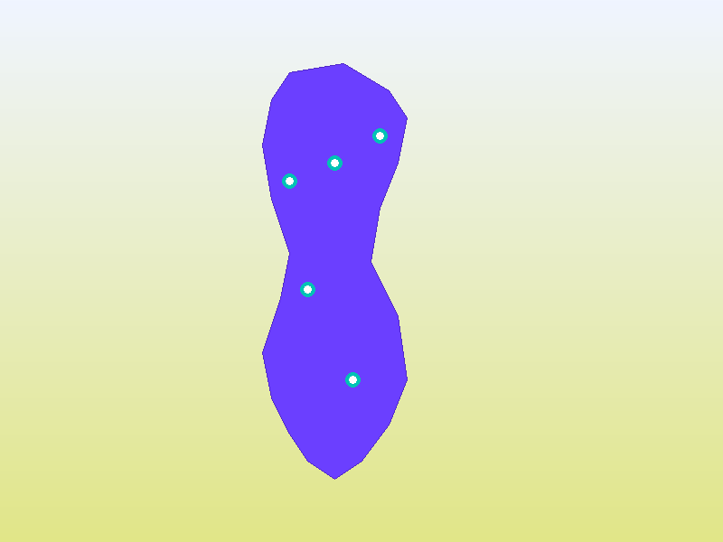
02 · Market Opportunity
A $15B market still untapped.
~90% of banking assets in 5 institutions. Small investors ignored. Local currencies losing value. Hapi fixes all three.

Slide 7
02 · MARKET OPPORTUNITY
hapi · Case Study 2026
Market Opportunity
US$15.23B
~90%
1M
LATAM Fintech Market
Banking controlled by 5 institutions
Users targeted by Hapi
IMARC Group
Mordor Intelligence
CEO target, Gestión 2025
Why the timing is right
→ Rising smartphone & internet penetration across LATAM
→ Local currencies losing value → demand for USD-denominated assets
→ Growing financial literacy — new generation of retail investors
→ Traditional banks never cared about small investors — structural gap

Slide 8
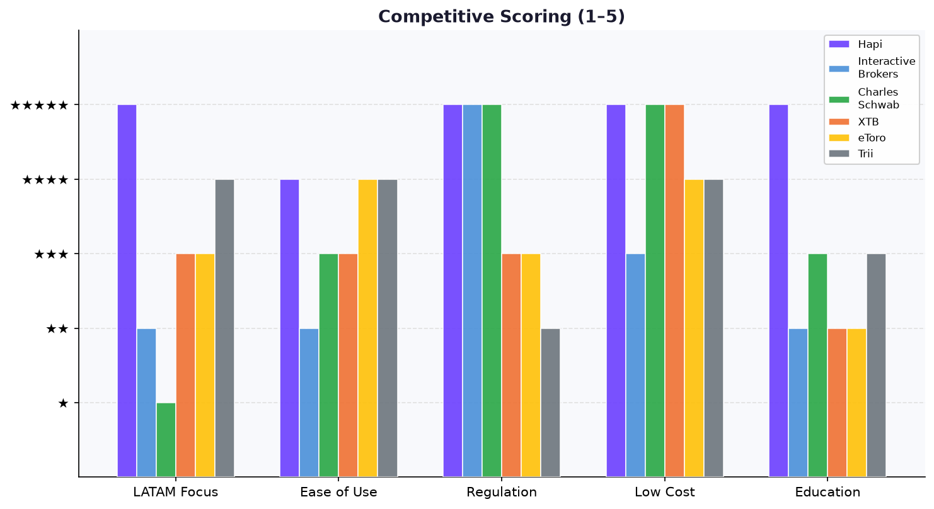
03 · COMPETITIVE LANDSCAPE
hapi · Case Study 2026
Competitive Landscape
Platform
Min.
Commission
SIPC
LATAM Focus
Fractional
Education
Hapi
US$5
Zero
✔ $500K
✔ Primary
✔
✔
Interactive Brokers
US$0
Low
✔ $500K
Partial
✔
✘
Charles Schwab
US$0
Zero
✔ $500K
✘
✔
Partial
XTB
US$0
Zero*
✘
Partial
✔
✔
eToro
US$10
Zero*
✘
Partial
✔
✔
Trii / Tyba
Low
Low
✘
✔ Local
Ltd
✔
* Zero commission on stocks, but spreads may apply

Slide 9
04 · Business Model
Zero commissions. Multiple revenue streams.
"The company makes money in several ways — so it doesn't depend on just one."

Slide 10
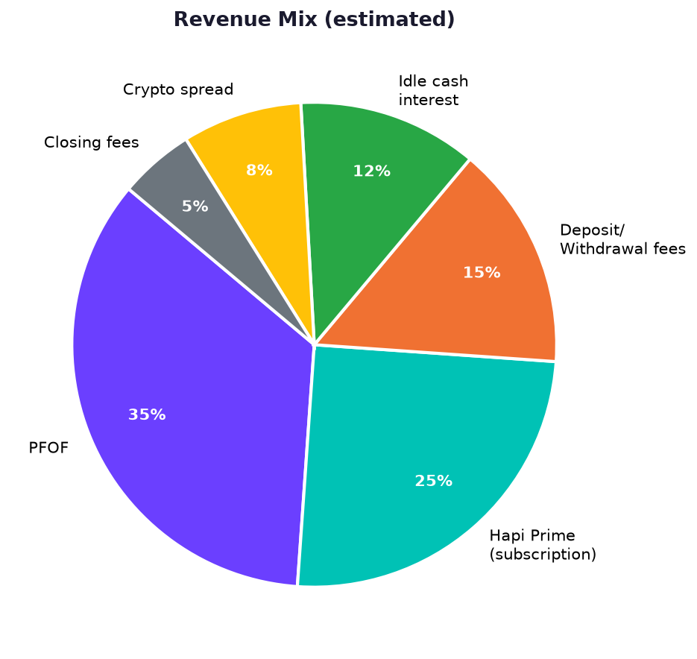
04 · BUSINESS MODEL
hapi · Case Study 2026
Revenue Streams
Payment for Order Flow
Hapi Prime US$9.99/mo
Deposit & Withdrawal
Idle Cash Interest
Crypto Spread
Closing Fees
Fees from routing orders to exchanges (PFOF)
Real-time prices, instant settlement, alerts
0.9–1% on deposits US$4.99–$10 withdrawals
Yield on uninvested cash in accounts
1% via Bakkt on all crypto trades
US$0.10 – $0.15 per trade close
~35%
~25%
~15%
~12%
~8%
~5%
Key Model Insight
Average position: ~US$250 per user Monetizes through volume & scale — not trade size
⚠ PFOF controversy: SEC tightened disclosure rules (605/606). Restricted in EU by ESMA.

Slide 11
05 · CUSTOMER SEGMENTS
hapi · Case Study 2026
Customer Segments
01
Beginner Investors
02
Long-term Retail Investors
03
Crypto Enthusiasts
1
Everyday retail users, students, young professionals
1
More experienced portfolio builders
1
Tech-savvy, digital-native
2
Zero-commission + fractional shares → start with US$5
2
USD exposure vs. local currency risk
2
Invest from US$1 in crypto
3
Mobile-first, simple UX
3
SIPC protection up to US$500K
3
One app: stocks + crypto
4
Financial education content
4
ETFs + DRIP for passive wealth
4
Note: crypto not SIPC-covered
"Invest in the world's biggest market from your phone — from US$5, in minutes, with US regulatory protection."

Slide 12
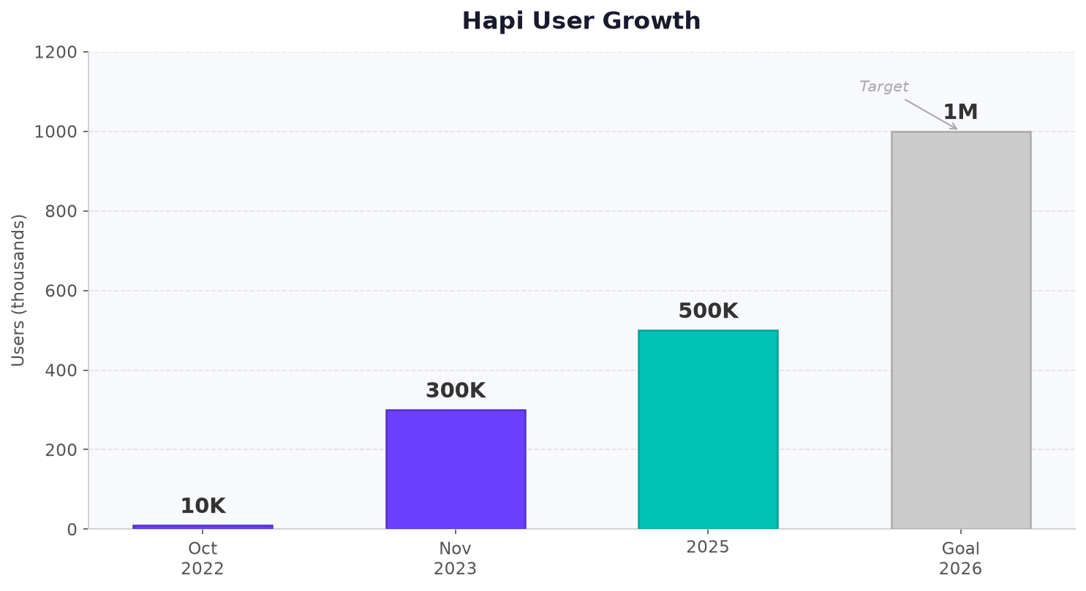
06 · KEY METRICS & FUNDING
hapi · Case Study 2026
Key Metrics & Funding
Key Numbers
AUM:
~US$40M
as of Nov 2023
Total Raised:
US$4.3M
across all rounds
Avg. Position:
~US$250
per user
Growth:
10K → 300K
in 13 months (2022-23)
Funding
Sep 2023 · US$1.6M
Total Raised · US$4.3M
Utec Ventures · Unpopular Ventures · Softeq Ventures · Mural Capital
Seed + angel rounds

Slide 13
07 · SWOT ANALYSIS
hapi · Case Study 2026
SWOT Analysis
STRENGTHS
WEAKNESSES
▸ Zero commissions + fractional shares from US$5
▸ Low brand awareness outside LATAM
▸ SEC/FINRA registered + SIPC up to US$500K
▸ Limited advanced tools for expert traders
▸ 20+ LATAM countries · Spanish/Portuguese UX
▸ Small team (37) — scalability pressure
▸ < 5 min sign-up · mobile-first design
▸ PFOF model faces regulatory scrutiny
▸ 12,000+ instruments + crypto in one app
▸ Crypto holdings not covered by SIPC
OPPORTUNITIES
THREATS
▸ LATAM fintech market still growing fast
▸ Global brokers entering LATAM (Schwab, IBKR)
▸ Currency devaluation drives USD-asset demand
▸ Regulatory fragmentation across 20+ countries
▸ Rising smartphone & internet penetration
▸ PFOF restrictions could cut primary revenue
▸ Huge unbanked/underinvested user base
▸ Local fintechs (Trii, Tyba) accelerating
▸ Expand financial education & content
▸ US market downturns erode user confidence

Slide 14
08 · STRATEGIC OUTLOOK
hapi · Case Study 2026
Strategic Outlook
Scale to 1M Users
Diversify Revenue
Regulatory Trust
Product Depth
Education + referrals + new country launches
Grow Prime subscriptions + reduce PFOF reliance
Maintain SEC/FINRA standing Navigate multi-country rules
Add tools for intermediate & expert traders
Challenges to Navigate
→ Differentiate before global brokers replicate the LATAM-first approach
→ Continue investing in financial education to convert and retain users
→ Diversify revenue to reduce exposure to PFOF regulatory risk
→ Manage multi-country compliance without blowing up cost structure
"The platform that wins LATAM earns trust first — through regulation, education, and a UX that feels local."

Slide 15
Thank You
Questions?
Daniel Taboada · Benjamin Pereyra · Luis Sanchez · Jorge Ramirez · Santiago Wiesse
Universidad del Pacífico · Sem. Fintech · June 2026
hapi.trade

