Slide 1
Keystroke Dynamics Authentication
Yuankai Guo Myungho Jung Junwei Shi Xu Wang

Slide 2
Lost a Password?
The Consequences
Lost social account, emails, payment account
Lost personal information & privacy
Lost bank account & money
Notes:
What if you lost a password, and the password is being used in many places? Well, it’s gonna have severe consequences. Your will lose your social account. Your emails, your personal information. Even someone could wipe out you bank account if you really prefer to use the same password everywhere.

Slide 3
One Solution
There is something cannot be stolen
The way you type your password
Procedural memory, intrinsic and unique
Hard to steal
Record the rhythm when you type the password
And match it against previously stored patterns
Notes:
There have been many efforts to strengthen the password-based authentication. We create another way because we observed that there is something about the password that cannot be stolen from you. It is the way you type it. The rhythm, the timing pattern when you type it. It is intrinsic and unique. And it’s your procedural memory, people cannot just break into your mind and steal it.
So, our solution is to record the rhythm when you type your password, and match it against patterns stored previously.
Okay, let’s start with the demo.

Slide 4
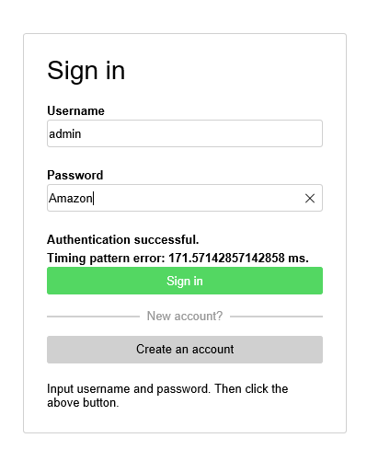
Demo Section

Slide 5
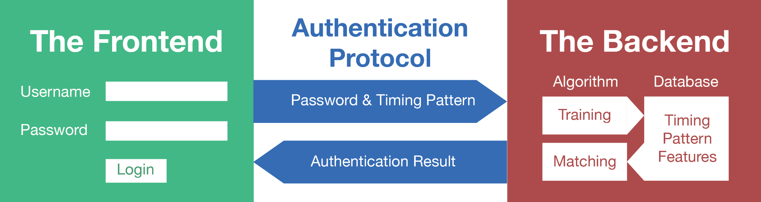
How It Works
Overview
The frontend: the login page. Records the timing pattern
The backend: the server side. Matches the timing pattern
Authentication protocol: secures the communication
Notes:
Alright, let’s talk about the demo. There are three parts.
The frontend is the login page you have seen. It records the timing pattern when you input the password in the box.
Then the pattern is encrypted in the way defined by the authentication protocol, and transmitted to the backend along with the username.
The backend is an HTTP server program written in Python. It uses Machine Learning algorithms to match the pattern against previous patterns stored in the database. If both the password and the pattern matches, the authentication is done.

Slide 6
Pattern Matching
Representation of the Pattern
120
80
80
A
D
F
S
80
0
+0
100
+100
200
+100
300
+100
ms
 |  |  | A |  | S |  | D |  | F
Durations | = | [ | 120 | , | 80 | , | 80 | , | 80 | ]
Intervals | = | [ | 0 | , | 100 | , | 100 | , | 100 | ]
Notes:
My part is pattern matching algorithm for detecting novelty.
Given a n characters password, the pattern is an array consists of intervals and duration of keystorkes.
So, a pattern can be regarded as a point in 2n-1 dimensional space.
For example, the pattern in the picture is 1st duration, 1st interval, 2nd duration, 2nd interval, and 3rd duration.
By doing so, the similarity can be measured by distance between two points.
Actually, in other researches, the interval is from released to pressed timing, so negative values exists.
However, we use between key pressed and pressed timing as interval.
So, there should be only positive values and it will make the precision doubled with the same data size.
We normalized timing data by dividing by the maximum timing values because the timing range varies depending on users.
The patterns are also normalized in dimensions because the length of each user’s pattern is different.

Slide 7
Pattern Matching
Representation of the Pattern
duration
A pattern has 2n-1 numbers of durations and intervals for password of n characters
A pattern can be represented a point in 2n-1 dimensional space
Use timing between key pressed and next pressed as interval
Normalize values for equivalent data size and precision
A
B
interval
C
duration
interval
e.g. pattern = [100, 150, 100,
150, 100]
100
200
250
350
400
450
time
interval
Notes:
My part is pattern matching algorithm for detecting novelty.
Given a n characters password, the pattern is an array consists of intervals and duration of keystorkes.
So, a pattern can be regarded as a point in 2n-1 dimensional space.
For example, the pattern in the picture is 1st duration, 1st interval, 2nd duration, 2nd interval, and 3rd duration.
By doing so, the similarity can be measured by distance between two points.
Actually, in other researches, the interval is from released to pressed timing, so negative values exists.
However, we use between key pressed and pressed timing as interval.
So, there should be only positive values and it will make the precision doubled with the same data size.
We normalized timing data by dividing by the maximum timing values because the timing range varies depending on users.
The patterns are also normalized in dimensions because the length of each user’s pattern is different.

Slide 8
Pattern Matching
Matching Algorithms
Statistical(Geometric) Measurement
Nearest Neighbor using Euclidean/Manhattan Distance
- Pros: Intuitive and fast, working with small number of samples
- Cons: Poor performance for sparsely distributed patterns
Mahalanobis Distance
- Pros: Works well even if samples are sparsely distributed
- Cons: Poor performance for multiple dense clusters
Slow for long password due to large covariance matrix
Machine Learning
One-Class SVMs(Supported Vector Machines)
- Pros: Show good performance in most cases
- Cons: Need a lot of samples
Notes:
There are many algorithms to detect outliers, such as geometric distance, machine learning, neural network, and genetic algorithm.
We selected common three algorithms and compared them.
First, find nearest neighbor and measure the distance from it.
It is intuitive and needs computed fast. And works with small number of samples.
But, it is not good for sparsely distributed samples.
Second, Mahalanobis distance is used.
By the method, we measured the distance from a point to cluster.
It shows how many standard deviation between a point and the mean of a cluster.
So, even if points are sparsely distributed, it works well.
However, the performance is low for long passwords.
Finally, One-Class SVMs which is one of the machine learning algorithms is selected.
It shows good performance but needs a lot of samples for high accuracy.

Slide 9
Pattern Matching
Problem in practical experiments
Reliable only if collecting a large amount of data from hundreds of people for years.
Data could be biased depending on the group.
Hard to create and control impostor’s data
Variation of patterns would not be observed in intentionally typed patterns in a short period of time.
→ We tried to generate well-controlled data to test from a different point of view
Notes:
In many researches, the practical experiments are conducted but we tested in synthetic environment.
Collecting real user’s patterns will be more reliable than virtual environment but it is only if it is tested for a long time with a lot of volunteers.
And the data from experienced users could be biased and so densely distributed.
Also, the impostor would have a pattern which means need to collect data from many imposters but in many previous studies, the imposter’s patterns generated by a few people.
And we want compare the performance of algorithms depending on variation of a user’s patterns. It should have been tested for a long period of time.
So, we tried to generate reliable synthetic environment for tests.

Slide 10
Pattern Matching
Process to form a test environment
Set a pattern
Generate evenly distributed patterns of imposters around
Create normally distributed patterns satisfying the condition
Predict a variation of a user’s patterns and set a condition
Notes:
Here’s the process.
First, set a pattern
And generate evenly distributed patterns for imposters.
And select a variation of patterns for a user.
And generate patterns satisfying the condition and normally distributed.
Finally, training data with the user’s patterns and predict for all points.

Slide 11
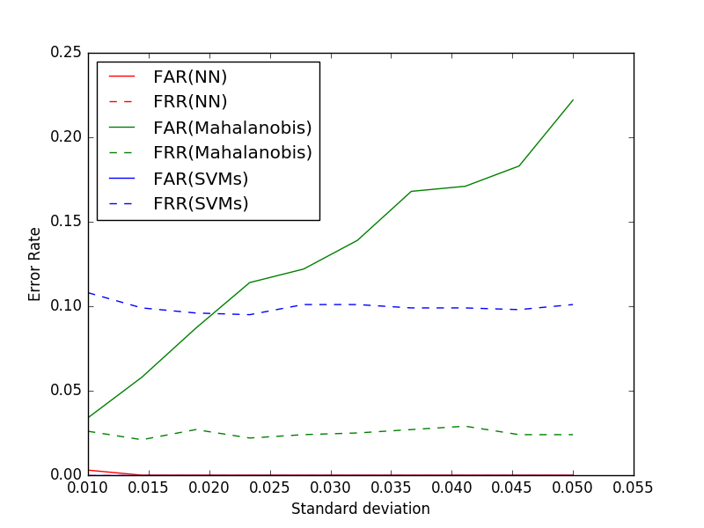
Pattern Matching
Test Result 1 – Only one interval varies
e.g.) password = ‘abcd1234’
Interval between ‘abcd’ and ‘1234’ would not be predictable
FAR(False Accept Rate)
Accepted patterns / tries by imposters
FRR(False Reject Rate) :
Rejected patterns / tries by genuine users
Execution Time:
Nearest Neighbor = 0.047 sec
Mahalanobis Distance = 0.197 sec
SVMs = 0.002 sec
Notes:
Before explaining the test results, there are two kinds of error rates.
First, false accept rate is the case that the imposter input password but accepted.
Second, false reject rate means the actual user type password but rejected.
In most cases, FAR is more important than FRR but high FRR will make the user annoyed.
For the test, 1000 user’s pattern and the same number of imposter’s pattern.
And the length of password is 10 which means each point is in 19 dimensional space.
And each case is tested 100 times and averaged.
First test is only one interval varies.
Think about a user’s password consists of words and numbers.
The pattern of word and the pattern of numbers will not change much but interval between the word and numbers would not be predictable.
The x axis is standard deviation for the patterns.
Higher ST generate sparsely distributed patterns which represent not experienced users.
And patterns with lower ST indicates experienced users.
The result shows that the SVMs shows the worst result because the number of samples is relatively small.
With 10,000 samples, SVMs showed the best results among them.

Slide 12
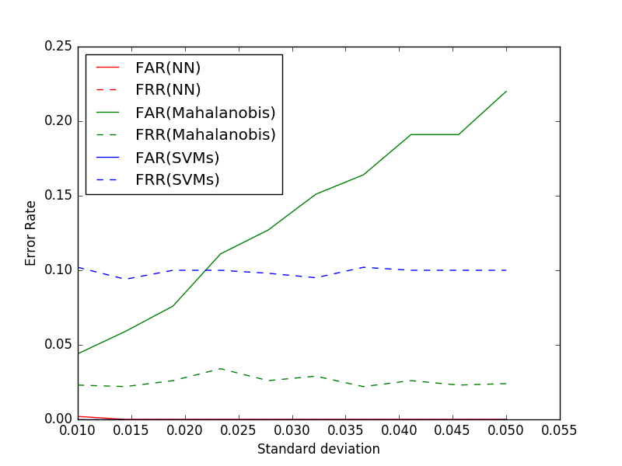
Pattern Matching
Test Result 2 – Patterns are proportional
e.g.) [20, 40, 60, 80], [10, 20, 30, 40], [30, 60, 90, 120]
Users would type faster or slower depending on the experience
Notes:
Second test is for proportional patterns.
It indicates the patterns are different but proportional.
The result is similar to the previous one.

Slide 13
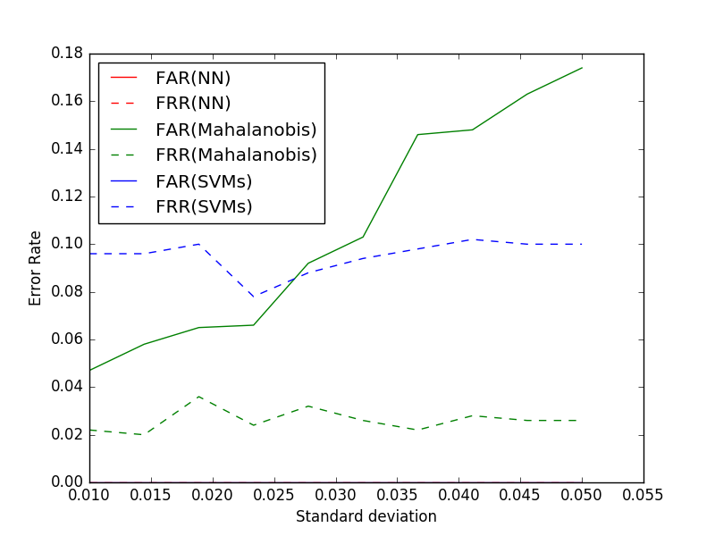
Pattern Matching
Test Result 3 – Multiple clusters
User’s pattern may form multiple clusters because of different types of devices such as, mobile and laptop keyboard.
Notes:
And this test is simulating the case that a user is using multiple devices.
For example, if a user logs in using mobile phone and laptop computer, the patterns would be divided into multiple clusters.
With these three tests, we concludes that there is no huge difference in results of algorithms depending on the user’s pattern. And Nearest Neighbor algorithms showed best performance unless there are more than 10,000 patterns.

Slide 14
Auth Protocol
What it does
Transmit password and timing pattern to the server securely
Design Goals
Avoid password transmitted in plaintext
Protect the timing pattern
Defeat the replay attack
Notes:
Our authentication protocol defines how to transmit the pattern and password to the server.
We had three design considerations for the protocol.
First, we don’t want the password exposed in plaintext.
Second, we want the timing pattern being well-protected.
Third, we want to prevent the replay attack.

Slide 15
Auth Protocol
Message Encapsulation
Key{ hash( TS | Pattern ) | TS | Pattern }
Key - the block cipher key derived from the password
TS - the timestamp
Pattern - the timing pattern, JSON string
hash - SHA-256
Notes:
Here is how we meet the design goals. We use this structure to send the timing pattern to the server.
The key is the AES encryption key. It is generated from the password.
The pattern is the timing pattern, encoded into a JSON string.
We concatenate pattern with a timestamp. And compute a hash of the two parts.
Then we use the generated key to encrypt the pattern as well as the hash and the timestamp, and send it to the server.
As you can see, the password is not being transmitted in any form in the message. And the pattern is protected by AES. And because we use the timestamp, the replay attack is also prevented. All of the three goals are met.

Slide 16

Auth Protocol
How to Authenticate the User
Key
Key{ hash( TS | Pattern ) | TS | Pattern }
hash( TS | Pattern ) | TS | Pattern
The Password
hash( TS | Pattern )
Match?
TS not expired?
Authenticated
Notes:
Here is a problem. How can we verify the password without transmitting it. Actually, it is implied in our design.
When server receive the encrypted pattern, it first retrieve the password of the user from the database.
Then, it generate the AES key in the same way as the frontend.
Then, decrypt the message with the key.
Extract the hash, the timestamp and the pattern.
Compute a hash of the timestamp and the pattern,
Check if the hash matches what was received.
Then check if the timestamp is still valid.
If so, the user is authenticated.
The trick is that if the user provides an incorrect password, we won’t be able to decrypt the message. Therefore, the two hash cannot match. The purpose of having the hash here is to determine whether the message is decrypted correctly. So only when the correct password is provided, everything would work.

Slide 17
Thank You!

