Slide 1
Data structure
duration
A pattern has 2n-1 numbers of durations and intervals for password of n characters
A pattern can be represented a point in 2n-1 dimensional space
Only positive values that is different from other research
A
B
interval
C
e.g. pattern = [100, 150, 150, 100, 100]
interval
time
100
200
250
350
400
450

Slide 2
Normalization for data size
Data size for each pattern will be different if store as integer time values.
Should not assume the maximum timing value unless it is exceptionally high.
We need equivalent data size for users and as high precision as possible.
Store t_{i}/M and M such that M = max(t_{i}) and t_{i} is timestamp for keystroke events
0 < t_{i} < 1, control size by floating-point precisions

Slide 3
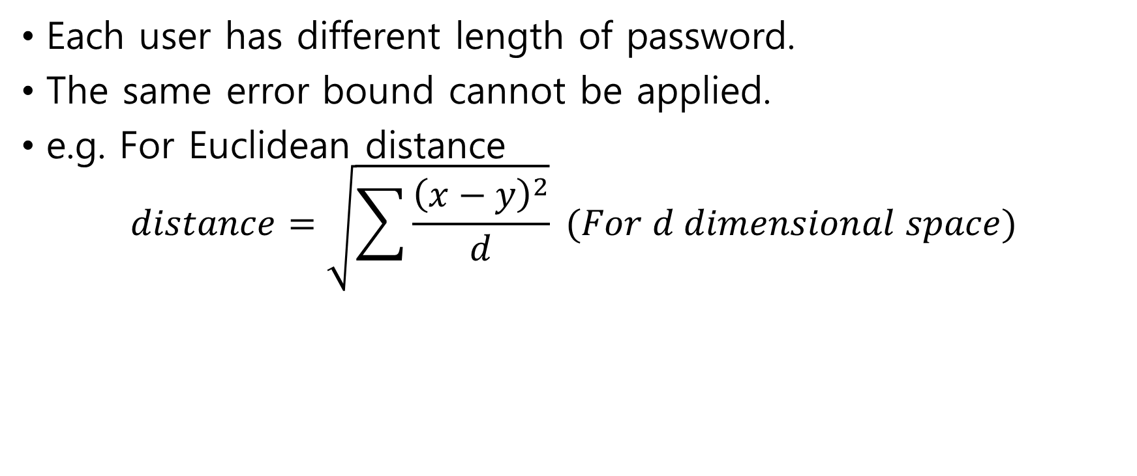
Normalization for dimension
Each user has different length of password.
The same error bound cannot be applied.
e.g. For Euclidean distance
$$distance=\sqrt{\sum{\frac{{\left(x−y\right)}^{2}}{d}}} (For d dimensional space)$$

Slide 4
Pattern Matching Algorithm - 1
Manhattan/Euclidean distance from the nearest neighbor
Pros: Intuitive and compute fast
Do not require a large number of samples
Cons: Poor performance for sparsely distributed patterns
Good for the case
Bad for the case

Slide 5
Pattern Matching Algorithm - 2
Mahalanobis distance
How many SD between a point and a cluster?
Pros: Show good performance for sparsely distributed cluster
Cons: Poor performance for multiple clusters
Slow for long password due of large covariance matrix
Good for the case
Bad for the case
α * SD
mean
mean

Slide 6
Pattern Matching Algorithm - 3
One-class SVMs(Supported Vector Machines)
Pros: Show good performance in most cases
Cons: Need lots of samples and more computation time than previous ones

Slide 7
Problem in practical tests
Reliable only if collecting a large amount of data from hundreds of people for years.
Data would be biased depending on the group.
Hard to create impostor’s data and figure out how many patterns overlap.
Variation of patterns would not be observed in intentionally typed patterns in a short period of time.
→ We tried to generate well-controlled data to test from a different point of view

Slide 8
Process to form a test environment
Set a pattern
Generate evenly distributed patterns around
Create normally distributed patterns in the condition
Remove false patterns satisfying a specific condition from the pattern

Slide 9
Error rate
FAR(False Accept Rate)
Accepted patterns / tries by imposters
FRR(False Reject Rate) :
Rejected patterns / tries by genuine users

Slide 10
Test Results by Euclidean distance

Slide 11
Test Results by Mahalanobis distance

Slide 12
Test Results by One-Class SVMs

Slide 13
Scenario
Apply as secondary authentication to enhance security
Apply as direct authentication
Required Error Rate : Balanced FAR and FRR
vs
Required Error Rate: As low FAR as possible regardless of high FRR
Input password
Input password
Is password correct?
No
No
Is password correct?
Yes
Yes
No
Is pattern valid?
No
Is pattern valid?
Yes
Yes
Send warning message by email or text
Log in
Log in

Slide 14
Application in existing web-services
Collect user’s patterns without checking until storing n patterns
(n is the number of patterns to be required for pattern-matching algorithm)
time
0
n
2. After n number of patterns are collected, start to check password as well as patterns
time
0
n
3. Compute with only the latest n patterns and the first s patterns are discarded
time
0
s
n
s+n

