Slide 1
Different Distributions of Upload Speed
01/27/10 – 02/09/10

Slide 2
Updates
Google Repository
  Code, Wiki, Notes, Introduction
Merged Functionality
  (Mustfa’s dynamic/relative window sizes)
Improved Functionality
  Changeable dump output
Redo previous simulations in 2000 Report

Slide 3
Distributions
Tail-heavy distribution (empirical data)
Pareto Distribution (Generated data)
Log Normal (Generated data)
Weibull (Generated data)
Exponential (Generated data) *

Slide 4
Simulations
Node : 100
Time : 6,000,000 cycles
Fx = 3
Gx = 2
Window Size = 100
Protocols : sqrt, fixed, random, full

Slide 5
Empirical Tail-heavy (avg = 428, std= 1531)

Slide 6
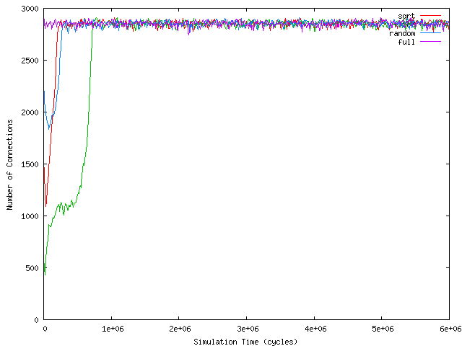

Slide 7
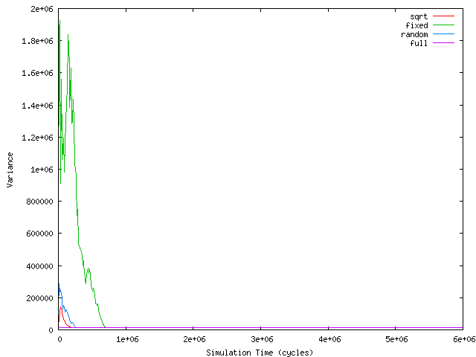

Slide 8
Pareto (avg = 209, std= 1219)

Slide 9
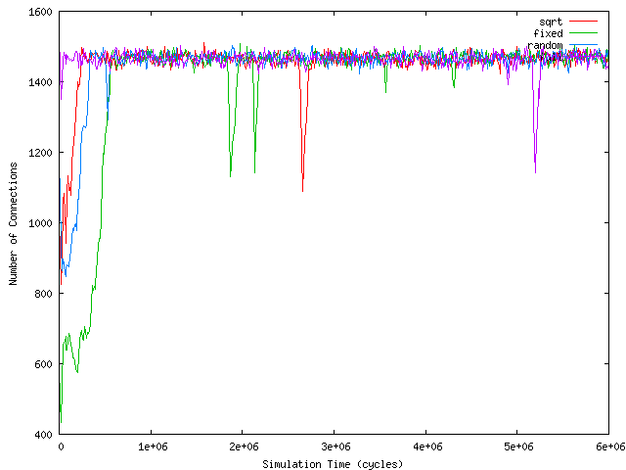

Slide 10
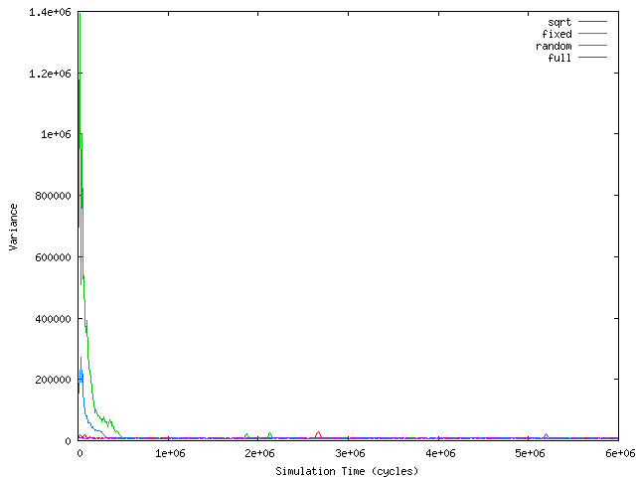

Slide 11
Weibull (avg = 424 kps, std= 1555)

Slide 12
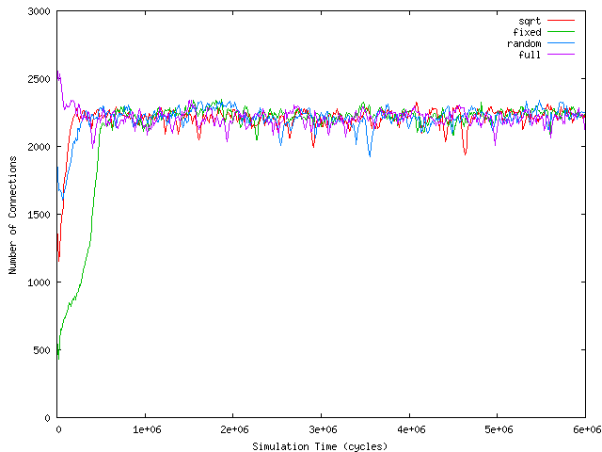

Slide 13
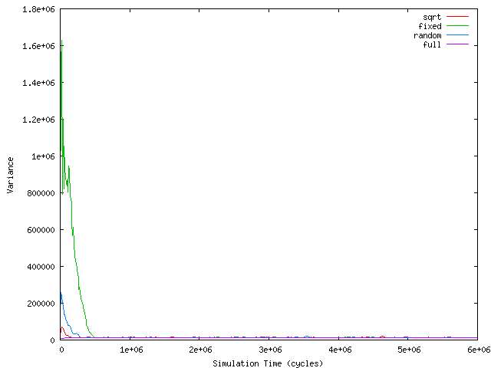

Slide 14
Lognormal (avg = 389 kbs std=1235)

Slide 15
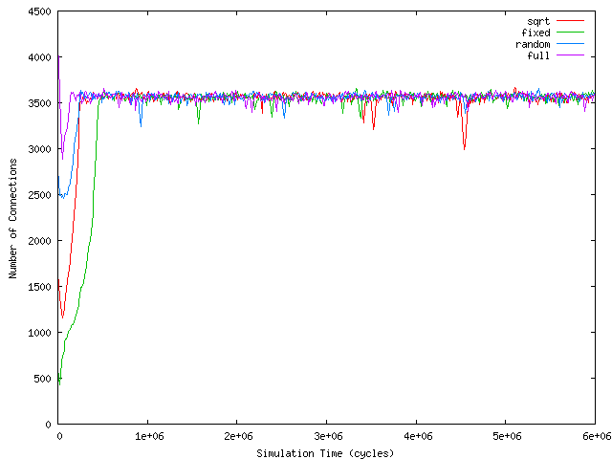

Slide 16
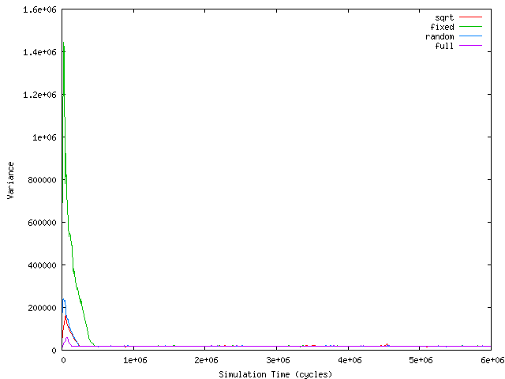

Slide 17
Exponential*

Slide 18
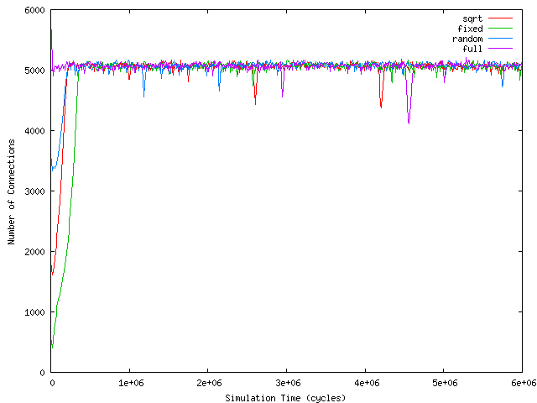

Slide 19
