Slide 1
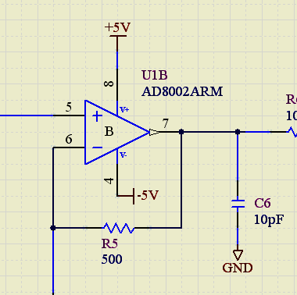
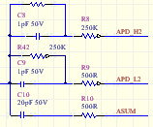
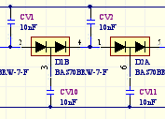
FEB64
CMB
MSCB
SCA2 Low/High
(76x512cells)
8 : N/C
64 : channels
ASIC AFTER
circuit
+5Vss
+6Va
-6Va
+6Vd
64
ADC
50Msps
Vreg U/I
Monitoring
SCA1 Low/High
(72x512cells)
8 : ASUM
64 : channels
ADC
50Msps
64
Slow Control
uC
C8051F133
+ -
Serializer
200MHz
CPU
Temperature
8
Asum
Config
Memory
Board
Temperature
Charge Division
Circuit
Asum 8 Branches
Threshold
8
External
Temperature
DAC
DAC
ASUM circuit
64
U/I 8 branches
Monitoring
Bias 8 Branches
Switch
U/I Qpump
Monitoring
Voltage Amplifier
Charge Pump
Voltage 40..75V
8
DAC
8
64
Bias Voltage
0..5V
MPPC High Voltage
MPPCs
64
DAC
8
DAC
Bus Board

