Slide 1
UML Class Diagram S2,S3
Owner: Supraja Kusam
Contributor: Dheeraj Kumar Maddineni
Peer Reviewer: Sankeerth Reddy Malapati

Slide 2
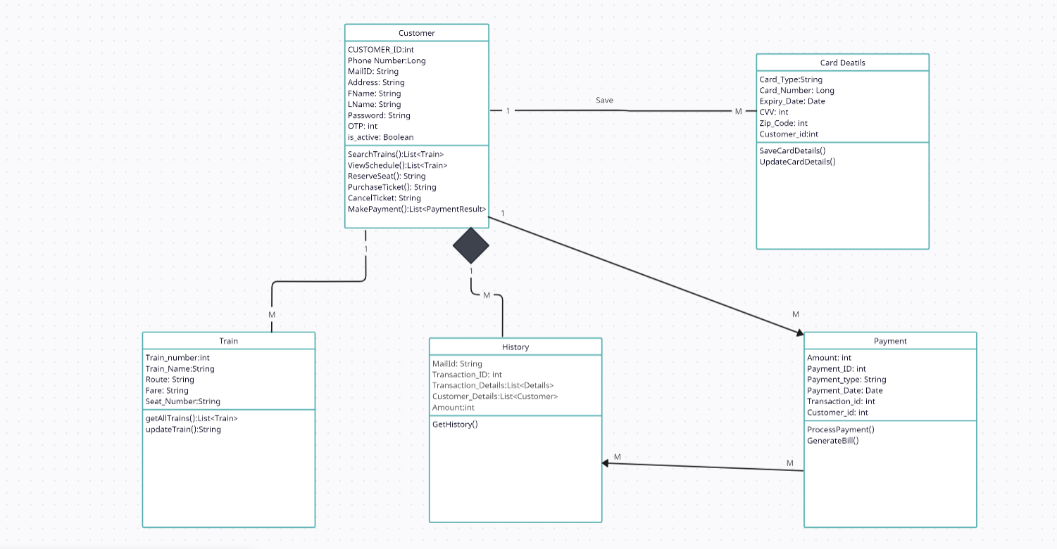

Slide 3
