Slide 1
UML Sequence Diagram for SwiftRails S2
Owner: Vrushali More Contributor: Peer Reviewer: Harsha

Slide 2
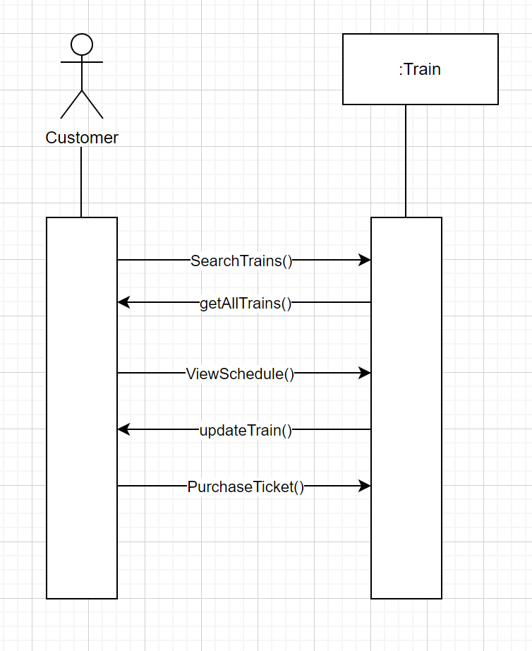
Use case- 02.01. Booking Fees Calculation
Use case Scenario:
This use case begins when the actor searches for the desired train.
System displays all the applicable train results and the customer can view their schedules.
Actor purchases the ticket for the selected train.

Slide 3
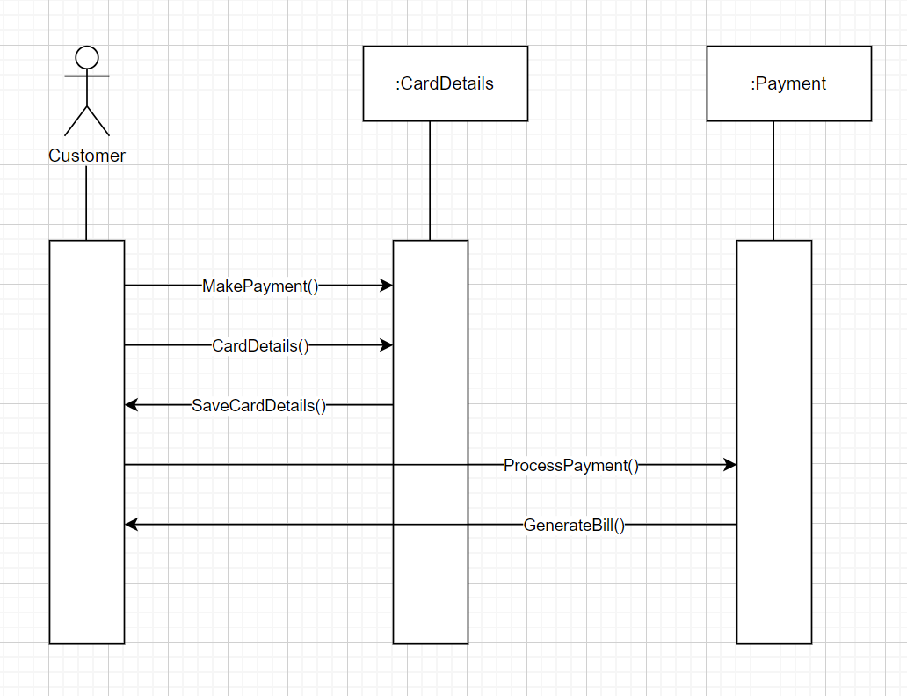
Use case- 02.02. Financial Reporting
Use case Scenario:
This use case begins when the actor proceeds to make a payment and gives card details.
System saves the card details.
Actor’s payment is processed via third-party payment API, and a bill is generated.

Slide 4
UML Sequence Diagram for SwiftRails S3
Owner: Vrushali More Contributor: Peer Reviewer: Harsha

Slide 5
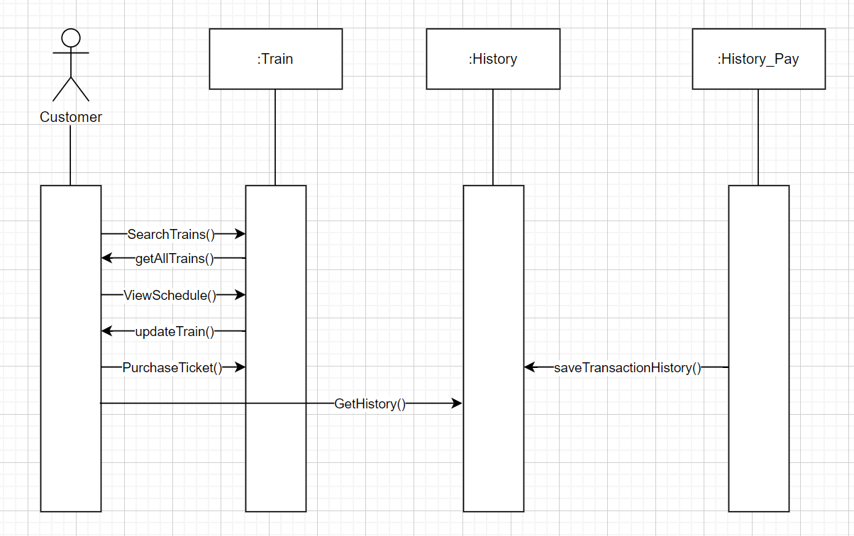
Use case- 02.01. Booking Fees Calculation
Use case Scenario:
This use case begins when the actor searches for the desired train.
System displays all the applicable train results and the customer can view their schedules.
Actor purchases the ticket for the selected train.
Actor can get and save the transaction history.

Slide 6
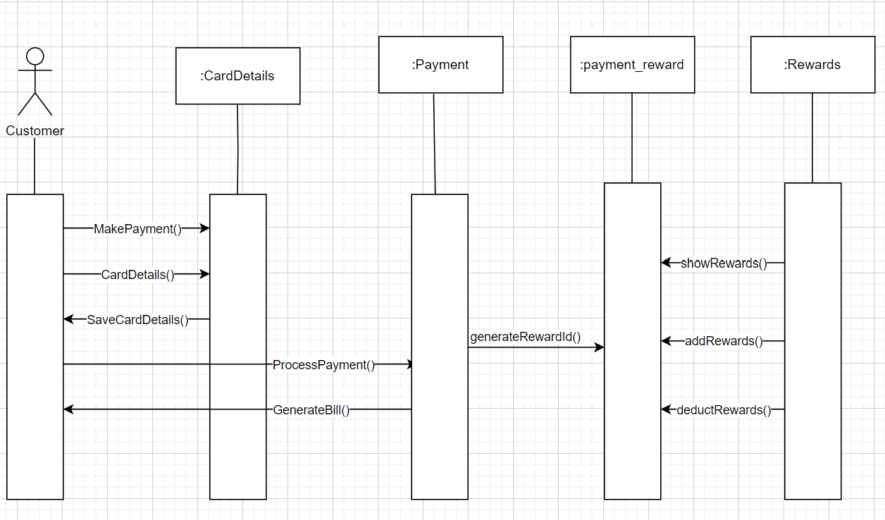
Use case- 02.02. Financial Reporting
Use case Scenario:
This use case begins when the actor proceeds to make a payment and gives card details.
System saves the card details.
Actor’s payment is processed via third-party payment API, and a bill is generated.
After payment is done, reward id’s are generated which can be displayed and modified.

