Slide 1
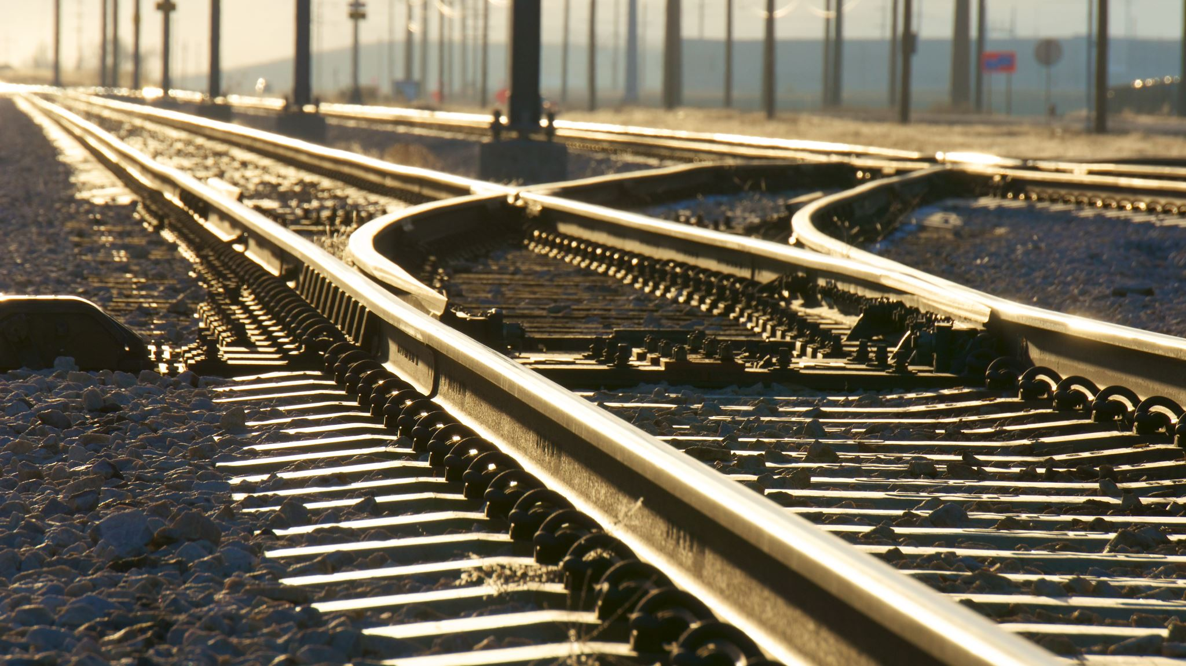
SWIFT RAILS
TEAM 5

Slide 2
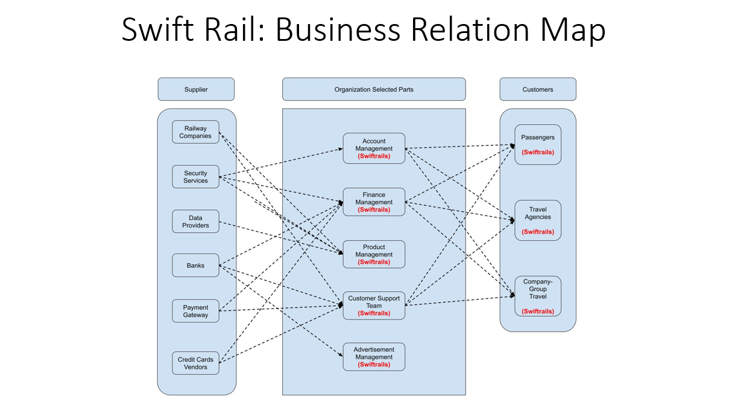
PRESENTED BY DIPESH

Slide 3
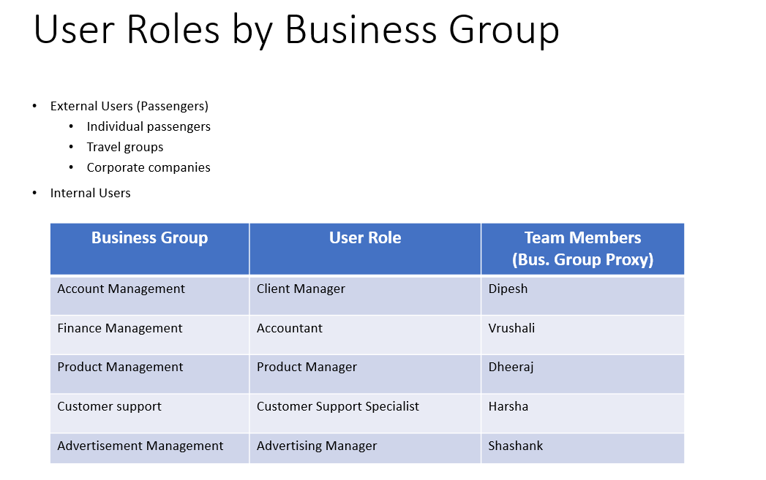
PRESENTED BY: MANIRAJ MUKKA

Slide 4
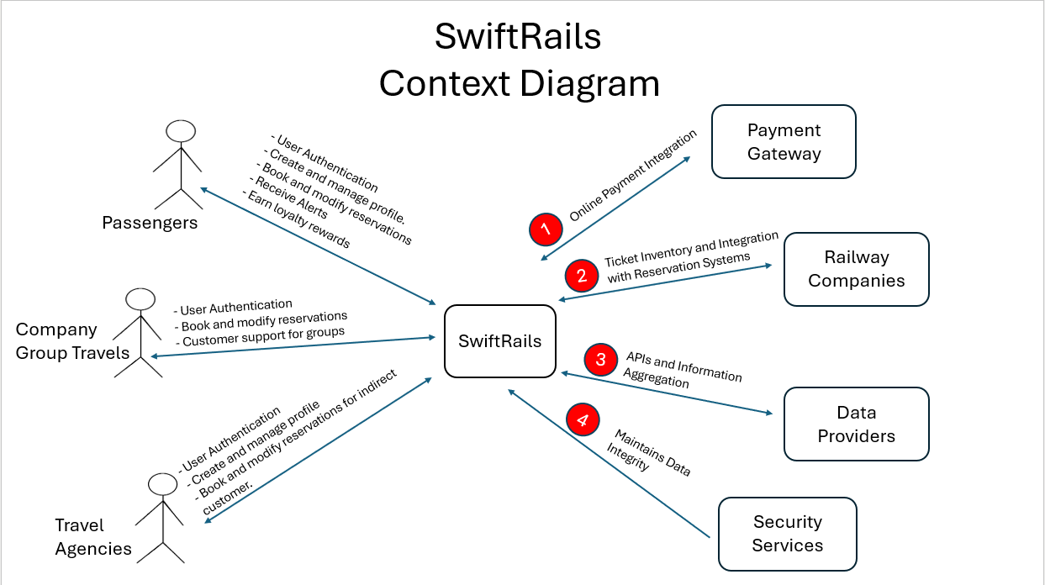
PRESENTED BY: SUPRAJA

Slide 5
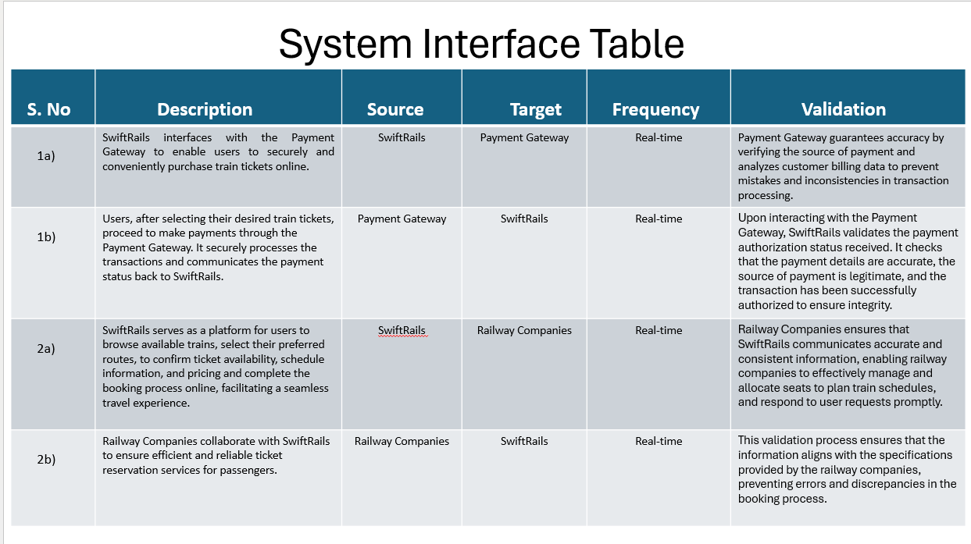
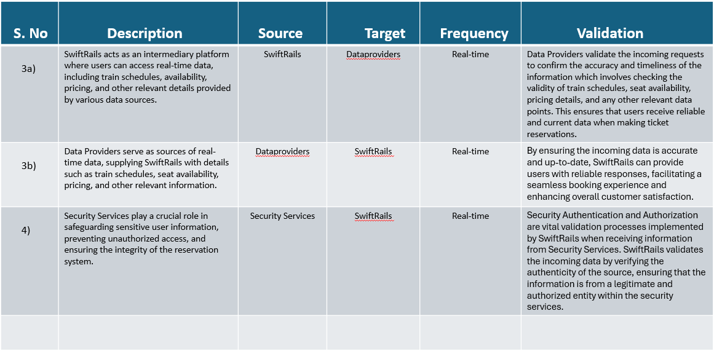
PRESENTED BY: HARSHA

Slide 6
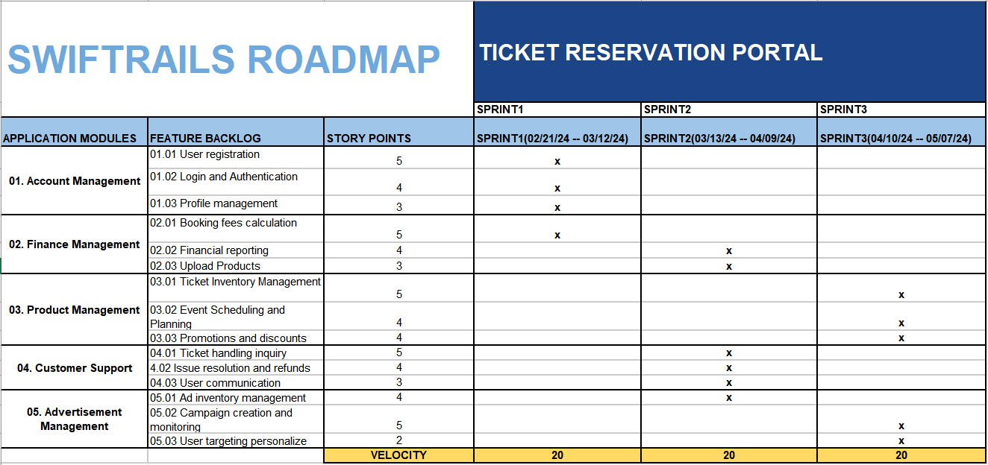
PRESENTED BY: PRIYABHAVANA

Slide 7
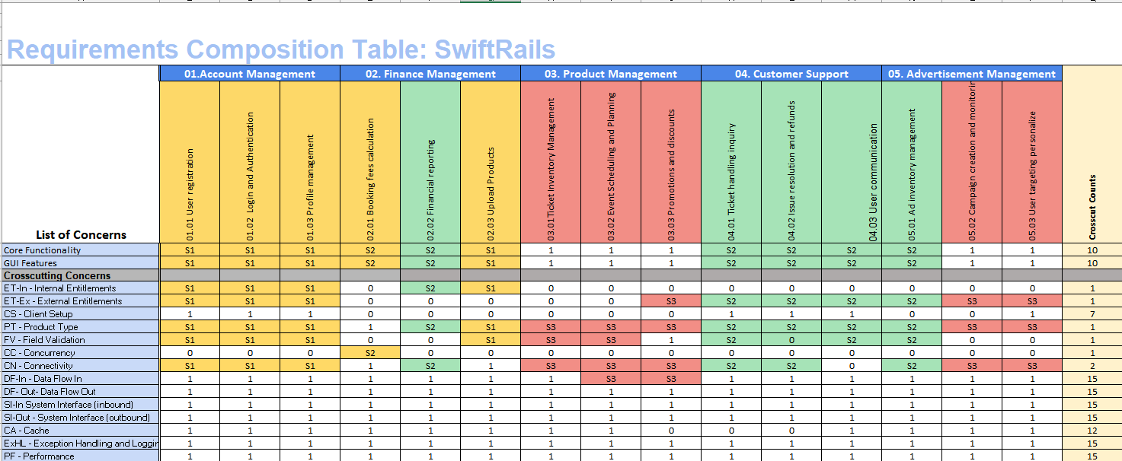
PRESENTED BY: VAISHNAVI

Slide 8
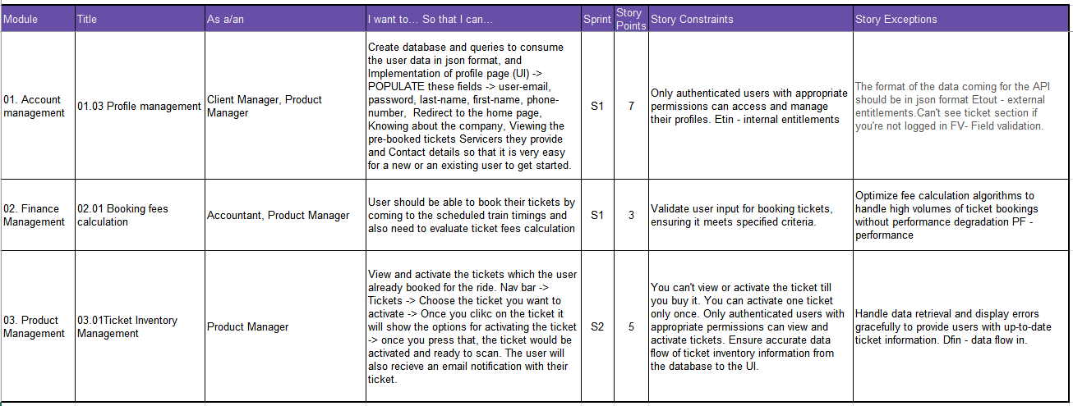
USER STORIES
PRESENTED BY SMITH AND KOUSHIK

Slide 9
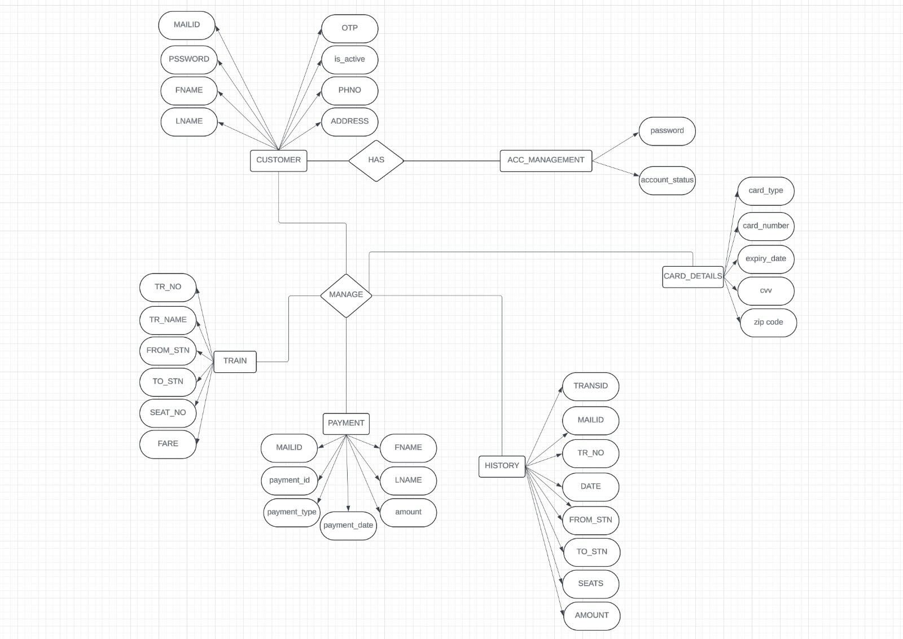
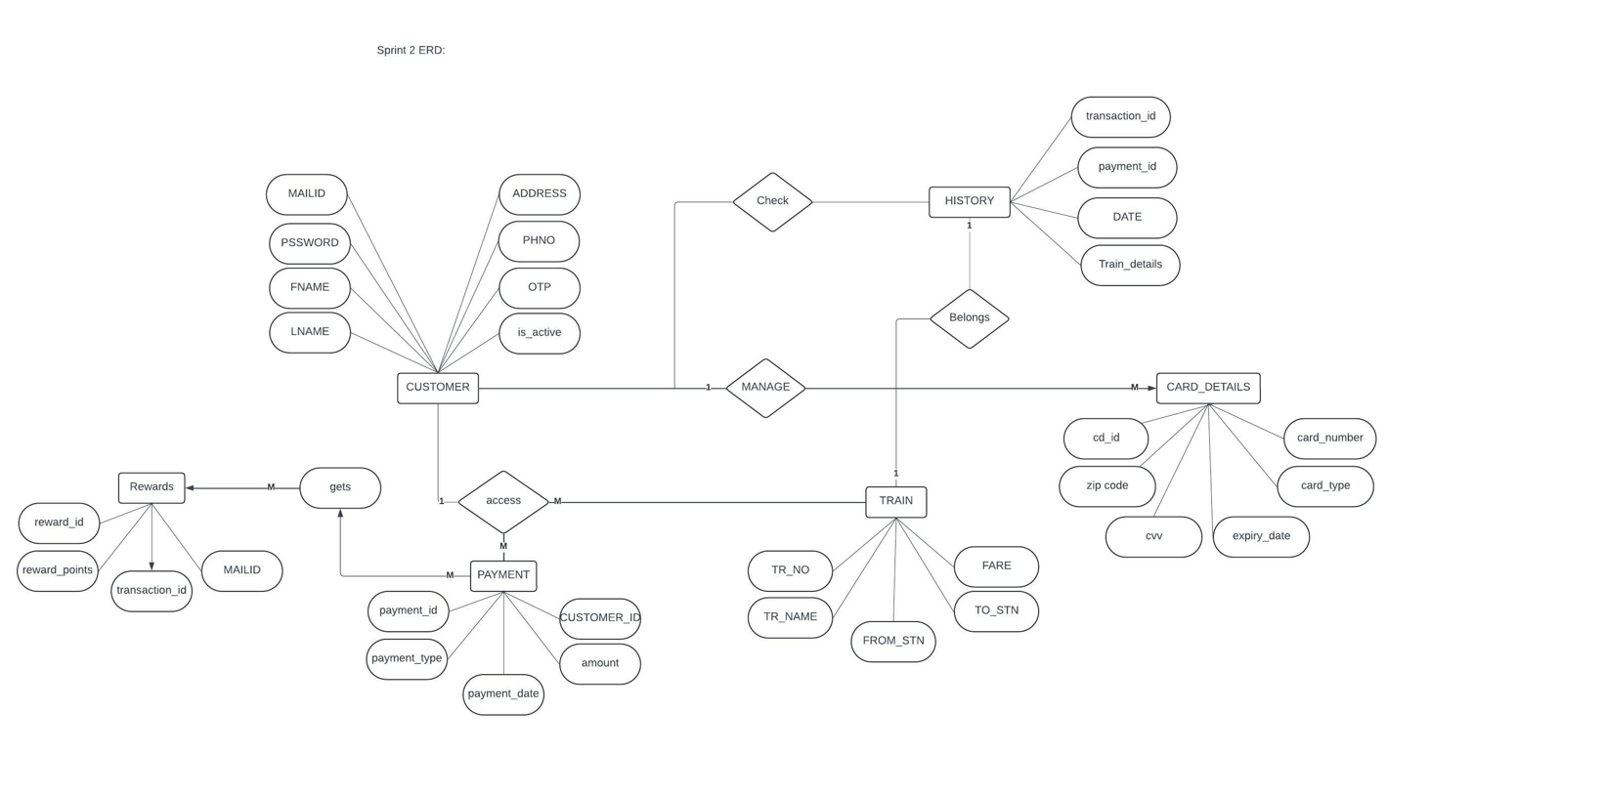
PRESENTED BY : MEHUL
ERD DIAGRAM

Slide 10
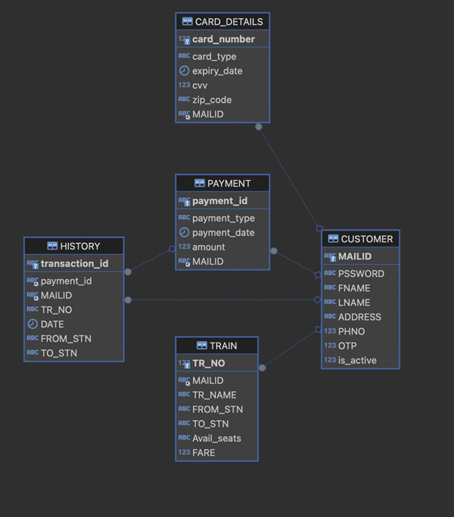

ERD DIAGRAM
PRESENTED BY: SANKEERTH AND PAVAN

Slide 11
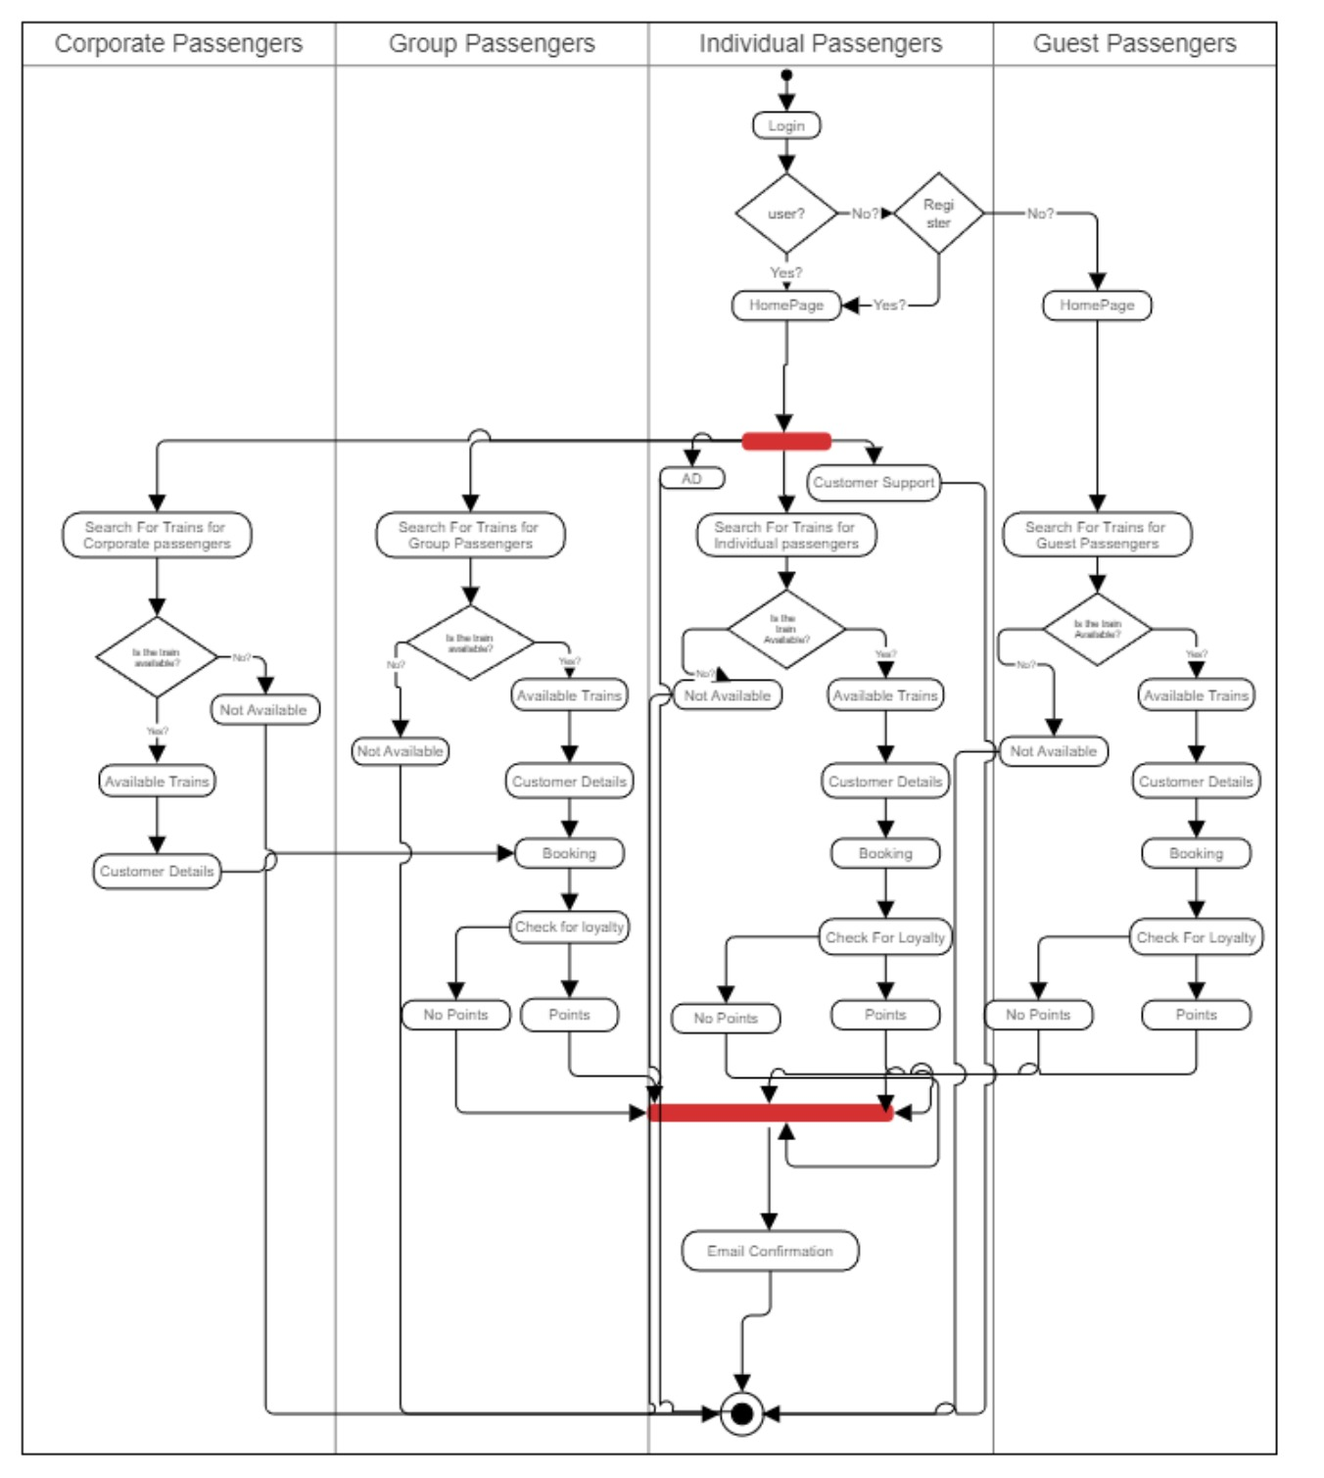
ACTIVITY DIAGRAM
PRESENTED BY: VRUSHALI

Slide 12
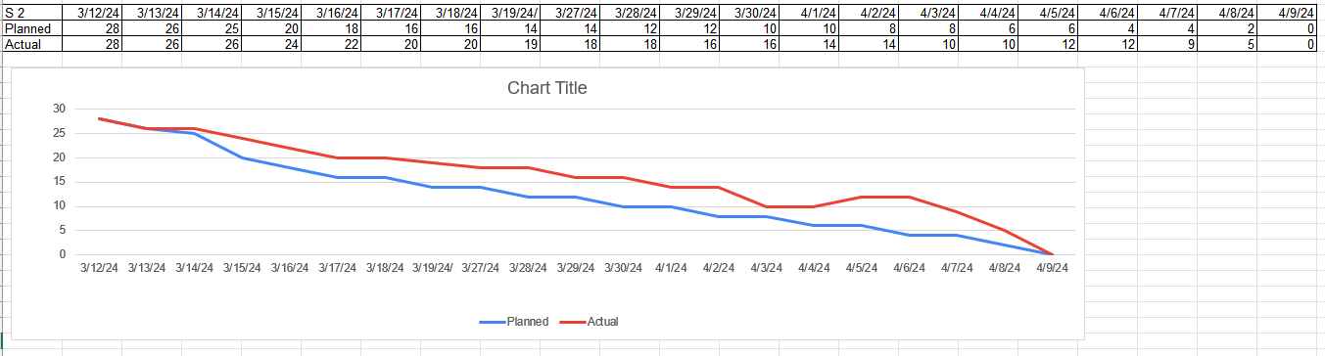
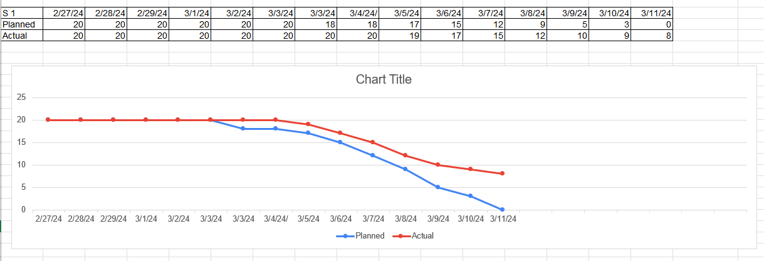
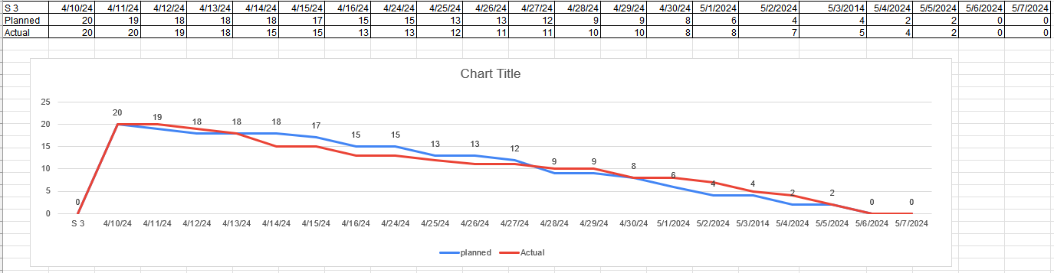
BURNDOWN CHART
PRESENTED BY: HARSHA & SHASHANK

Slide 13
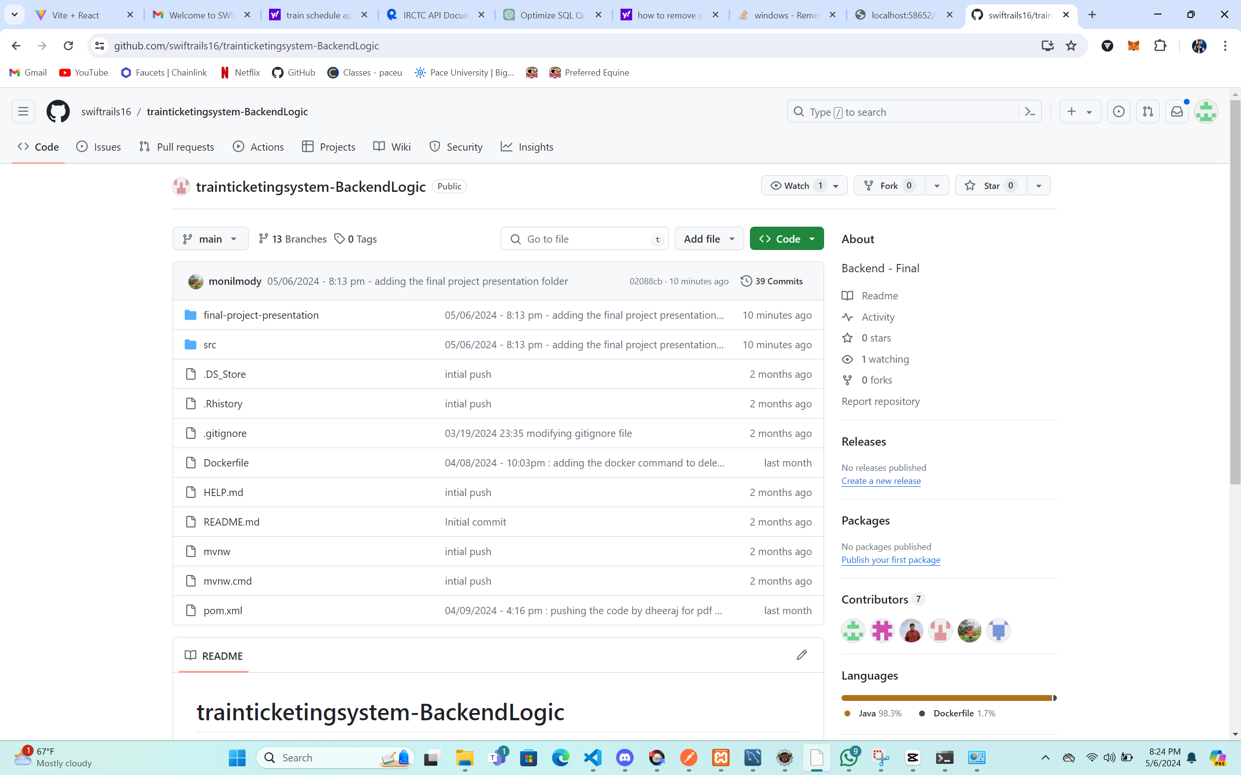
PRESENTATION BY: DHEERAJ
GIT HUB REPOSITORY

Slide 14
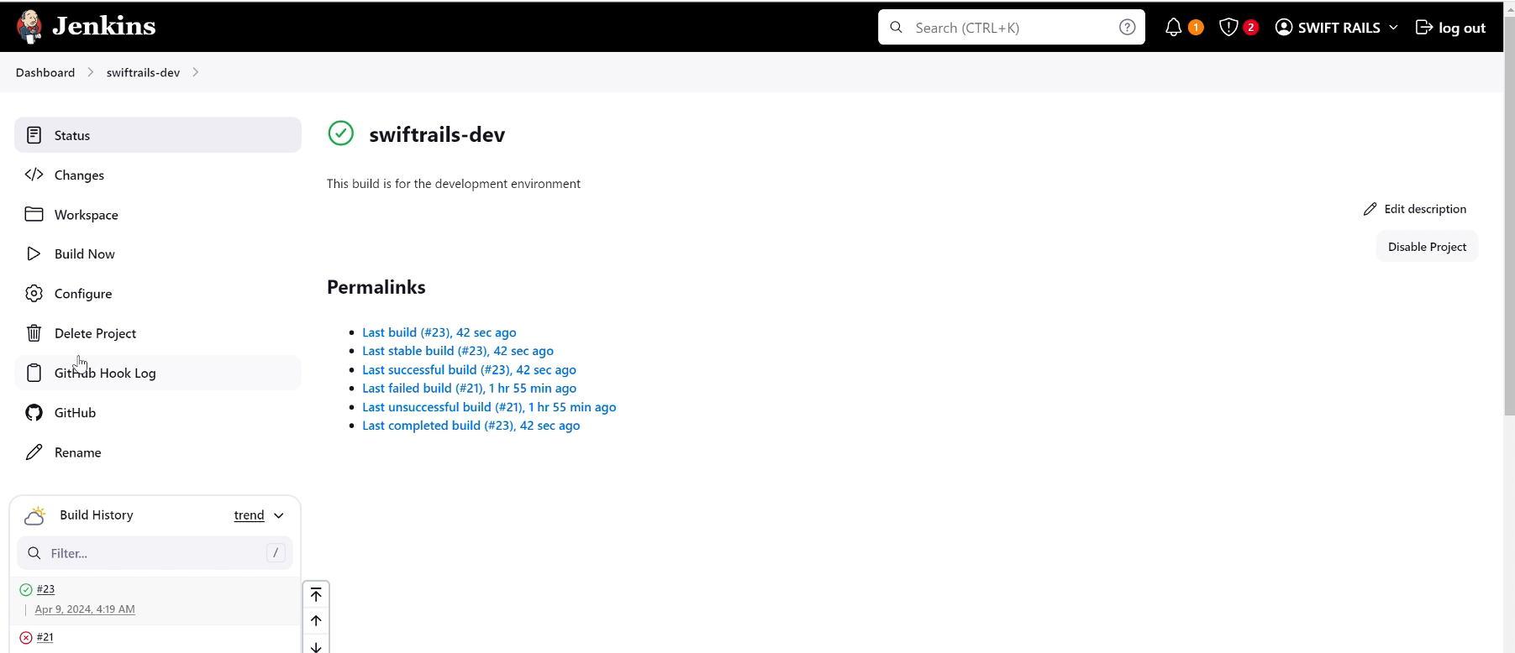
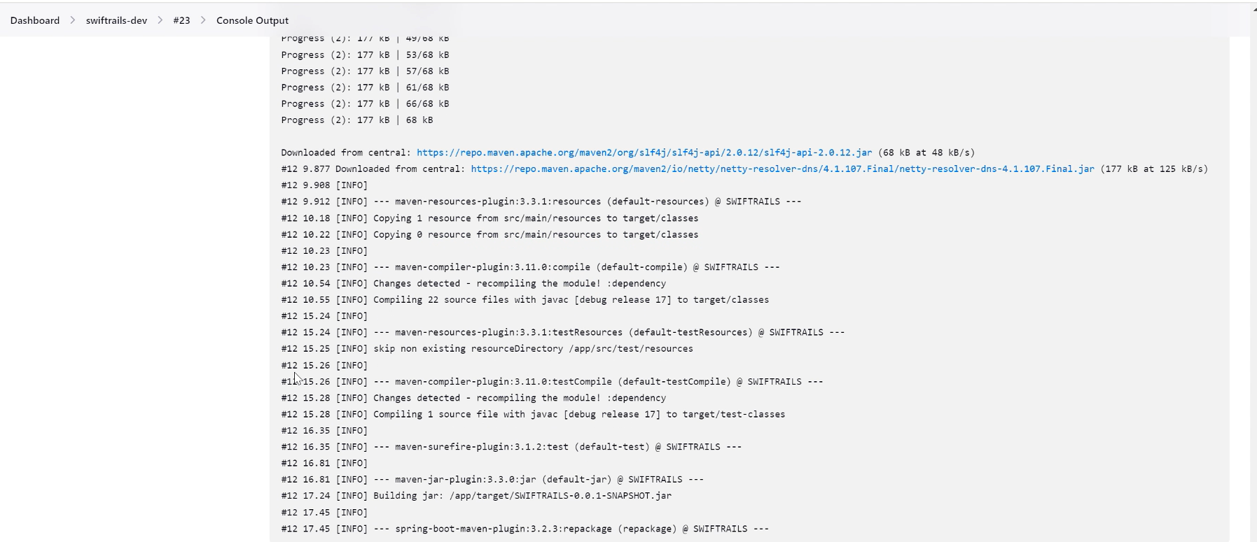
JENKINS REPORT
PRESENTATION BY: MONIL

Slide 15
TEAM-5
Priyabhavana Mallugari
Dipesh Sanjay Bharambe
Supraja Kusam
Monil Samir Mody
Harish Naik Sabawath
Sankeerth Malapati
Dheeraj Kumar Maddineni
Maniraj Mukka
Shashank Avinash Mishra
Vaishnavi Konda
Vrushali Prakash More
Smith Dsouza
Koushik Yeluguri
Mehul Ahire
Pakkela Pavan Sai
Harsha Vardhan Andra
THANK YOU

