Slide 1


Azure Workshops
Azure Services as Code
#AZWorkshops

Slide 2


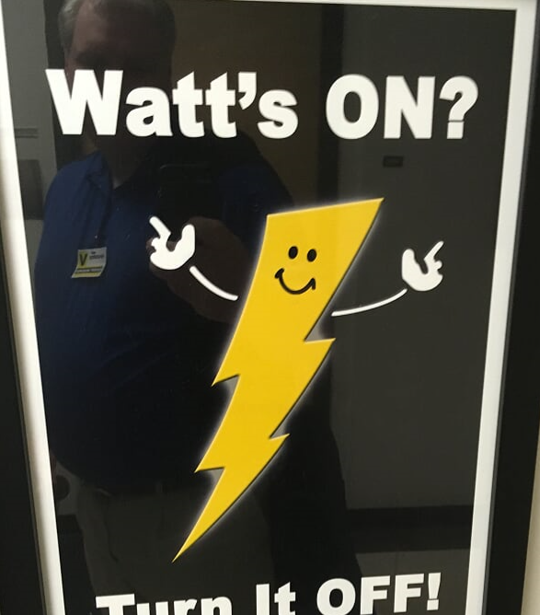

Nathan Swift Azure Infrastructure
https://www.linkedin.com/in/swiftsolves/
@SwiftSolves
https://github.com/swiftsolves-msft

Slide 3
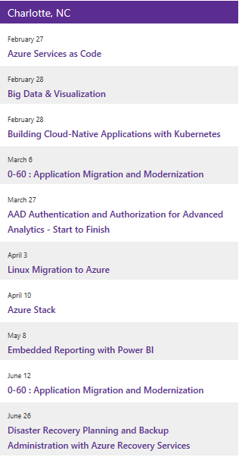
Upcoming Workshops
http://aka.ms/azureworkshops
Notes:
https://www.congrego.io/events/a5b2342d-095d-451e-a318-3685d2700821/0-60-Application-Migration-and-Modernization

Slide 4
Objectives
DAY 1
(9:00 – 9:30) Introduction
Introductions
Setup Environment
(9:30-9:45) Module 1: Overview
(9:45-10:00) Module 2: PowerShell
PowerShell Deployment – SimpleVM, SampleVM
(10:00-12:00) Module 3: ARM Templates
Module 3.1
Break @ 10:30 – 15 Minutes
Exercise Networking: ARM Template: 14
Module 3.2 and 3.3
(12:00-12:30) Lunch Break 30 Minutes
(12:30-2:00) Module 3: ARM Templates Cont
Module 3.4 and 3.5
Exercise VM: ARM Template: 16
(2:00-2:15) 15 Minute Break
(2:15-3:45) Module 4: ARM Functions
Module 4.1,4.2,4.3,4.4
Exercise VM: ARM Template Function: 17
(3:45-4:00) 15 Minute Break
(4:00-4:30) Module 5: Nesting Templates
DAY 2
(9:00 – 9:15) Recap
(9:15-10:15) Module 6: Terraform
Module 6.1,6.2,6.3
Exercise VM: Terraform: 19
(10:15-10:30) 15 Minute Break
(10:30-12:00) Module 7: AZBB
(12:00-12:30) Lunch Break 30 Minutes
(12:30-3:30) Module 8: Build Something, AMA
(3:30-4:15) Module 8: Show and Tell

Slide 5
Why Deploy Infrastructure and Services as Code
Can easily spin up and scale complex environments / application solutions in minutes
Versioning history of changes to environments / application solutions
Export and import into other subscriptions Dev/Test/Prod

Slide 6
Infrastructure as Code
Azure Resource Manager API
Azure PowerShell
ARM Template
Terraform
Azure Building Blocks

Slide 7
Azure PowerShell
Does not run and execute in parallel, waits for completion of resource
Does not create a version history
Requires a lot of PS code lines and only increases as more of the same resources are introduced

Slide 8
ARM Template
Written in Declarative JSON
Provides a lot of functionality and flexibility
Syntax is very sensitive

Slide 9
Terraform
Utilizes Scripting block language
Cross Platform
May not have the latest Public Preview Azure Resources Defined as Providers
https://www.terraform.io/docs/providers/azurerm/index.html
Notes:
Terraform init
Terraform plan
Terraform Grapth | dot > graph.gv
## terraform import "azurerm_subnet.existSubnet" "/subscriptions/6820d920-c94a-41f8-9e08-811fa97a1624/resourceGroups/rgSwiftNetworking/providers/Microsoft.Network/virtualNetworks/VNET-EUS2-01/subnets/AAA"
Terraform Apply

Slide 10
Azure Building Blocks
Developed by MS Patterns and Practices team
Need Azure CLI, Node.JS and azbb package
Simplified JSON, treats as blocks similar to Terraform
Flexibility \ customization is limited to blocks defined by azbb
https://github.com/mspnp/template-building-blocks/wiki
https://github.com/mspnp/template-building-blocks/tree/master/scenarios
Notes:
Az login
azbb -g rgRentPathAAA3 -s 6820d920-c94a-41f8-9e08-811fa97a1624 -l eastus2 -p C:\Users\naswif\Downloads\Rentpath\SampleADDCInfraPush.json --deploy

Slide 11
Objectives
DAY 1
(9:15 – 9:30) ARM Networking
Build a VNET in Portal
Build a VNET in ARM template
Connect VNETs in Portal
Review updated ARM service as code around connections
(10:00-12:00) Building VMs w/Storage
Create a storage account for diagnostics \ create containers
Build a VM in Portal
Build a VM in ARM Template
(11:30-12:00) Lunch
(12:00-1:00) ARM Functions
Update templates to use Copy
(1:00-2:00) Secure Secrets
Deploy KeyVault
Update ARM Templates to use KeyVault
(2:00-3:30) Investigate Terraform
Authenticate to Azure
Using Script Block
Using ARM Template in Script Block
(3:30-4:15) Investigate Azure Building Blocks
Use Azure Building Blocks
(4:15-5:00) Buildout Infrastructure and Services as Code in Sandbox
Continue deploying and testing
Questions and Answers

Slide 12
Be Sure to:
When creating Resources and Resource Groups use a xxx as your initials prefix to the names
this way you do not overstep or use other peoples resources in the same Subscription

Slide 13
Resources to Help
Detailed ARM Template References
Resources.azure.com Portal
Patterns | Writing World Class ARM Templates
Azure Quickstarts
Terraform Azure Providers
Terraform Github Examples
Azure Building Blocks

Slide 14
Networking
Build
Build a VNET in East US using IP space of 172.16.0.0/16 in portal
Subnets DefualtGateway, AAA, DATA, APP, WEB using /24
Build
Build a VNET in West US US using IP space of 192.168.0.0/16 ARM Template
Subnets DefualtGateway, AAA, DATA, APP, WEB using /24
Create
Create a S2S connection

Slide 15

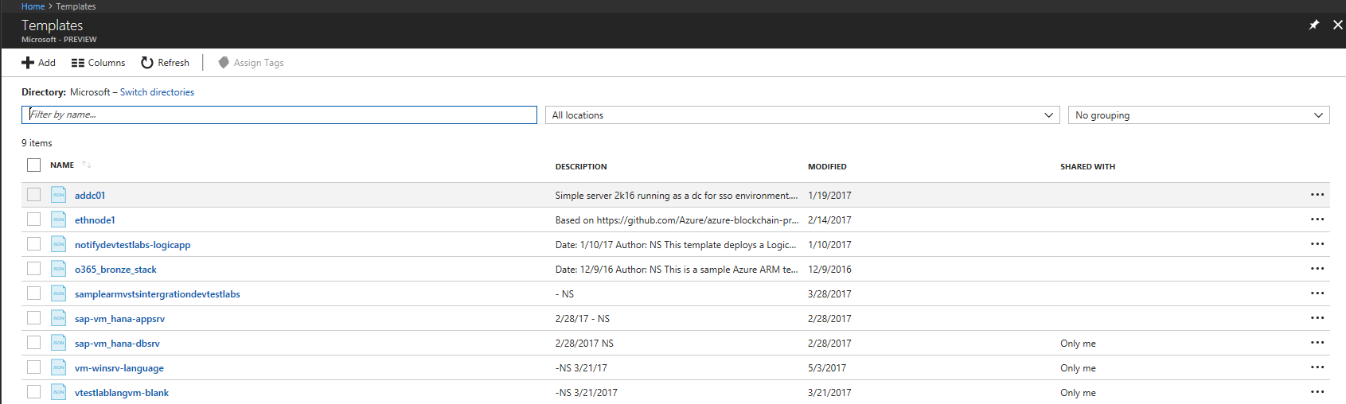
Azure MyPrivate Repo Templates
https://docs.microsoft.com/en-us/azure/marketplace-consumer/mytemplates-getstarted

Slide 16
VMs
Create
Create a Diagnostic Storage Account
Build
Build a VM from the Portal and place in VNET East US
Build
Build a VM from an ARM Template and place in West US

Slide 17
Update ARM Template using Functions
Update
Virtual machines to use copyindex() function
Update
ARM template and various pieces to use copyindex()
Build
Deploy New Virtual Machines using updated ARM template and functions
Notes:
https://docs.microsoft.com/en-us/azure/azure-resource-manager/resource-group-template-functions-numeric#copyindex

Slide 18
Terraform
Create
Azure AD SPN for Terraform
Build
Build a VNET in East US using IP space of 10.10.0.0/16 in Terraform
Build
Build a VM in Terraform in East US
Subnets DefualtGateway, AAA, DATA, APP, WEB using /24
Update Terraform Authentication Script Block
Leverage VNET
Create a Storage Diagnostic Account to Leverage

Slide 19
Azure Building Blocks
Create
Azure AD SPN for Terraform
Build
Build a VNET in East US using IP space of 10.10.0.0/16 in Terraform
Build
Build a VM in Terraform in East US
Subnets DefualtGateway, AAA, DATA, APP, WEB using /24
Update Terraform Authentication Script Block
Leverage VNET
Create a Storage Diagnostic Account to Leverage
Notes:
https://github.com/mspnp/template-building-blocks/wiki/overview

Slide 20
Sandbox
Create
Create a AD Forest
Create
Build a Application Solution in IaaS
Create
Build a PaaS Web App
1 Web Server
2 Web Apps (East US | West US)
1 Traffic Manager
2 DCs
1 AV Set
1 VNET, Multiple Subnets
Use Custom Script Extension for IIS install, AppDeploy, ect
1 VNET, Multiple Subnets
1 AV Set
Load Balancer L4 or L7 in front of Web Server
2 Public IP Address
2 Public IP Address

Slide 21
SandBox Secure Secrets with KeyVault
Create
An Azure KeyVault
Store
Store secrets in Azure KeyVault
Build
Build a VM from an ARM Template using KeyVault to reference Secrets
Notes:
https://azure.microsoft.com/en-us/blog/keyvault-support-for-arm-templates/

Slide 22
What the Solution Architect can also do
Think of us as answering the How of Azure.
Answer any questions related to Azure
Create and develop Azure POCs, Pilots, and Prototypes with Lowe’s
Provide Demonstrations of Azure
Engage in training and education, deep dive on Azure topics
Coordinate with Product teams and customer on Azure
Whiteboard \ Architectural Design Sessions
Deployment Guidance and Standard Setting in Azure

Slide 23
Anonymous Feedback
Please send me feedback
https://swiftsolves.sarahah.com/

