Slide 1

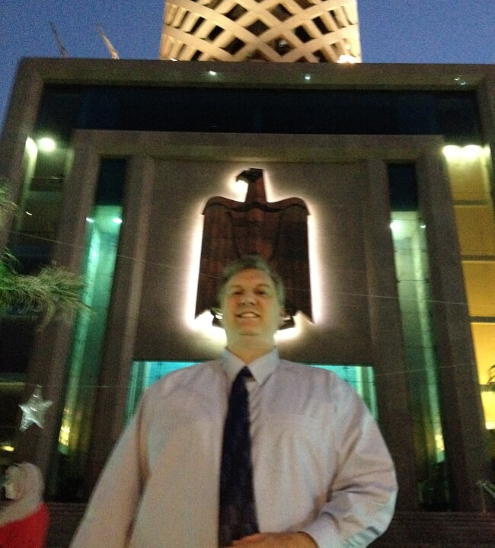


Nathan Swift Azure Infrastructure
https://www.linkedin.com/in/swiftsolves/
@SwiftSolves
https://github.com/swiftsolves-msft

Slide 2
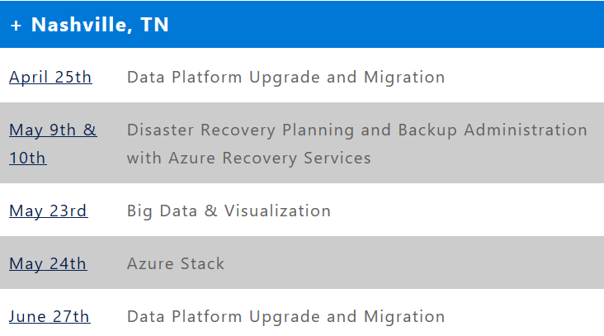
Upcoming Workshops
http://aka.ms/azureworkshops

Slide 3
What the Solution Architect can also do
Think of us as answering the How of Azure.
Answer any questions related to Azure
Create and develop Azure POCs, Pilots, and Prototypes with Lowe’s
Provide Demonstrations of Azure
Engage in training and education, deep dive on Azure topics
Coordinate with Product teams and customer on Azure
Whiteboard \ Architectural Design Sessions
Deployment Guidance and Standard Setting in Azure

Slide 4
Anonymous Feedback
Please send me feedback
https://swiftsolves.sarahah.com/

