Slide 2
Authoring VM | Steps involved

Slide 3
Build Authoring VM | Author DSC CheckForService.ps1
Step 1
Compile DSC to create .MOF
Step 2
Create a Guest Configuration package .zip
Step 3
Test Guest Configuration Policy in environment
Step 4
Publish custom Guest Configuration policy to Azure Storage blob
Step 5
Create the custom Azure policy definition
Step 6

Slide 4
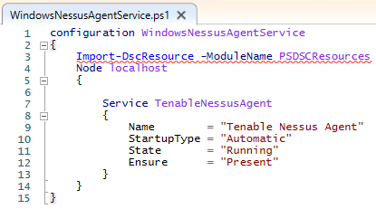
Install PowerShell 7
Install-Module Az
Install-Module GuestConfiguration
Step 1
. .\WindowsNessusAgentService.ps1
WindowsNessusAgentService
Step 2
New-GuestConfigurationPackage `
-Name 'WindowsNessusAgentService' `
-Configuration './WindowsNessusAgentService/localhost.mof' `
-Type Audit `
-Force
Step 3
Start-GuestConfigurationPackageRemediation -Path ./WindowsNessusAgentService/WindowsNessusAgentService.zip
Step 4
Publish-GuestConfigurationPackage -Path ./WindowsNessusAgentService/WindowsNessusAgentService.zip -ResourceGroupName SwiftSolvesDSC -StorageAccountName swiftsolvesdsc | % ContentUri
Step 6
New-GuestConfigurationPolicy `
-PolicyId '7213d788-9e67-4807-9f09-1cd9ddab2581' `
-ContentUri 'https://somestorage.blob.core.windows.net/guestconfiguration/WindowsNessusAgentService.zip?sv=2020-08-04&st=2022-02-09T16%3A18%3A02Z&se=2025-02-09T16%3A18%3A02Z&sr=b&sp=rl&sig `
-DisplayName 'Windows Nessus Agent Service.' `
-Description 'Compliance check for Windows Nessus Agent Service. Ensure it is present on VM, Startup set to Automatic and Status is Running' `
-Path './policies' `
-Platform 'Windows' `
-Version 1.0.0 `
-Verbose
Step 7

Slide 5
New-GuestConfigurationPolicy `
-PolicyId '7213d788-9e67-4807-9f09-1cd9ddab2581' `
-ContentUri 'https://somestorage.blob.core.windows.net/guestconfiguration/WindowsNessusAgentService.zip?sv=2020-08-04&st=2022-02-09T16%3A18%3A02Z&se=2025-02-09T16%3A18%3A02Z&sr=b&sp=rl&sig `
-DisplayName 'Windows Nessus Agent Service.' `
-Description 'Compliance check for Windows Nessus Agent Service. Ensure it is present on VM, Startup set to Automatic and Status is Running' `
-Path './policies' `
-Platform 'Windows' `
-Version 1.0.0 `
-Verbose
Step 7

Slide 6
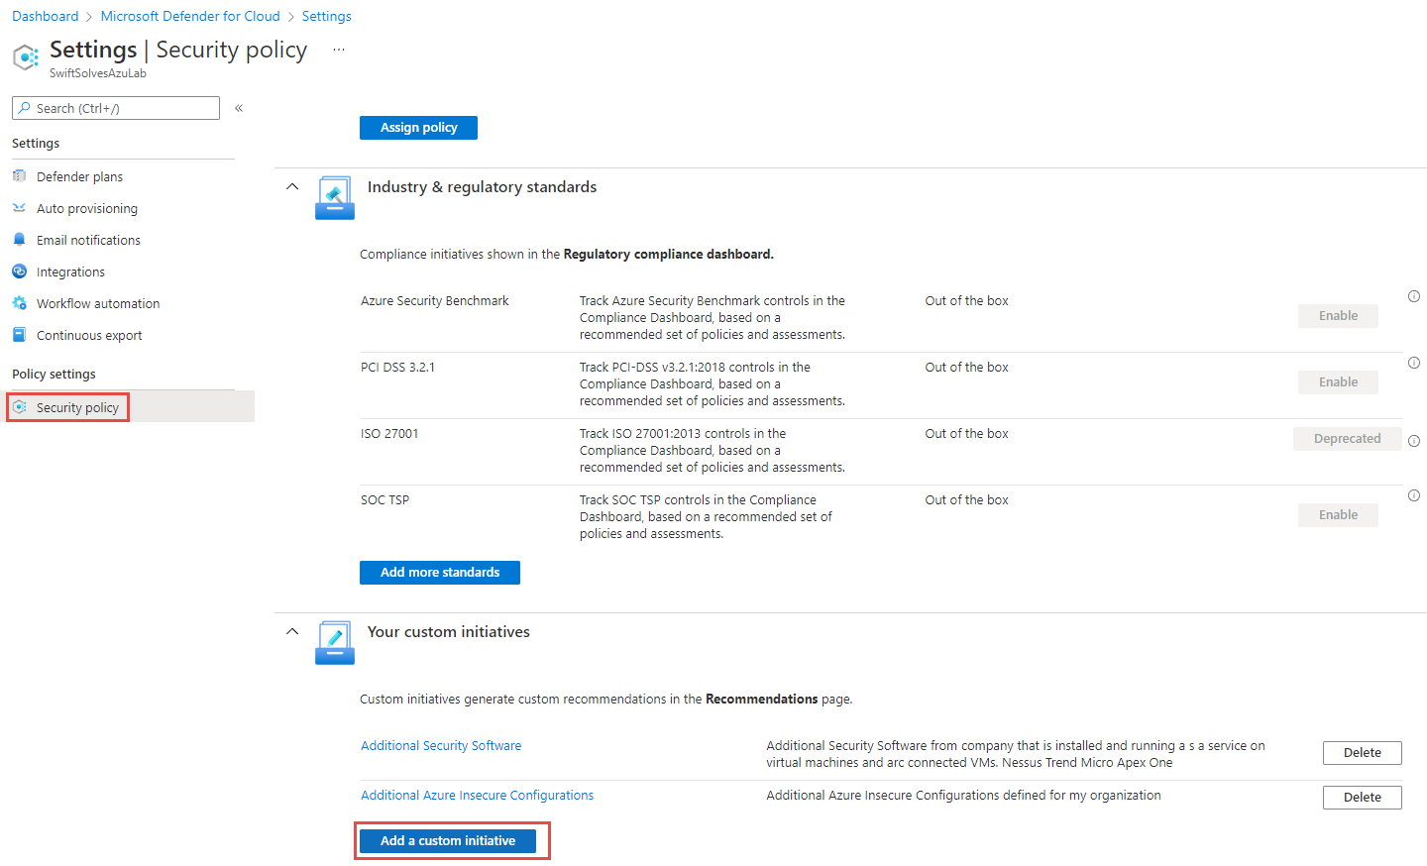
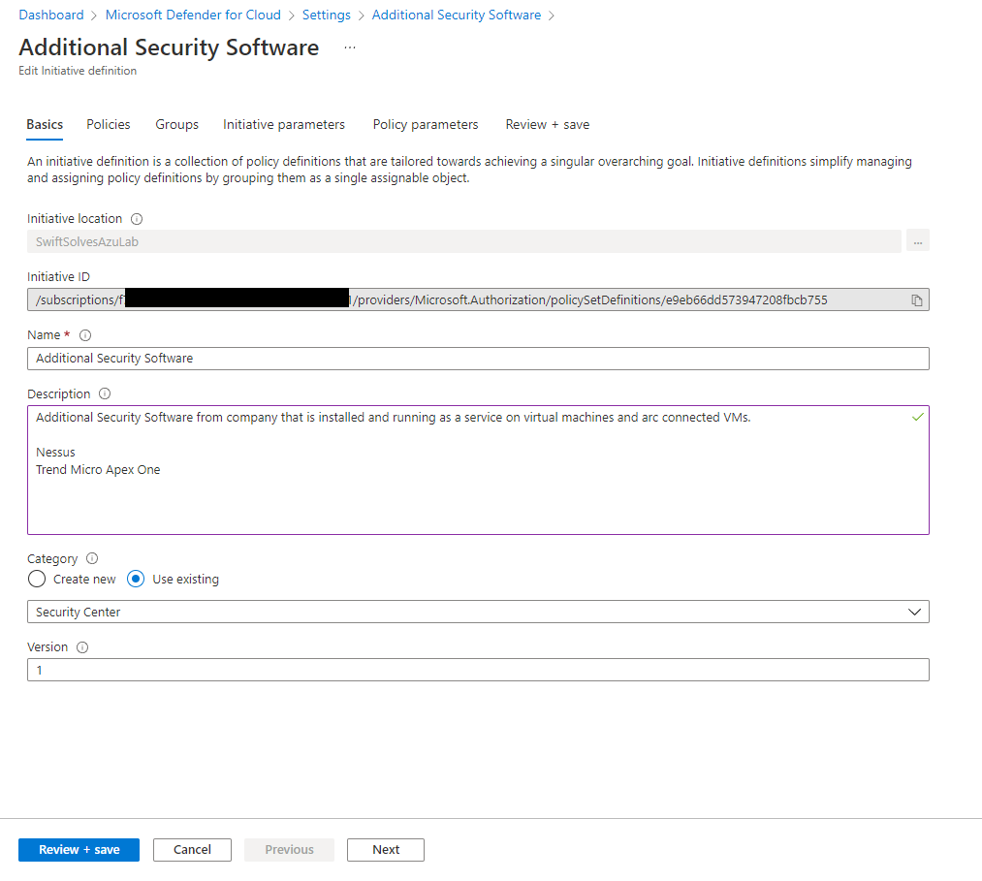
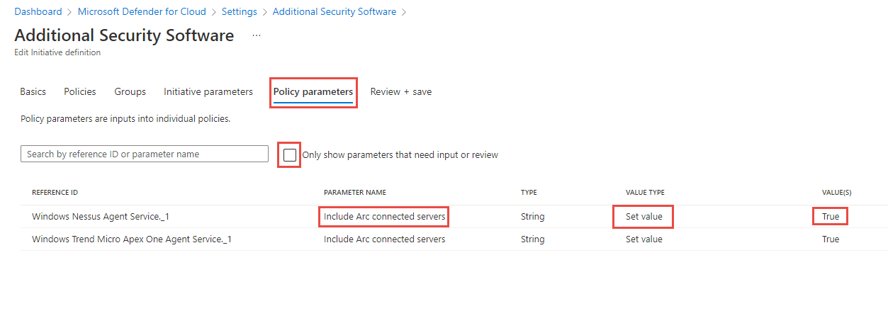
Defender for Cloud - custom security initiative

