Slide 2
Authoring VM | Steps involved

Slide 3
Build Authoring VM | Author DSC CheckForService – Set WDAV Passive
Step 1
Compile DSC to create .MOF
Step 2
Create a Guest Configuration package .zip
Step 3
Test Guest Configuration Policy in environment
Step 4
Publish custom Guest Configuration policy to Azure Storage blob
Step 5
Create the custom Azure policy definition
Step 6

Slide 4
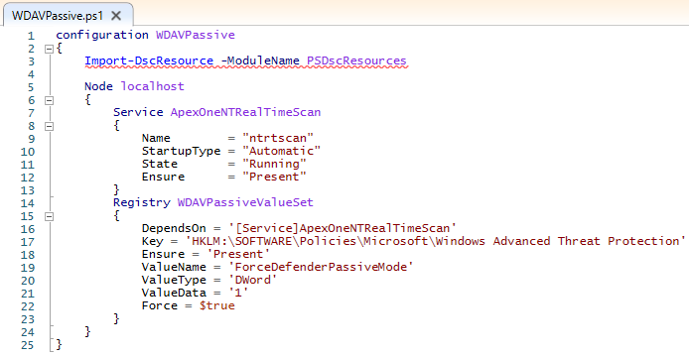
Install PowerShell 7
Install-Module Az
Install-Module GuestConfiguration
Install-Module PSDResources
Step 1
. .\WDAVPassive.ps1
WDAVPassive
Step 2
New-GuestConfigurationPackage `
-Name 'WDAVPassive' `
-Configuration './WDAVPassive/localhost.mof' `
-Type AuditandSet `
-Force
Step 3
Start-GuestConfigurationPackageRemediation -Path ./WDAVPassive/WDAVPassive.zip
Step 4
$BlobSASUUri = “REPLACE from Above $contenturi use the URL SAS Signature”
New-GuestConfigurationPolicy `
-PolicyId $Guid `
-ContentUri $BlobSASUUri `
-DisplayName 'Windows Check 3rd Party AV - Set WDAV Passive' `
-Description 'Setup WDAV Passive Mode if certain 3rd party AV is installed' `
-Path './policies' `
-Mode ApplyAndAutoCorrect `
-Platform 'Windows' `
-PolicyVersion 1.0.0 `
-Verbose
Step 6
New-AzPolicyDefinition -Name 'WDAVPassive' -Policy '.\policies\WDAVPassive_DeployIfNotExists.json'
Step 7

Slide 5
$BlobSASUUri = “REPLACE from Above $contenturi use the URL SAS Signature”
New-GuestConfigurationPolicy `
-PolicyId $Guid `
-ContentUri $BlobSASUUri `
-DisplayName 'Windows Check 3rd Party AV - Set WDAV Passive' `
-Description 'Setup WDAV Passive Mode if certain 3rd party AV is installed' `
-Path './policies' `
-Mode ApplyAndAutoCorrect `
-Platform 'Windows' `
-PolicyVersion 1.0.0 `
-Verbose
Step 6

Slide 6
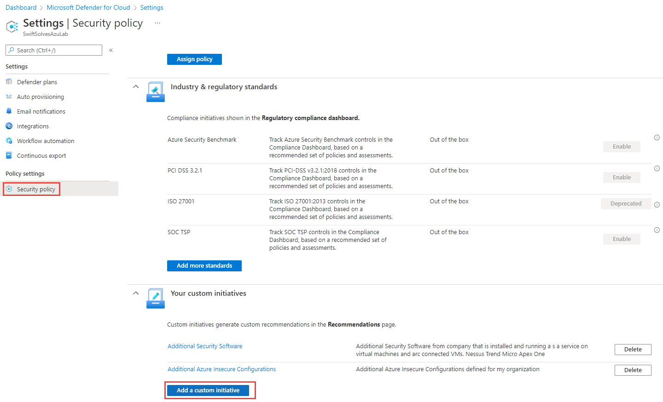
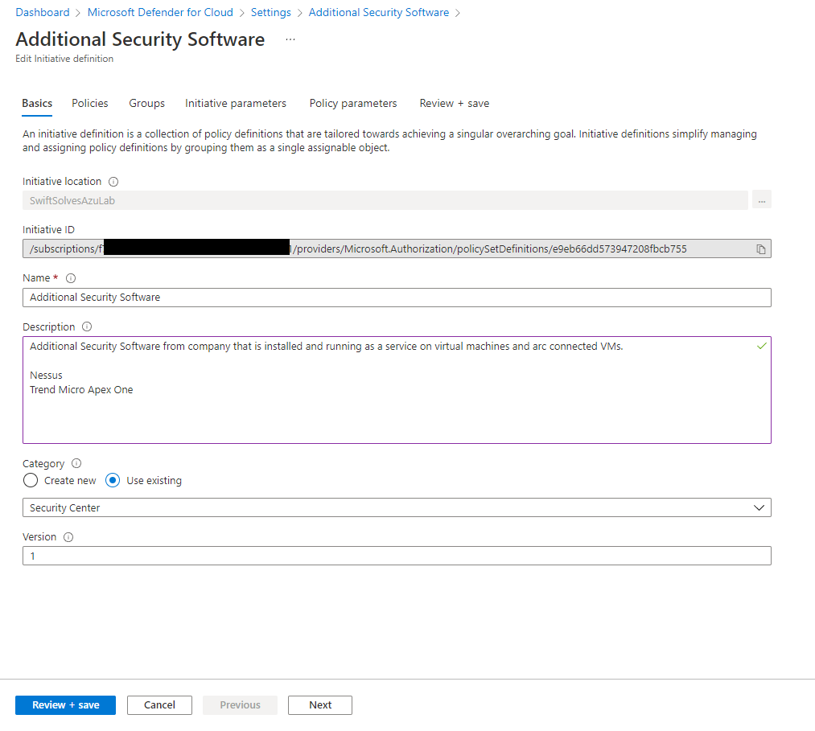
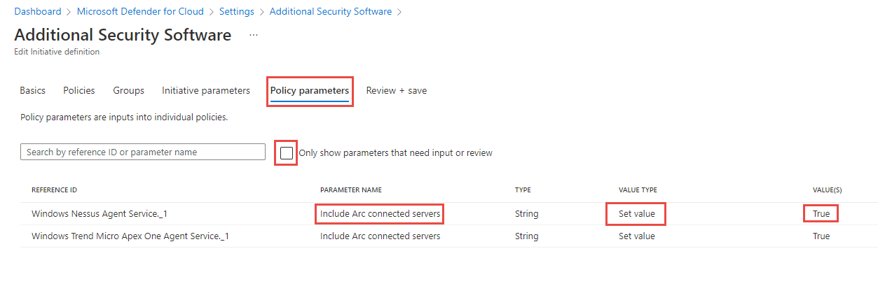
Defender for Cloud - custom security initiative

