Slide 1

Big Box Company
Big Box Company Software Development Lifecycle Assessment:
Findings and Recommendations
June 15, 2010

Slide 2
Contents
Big Box Company Assessment Focus
Approach
Survey vs. Interview Results
What’s Working Well
Representative Challenges
Challenges: Identifying Gaps
Options: Effort vs. Value
Potential Inhibitors to Adoption
Next Steps

Slide 3
Assessment Focus
Identify opportunities to help Big Box Company balance speed to market with quality
Understand where Big Box Company performs relative to modern software development practices
Identify opportunities for improvements in SDLC and establish an actionable roadmap

Slide 4

Approach
The IBM Assessment offers a structured approach to help teams measure and iteratively improve the business process of software delivery using:
  Surveys
  Interviews
  Selected Artifact Review
  Findings and Recommendations
  Roadmap
Phase
1
Elicit and set business value objectives
Phase
2
Determine the practice
focus areas
Phase
3
Accelerate and monitor practice adoption
Phase
4
Review and communicate business results
Confirm results delivered
and start next project
Go back to Phase 2
Empower teams to measure, manage and incrementally improve their software delivery capability.

Slide 5
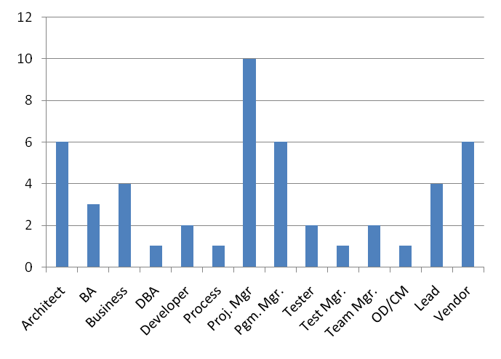
Background
Thank you!
  … for your openness & participation
  … for the time you spent with us
Over the past weeks we have
  Surveyed 51 individuals with 29 responses
  Interviewed 34 stakeholders - 3 have multiple roles - 9 also in survey
  Gathered CIO and executive perspectives
  Reviewed representative artifacts and templates provided by Big Box Company

Slide 6
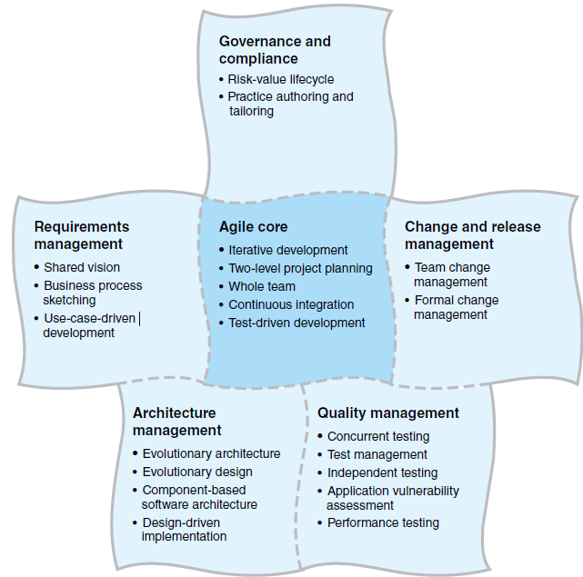
Core SDLC Practices
Practices used for the assessment
*
*
*
*
= Focus Areas

Slide 7
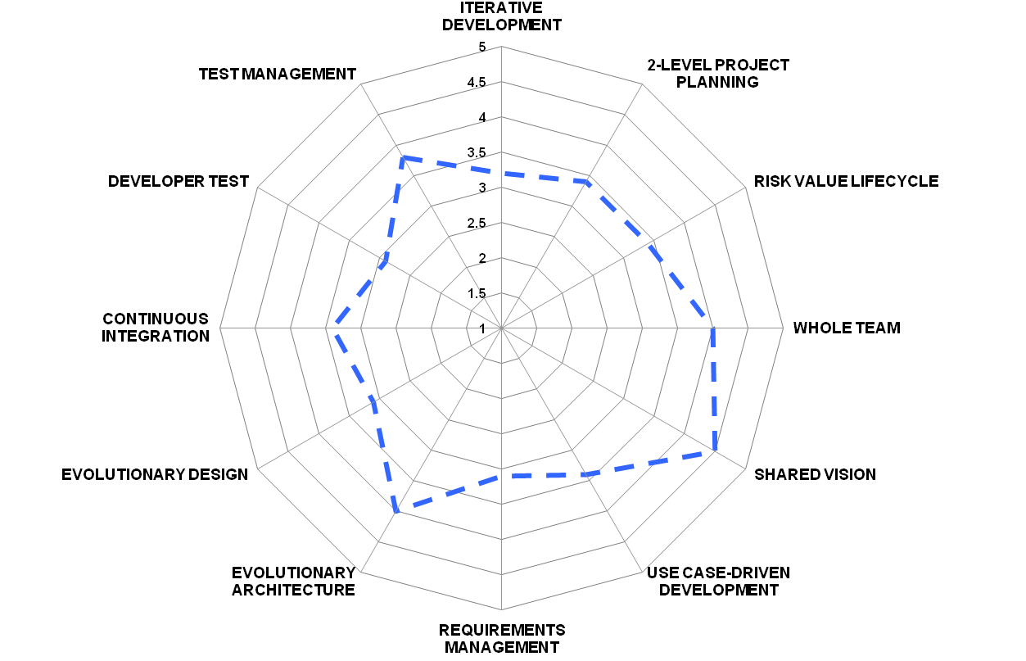
Typical Large Company Profile

Slide 8
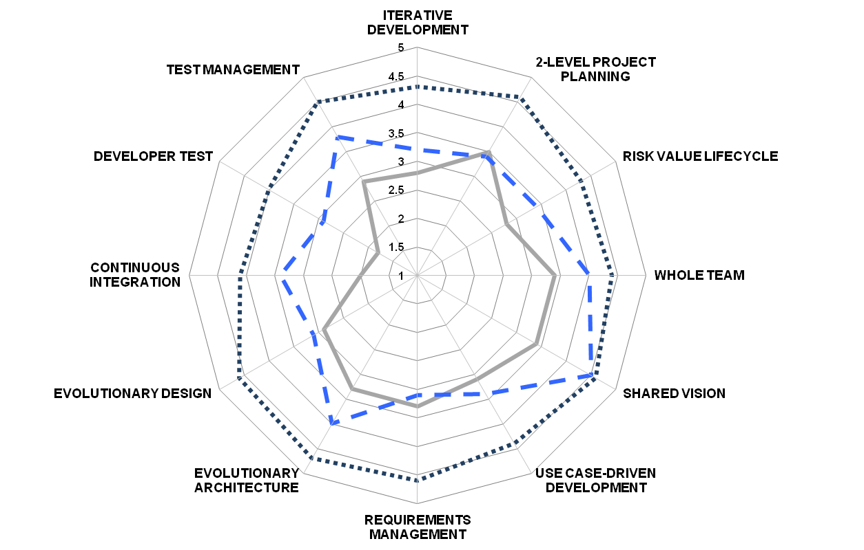
Big Box Company’s Self-Assessment
BBC current view
What IBM typically sees
BBC’s future

Slide 9
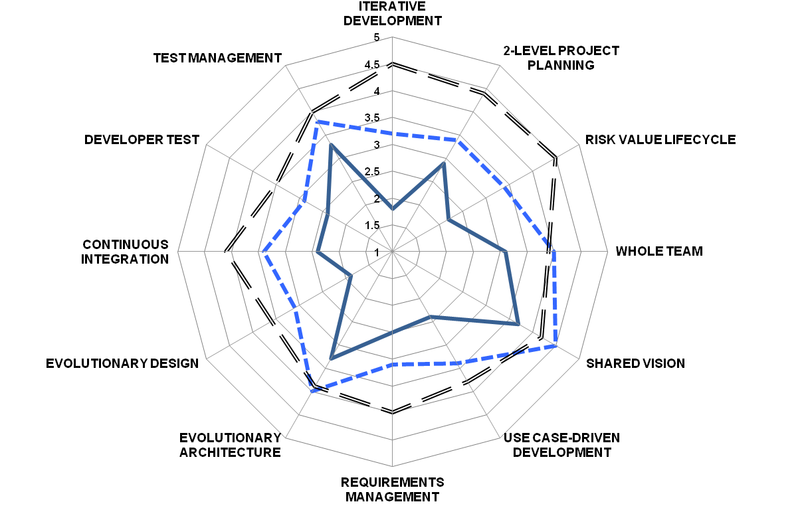
IBM Findings
BBC’s assessed state
What IBM typically sees
Effective practices

Slide 10
What’s Working Well
Current process provides valuable checkpoints
Organizational focus on testing
Pockets of good practices for requirements definition, architecture, quality and supporting disciplines
Commitment to follow the SDLC
Early prototyping supports requirements visualization
Beginning to enable data governance

Slide 11
Representative Challenges
Timing, Accountability and Collaboration between Business and IT needs to be optimized
Requirements Definitions techniques are applied inconsistently
Inflexible application of SDLC and Gating process
Access and identification of reusable content is limited
Manually intensive software development process
Requirements lack enough detail for test
Developer test is incomplete
Test Cases are not consistently traced
Builds are manual and inconsistent
Architecture Governance stops at Gate 2

Slide 12
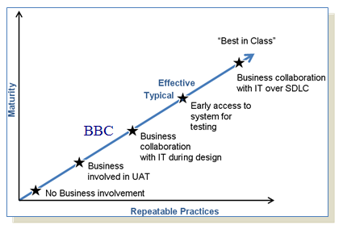
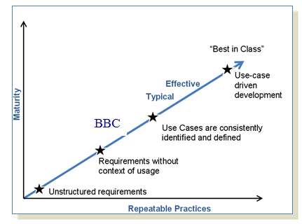
Challenges: Identifying Gaps
1) Timing, Accountability and Collaboration between Business and IT needs to be optimized
Inconsistent implementation
2) Requirements Definitions techniques are applied inconsistently
Wide variation in usage

Slide 13
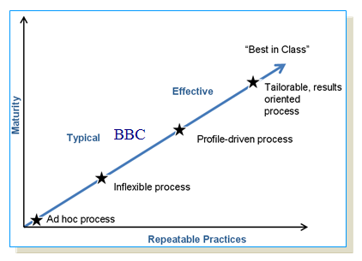
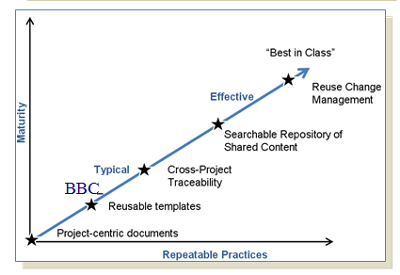
Challenges: Identifying Gaps
Inflexible application of SDLC and Gating process
Impacts ability to respond to change
4) Access and identification of reusable content is limited
Project-centric focus

Slide 14
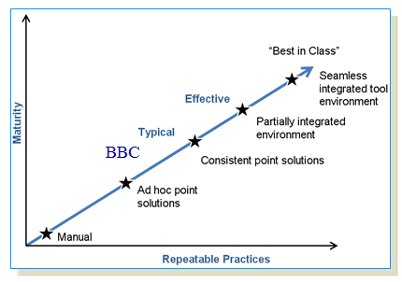
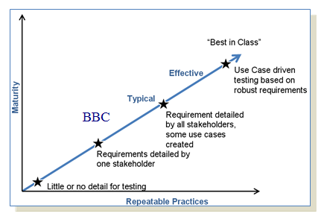
Challenges: Identifying Gaps
Manually intensive software development process
Limited automation and integration
6) Requirements lack enough detail for test
Additional work rather then using current artifacts

Slide 15
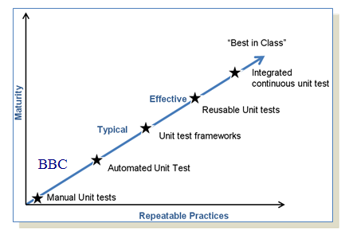
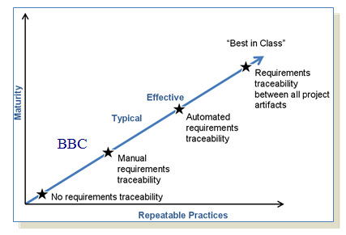
Challenges: Identifying Gaps
7) Developer test is incomplete
Limited implementation of test frameworks and build integration
8) Test Cases are not consistently traced
Not all test cases traced to original requirements

Slide 16
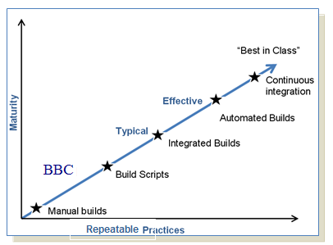
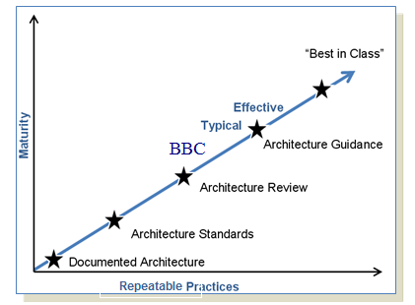
Challenges: Identifying Gaps
9) Builds are manual and inconsistent
Very early adoption with build scripts
Architecture Governance stops at Gate 2
Focused on infrastructure and not verified during implementation
Repeatable

Slide 17
Options: Effort vs. Value
Use
Case
Consistency
Engage
Business
Resources
Early
Involve all in development of detailed design and requirements
Pilot incremental and iterative delivery (1)
Developer
Unit Testing
Automate
Builds
Shared
Vision
Develop automated testing suites
Medium to Very High
Requirements Management & Common
Traceability
Enterprise Asset
Mgmt (2)
Enhance
SDLC
Training
Establish hardware testing suites
Business
Process Modeling
Enhance
Enterprise Architecture
Arch
Self-Audits
Enhance
Architectural Governance
Enhance
SDLC
Tailoring
Enhance
Metrics
Design
Modeling
Enhance
Governance
Potential Business Value
Notes:
includes right-timing requirements
includes shared view of requirements
Low to Medium
addresses top challenges
addresses other challenges
Effort to Implement

Slide 18
Potential Inhibitors to Adoption
Inhibitor | Mitigation Strategy
Difficulty accepting alternative forms of documentation and development and/or agile practices | Training and knowledge transfer Pilot projects with alternative development approaches
Perceived initial impact of recommendations on program and project time and cost | Ensure visible sponsorship Performance goals related to adoption of modifications Expect a learning curve
Business/IT Collaboration | Move to shared business and IT ownership of solution

Slide 19
Next Steps….
Roadmap Workshop
Finalize Roadmap
Executive
Summary
Communicate
Roadmap
March 31st
Prioritize options in
Roadmap workshop
VP’s, Core Team
IBM On-site
April 10th
Provide feedback
To IBM on Roadmap
Sponsors & Core Team
Conference Call
April 20th
Late April
Present Executive
Review Presentation
Sponsors
IBM On-site
Present Roadmap
& Next Steps
VP’s, Participants,
Core Team, Directors
April 6th
IBM to Deliver Draft Roadmap
April 16th
Deliver Roadmap
VP’s, Core Team
IBM On-site
April 8th
Formal Review of Draft Roadmap
Sponsors & Core Team
Conference call
Key:
Deliverable

