Slide 1
INaturalist Observation Prediction Model
Group 370 – Piotr Rajchel

Slide 2
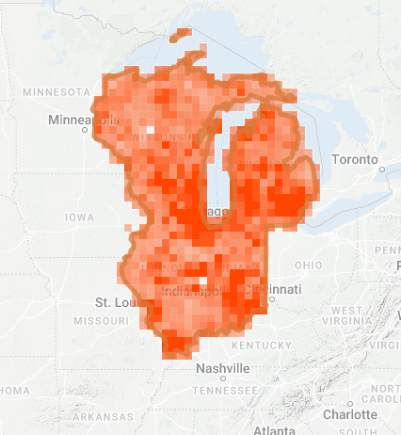
Introduction
I wanted to work with environment related data and decided to work with observational data of Reptiles and Amphibians between 2015-2022, within Illinois, Michigan, Wisconsin, and Indiana.
This data contained about 71k observations.
The two ideas I initially came up with were to predict an average latitude/longitude that’s most likely to be home to a given species, or to determine what month is most likely for a species to be found in. I ended up pursuing the later.
Changes to the presentation will be in red.

Slide 3
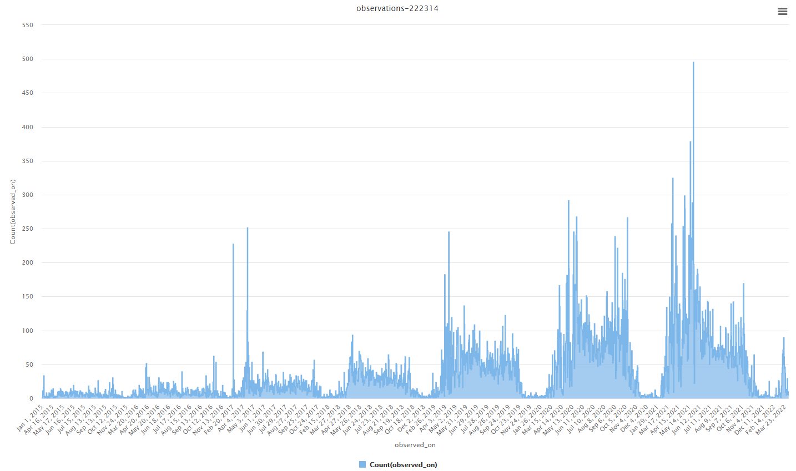
Visualizing the Data
In order to explore the data a bit, I went to use RapidMiner. The first thing I did was see what months were more active when it came to observations.
Logically, colder months should yield less observations, and that’s exactly what I found in the graphs.
It also shows a general increase in data collection over the 5-year period, as more users must’ve found the app or website.

Slide 4
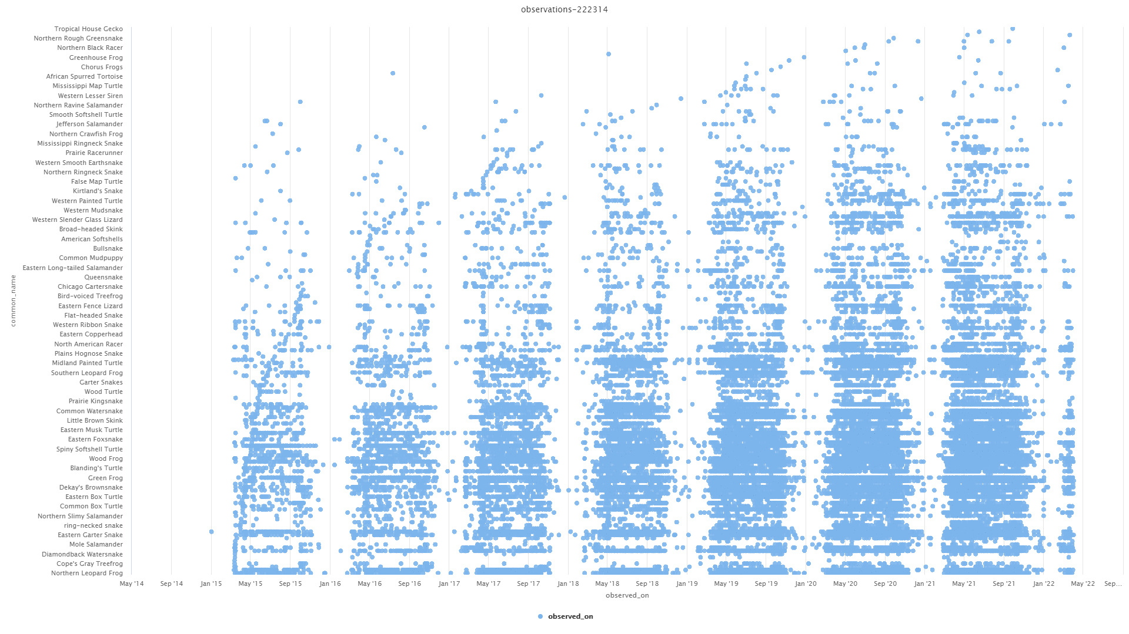
Visualizing the Data pt.2
I also went ahead and looked at species observations by date, to get a similar graph but one that shows noticeable gaps during certain seasons, better than the previous graph.

Slide 5
Visualizing the Data pt.3
The last thing I wanted to see out of curiosity, was which species had the most observations, which is a big graph, so it’ll be on the next slide to allow for reading the names. The species with the most records by a pretty large margin comparatively is the American Toad.

Slide 6
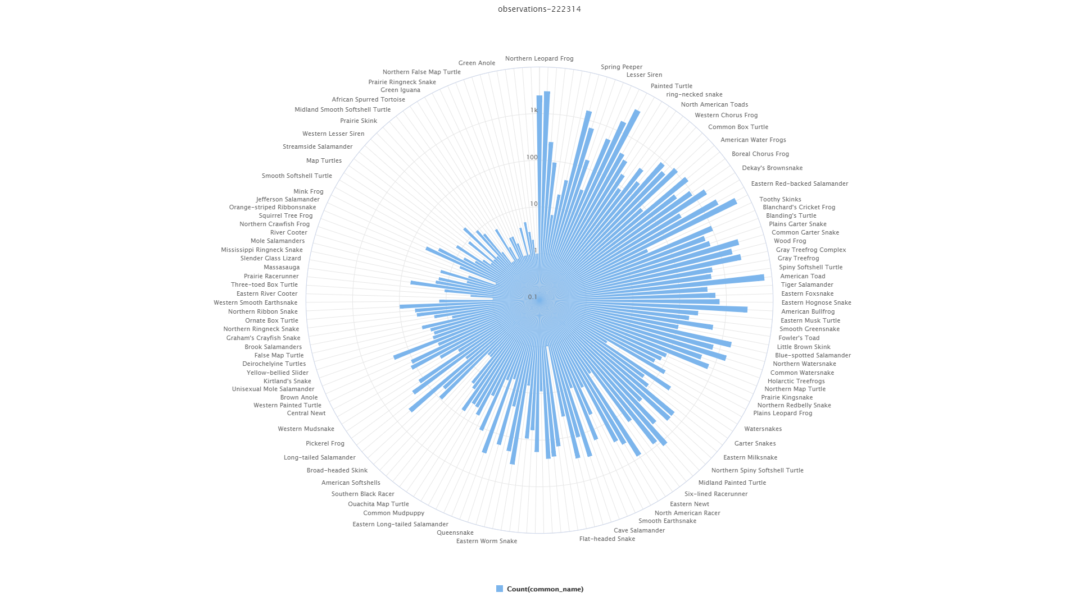

Slide 7
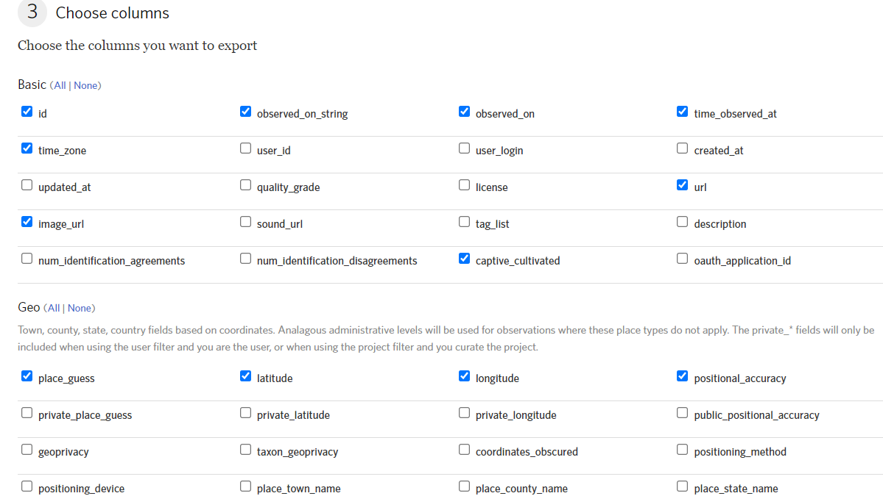
Data Pre-Processing
The observation table came with significantly more information than what was useful for machine learning, so I did multiple stages of trimming data down and modifying it. The website itself also included feature selection of which columns you wanted to export with the database.

Slide 8
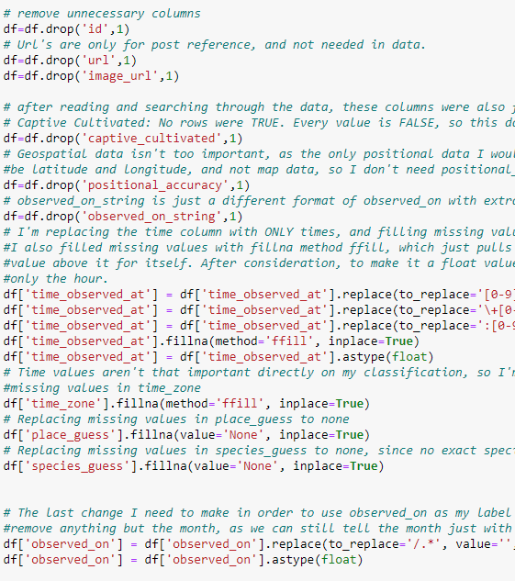
Data Pre-processing pt.2
The rest of the Pre-processing was in python. Many columns were unique and unhelpful when it came to correlation, as I found when briefly testing a correlation matrix as well. Other columns were essentially matching others (such as not needing taxon, species_guess, etc. when I am using one of them that works well for the purpose, such as common_name).

Slide 9
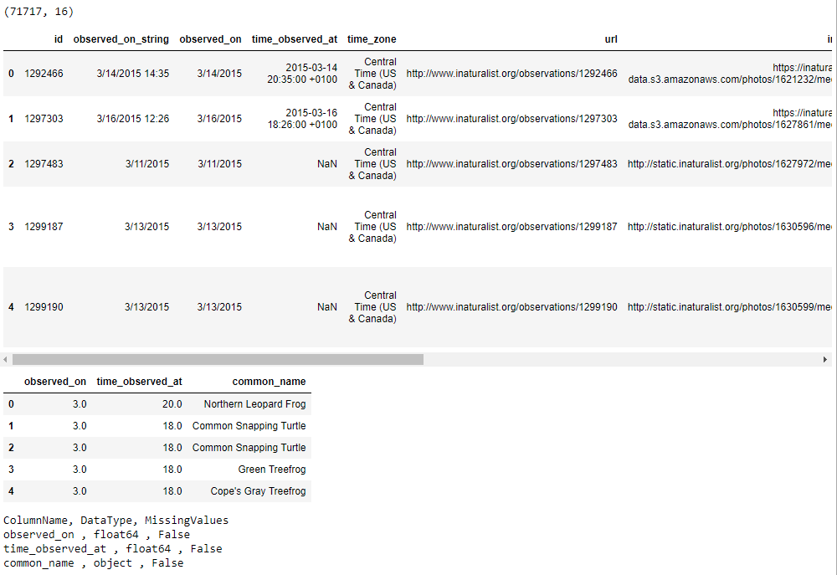
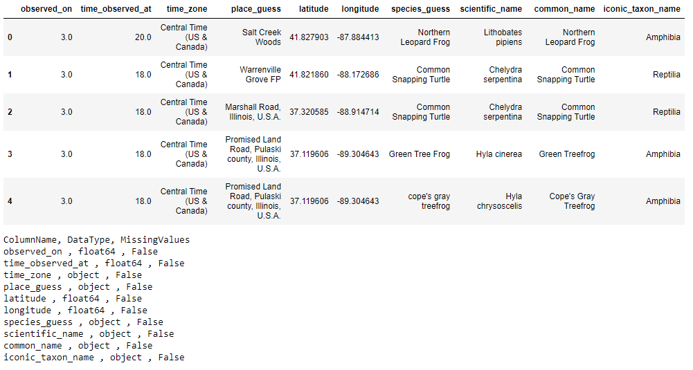
Data Pre-processing pt.3
Those changes ultimately left me with a table that looked like this to work with:
I undid my feature removal for some of the features I previously just deemed unnecessary, and the next table is the 2nd image:

Slide 10
Processing the Data
I used 3 different methods for classification, which were K-Nearest Neighbor, Naïve Bayes, and Decision Tree (primarily because others such as SVM and Neural networks were taking too long with my settings), and each performed a bit differently.
My label was “observed_on”, which was originally a full date, but I narrowed down to integers representing months, and I used timestamps and common names of species to try and determine the month that was most likely based on the inputs.
I wasn’t able to ger precision and recall working for N-Fold Cross Validation in time, though I did attempt other methods such as cross_validate rather than cross_val_score, etc., but they worked for hold-out evaluation on each of the three attempts.
Modified: I did get precision, recall, and f1 working after the presentationn , and the new screenshots will be included on the next pages. Naïve Bayes gave me the best results ultimately, with an accuracy of about 72%.

Slide 11
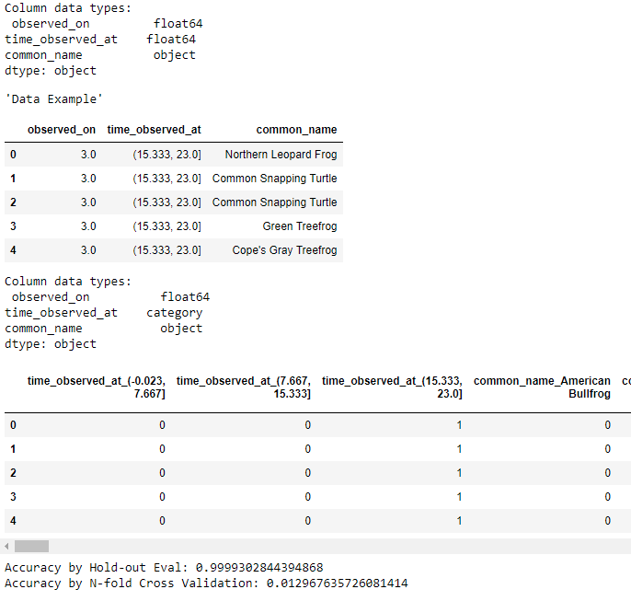
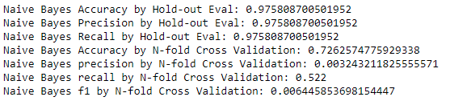
Naïve Bayes Results
Updated, with more columns on right image. Naïve Bayes was the only one where all N-Fold cross validation statements ran properly and gave reasonable values. This provides an accuracy of 72% or so.

Slide 12
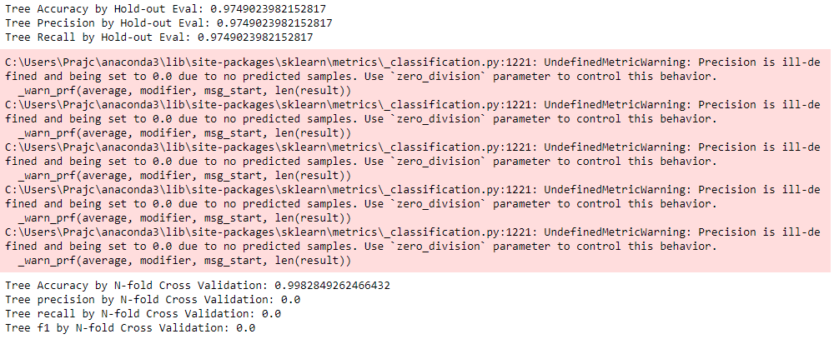

Decision Tree Results
Updated, with more columns on right image. N-Fold Cross Validation seemed to be incorrect, so I’m not sure what values I put in wrong, and I had to use a binary function to allow precision, recall, and f1 to be calculated here.

Slide 13
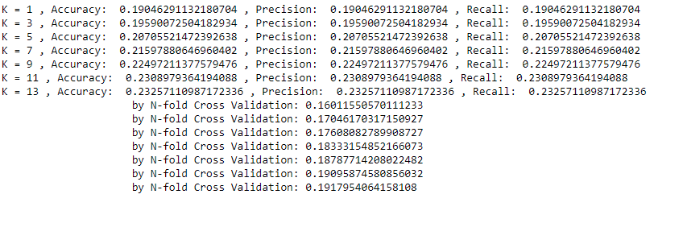
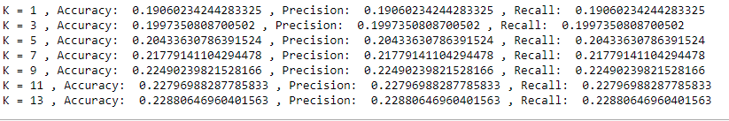
K-Nearest Neighbor Results
Updated, with more columns on right image. N-Fold Cross Validation never finished running for me this time, however.

Slide 14
Conclusion
Just looking at the results of the three, it seems Hold-out is not reliable, as all the values are extremely high, but I’m not too surprised. As for N-Fold Cross Validation, Naïve Bayes had the lowest accuracy, while Decision Tree and KNN had the highest and closest, around 19%, which still isn’t the best.
After modifications, my best accuracy was Naïve bayes with an accuracy of 72%. This is after I removed less features, and included other metrics.
I wish I was able to make a better and cleaner working project when it came to the classifying and prediction, but I enjoyed the thought process that went into pre-processing.

