Slide 1

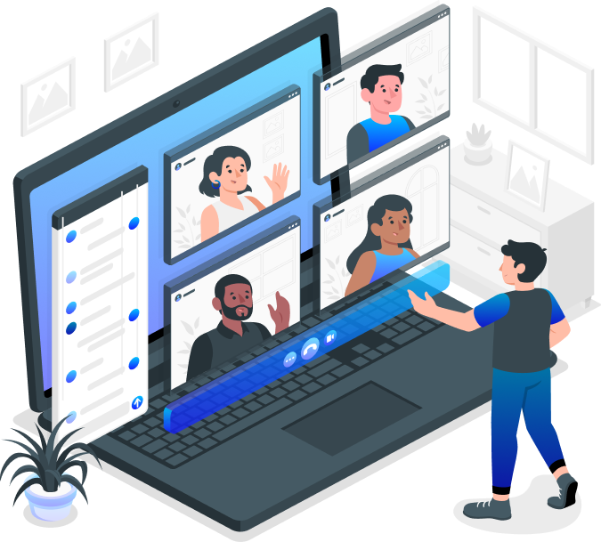

Swiggy i++ - Week 0 Case Study
Converge
Meeting Application
Ashwin Gopalsamy
swiggyb1019@datascience.manipal.edu

Slide 2
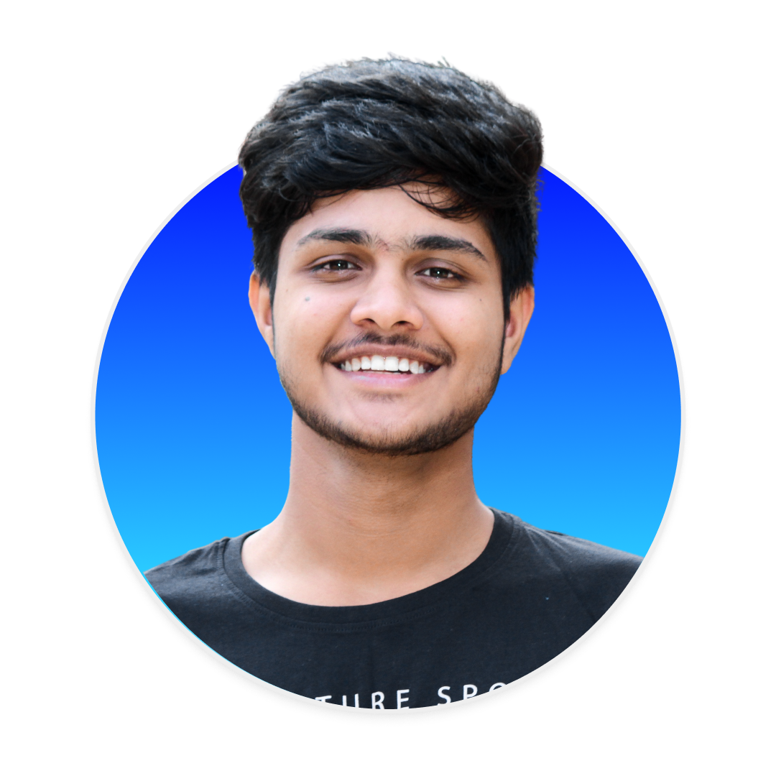


Introduction
Ashwin Gopalsamy
B.Tech IT, Chennai, Tamil Nadu.
swiggyb1019@datascience.manipal.edu
| ashwin2125

Slide 3
Converge - An Introduction
Converge, is a simple meeting application with vital features.
It focuses on enabling users to create instant meetings, have individual user accounts, search meetings assigned to their respective mail ids, thus delivering core value to the users delightfully.

Slide 4
Tech Stack
1. Node.Js
Express
To render and handle node.js applications efficiently.
The core spearhead of our application
3. JSON
4. REST APIs
Powered by simplee yet clean JSON database.
APIs to communicate forward and backward easily.

Slide 5
Additional Libraries Used:
bcrypt :
to hash the user passwords with salt
Jsonwebtoken :
to authorize the user to access webpages through encoded values.
express-validator :
to validate the user inputs during registration/login process.

Slide 6
Future Improvements:
Database
Hosting
Front-End
Optimization

Slide 7
Any Questions ?

Slide 8
Thank You.
Looking forward for Week- 1 of i++ Program.

