Slide 1
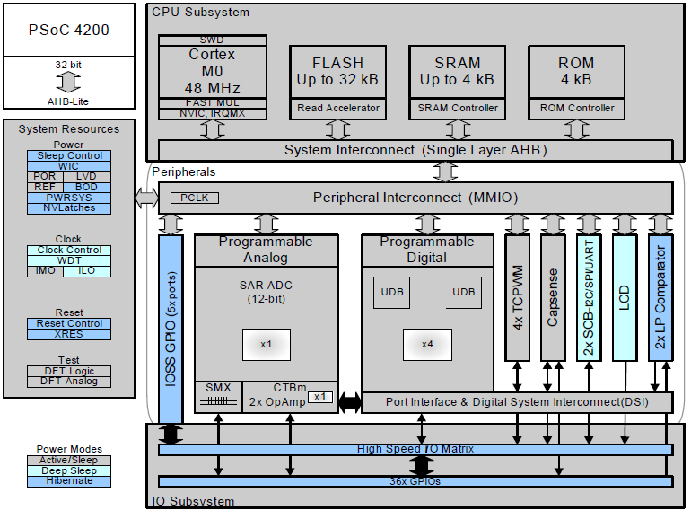
The Cypress PSoC-4 4200 Family
32-Bit ARM CPU Core
With RAM and ROM
Blocks for processing
Digital signals
Blocks for processing
Analog signals
Lots of I/O Pins

Slide 2
What can you do with Digital/Analog Blocks?
Analog-to-Digital Converters
  8- to 12-bit resolution, 1M samples/s
Digital-to-Analog Converters
  8-bit arbitrary waveform
Timers, Counters, PWMs
  8- to 32-bit resolution
Serial Interfaces
  RS232, I2C, SPI
Programmable Gain Amplifiers, Comparators
Etc.

Slide 3
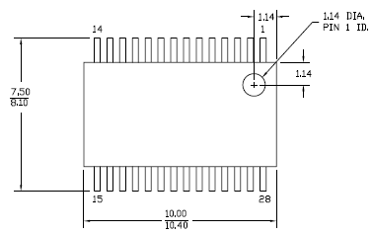
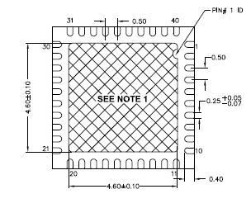
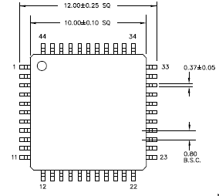
PSoC 4200 Mechanical Characteristics
28 Pin
SSOP
24 GPIO
40 Pin
QFN
34 GPIO
SSOP – Shrink Small Outline Package
TQFP – Thin Quad Flat Pack
QFN – Quad Flat No Leads
44 Pin
TQFP
36 GPIO

Slide 4
Key PSoC 4200 Electrical Characteristics
Supply voltage between 1.8V and 5.5V
  3.3V is typical, but 1.8V and 5V compatible
Clock speed: Up to 48MHz
  Can use internal oscillator (+/- 2%) or external clock
Power usage (running): 7 – 45 mW
  Proportional to clock speed and supply voltage
Sleep, Hibernate, and Stop modes
  70 nanoWatts – 7 microWatts depending on mode
See the PSoC4 Family Datasheet for details

Slide 5
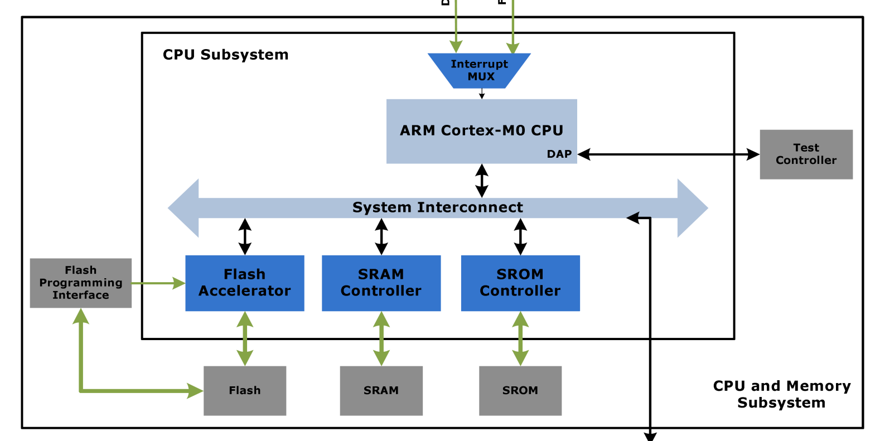
The PSoC4 CPU Core – ARM Cortex M0
Interrupt Controller
Allows external events to be
communicated to the CPU
ARM Cortex M0
Executes instructions
System Bus – 32 Bits Wide
Passes data between the CPU,
memory, ports and peripherals
Flash Memory – 32KB
Holds program code (nonvolatile!)
Can be used to hold user data.
Supervisory ROM
Holds boot-up code and
code to read from flash memory.
SRAM – 4KB
Regular memory for use of
CPUand peripherals..

Slide 6
Cortex M0 Core Registers
31 R0 0
13 General Purpose 32-bit Registers
Used to hold results of instructions
31 R12 0
Stack Pointer
Points to top of stack
31 R13 SP 0
Link Register
Stores Return Address
31 R14 LR 0
Program Counter
Points to current instruction
31 R15 PC 0

Slide 7
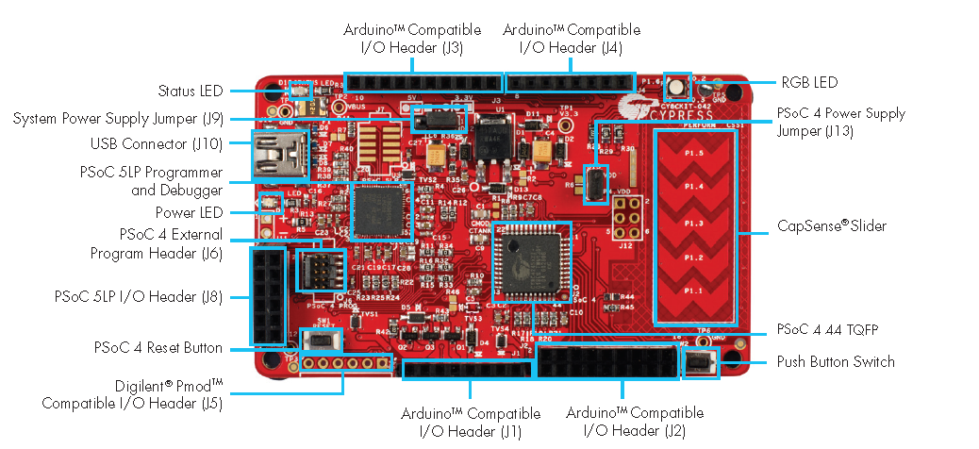
Cypress PSoC 4 Pioneer Kit

Slide 8
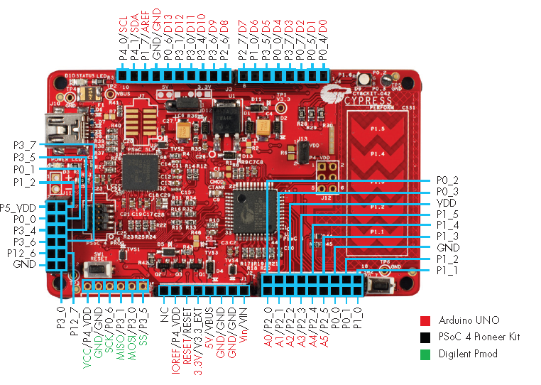
Cypress PSoC4 Pioneer Pinout

Slide 9
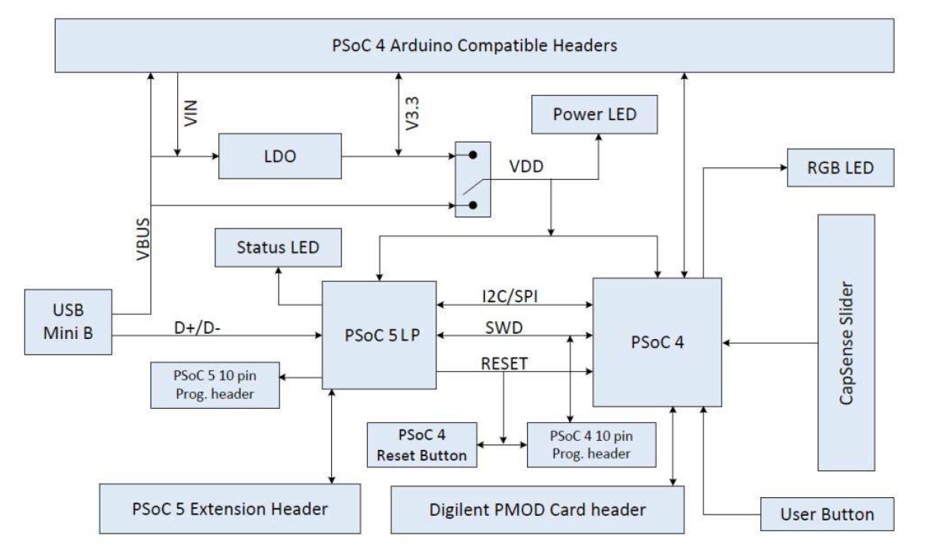
Cypress PSoC4 Pioneer Block Diagram

Slide 10
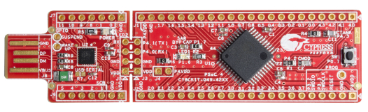
Do you really need all this stuff?
All you really need is the PSoC4,
a few capacitors, and a power supply
PSoC 4 CY8CKIT-049 4200 Prototyping Kits ($4.00)
USB Bridge for programming
Detachable
PSoC4 + Caps + Reset SW + Connector Holes

Slide 11
Three Things to Program
Code:
Stored in FLASH
Executed by CPU
Uses SRAM
Main.c
Internal Blocks:
Configured using
Schematics
*.cysch
I/O Pins:
Configured through
Design-Wide Resources
*.cydwr

