Slide 1
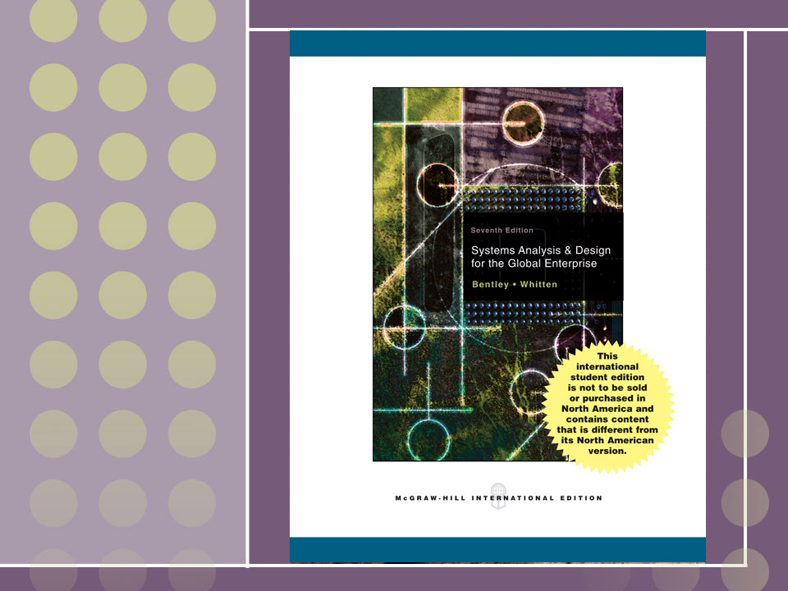
Chapter 11
Feasibility Analysis and the System Proposal

Slide 2
Objectives
Payback Analysis
Return On Investment
Net Present Value
EV
11-<number>
Notes:
No additional notes.

Slide 3
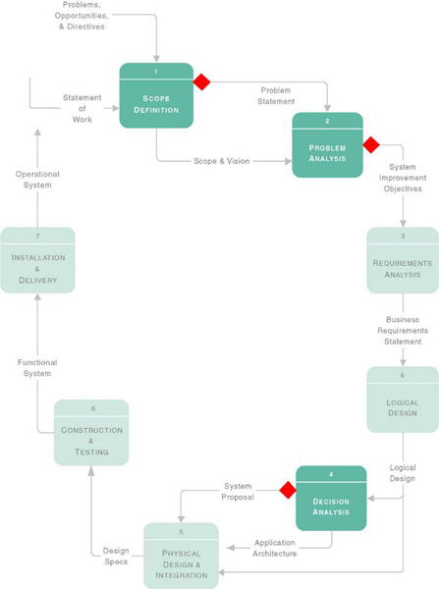
11.1 Feasibility Checkpoints During Systems Analysis
See pp.290
11-<number>
Notes:
No additional notes.

Slide 4
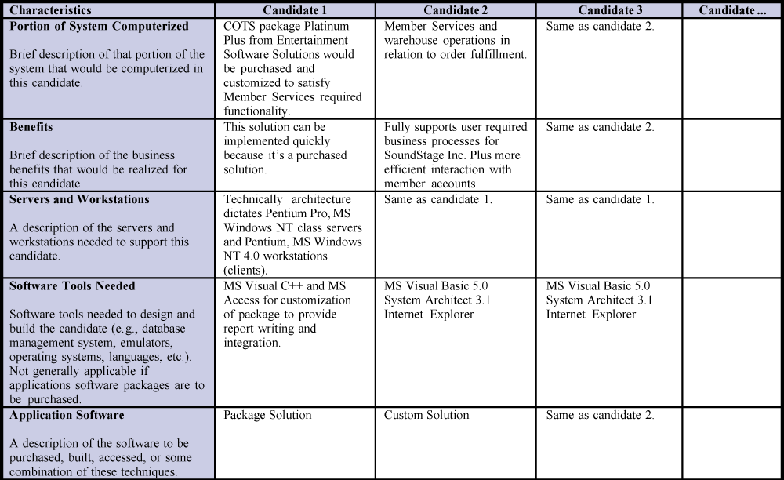
Candidate Systems Matrix
5-<number>
Notes:
No additional notes

Slide 5
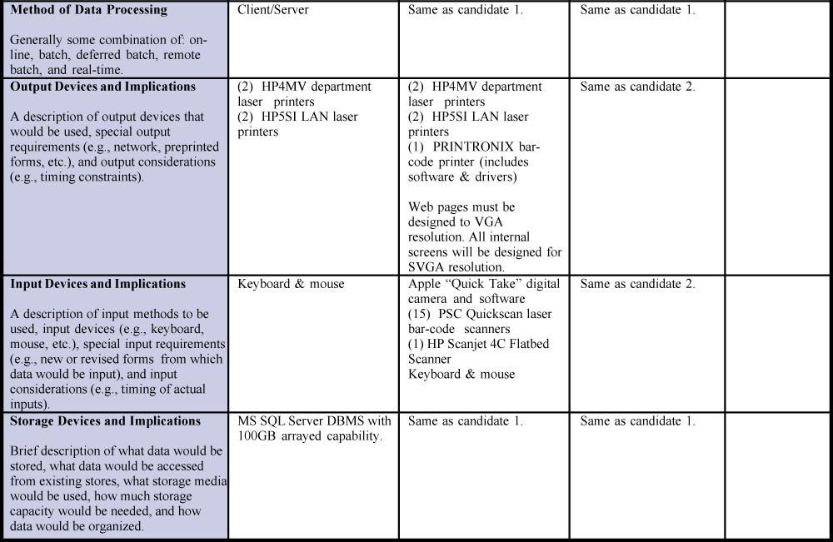
Candidate Systems Matrix (cont.)
5-<number>
Notes:
No additional notes

Slide 6
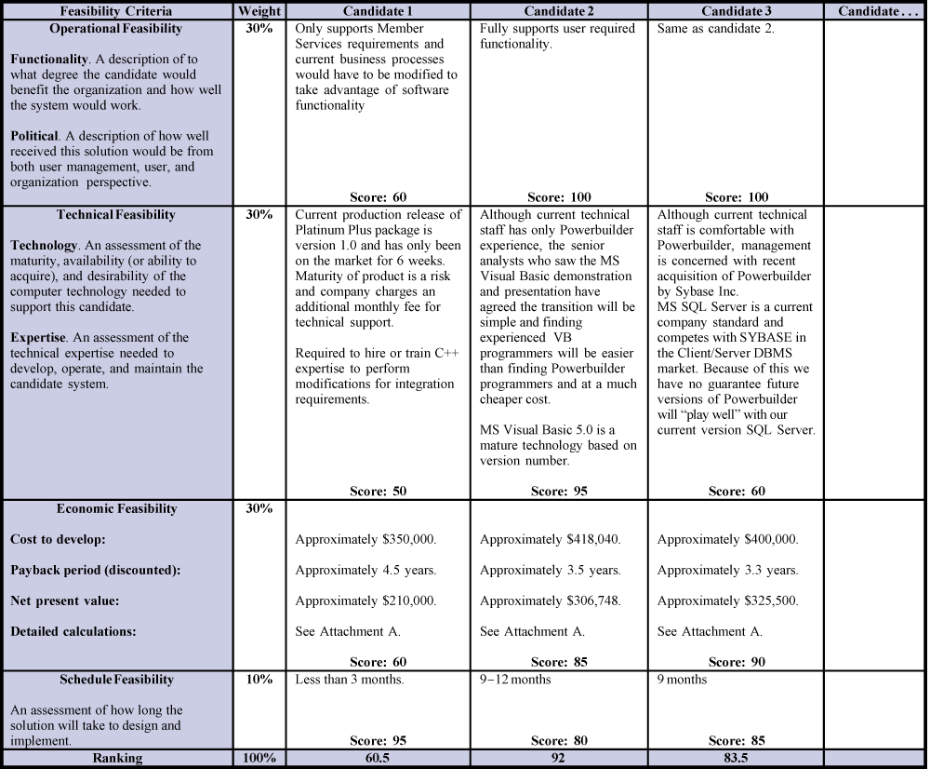
Feasibility Matrix
5-<number>
Notes:
No additional notes

Slide 7
11.2 Six Tests For Feasibility
Operational feasibility – a measure of how well a solution meets the system requirements.
Cultural (or political) feasibility - a measure of how well a solution will be accepted in an organizational climate.
Technical feasibility – a measure of the practicality of a technical solution and the availability of technical resources and expertise.
Schedule feasibility – a measure of how reasonable the project timetable is.
Economic feasibility - a measure of the cost-effectiveness of a project or solution.
Legal feasibility - a measure of how well a solution can be implemented within existing legal/contractual obligations.
11-<number>

Slide 8
Operational Feasibility
How well proposed system solves the problems and takes advantage of opportunities identified during the scope definition and problem analysis phases
How well proposed system satisfies system requirements identified in the requirements analysis phase
Is the problem still worth solving?
11-<number>
Notes:
Conversion Notes
This is a new slide in the seventh edition.

Slide 9
Cultural (or political) feasibility
Does management support the system?
How do end users feel about their role in the system?
What end users may resist or not use the system? How can this be overcome?
How will the working environment change? Can users and management adapt to the change?
11-<number>
Notes:
Conversion Notes
This is a new slide in the seventh edition.

Slide 10
Technical feasibility
Is the proposed technology or solution practical?
Do we currently possess the necessary technology?
Do we possess the necessary technical expertise?
11-<number>
Notes:
Conversion Notes
This is a new slide in the seventh edition.

Slide 11
Schedule feasibility
Are specified deadlines mandatory or desirable?
Are mandatory deadlines realistic for proposed solution?
11-<number>
Notes:
Conversion Notes
This is a new slide in the seventh edition.

Slide 12
Economic feasibility
During Scope Definition
  Do the problems or opportunities warrant the cost of a detailed study and analysis of the current system?
During Problem Analysis
  After a detailed study of the current system
  Better estimates of development costs and benefits
During Decision Analysis
  Requirements now defined
  Development costs can be better estimated
11-<number>

Slide 13
Legal feasibility
Copyrights
Union contracts
Legal requirements for financial reporting
Antitrust laws
National data and work laws
11-<number>
Notes:
Conversion Notes
This is a new slide in the seventh edition.

Slide 14
11.3 Information System Costs
Development costs - one time costs that will not recur after the project has been completed.
Many organizations have standard cost categories that must be evaluated. In the absence of such categories, the following list should help:
  Personnel
  Computer usage
  Training
  Supply, duplication, and equipment
  Computer equipment and software
11-<number>

Slide 15
11.3 Information System Costs
Operating costs - costs that recur throughout the lifetime of the system.
  Fixed costs — occur at regular intervals but at relatively fixed rates.
  software license payment prorated salaries
  Variable costs — occur in proportion to usage.
  costs of computer usage(e.g., CPU time used,
  terminal connect time used) ,which vary with the
  workload
  supplies(e.g., preprinted forms, printer paper used)
  that vary with the workload
11-<number>

Slide 16
Information System Benefits
Tangible(有形) benefits are those that can be easily quantified(量化).
While processing student housing application, we discover that considerable data is being redundantly typed and file. An analysis reveals that the same data is typed seven times, requiring an average of 44 additional minutes of clerical work per application. The office processes 1,500 applications per year. That means a total of 66,000 minutes or 1,100 hours of redundant work per year. If the average salary of a secretary is $15 per hour, the cost of this problem and the benefit of solving the problem is $16,500 per year.
11-<number>

Slide 17
Information System Benefits
Tangible(有形) benefits are those that can be easily quantified(量化).
  Fewer processing errors
  Increased throughput
  Decreased response time
  Elimination of job steps
  Increased sales
  Reduced credit losses
  Reduced expenses
11-<number>

Slide 18
Information System Benefits
Intangible(无形) benefits are those benefits believed to be difficult or impossible to quantify.
  Improved customer goodwill
  Improved employee morale
  Better service to community
  Better decision making
11-<number>

Slide 19
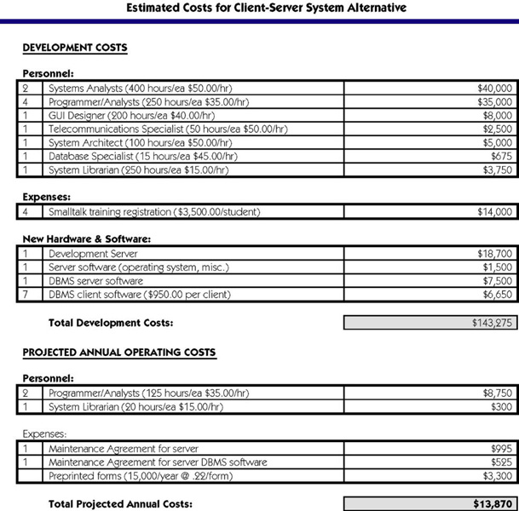
Costs for a Proposed Solution
11-<number>
Notes:
Teaching Notes
We often walk through this line-by-line. Though this is not representative of every information system project, it does illustrate typical costs. For instance, note that programmer/analysts are needed after the system goes into operation. Users always want some revisions.

Slide 20
Three Popular Techniques to Assess Economic Feasibility
Payback Analysis
Return On Investment
Net Present Value
11-<number>
Notes:
Teaching Notes
While the textbook covers only the above popular techniques, it is important to stress that there may be others that organizations choose to use in assessing the economic feasibility of an investment.
Stress the importance of determining the investment decision-making process or techniques used by the organization. It should also be pointed out that sometimes the techniques vary according to the individuals involved.

Slide 21
Time Value of Money
Used with all three cost-effectiveness techniques.
Concept that recognizes that a dollar today is worth more than a dollar one year from now.
  Invest $100 at 2% for one year yields $102.
  So $100 today and $102 one year from today represent the same value.
  Given $20,000 benefit from information system two years from now and 10% return from other investments, means that benefit is worth $16,528 today.
11-<number>
Notes:
Teaching Notes
It is well worth going over this concept carefully as it is the basis for all calculations on succeeding slides.

Slide 22
Payback Analysis
Payback analysis – a technique for determining if and when an investment will pay for itself.
Payback period – the period of time that will lapse before accrued benefits overtake accrued and continuing costs.
11-<number>
Notes:
No additional notes.

Slide 23
Present Value Formula
Present value – the current value of a dollar at any time in the future.
PV_{n} = 1/(1 + i)^{n}
Where n is the number of years and i is discount rate
Discount rate – a percentage similar to interest rates that you earn on your savings.
  In most cases the discount rate for a business is the opportunity cost of being able to invest money in other projects or investments
11-<number>
Notes:
Teaching Notes
While you may want your students to know this formula, be sure to emphasize that PV tables are available and spreadsheets generally include a PV function.
Point out that the lifetime of an investment may be dictated by an organization and its investment decision makers.
Point out that the interest rate is often dictated. Many companies choose to use the current prime rate.

Slide 24
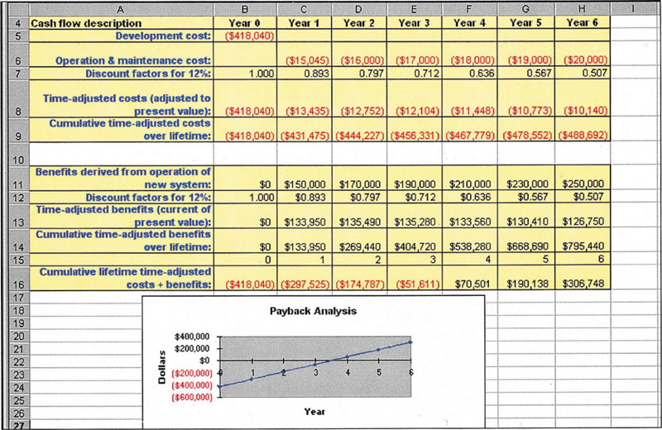
Payback Analysis for a Project
11-<number>
Notes:
No additional notes.

Slide 25
Return-on-Investment Analysis (ROI)
Return-on-Investment (ROI) analysis – a technique that compares the lifetime profitability of alternative solutions.
  The ROI for a solution or project is a percentage rate that measures the relationship between the amount the business gets back from an investment and the amount invested.
Lifetime ROI =
(estimated lifetime benefits – estimated lifetime costs) / estimated lifetime costs
Annual ROI = lifetime ROI / lifetime of the system
11-<number>
Notes:
No additional notes.

Slide 26
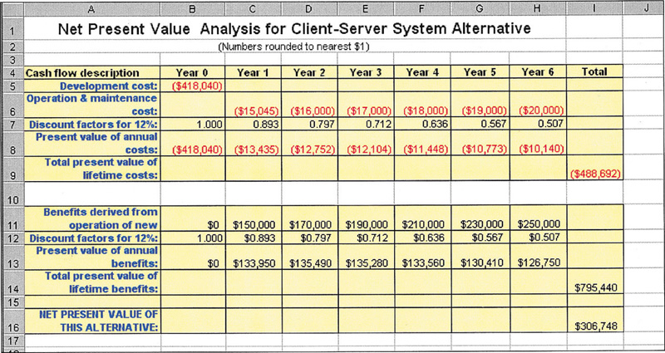
Net Present Value (NPV) Analysis
Net present value – analysis technique that compares annual discounted costs and benefits of alternative solutions.
11-<number>
Notes:
No additional notes.

Slide 27
Earned Value Management, EMV
挣得值管理：是一种综合项目范围、时间、进度
计划、成本绩效测量的方法。它通
过与计划工作量、实际挣得收益、
实际花费成本进行比较，从而确定
成本和进度绩效是否符合原定计划
,从而选取不同的对应措施，以保
证最终完成项目目标。
11-<number>

Slide 28
基本概念
1. PV (planned value)：计划成本。指截止到成本挣得值分析图中当前时间，计划应该完成的工作对应的预算成本，即根据批准认可的进度计划和预算到某一日期应当完成的工作所需的投入资金。PV值是项目进度是否滞后、费用是否超支的一个衡量标准。
通常：PV值在项目实施过程中应保持不变。如发生预算、计划或合同等变更，则相应的PV基准也应作相应的更改。
11-<number>

Slide 29
计划工作量的预算费用(BCWS)，即(Budgeted Cost for Work Scheduled)。计划成本
BCWS是指项目实施过程中某阶段计划要求完成的工作量所需的预算工时(或费用)。
BCWS主要是反映进度计划应当完成的工作量而不是反映应消耗的工时(或费用)。
11-<number>

Slide 30
2. 实际成本(AC):指截止到当前日期,实际已完成工作的成本总额,即在某一日期所完成工作的实际成本.该值必须符合PV值与EV值所做的预算.
已完成工作量的实际费用(ACWP)，即(Actual Cost for Work Performed)。(实际成本)
ACWP是指项目实施过程中某阶段实际完成的工作量所消耗的工时(或费用)。
ACWP主要是反映项目执行的实际消耗指标。
11-<number>

Slide 31
3. 挣值(EV):指截止到当前日期,实际完成工作对应的预算成本(已完成工作的预算成本)。该值是批准认可的预算,即到某一日期已完成工作应当投入的资金。
例:有一项任务预定在测量时间点上完工,其计划成本为1000元.但只完成这项任务的95%.这样,就完成了950元的工作量,这就是挣值(EV).
11-<number>

Slide 32
已完工作量的预算成本(BCWP)，即(Budgeted Cost for Work Performed)。BCWP是指项目实施过程中某阶段按实际完成工作量及按预算定额计算出来的工时(或费用)，即挣得值(Earned Value)。 （挣值）
BCWP的计算公式为：ＢＣＷＰ=预算定额×已完工作量。
例如：第一周购买了服务器和软件，是完成总计划工作量的70%，你第一周的计划成本是3万元。那么你第一周的挣值就是：第一周的BCWP=70%*3万=2.1万元。即你在第一周时间点上的挣值是2.1万元。
11-<number>

Slide 33
4. BAC = Budgeted Cost at Completion（完工预算） [完成整个项目的预算成本]
CV = BCWP-ACWP（费用偏差） =EV-AC
[已经完成的工作是超过预算还是低于预算]
SV = BCWP-BCWS（进度偏差）=EV-PV
[得出当前进度是提前还是滞后]
SPI=BCWP/BCWS (SPI = Schedule Performance Index) （进度绩效指数）
CPI=BCWP / ACWP (CPI = Cost Performance Index )（成本绩效指数）
11-<number>

Slide 34
四个评价指标
(1)成本偏差(CV,用Cost Variance):将挣值(EV)减去实际成本(AC), 即:CV=EV-AC=BCWP-ACWP.
例:已完成了950元的工作量(EV),但为完成这一工作实际花费了1100元(AC).完成这项工作比原先预想的多花了150元(CV).
当CV>0(即EV>AC),表明项目的实施成本处于节约状态;反之,当CV<0(EV<AC),则表明项目实施成本超支,当CV=0,表明项目实施成本与预算相符.
11-<number>

Slide 35
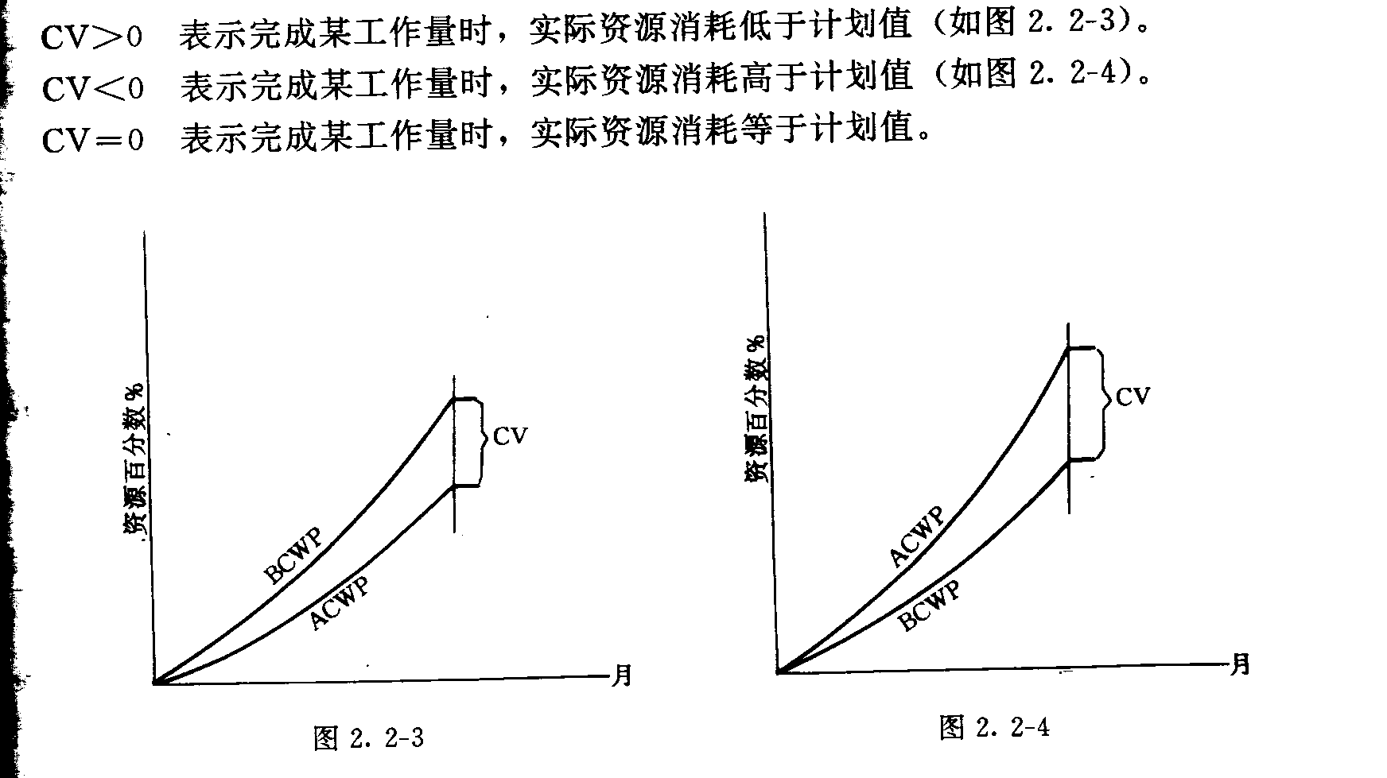
EV 挣值
11-<number>

Slide 36
(2) 进度偏差: SV=EV-PV = BCWP-BCWS
[得出当前进度是提前还是滞后]
SV>0:进度提前，SV<0:进度延误。
例:对于一项工作,原先预计到测量时间点为止会完成1000元的工作量(PV).而实际上完成了950元的工作量(EV).这样就比原计划少完成了50元的工作量.
11-<number>

Slide 37
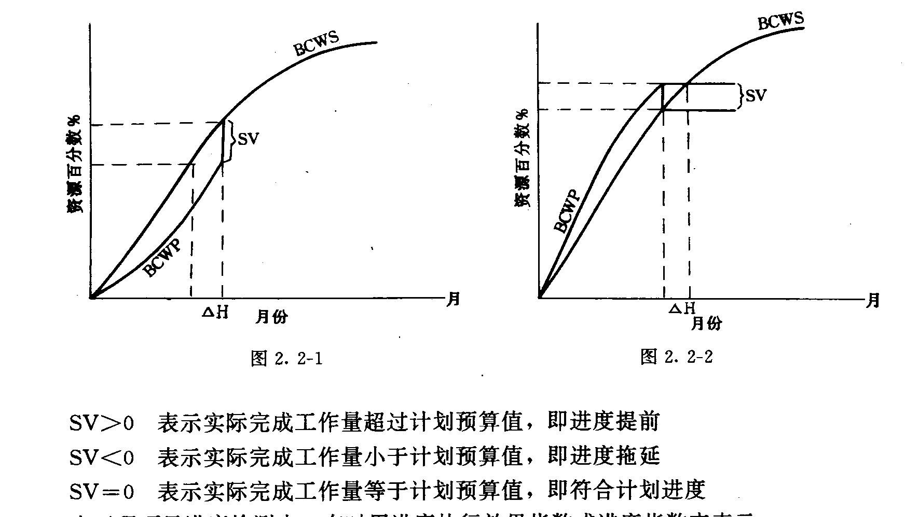
PV计划成本
11-<number>

Slide 38
(3) 成本绩效指数(CPI, Cost Performance Index):挣值和实际费用的比
CPI=EV/AC.
CPI=950/1100=0.864(实际花一元完成了0.864元的工作量,成本与绩效之比)
CPI=1.0: 表明资金使用效率一般
CPI>1.0: 表明资金使用效率较高,成本节余
CPI<1.0: 表明资金使用效率低.成本超支.
11-<number>

Slide 39
(4) 进度绩效指数(SPI: Schedule Performance Index): SPI=EV/PV
SPI=950/1000=0.95(计划完成1元的工作量,实际完
成了0.95元的工作量,进度绩效之比).
SPI=1.0: 表明进度效率与计划相符
SPI>1.0: 表明进度效率较高,进度超前
SPI<1.0: 表明进度效率较低,进度滞后
11-<number>

Slide 40
挣值曲线示意图
成本
实际成本曲线
CV
预算（基线）
挣值曲线
SV
EV
AC
PV
实际工期
日历工期
3 个月
1年
11-<number>

Slide 41
信息系统成本收益分析表
参数关系
偏差指标
绩效指标
调整措施
AC>PV>EV
CV=EV-AC<0,资金投入超前, SV=EV-PV<0, 进度拖延
CPI=EV/-AC<1.0,资金使用效率低SPI=EV/PV<1.0,进度效率低
加强成本监控,赶工\工作并行以追赶进度，提高工作效率
CV=EV-AC<=0,成本支出适当, SV=EV-PV<0, 进度拖延
CPI=EV/AC<=1.0,资金使用效率一般. SPI=EV/PV<1.0,进度效率低
加大成本投入,赶工\工作并行以追赶进度，增加高效率工作人员
PV>AC>=EV
AC>=EV>PV
CV=EV-AC<=0,成本支出适当, SV=EV-PV>0, 进度提前
CPI=EV/AC<=1.0,资金使用效率一般.SPI=EV/PV>1.0,进度效率高
加大成本投入,提高整体效率,加强人员培训和质量控制
EV>PV>AC
CV=EV-AC>0,资金投入延后, SV=EV-PV>0, 进度提前
CPI=EV/AC>1.0,资金使用效率一般.配SPI=EV/PV>1.0,进度效率高
加强质量控制,密切监控
11-<number>

Slide 42
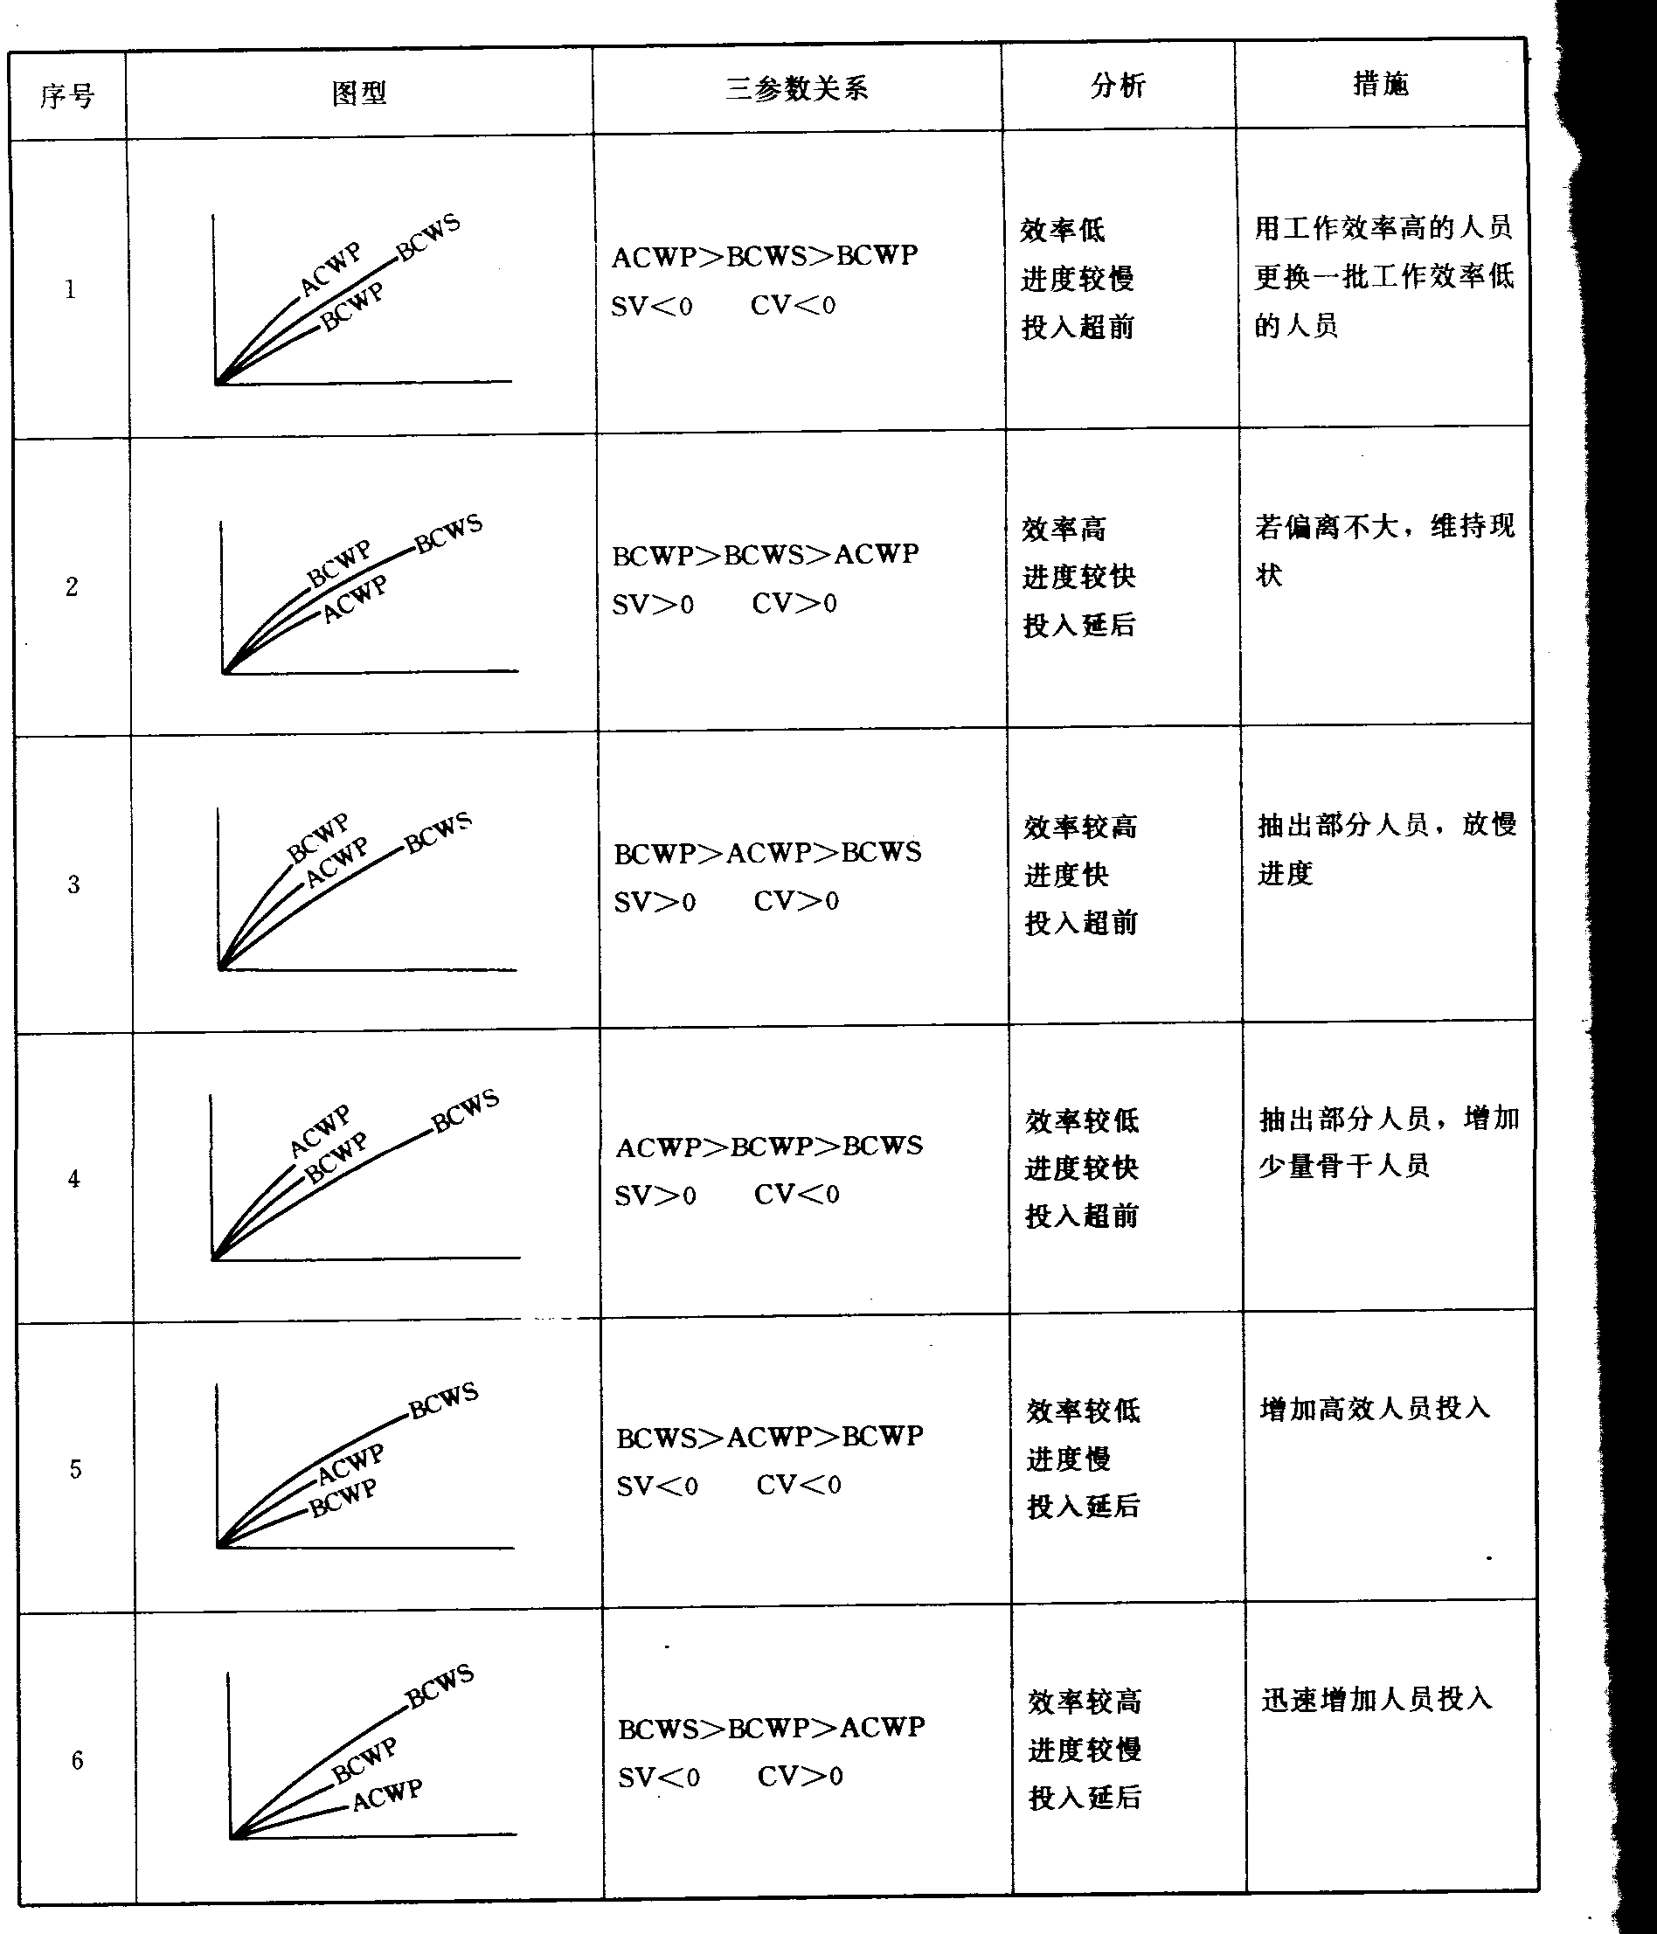
11-<number>

Slide 43
运用挣值分析进行项目成本预测
预测项目完工成本（EAC，Estimate At Completion)，
即最终成本， 有三种方法：
假定项目未完工部分按目前实际效率预测方法
EAC=AC+(BAC-EV)/CPI = BAC/CPI
其中，BAC（Budget At Completion）= 总预算（Total Budget）。
假定项目未完工部分按计划效率的预测方法
EAC=AC+BAC－EV
全面重新估算剩余工作成本的预测方法
EAC=AC+ETC
其中ETC (Estimate To Completion)是全面重新估算项目剩余工作的成本。
11-<number>

Slide 44
自学
4. 完工偏差VAC (Variance at Completion): 即全部工作预算(BAC)与全部工作概算价值(EAC)之差:
VAC=BAC-EAC
正值是项目组追求的目标，表明成本比预计情况要
好。VAC=2000-2315=-315
5. 绩效指数TCPI (To Complete Performance Index):为按预算完成项目,从现在开始每一元钱要产生的价值
TCPI=(BAC-EV)/(BAC-AC)
=(2000-950)/(2000-1100)=1.17
每花费一元要完成1.17元的价值,以便用预计剩下的
资金完成余下的工作。
11-<number>

Slide 45
（自学）例：项目计划在7月份完成，总的项目预算是 70700元。下表是前5个月个项目绩效的测量参数：
 | PV | EV | AC | SV | CV | SPI | CPI
1月 | 0 | 0 | 0 | 0 | 0
2月 | 2500 | 3600 | 6000 | 1100 | -2400 | 144% | 60%
3月 | 8000 | 8000 | 8000 | 0 | 0 | 100% | 100%
4月 | 13000 | 10000 | 8000 | -3000 | 2000 | 77% | 125%
5月 | 42000 | 35000 | 51000 | -7000 | -16000 | 83% | 69%
6月 | 62000
7月 | 70700
11-<number>

Slide 46
预测：自学
从项目绩效测量参数可以看出，该项目在5月份时的SV和CV都为负，SPI和CPI都小于1，因此可以预测该项目的进度将延迟，成本将超支。
最终成本EAC=BAC/CPI=70700 / 69% = 102464
完工成本偏差：
VAC=BAC – EAC = 70700 – 102464 = – 31764
得出结论：该项目的完工估算比最初的计划将超支31764元，并将延期才能完成。
11-<number>

Slide 47
自学
6. 任务完成百分比PC (Percent Complete), 即已完成的工作占总工作量的比例.
PC=EV/BAC=950/2000=47.5%
7. 成本消耗百分比PS (Percent Spent):已消耗的成本占项目总预算的比例.
PS=1100/2000=55%
所有的价值,无论是计划的还是实际的,都用货币值表示偏差.这会使大家认为挣值与货币有关,但它反应的是项目绩效.因此挣值是沟通管理的一个重要工具,也是项目绩效度量的一个非常有帮助的工具.
11-<number>

Slide 48
Feasibility Analysis Matrix
Feasibility Analysis Matrix – a tool used to rank candidate systems.
 | Weighting | Candidate 1 | Candidate 2 | Candidate 3
Description
Operational Feasibility
Cultural Feasibility
Technical Feasibility
Schedule Feasibility
Economic Feasibility
Legal Feasibility
Ranking
11-<number>
Notes:
Teaching Notes
The weightings serve to make some kinds of feasibility more important in the rankings than others kinds.
The weightings should add up to 100%.

Slide 49
Sample Feasibility Analysis Matrix
 | Wt | Candidate 1 | Candidate 2 | Candidate 3
Description |  | Purchase commercial off-the-shelf package for member services. | Write new application in-house using new company standard VB.NET and SQL Server database | Rewrite current in-house application using Powerbuilder.
Operational feasibility | 15% | Supports only Member Services requirements. Current business process would have to be modified to take advantage of software functionality. Also there is concern about security in the system. Score: 60 | Fully supports user-required functionality. Score: 100 | Fully supports user-required functionality. Score: 100
Cultural Feasibility | 15% | Possible user resistance to non-standard user interface of proposed purchased package. Score: 70 | No foreseeable problems. Score: 100 | No foreseeable problems. Score: 100
11-<number>
Notes:
No additional notes.

Slide 50
Sample Feasibility Analysis Matrix (cont.)
 | Wt | Candidate 1 | Candidate 2 | Candidate 3
Technical feasibility | 20% | Current production release of Platinum Plus package is version 1.0 and has been on the market for only 6 weeks. Maturity of product is a risk, and company charges and additional monthly fee for technical support. Required to hire or train Java J2EE expertise to perform modifications for integration requirements. Score: 50 | Solution requires writing application in VB .NET. Although current technical staff has only Powerbuilder experience, it should be relatively easy to find programmers with VB .NET experience. Score: 95 | Although current technical staff is comfortable with Powerbuilder, management is concerned about acquisition of Powerbuilder by Sybase Inc. MS SQL Server is the current company standard for database, which competes with Sybase DBMS. We have no guarantee that future versions of Powerbuilder will "play well" with our current version of SQL Server. Score: 60
11-<number>

Slide 51
Sample Feasibility Analysis Matrix (cont.)
 | Wt | Candidate 1 | Candidate 2 | Candidate 3
Economic feasibility Cost to develop: Payback (discounted): Net present value: Detailed calculations: | 30% | Approx. $350.000 Approx. 4.5 years Approx. $210,000 See Attachment A Score: 60 | Approx. $418.000 Approx. 3.5 years Approx. $307,000 See Attachment A Score: 85 | Approx. $400.000 Approx. 3.3 years Approx. $325,000 See Attachment A Score: 90
11-<number>
Notes:
No additional notes.

Slide 52
Sample Feasibility Analysis Matrix (cont.)
 | Wt | Candidate 1 | Candidate 2 | Candidate 3
Schedule feasibility | 10% | Less than 3 months Score: 95 | 9-12 months Score: 80 | 9 months Score: 85
Legal feasibility | 10% | No foreseeable problems Score: 100 | No foreseeable problems Score: 100 | No foreseeable problems Score: 100
Weighted score | 100% | 67 | 92.5 | 87.5
11-<number>

Slide 53
The System Proposal(看书自学）
System proposal – a report or presentation of a recommended solution.
  Usually formal written report or oral presentation
  Intended for system owners and users
11-<number>
Notes:
No additional notes.

