Slide 1
Information Systems
Analysis and Design
—The aim of the course is knowledge and ability
2-<number>

Slide 2
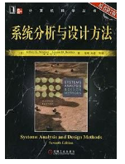
Textbook：
System Analysis and Design Method
（SeventhEdition）, L.Whitten , Bentley
系统分析与设计方法
（原书第七版）
肖刚，孙慧译，
机械工业出版
2-<number>

Slide 3
reference
John Zachman. A framework for information systems architecture. IBM systems Journal, Vol.26, No.3, 1987
2-<number>

Slide 4
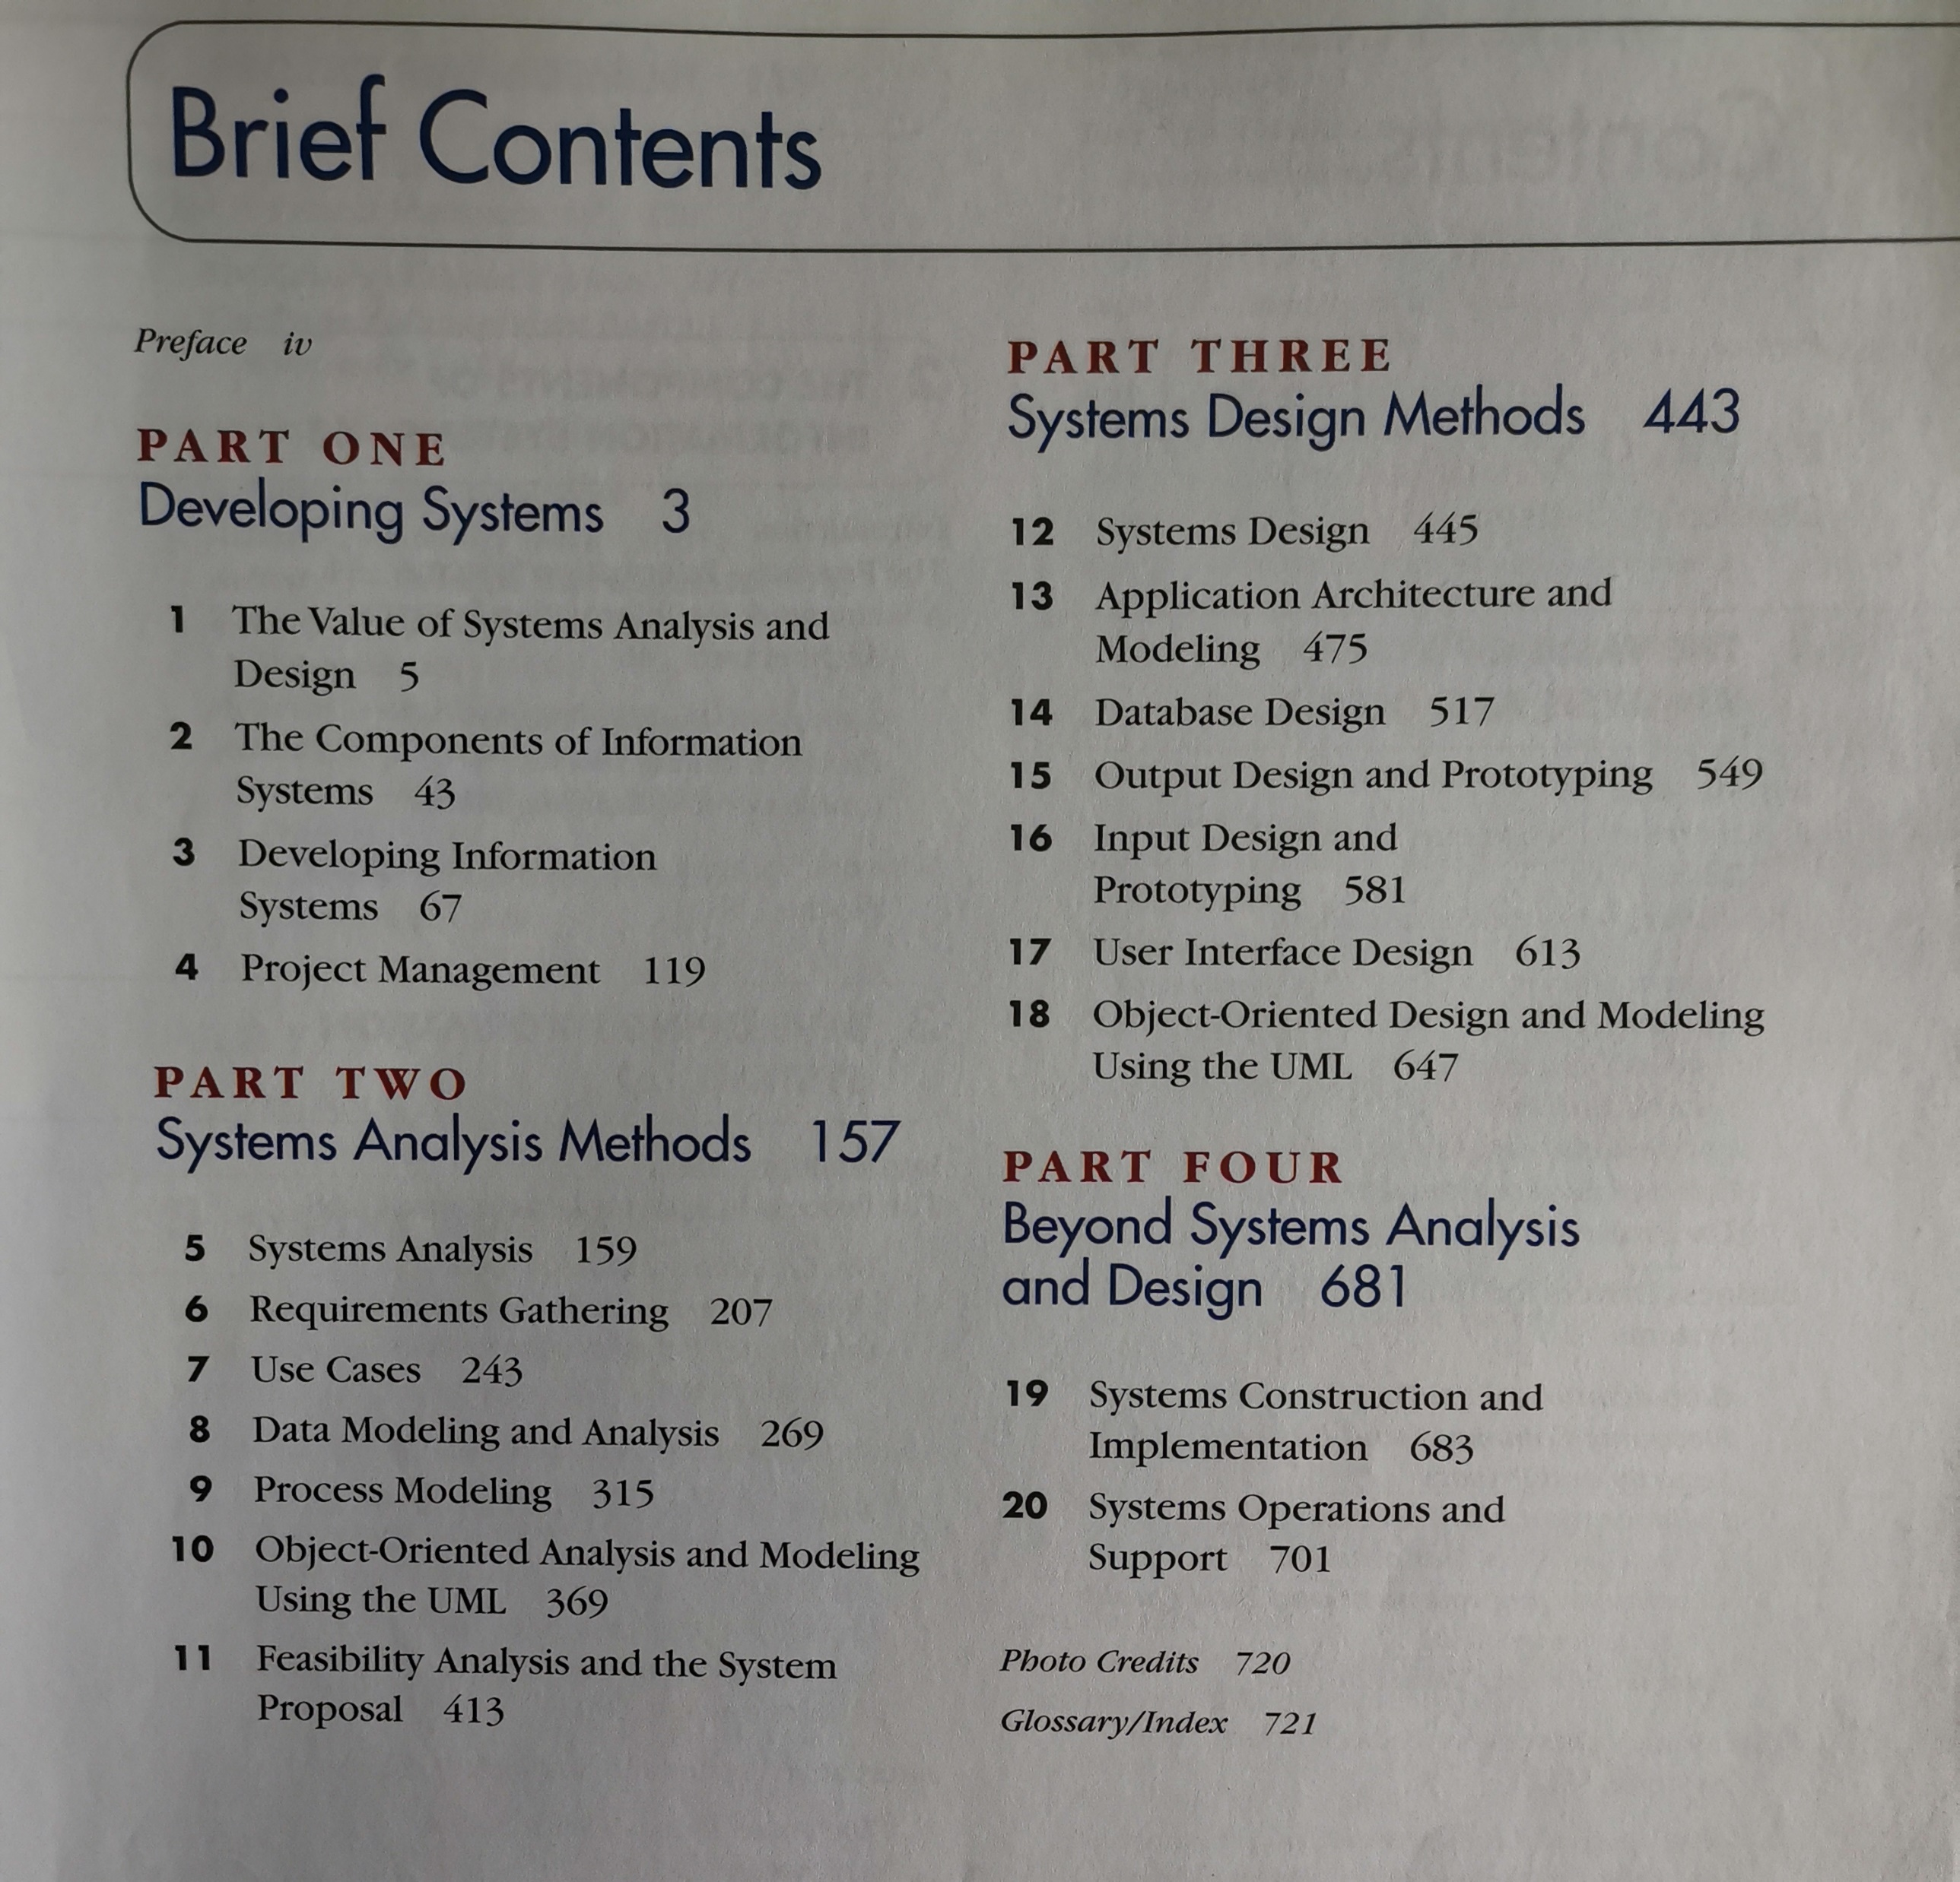
2-<number>

Slide 5
Content
The Components of information System
Developing IS
Project management
System analysis
System design
Feasibility analysis
Application Architecture
2-<number>

Slide 6
Tools
Unified Modeling Language，UML
Rational Rose
StarUML
PowerDesigner
Visio
……..
Project management
project
2-<number>

Slide 7
Chapter 2
The Components
of
Information System
2-<number>

Slide 8
Objectives
Identify different types of stakeholders who use or develop information systems, and give examples of each.
Differentiate between front- and back-office information systems.
Describe building blocks of the information system.
KNOWLEDGE
PROCESS
COMMUNICATIONS
2-<number>
Notes:
No additional notes

Slide 9
2.1 Stakeholders: Players in the Systems Game
A stakeholder is any person who has an interest in an existing or proposed information system. Stakeholders can be technical or nontechnical workers. They may also include both internal and external workers.
2-<number>

Slide 10
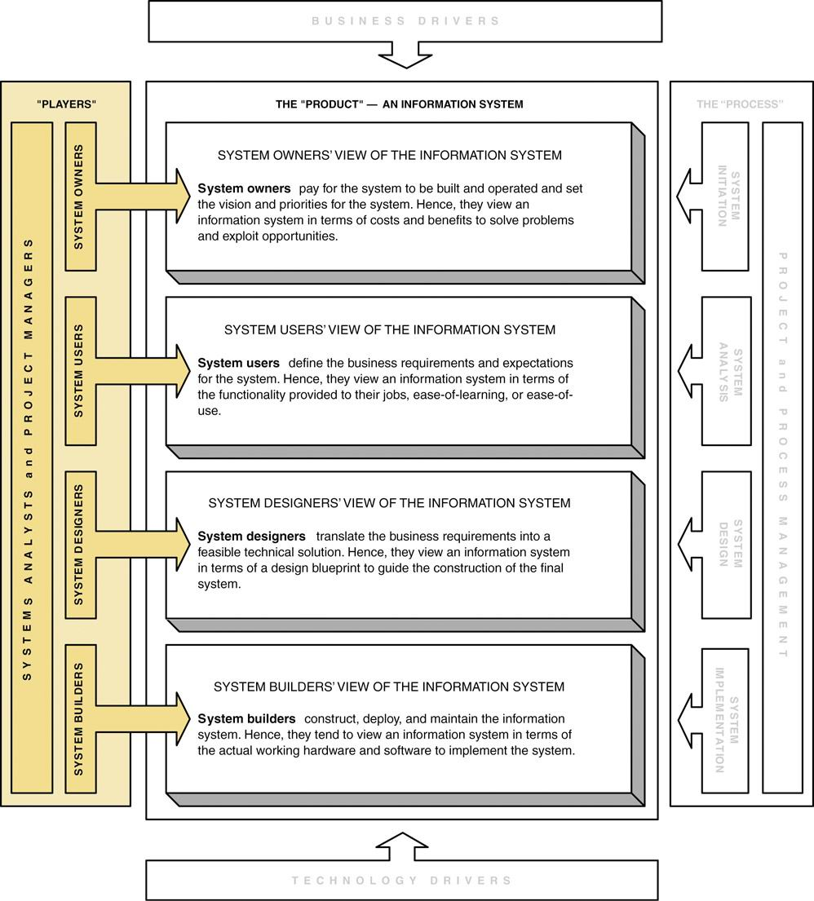
2-<number>

Slide 11
System Owners
System owners – an information system’s sponsor and executive advocate(发起人和主要倡导者), usually responsible for funding the project of developing, operating, and maintaining the information system.
2-<number>

Slide 12
System Users
System users – a “customer” who will use or is affected by an information system on a regular basis – capturing, validating, entering, responding to, storing, and exchanging data and information.
-- Internal System Users
-- External System Users
2-<number>

Slide 13
Internal System Users
Clerical and service workers
Technical and professional staff
Supervisors, middle managers, and executive managers
2-<number>

Slide 14
External System Users
Customers
Suppliers
Partners
Remote users - users who are not physically located on the premises but who still requires access to information systems.
Mobile users - users whose location is constantly changing but who requires access to information systems from any location
2-<number>

Slide 15
System Designers and
System Builders
System designer – a technical specialist who translates system users’ business requirements and constraints into technical solution. She or he designs the computer databases, inputs, outputs, screens, networks, and software that will meet the system users’ requirements.
System builders – a technical specialist who constructs information systems and components based on the design specifications generated by the system designers.
2-<number>

Slide 16
Systems Analysts
Systems analyst – a specialist who studies the problems and needs of an organization to determine how people, data, processes, and information technology can best accomplish improvements for the business.
2-<number>

Slide 17
The Systems Analyst as a Problem-Solver
By "Problems" that need solving, we mean:
  Problems, either real or anticipated, that requires corrective action
  Opportunities to improve a situation despite the absence of complaints
  Directives to change a situation regardless of whether anyone has complained about the current situation
2-<number>

Slide 18
2.2Front- and Back-Office
Information Systems
Front-office information systems support business functions that extend out to the organization’s customers (or constituents 委托人).
  Marketing
  Sales
  Customer management
Back-office information systems support internal business operations of an organization, as well as reach out to suppliers (of materials, equipment, supplies, and services).
  Human resources
  Financial management
  Manufacturing
  Inventory control
2-<number>

Slide 19
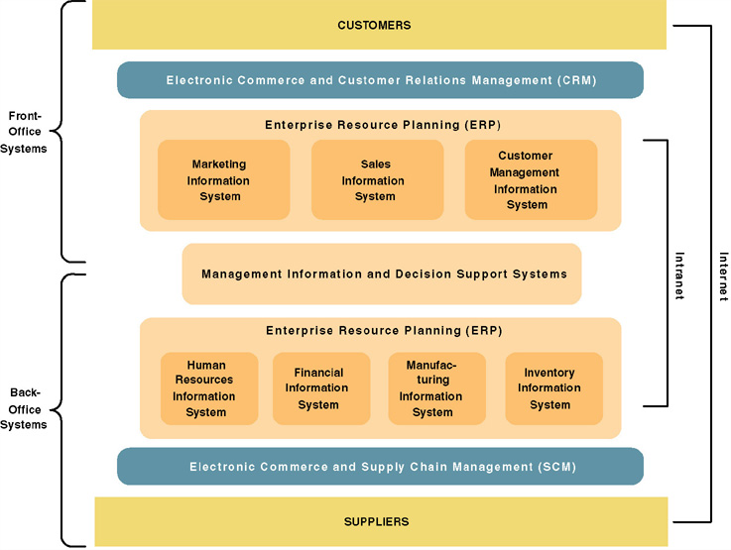
A Federation of Information Systems
2-<number>

Slide 20
Building blocks for Information Systems
Knowledge — the material used to create useful information.
Process — the activities (including management) that carry out the mission of the business.
Communication — how the system interfaces with its users and other information systems.
2-<number>

Slide 21
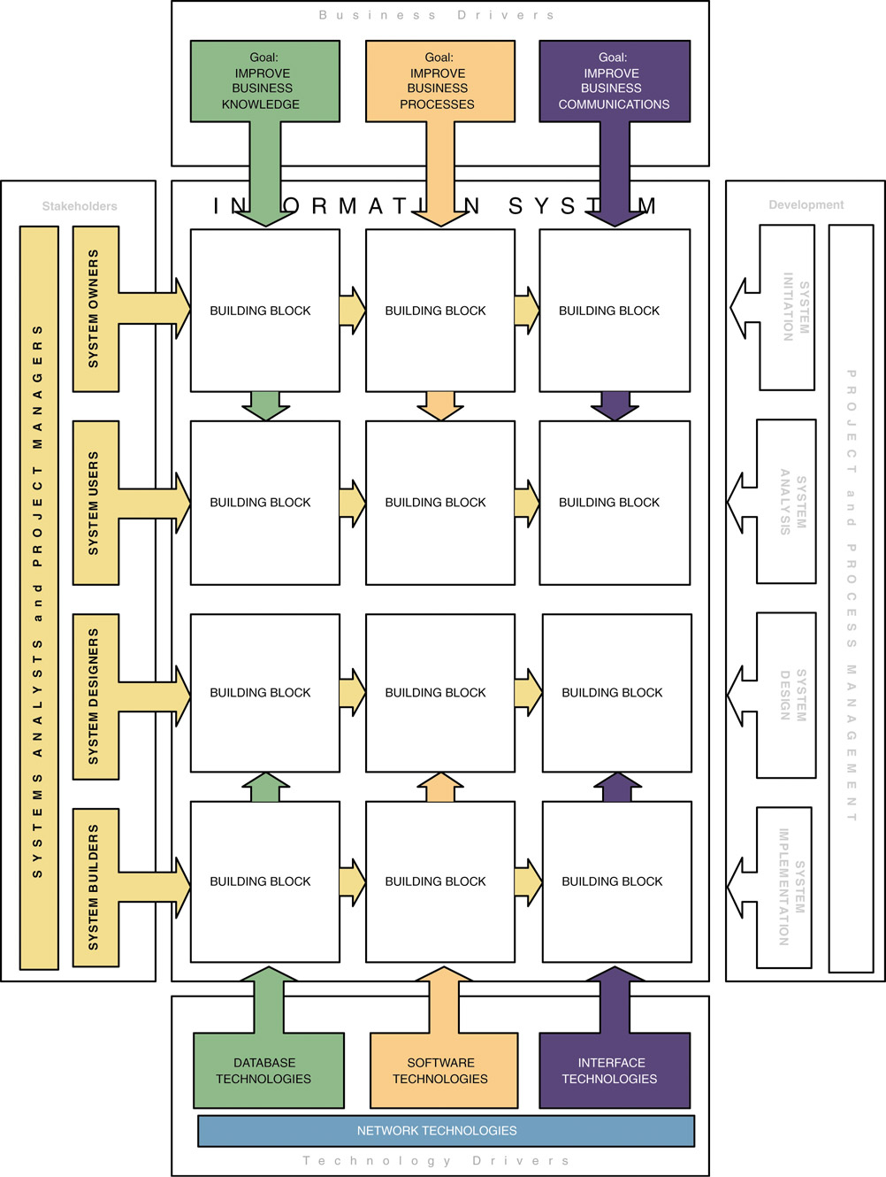
Information System Building Blocks
2-<number>

Slide 22
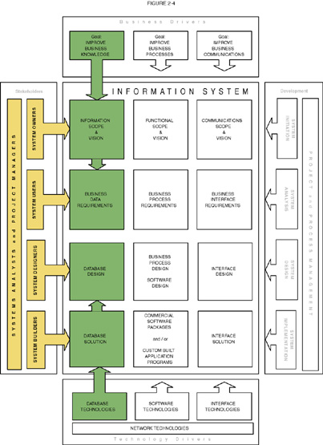
KNOWLEDGE Building Blocks
Information scope &vision
Business data requirements
Database create
Database solution
2-<number>
Notes:
Teaching Notes
This slide visually illustrates the chapter’s discussion of the KNOWLEDGE focus as seen by different stakeholders.
If your students have taken a database course, it can be useful to summarize that experience within the context of the KNOWLEDGE column.

Slide 23
Views of KNOWLEDGE
System owners’ view
  Interested not in raw data but in information that adds new business knowledge and helps managers make decisions.
  Business entities and business rules.
System users’ view
  View data as something recorded on forms, stored in file cabinets, recorded in books and spreadsheets, or stored on computer.
  Focus on business issues as they pertain to（属于，涉及） data.
  Data requirement – a representation of users’ data in terms of entities, attributes, relationships, and rules independent of data technology.
2-<number>

Slide 24
Views of KNOWLEDGE (cont.)
System designers’ view
  Data structures, database schemas, fields, indexes, and constraints of particular database management system (DBMS).
System builders’ view
  SQL
  DBMS or other data technologies
2-<number>

Slide 25
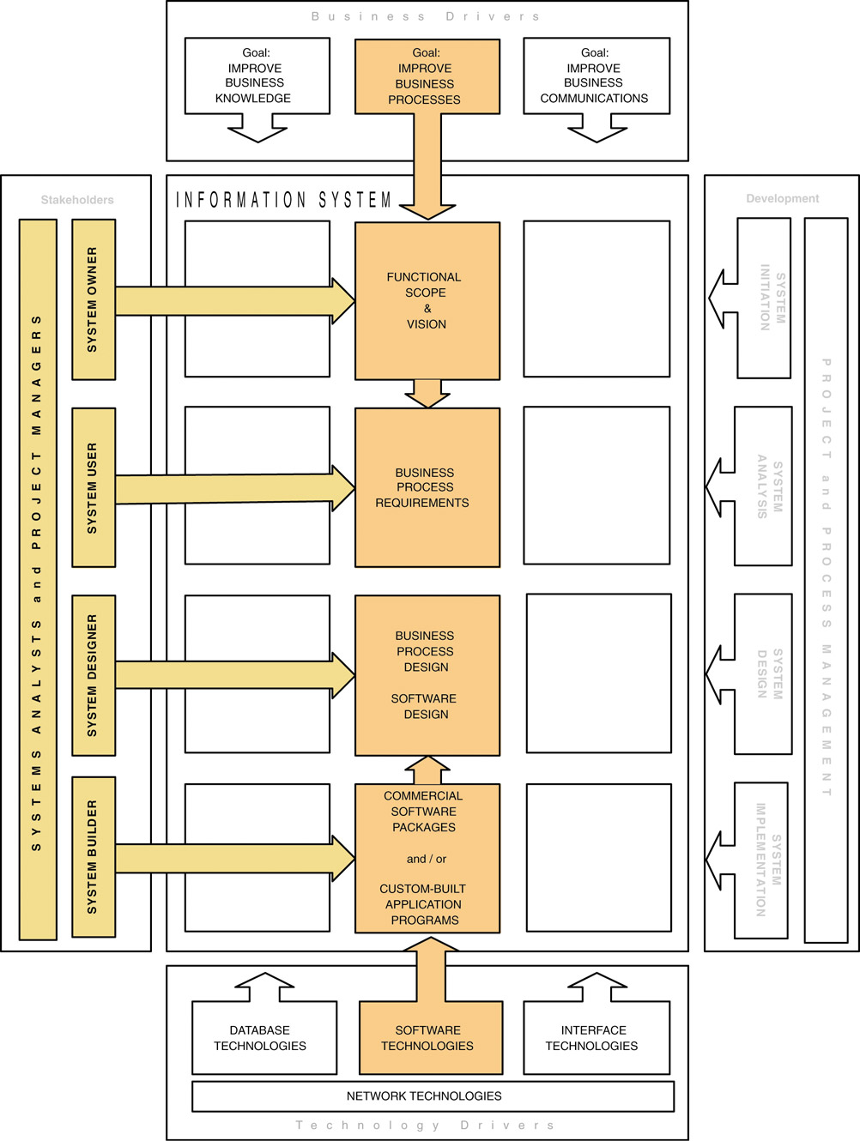
2.3.2 PROCESS Building Blocks
2-<number>
Notes:
Teaching Notes

Slide 26
Views of PROCESS
System owners’ view
  Concerned with high-level processes called business functions.
  Business function – a group of related processes that support the business. Functions can be decomposed into other subfunctions and eventually into processes that do specific tasks.
  A cross-functional information system – a system that supports relevant business processes from several business functions without regard to traditional organizational boundaries such as divisions, departments, centers, and offices.
2-<number>

Slide 27
Views of PROCESS (cont.)
System users’ view
  Concerned with work that must be performed to provide the appropriate responses to business events.
  Business processes – activities that respond to business events.
  Process requirements – a user’s expectation（理解） of the processing requirements for a business process and its information systems.
  Policy – a set of rules that govern a business process.
  Procedure（规程） – a step-by-step set of instructions and logic for accomplishing a business process.
  Work flow – the flow of transactions through business processes to ensure appropriate checks and approvals are implemented.
2-<number>

Slide 28
Views of PROCESS (cont.)
System designers’ view
  Concerned with which processes to automate and how to automate them
  Constrained by limitations of application development technologies being used
  Software specifications – the technical design of business processes to be automated or supported by computer programs to be written by system builders.
2-<number>

Slide 29
Views of PROCESS (cont.)
System builders’ view
  Concerned with programming logic that implements automated processes
  Application program – a language-based, machine-readable representation of what a software process is supposed to do, or how a software process is supposed to accomplish its task.
  Prototyping – a technique for quickly building a functioning, but incomplete model of the information system using rapid application development tools.
2-<number>

Slide 30
Views of COMMUNICATION
System owners’ view
  Who (which business units, employees, customers, and partners) must interact with the system?
  Where are these business units, employees, customers, and partners located?
  What other information systems will the system have to interface with?
System users’ view
  Concerned with the information system’s inputs and outputs.
2-<number>
Notes:
Teaching Notes
This slide places definitions and key terms relevant to the COMMUNICATION focus into the context of stakeholders.

Slide 31
Views of COMMUNICATION (cont.)
System designers’ view
  Concerned with the technical design of both the user and the system-to-system communication interfaces.
  Interface specifications – technical designs that document how system users are to interact with a system and how a system interacts with other systems.
  User dialogue – a specification of how the user moves from window to window or page to page, interacting with the application programs to perform useful work.
2-<number>
Notes:
Teaching Notes
This slide places definitions and key terms relevant to the COMMUNICATION focus into the context of stakeholders.

Slide 32
Views of COMMUNICATION (cont.)
System builders’ view
  Concerned with the construction, installation, testing and implementation of user and system-to-system interface solutions.
  Middleware – utility software that allows application software and systems software that utilize differing technologies to interoperate.
2-<number>
Notes:
Teaching Notes
This slide places definitions and key terms relevant to the COMMUNICATION focus into the context of stakeholders.

Slide 33
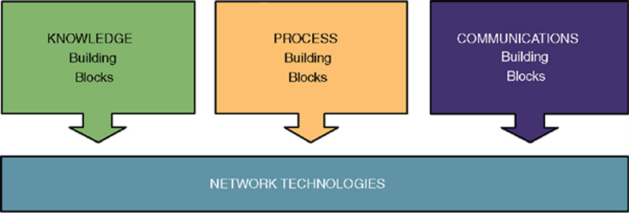
2.4 Network Technologies and the
IS Building Blocks
Clean-layering approach allows any one building block to be replaced with another while having little or no impact on the other building blocks
2-<number>

