Slide 1
Chapter 3
Developing
Information System
3-<number>

Slide 2
Objectives
Describe the Capability Maturity Model (CMM).
Differentiate between the system life cycle and a system development methodology.
Describe the PIECES framework for categorizing problems, opportunities, and directives.
3-<number>
Notes:
No additional notes

Slide 3
Objectives
Describe the essential phases of system development. For each phase, describe its purpose, inputs, and outputs.
Describe typical alternative “routes” through the basic phases of system development.
3-<number>

Slide 4
3.1Process of System Development
System development process – a set of activities, methods, best practices, deliverables, and automated tools that stakeholders (Chapter 1) use to develop and continuously improve information systems and software (Chapters 1 and 2).
  Using a consistent process for system development:
    Create efficiencies that allow management to shift resources between projects
    Produces consistent documentation that reduces lifetime costs to maintain the systems
    Promotes quality
3-<number>

Slide 5



Difficult 软件难做
  Scott Rosenberg见证了软件世界中无数个悲惨的故事，并得出结论：无论是跨国公司、政府机构，还是军工大鳄，都曾一头撞上过代码的冰山。
3-<number>

Slide 6
Examples
FBI投资4亿美元，花费10年时间，开展的名为Trilogy的计算机现代化项目，当进行到耗资1亿7千万美元的第三个模块时，撞上了冰山，1亿7千万美元也就此打了水漂。
美国国内税务局（IRS）是另一个活生生的例子。IRS在过去40年里，曾3次尝试改造计算机系统。
联邦航空管理局（FAA）的先进自动系统（AAS）项目，从1981年启动到1994年宣告终止，花费了几十亿美元。
麦当劳的"Innocvate"项目耗资1亿7千万美金，也以失败告终。
福特公司耗资数亿美金的"Everest"采购系统，也成了一个历时5年的黑洞。
3-<number>

Slide 7
3.1.1CMM Process Management Model
Capability Maturity Model (CMM) – a standardized framework for assessing the maturity level of an organization’s information system development and management processes and products. It consists of five levels of maturity:
  Level 1—Initial: System development projects follow no prescribed process.
  Level 2—Repeatable: Project management processes and practices established to track project costs, schedules, and functionality.
  Level 3—Defined: Standard system development process (methodology) is purchased or developed. All projects use a version of this process.
  Level 4—Managed: Measurable goals for quality and productivity are established.
  Level 5—Optimizing: The standardized system development process is continuously monitored and improved based on measures and data analysis established in Level 4.
3-<number>

Slide 8
Level 4—Managed:
Measurable goals for quality and productivity are established.
LEVEL
5
optimized
Level 3—Defined:
A standard system development process (sometimes called a “methodology”) is purchased or developed, and integrated throughout the information systems/services unit of the organization.
Level 2--Repeatable:
Project management processes and practices are established to track project costs, schedules, and functionality.
Level 5—Optimizing:
The standardized system development process is continuously monitored and improved based on measures and data analysis established in Level 4.
LEVEL
4
managed
LEVEL
3
defined
LEVEL
2
repeatable
LEVEL
1
initial
COMPETITIVENESS
Level 1—Initial: System development projects follow no prescribed process.
3-<number>

Slide 9
Key Process Area
关键过程域: 指一系列相互关联的操作活动，这些活动反映了一个软件组织改进过程时必须集中精力改进的几个方面。换句话说，关键过程域标识了达到某个成熟度等级时所必须满足的条件。
在 CMM 中每个成熟度等级（第 1 级除外）规定了不同的关键过程域，一个软件组织如果希望达到某一个成熟度等级，就必须完全满足关键过程域所规定的不同要求，即满足每个关键过程域的目标。
在 CMM 中一共有 18 个关键过程域，分布在 2~5 级中。
3-<number>

Slide 10
● 第 2 级（可重复级）有 6 个关键过程域，主要涉及建立软件项目管理控制方面的内容。
• 需求管理（ Requirements Management ， RM ）
• 软件项目计划（ Software Project Planning ， SPP ）
• 软件项目跟踪与监控（ Software Project Tracking and Oversight ， SPTO ）
• 软件子合同管理（ Software Subcontract Management ， SSM ）
• 软件质量保证（ Software Quality Assurance ， SQA ）
• 软件配置管理（ Software Configuration Management ， SCM ）
3-<number>

Slide 11
第 3 级（定义级）有 7 个关键过程域，主要涉及项目和组织的策略。 使软件组织建立起对项目中的有效计划和管理过程的内部细节。
• 组织过程焦点（ Organization Process Focus ， OPF ）
• 组织过程定义（ Organization Process Definition ， OPD
• 培训程序（ Training Program ， TP ）
• 集成软件管理（ Integrated Software Management ， ISM ）
• 软件产品工程（ Software Product Engineering ， SPE ）
• 组间协调（ Intergroup Coordination ， IC ）
• 同级评审（ Peer Reviews ， PR ）
3-<number>

Slide 12
第 4 级（管理级）有 2 个关键过程域，主要的任务是为软件过程和软件产品建立一种可以理解的定量的方式。
• 定量过程管理（ Quantitative Process Management ， QPM ）
• 软件质量管理（ Software Quality Management ， SQM ）
第 5 级（优化级）有 3 个关键过程域，主要涉及的内容是软件组织和项目中如何实现持续不断的过程改进问题。
• 缺陷预防（ Defect Prevention ， DP ）
• 技术变更管理（ Technology Change Management ， TCM ）
• 过程变更管理（ Process Change Management ， PCM ）
3-<number>

Slide 13
Impact of System Development “Process” on Quality
CMM Project Statistics for a Project Resulting in 200,000 Lines of Code
Organization’s CMM Level | Project Duration (months) | Project Person-Months | Number of Defects Shipped | Median Cost ($ millions) | Lowest Cost ($ millions) | Highest Cost ($ millions)
1 | 30 | 600 | 61 | 5.5 | 1.8 | 100+
2 | 18.5 | 143 | 12 | 1.3 | .96 | 1.7
3 | 15 | 80 | 7 | .728 | .518 | .933
3-<number>

Slide 14
ISO9000 and CMM
对比项 | ISO9000 | CMM
适应对象 | 全部产品（含软件） | 只有计算机软件
服务对象 | 企业市场各方 | 承制方
性质 | 强调可接收的企业质量管理体系的最低标准 | 软件过程能力成熟度标准
用途 | 认证合格与否 | 评价能力等级
目的 | 向顾客提供信任 | 降低风险或进行过程改进
3-<number>

Slide 15
3.1.2 Life Cycle
System life cycle – the factoring of the lifetime of an information system into two stages, (1) systems development and (2) systems operation and maintenance.
3-<number>

Slide 16
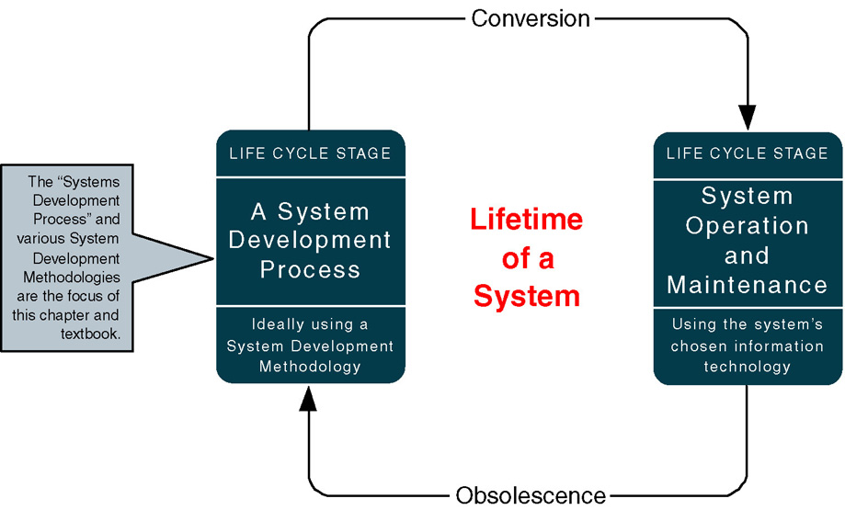
A System Life Cycle
3-<number>

Slide 17
3.2.1The PIECES Problem-Solving Framework
P the need to improve performance
I the need to improve information (and data)
E the need to improve economics, control costs, or increase profits
C the need to improve control or security
E the need to improve efficiency of people and processes
S the need to improve service to customers, suppliers, partners, employees, etc.

Slide 18
The PIECES Framework and checklist
Performance: throughput Response times
Information (and Data)
outputs inputs stored data
Economics: costs profits
Control (and Security)
too little security or control
too much control or security
Efficiency
data is redundantly input ,copied, processed
Service
the system is not easy to use and learn
The system is incompatible with other system
3-<number>

Slide 19
The categories of the PIECES framework are neither exhaustive nor mutually exclusive---they overlap. Any given project is usually characterized by one or more categories, and any given problem or opportunity may have implications with respect to more than one category. PIECES is a practical framework, not just an academic exercise.
3-<number>

Slide 20


Example
1.改进性能的需要 P
网站的展现速度有点慢，挑战访客的耐心，仍需加强改进。
在等待的这段时间里访客估计又可以搜索到另一个同类网站了。
高峰期很慢，有点瘫痪。从购买到收到需要1周。
2. 改进信息（和数据）的需要 I
唯品会系统追踪不到订单
唯品会系统品牌供应商申请上线不能在线申请，只能
3. 页面设计、排版 I
4. 提升对产品描述的吸引力 I
3-<number>

Slide 21
Example
5. 改进经济、控制成本或增加收益的需要 E
库存费用，库存成本仍然较大
物流系统费用高
宣传与广告费用大
6. 改进控制或安全的需要 C
发货发错
抢购唯品会商品遇系统问题，数据库录入错误，拍下产品后却没货。
安全控制系统不够，如可以通过条形码在网上进行在线检验，
避免顾客对产品的真伪怀疑。
7. 改进人与过程的效率的需要 E
在唯品会网页端把商品加入购物车不方便
3-<number>

Slide 22

Example
8. 改进对客户、供应商、合作伙伴、雇员等的服务需要 S
唯品会退款不及时，客服称是系统问题
下单一月货未收到 唯品会自动确认收货
当重视用户购物体验，出现问题应及时处理，注重效率
3-<number>

Slide 23
3.2.2 Project Phases
FAST - (Framework for the Application of Systems Thinking ) a hypothetical methodology used throughout this book to demonstrate a representative systems development process.
Each methodology will use different project phases.
FAST Phases | Classic Phases (from Chapter 1)
 | Project Initiation | System Analysis | System Design | System Implementation
Scope Definition | X
Problem Analysis | X | X
Requirements Analysis |  | X
Logical Design |  | X
Decision Analysis | (a system analysis transition phase)
Physical Design and Integration |  |  | X
Construction and Testing |  |  | X | X
Installation and Delivery |  |  |  | X
3-<number>

Slide 24
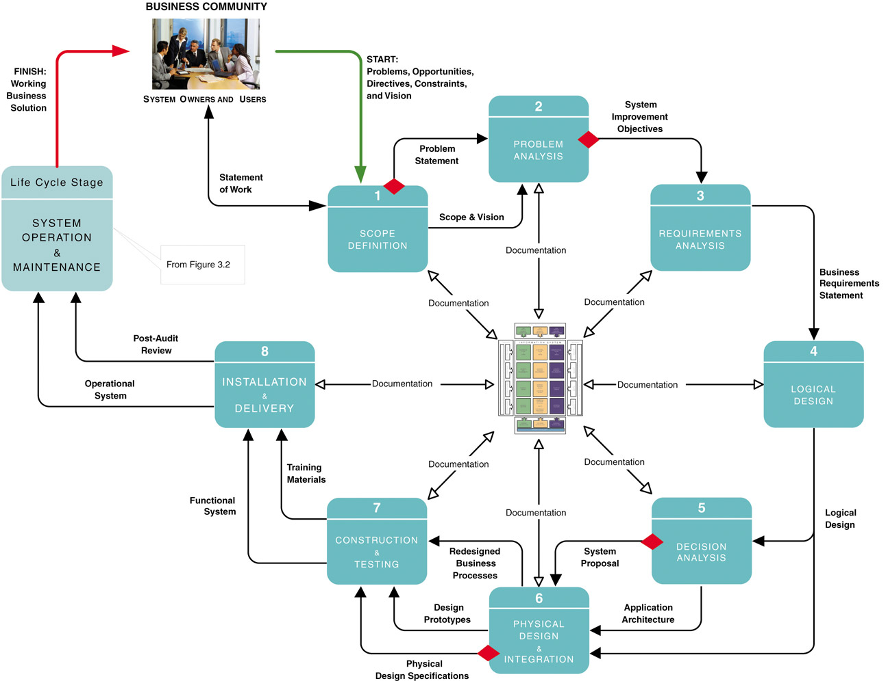
FAST Project Phases
3-<number>

Slide 25
Scope Definition Phase
Problem statement – a statement and categorization of problems, opportunities, and directives; may also include constraints and an initial vision for the solution. Synonyms include preliminary study and feasibility assessment. --PIECES
Constraint – any factor, limitation, or restraint that may limit a solution or the problem-solving process.
Scope creep (范围蔓延）– a common phenomenon wherein the requirements and expectations of a project increase, often without regard to the impact on budget and schedule.
Statement of work – a contract with management and the user community to develop or enhance an information system; defines vision（目标）, scope, constraints, high-level user requirements, schedule, and budget. Synonyms include project charter, project plan, and service-level agreement.
3-<number>
Notes:
Teaching Notes
If any of these will be a later assignment, it can be helpful to make note of it.

Slide 26
Problem Analysis
Milestone： system improvement objectives
Define the business criteria on which any new system will be evaluated.
-- reduce the time between order processing and shipping by
three days.
-- reduce bad credit losses by 45%
Checkpoint
-- canceled if the problems are deemed no longer worth solving
-- approved to continue to the next step
-- reduce or extended in scope (with budget and schedule
modifications) and then approved to continue to the next step
3-<number>

Slide 27
Requirements Analysis Phase
What capabilities should the new system provide for its users?
What data must be captured and stored?
What performance level is expected?
What are the priorities of the various requirements? Why？P57
3-<number>
Notes:
Conversion Notes
This slide is new in the seventh edition.

Slide 28
Logical Design Phase
Logical design – the translation of business user requirements into a system model that depicts only the business requirements and not any possible technical design or implementation of those requirements. Common synonyms include conceptual design and essential design.
System model – a picture of a system that represents reality or a desired reality. System models facilitate improved communication between system users, system analysts, system designers, and system builders.
Analysis paralysis – a satirical（讽刺） term coined to describe a common project condition in which excessive system modeling dramatically slows progress toward implementation of the intended system solution.
3-<number>

Slide 29
Decision Analysis Phase
Candidate solutions evaluated in terms of:
  Technical feasibility – Is the solution technically practical? Does our staff have the technical expertise to design and build this solution?
  Operational feasibility – Will the solution fulfill the users’ requirements? To what degree? How will the solution change the users’ work environment? How do users feel about such a solution?
  Economic feasibility – Is the solution cost-effective?
  Schedule feasibility – Can the solution be designed and implemented within an acceptable time?
  Risk feasibility – What is the probability of a successful implementation using the technology and approach?
3-<number>
Notes:
Teaching Notes
These will be covered in detail in Chapter 11.

Slide 30
Physical Design & Integration Phase
Physical design – the translation of business user requirements into a system model that depicts a technical implementation of the users’ business requirements. Common synonyms include technical design or implementation model.
Two extreme philosophies （极端情况）of physical design
Design by specification – physical system models and detailed specification are produced as a series of written (or computer-generated) blueprints for construction.
Design by prototyping – Incomplete but functioning applications or subsystems (called prototypes) are constructed and refined based on feedback from users and other designers.
3-<number>
Notes:
No additional notes.

Slide 31
Logical vs. Physical Models
Logical model - a pictorial representation that depicts what a system is or does.
Physical model - a technical pictorial representation that depicts what a system is or does and how the system is implemented.
3-<number>
Notes:
Conversion Notes
This slide is new to the seventh edition.
Teaching Notes
We always emphasize to students that logical models are built in the analysis phases while physical models are built in the design phases after the implementation architecture is selected.

Slide 32
Construction and Testing Phase
Construct and test system components
  Software
    Purchased
    Custom-built
  Databases
  User and System Interfaces
  Hardware
  Networks
3-<number>
Notes:
Conversion Notes
This slide is new in the seventh edition.

Slide 33
Installation and Delivery Phase
Deliver the system into operation (production)
Deliver User training
Deliver completed documentation
Convert existing data
3-<number>
Notes:
Conversion Notes
This slide is new in the seventh edition.

Slide 34
System Operation & Maintenance
System support – the ongoing technical support for users of a system, as well as the maintenance required to deal with any errors, omissions, or new requirements that may arise.
3-<number>
Notes:
No additional notes.

Slide 35
3.3.1 Model-Driven Development Strategy
Model-driven development – a system development strategy that emphasizes the drawing of system models to help visualize and analyze problems, define business requirements, and design information systems.
  Process modeling – a process-centered technique popularized by the structured analysis and design methodology that used models of business process requirements to derive effective software designs for a system.
  Data modeling – a data-centered technique used to model business data requirements and design database systems that fulfill those requirements.
  Object modeling – a technique that attempts to merge the data and process concerns into singular constructs called objects. Object models are diagrams that document a system in terms of its objects and their interactions.
3-<number>
Notes:
Notes
The model-driven “route” is most typically associated with “methodologies based on structured analysis and design, information engineering (data modeling), or object-oriented analysis and design (use-case, UML, etc.).
It was not the intent to teach the techniques in this chapter. That is why we elected not to include sample models that the students would not truly understand until they read the modeling chapters themselves.

Slide 36
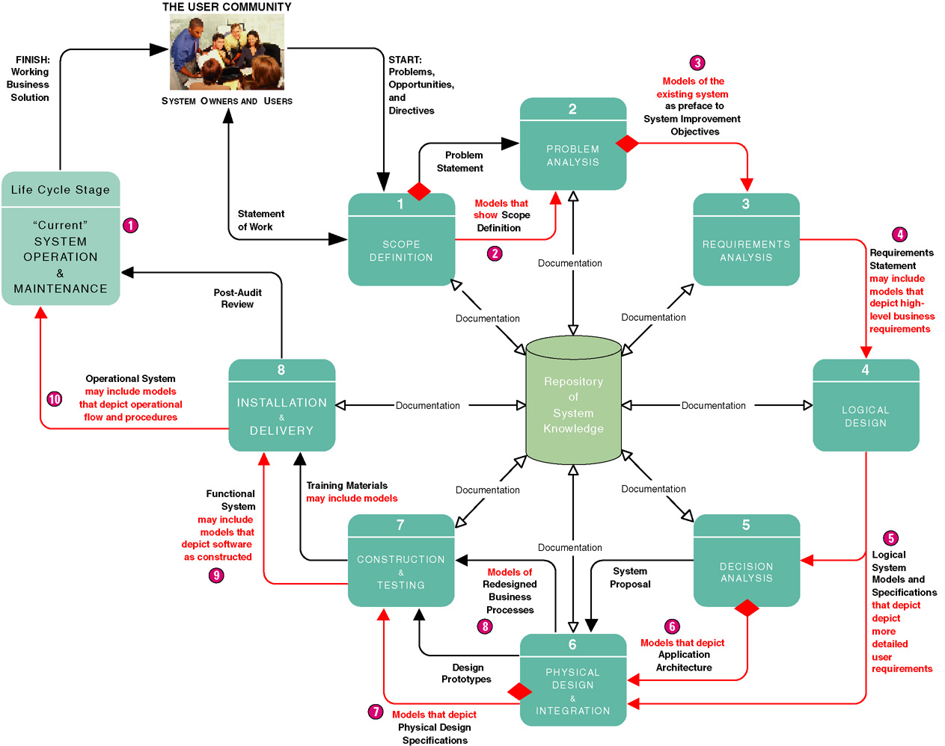
Model-Driven Development Strategy
3-<number>
Notes:
Notes
The model-driven approach (with the notable exception of OOAD) is most commonly associated with the “waterfall” approach to system development. While often criticized for its time and effort intensity, model-driven strategies still work well with large and unstructured problem domains.

Slide 37
Advantages
Disadvantages
Requirements often more thorough
Easier to analyze alternatives
Design specifications often more stable and flexible
Systems can be constructed more correctly the first time
Time consuming
Models only as good as users' understanding of requirements
Reduces users' role because pictures are not software
Can be Inflexible
3-<number>

Slide 38
Model-driven development is most effective for systems for which requirements are well understood and which are so complex that they require large project teams to complete. The approach also works well when fulfillment of user expectations and quality is more important than cost and schedule.
3-<number>

Slide 39
3.3.2 Rapid Application Development Strategy
Rapid application development (RAD) – a system development strategy that emphasizes speed of development through extensive user involvement in the rapid, iterative, and incremental (持续不断增加的）construction of series of functioning prototypes of a system that eventually evolves into the final system.
  Prototype – a small-scale, representative, or working model of the users’ requirements or a proposed design for an information system.
  Time box – the imposition(强迫接受) of a non-extendable period of time, usually 60-90 days, by which the first (or next) version of a system must be delivered into operation.
3-<number>

Slide 40
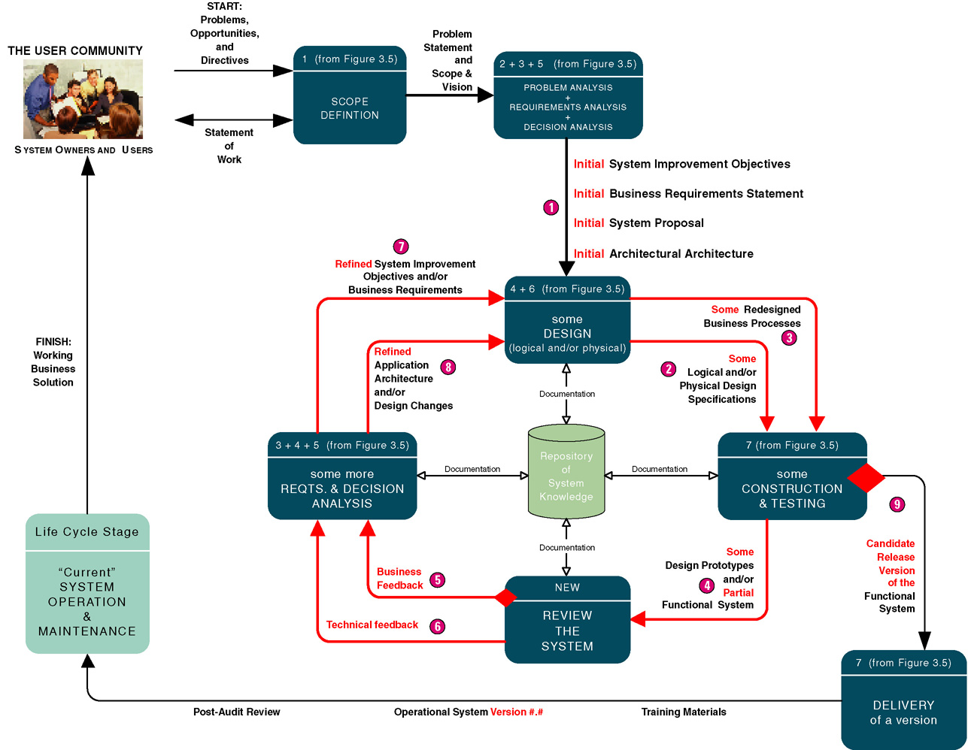
3-<number>
Notes:
Teaching Notes
The rapid application development approach is most commonly associated with an incremental or iterative approach to system development. It is very popular for smaller and relatively structured projects in which requirements are fairly well understood from the beginning of the project.

Slide 41
RAD is most popular for small-to medium-size projects.
3-<number>

Slide 42
3.3.3 Commercial Application Package Implementation Strategy(自学）
Commercial application package – software application that can be purchased and customized to meet business requirements of a large number of organizations or specific industry. A synonym is commercial off-the-shelf (COTS) system.
  Request for proposal (RFP)(建议申报书) – formal document that communicates business, technical, and support requirements for application software package to vendors that may wish to compete for the sale of application package and services.
  Request for quotation (RFQ) (报价申报书)– formal document that communicates business, technical, and support requirements for an application software package to a single vendor that has been determined as being able to supply that application package and services.
  Gap analysis – comparison of business and technical requirements for a commercial application package against capabilities and features of a specific commercial application package to define requirements that cannot be met.
3-<number>
Notes:
Teaching Notes
COTS has become extraordinarily important to aspiring systems analysts because an ever-increasing percentage of all information systems are purchased, not built in-house.
Emphasize to students that tomorrow’s systems analysts will be as likely to participate in a software package selection and integration as they will in a traditional design-and-construction style project.

Slide 43
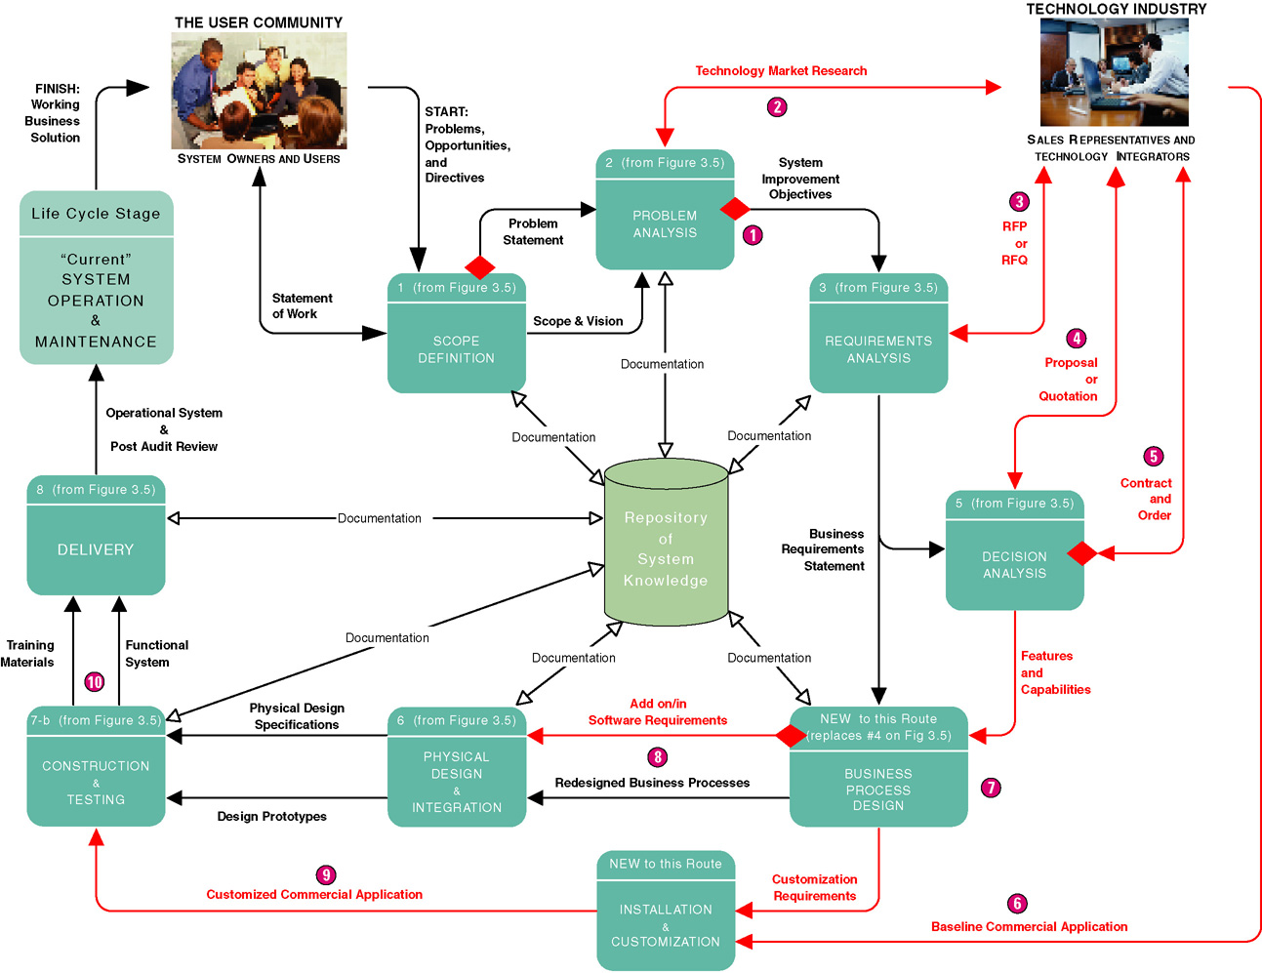
3-<number>
Notes:
Teaching Notes
This slide depicts a typical project to select a software package and then integrate that package into a business (and its other existing information systems).
In the chapter, we specifically omitted ERP applications from this COTS route. ERP applications are so large and complex that their vendors typically provide a custom methodology (and consulting) to implement the ERP solution.
The COTS route looks more complex because few software packages fulfill 100 percent of an organizations requirements. Thus, a COTS project does not preclude traditional analysis, design, and construction activities to supplement capabilities not provided by the chosen software package.
Additionally, most software packages require customization that requires additional requirements analysis, design customization, and programming within the application’s embedded language.

Slide 44
Commercial Application Package Implementation Strategy
Advantages
Disadvantages
Systems usually implemented more quickly
Avoids staffing required to develop in-house solutions
Generally less expensive
Vendor assumes responsibility for improvements and corrections
Many business functions more similar than dissimilar for all businesses in a given industry
Dependent on long-term viability of vendor
Rarely reflects ideal solution
Often resistance to changes business processes to adapt to software
3-<number>

Slide 45
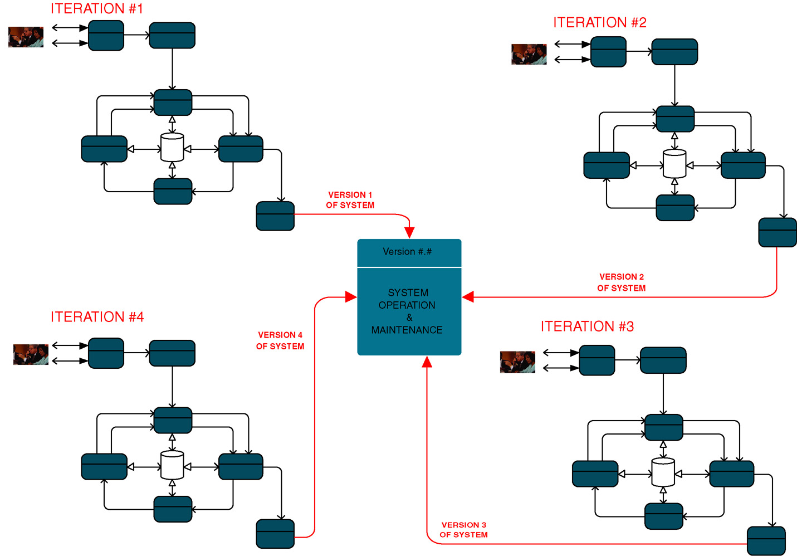
3.3.4 Hybrid Strategies
3-<number>
Notes:
Teaching Notes
This is one possible hybrid strategy using an incremental strategy in combination with rapid application development.

Slide 46
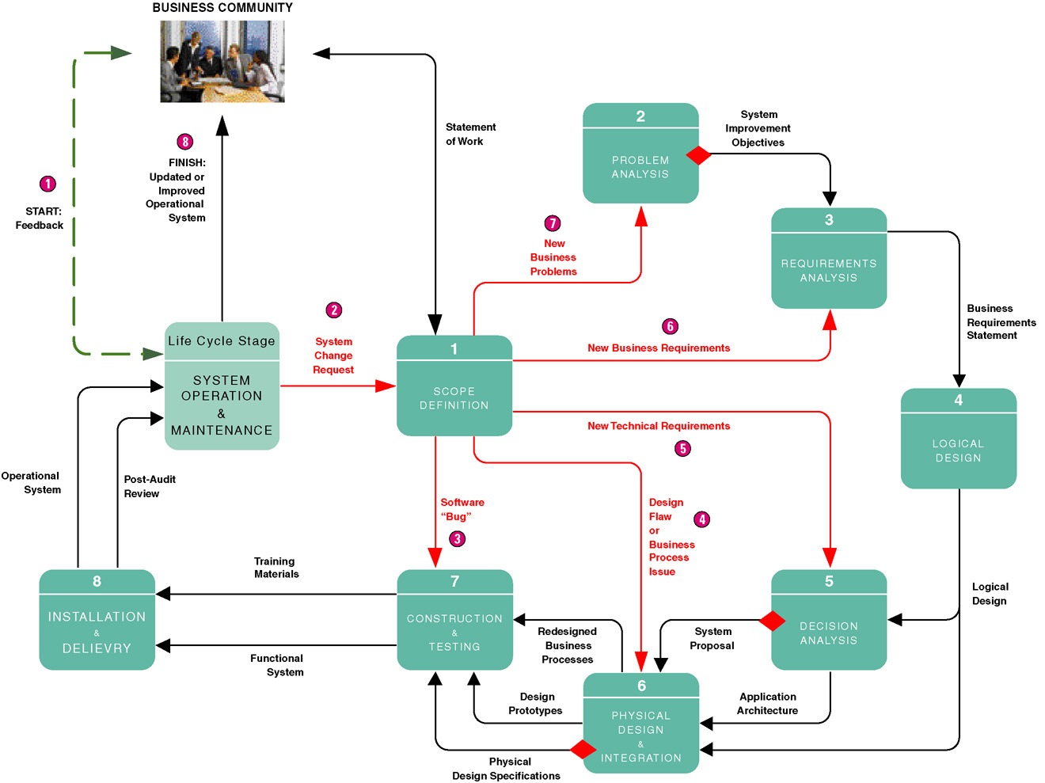
3.3.5 A System Maintenance Perspective
3-<number>

Slide 47
思考题：
1. 在选择开发方法时，不适合使用原型法的情况是（ ）。
A.用户需求不清楚 B. 系统设计方案难以确定
C.系统使用范围变化很大
D. 用户的数据资源缺乏组织和管理
以下情况为不适合使用原型法:
用户的数据资源缺乏组织和管理
用户的软件资源缺乏组织和管理
用户不参与,不积极配合开发过程
3-<number>

Slide 48
思考题：
2. 在开发一个系统时，如果用户对系统目标不很清楚，难以定义需求，这时最好使用什么开发路线？
快速应用开发
模型驱动
3-<number>

Slide 49
3.4 Automated Tools and Technology
Computer-aided systems engineering (CASE)
Application development environments (ADEs)
Process and project managers
3-<number>
Notes:
No additional notes.

Slide 50
3.4.1 Computer-Assisted Software
Engineering (CASE)
Computer-aided systems engineering (CASE) –automated software tools that support the drawing and analysis of system models and associated specifications. Some CASE tools also provide prototyping and code generation capabilities.
  CASE repository – system developers’ database where developers can store system models, detailed descriptions and specifications, and other products of system development. Synonyms: dictionary and encyclopedia.
  Forward engineering – CASE tool capability that can generate initial software or database code directly from system.
  Reverse engineering – CASE tool capability that can generate initial system models from software or database code.
3-<number>
Notes:
Teaching Notes
Different CASE tools may refer to their repository as a dictionary or encyclopedia.
Some CASE tools maintain a repository at a project-by-project level. Others provide or integrate into a project-independent repository to promote sharing of models and specifications between projects.
Most CASE tools interface with one or more ADEs to provide round-trip engineering that supports the full life cycle.
If the students will be using a CASE tool during the semester, this would be a good time to introduce it.

Slide 51
3.4.2 Application Development Environments(自学）
Application development environments (ADEs) – an integrated software development tool that provides all the facilities necessary to develop new application software with maximum speed and quality. A common synonym is integrated development environment (IDE)
  ADE facilities may include:
    Programming languages or interpreters
    Interface construction tools
    Middleware
    Testing tools
    Version control tools
    Help authoring tools
    Repository links
3-<number>

