Slide 1

Information Systems
Analysis and Design
—The aim of the course is knowledge and ability
5-<number>

Slide 2
Chapter 5
System Analysis
5-<number>

Slide 3
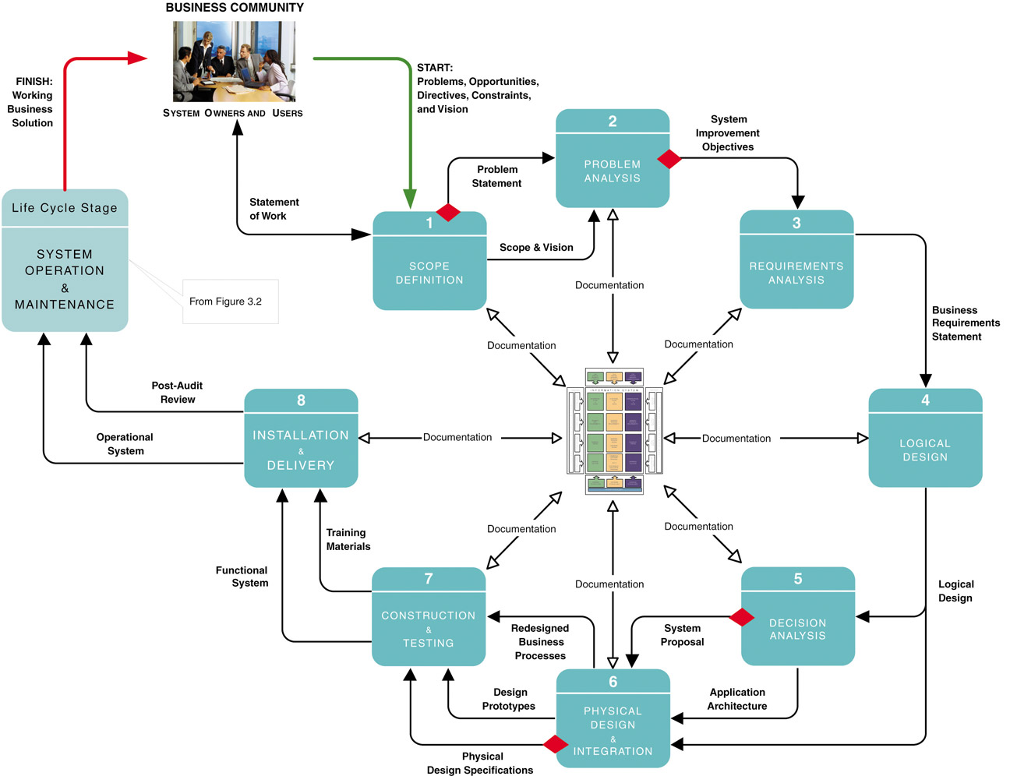
5-<number>

Slide 4
Objectives
Context diagram
Cause-and-effect analysis
Functional requirement and Nonfunctional requirement
Sampling
5-<number>

Slide 5
5.1 What is Systems Analysis ?
  Information systems analysis – those development phases in an information systems development project primarily focus on the business problem and requirements, independent of any technology that can or will be used to implement a solution to that problem.
5-<number>

Slide 6
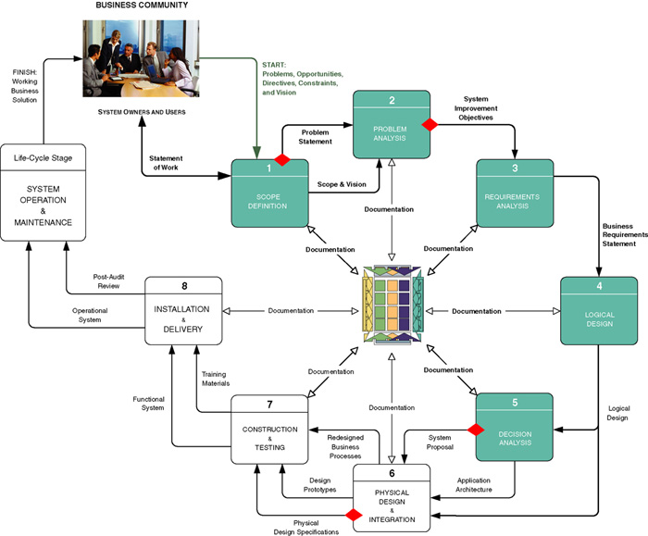
Context of Systems Analysis
5-<number>

Slide 7
5.2 Model-Driven Analysis Methods(自学）
  Model-driven analysis – a problem-solving approach that emphasizes the drawing of pictorial system models to document and validate both existing and/or proposed systems. Ultimately, the system model becomes the blueprint for designing and constructing an improved system.
  Model – a representation of either reality or vision. Since “a picture is worth a thousand words,” most models use pictures to represent the reality or vision.
5-<number>

Slide 8
5.2.1 Model-Driven Approaches
Traditional Approaches
  Structured Analysis
    Focuses on the flow of data through processes
    Key model: data flow diagram
  Information Engineering
    Focuses on structure of stored data
    Key model: entity relationship diagram
Object-Oriented Approach
  integrates data and process concerns into objects
    Object – the encapsulation of the data (called properties) that describes a discrete person, object, place, event, or thing, with all the processes (called methods) that are allowed to use or update the data and properties. The only way to access or update the object’s data is to use the object’s predefined processes.
  Unified Modeling Language (UML)
5-<number>

Slide 9
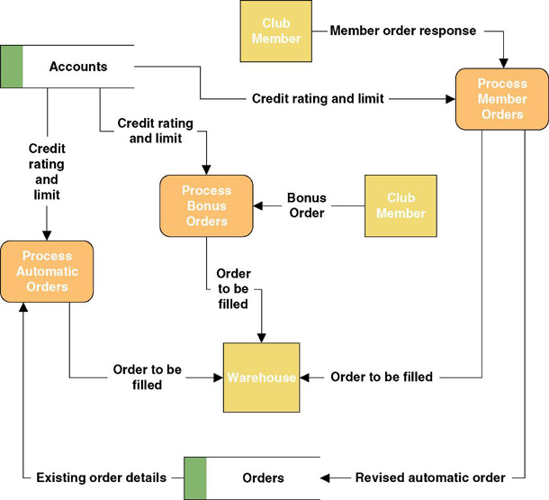
A Simple Process Model
5-<number>

Slide 10
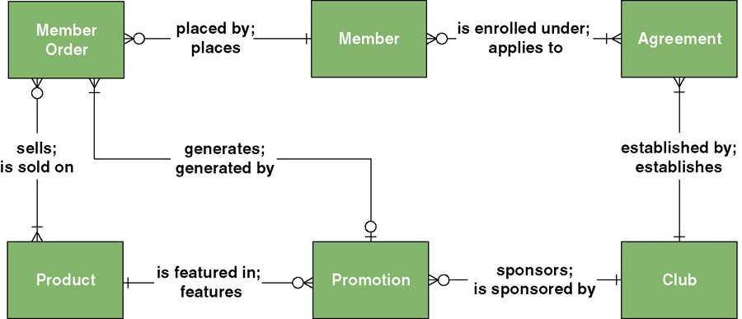
A Simple Data Model
5-<number>
Notes:
Teaching Notes
It is not the intent to teach the tool in this chapter. ERDs will be taught in Chapter 8.

Slide 11
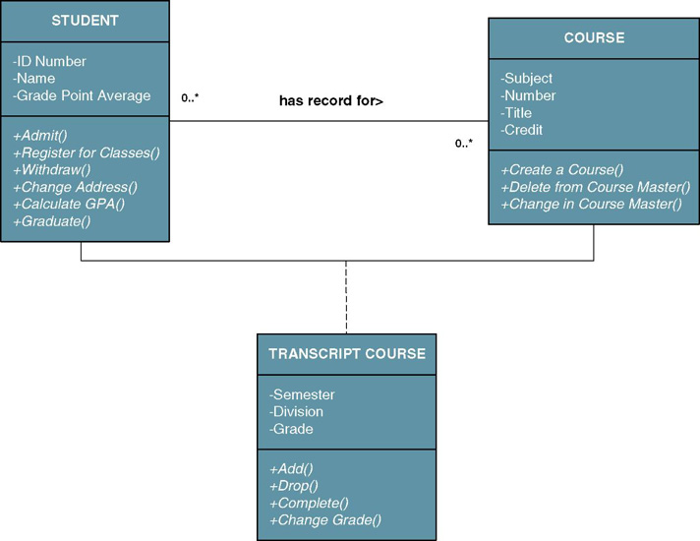
A Simple Object Model
5-<number>
Notes:
Teaching Notes
It is not the intent to teach the tool in this chapter. Object modeling will be taught in Chapters 10 and 18.

Slide 12
5.2.2 Accelerated Systems Analysis（自学）
Accelerated systems analysis approaches emphasize the construction of prototypes to more rapidly identify business and user requirements for a new system.
prototype – a small-scale, incomplete, but working sample of a desired system.
  Accelerated systems analysis approaches
    Discovery Prototyping
    Rapid Architected Analysis
5-<number>
Notes:
Teaching Notes
Prototypes are “incomplete” in that they lack error checking, data validation, security, and processing completeness

Slide 13
Discovery Prototyping
Discovery prototyping – a technique used to identify the users’ business requirements by having them react to a quick-and-dirty implementation of those requirements.
  Advantages
    Prototypes cater to the “I’ll know what I want when I see it” way of thinking that is characteristic of many users and managers.
  Disadvantages
    Can become preoccupied with final “look and feel” prematurely
    Can encourage a premature focus on, and commitment to, design
    Users can be misled to believe that the completed system can be built rapidly using prototyping tools
5-<number>
Notes:
Teaching Notes
Discovery prototyping is sometimes called requirements prototyping.

Slide 14
Rapid Architected Analysis
  Rapid architected analysis – an approach that attempts to derive system models (as described earlier in this section) from existing systems or discovery prototypes.
    Reverse engineering – the use of technology that reads the program code for an existing database, application program, and/or user interface and automatically generates the equivalent system model.
5-<number>

Slide 15
5.2.3 FAST Systems Analysis Phases
Scope Definition Phase
  Is the project worth looking at?
Problem Analysis Phase
  Is a new system worth building?
Requirements Analysis Phase
  What do the users need and want from the new system?
Logical Design Phase
  What must the new system do?
Decision Analysis Phase
  What is the best solution?
5-<number>
Notes:
No additional notes.

Slide 16
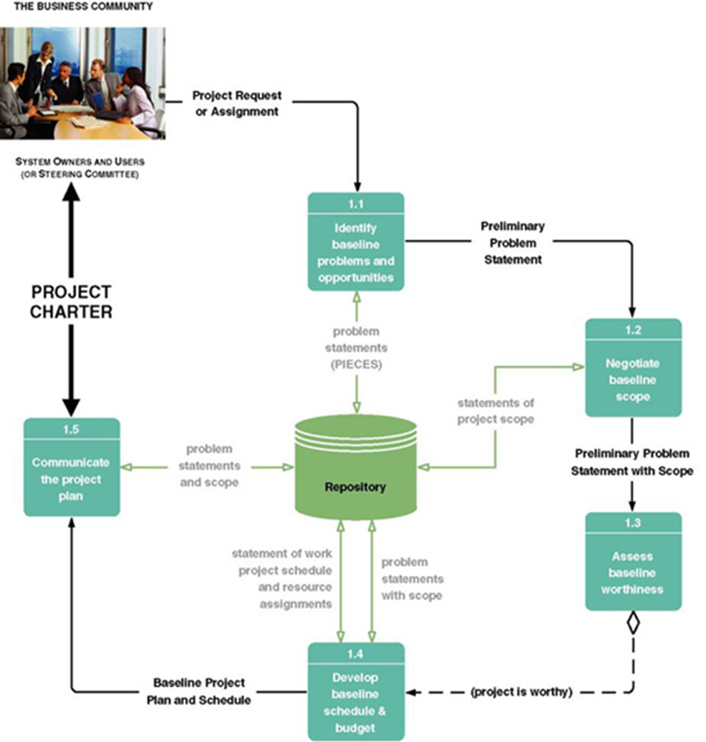
5.3 Tasks for the Scope Definition Phase
5-<number>

Slide 17
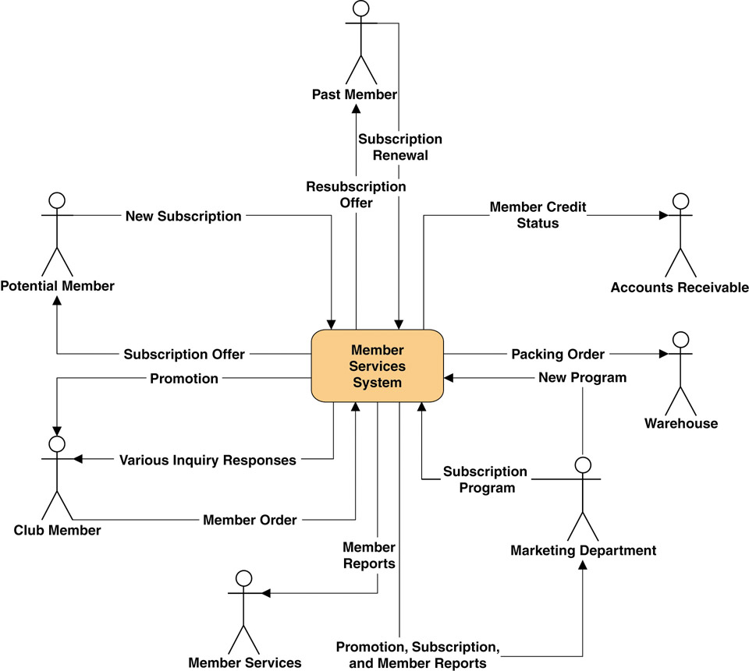
Sample Context Diagram
  Context Diagram – a pictorial model that shows how the system interacts with the world around it and specifies in general terms the system inputs and outputs.
5-<number>

Slide 18
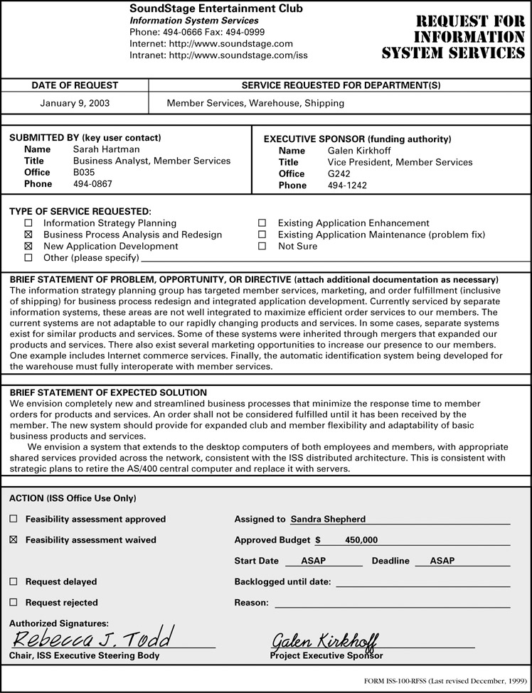
5-<number>
Notes:
Teaching Notes
Not all organizations have a formal document to initiate projects.

Slide 19
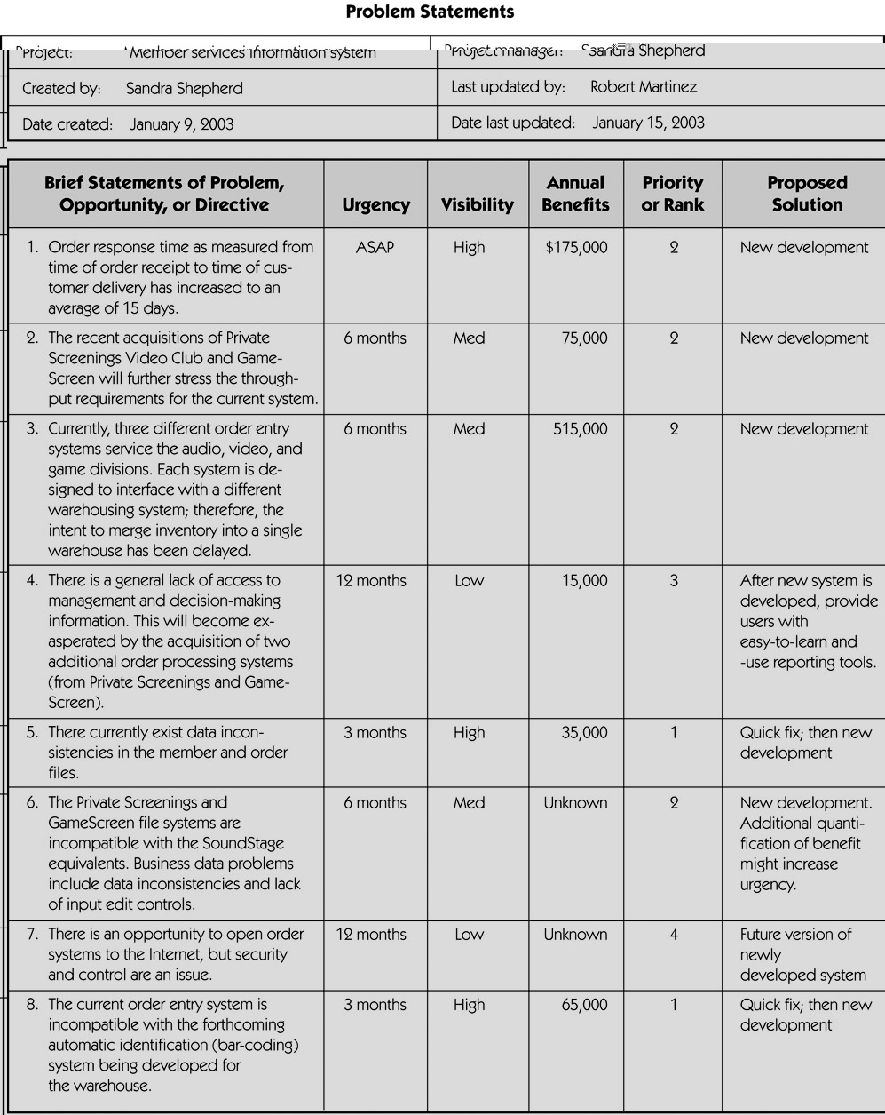
Sample Problem Statements
5-<number>

Slide 20
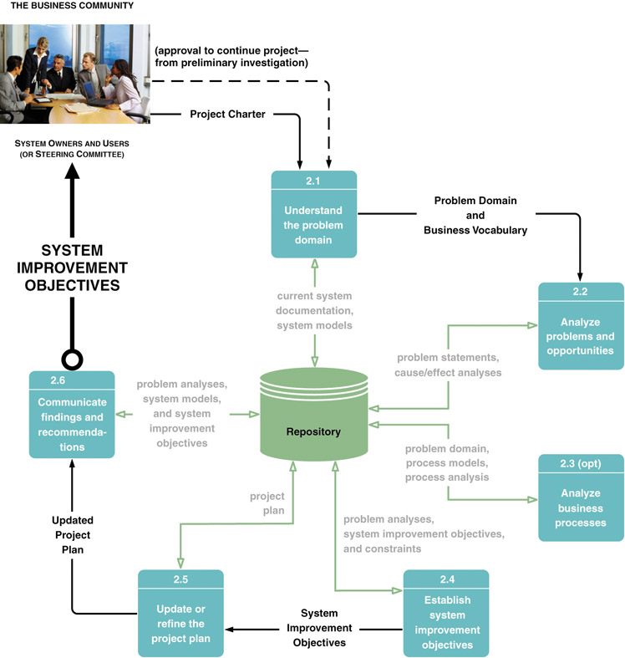
5.4 Tasks of the Problem Analysis Phase
BPR
5-<number>
Notes:
No additional notes

Slide 21
Key Terms of the
Problem Analysis Phase
  Cause-and-effect analysis – a technique in which problems are studied to determine their causes and effects.
    In practice, effects can be symptomatic of more deeply rooted problems which, in turn, must be analyzed for causes and effects until the causes and effects do not yield symptoms of other problems.
Ishikawa Diagram
5-<number>

Slide 22
Ishikawa Diagram P148
Graphical tool used to identify, explore, and depict problems and the causes and effects of those problems. It is often referred to as a cause-and-effect diagram or a fishbone diagram.
  Problem at right (fish head)
  Possible causes drawn as "bones" off main backbone
  Brainstorm for 3-6 main categories of possible causes
5-<number>
Notes:
Teaching Notes
Explain concept to students.
The name of the problem goes at the right of the diagram (the fish’s head).
The possible causes of the problem are drawn as bones off the main backbone, grouped by 4 Ms (Materials, Machines, Manpower [People], and Methods) plus other categories that are appropriate to the problem at hand.
The team can then determine the most likely cause or causes.
Try to do another example during lecture based on a well-known problem that most students experience, such as college class registration.

Slide 23
鱼骨图的类型
整理问题型鱼骨图
各要素与特性之间不存在因果关系，而是结构构成关系
原因型鱼骨图
特性值常以”为什么….”来写
对策型鱼骨图
特性值常以”如何提高/改善”来写
5-<number>

Slide 24
举例: 整理问题型鱼骨图
培训计划实施
培训计划制定
培训项目
师资
教材
课时计划
员工培训
晋升比例
学生反馈
课时跟踪
实际应用
成绩评比
培训监督
结果跟踪
效果评估
5-<number>

Slide 25
举例:对策型
消除燃烧介质
控制火源
降低火灾
完善管理
增加防火设施
5-<number>

Slide 26
举例:原因型
燃烧介质
火源
林地火灾
管理
防火设施
5-<number>

Slide 27
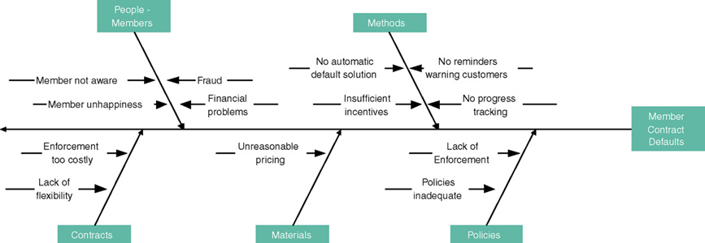
P148
5-<number>

Slide 28
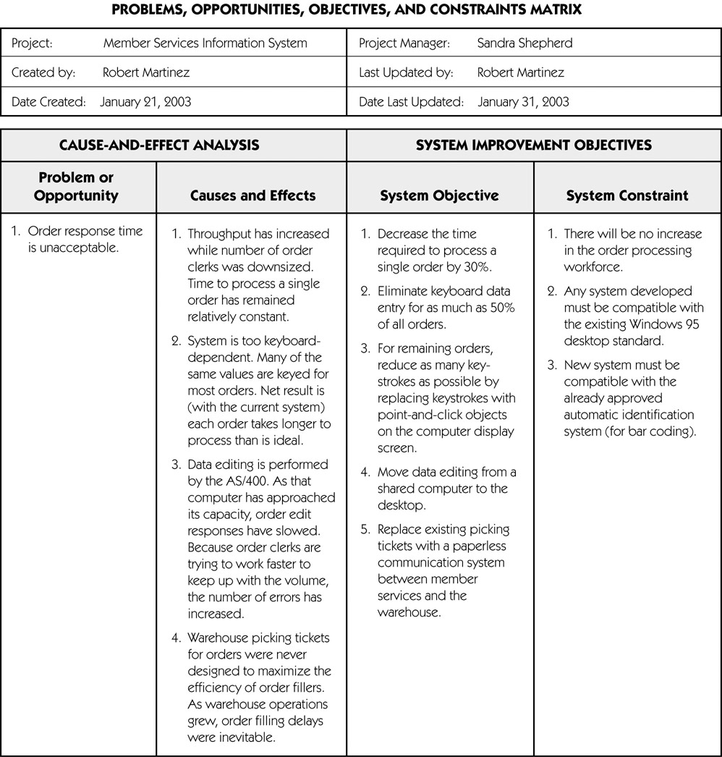
Sample Cause-and-Effect Analysis
5-<number>
Notes:
No additional notes

Slide 29
Key Terms of the
Problem Analysis Phase (cont.)
Objective – a measure of success. It is something that you expect to achieve, if given sufficient resources.
  Reduce the number of uncollectible customer accounts by 50 percent within the next year.
  Increase by 25 percent the number of loan applications that can be processed during an eight-hour shift.
  Decrease by 50 percent the time required to reschedule a production lot when a workstation malfunctions.
Constraint – something that will limit your flexibility in defining a solution to your objectives. Essentially, constraints cannot be changed.
  The new system must be operational by April 15.
  The new system cannot cost more than $350,000.
  The new system must be web-enabled.
  The new system must bill customers every 15 days.
5-<number>

Slide 30
System Improvement Report Outline
Executive summary (approximately 2 pages)
  Summary of recommendation
  Summary of problems, opportunities, and directives
  Brief statement of system improvement objectives
  Brief explanation of report contents
Background information (approximately 2 pages)
  List of interviews and facilitated group meetings conducted
  List of other sources of information that were exploited
  Description of analytical techniques used
Overview of current system (approximately 5 pages)
  Strategic implications (if project is part of or impacts existing IS strategic plan)
  Models of the current system
    Interface model (showing project scope)
    Data model (showing project scope)
    Geographical models (showing project scope)
    Process model (showing functional decomposition only)
5-<number>
Notes:
Teaching Notes
The focus is on system user perspectives.
Requirements can be expressed in narrative, model, and prototype forms, or any combination thereof.

Slide 31
System Improvement Report Outline (cont.)
Analysis of the current system (approx. 5-10 pages)
  Performance problems, opportunities, cause-effect analysis
  Information problems, opportunities, cause-effect analysis
  Economic problems, opportunities, cause-effect analysis
  Control problems, opportunities, cause-effect analysis
  Efficiency problems, opportunities, cause-effect analysis
  Service problems, opportunities, and cause-effect analysis
Detailed recommendations (approx. 5-10 pages)
  System improvement objectives and priorities
  Constraints
  Project Plan
    Scope reassessment and refinement
    Revised master plan
    Detailed plan for the definition phase
Appendixes
  Any detailed system models
  Other documents as appropriate
5-<number>
Notes:
No additional notes

Slide 32
阅读以下关于需求分析的叙述，回答问题：
某软件企业为网络音像制品销售公司W重新开发一套影音
产品在线管理及销售系统，以改进原有系统AVMSS中存在
的问题。在系统需求分析阶段，完成的工作包括：
1. 系统分析员老王利用PIECES框架组织了系统需求，如下表：
需求类型 | 需要获取的需求
性能(performance) | (a)
信息（information） | (b)
经济（Economics） | (c)
控制（Control） | (d)
效益（Efficiency） | (e)
服务（Service） | (f)
5-<number>

Slide 33
2. 项目组小赵从W公司客户代表处了解到现有系统中经常会有会员拒绝履行订单，并将其作为问题记录下来。老王指出了小赵并未发现系统真正的问题，并以会员拒绝履行订单为例，利用下图所示的鱼骨图分析了系统中真正存在的问题。
人
方法
g h
I j
会员拒绝履行合同
k i
m
n
合同
材料
制度
5-<number>

Slide 34
3. 获取需求后, 记录下来形成需求文档，同其他项目信息合并形成需求陈述，作为需求分析阶段最终的交付成果。
【问题1】PIECES框架的主要作用是什么？将以下需求
(1)~(8)根据PIECES框架分类并将序号填入表的单元格内。
（1）系统能否采用新方法降低使用资源的成本？
（2）系统可接受的吞吐率是多少？
（3）系统可接受的响应时间是多少？
（4）应该减少多少开支或增加多少效益？
（5）对用户隐私有什么要求？
（6）对系统的可靠性和可用性有什么要求？
（7）系统中需要包括哪些文档和培训材料？
（8）对外部系统的接口是什么？
5-<number>

Slide 35
【问题2】 请将下列问题按照不同的类型序号填入鱼骨图
(g)~(n)中 。
缺少强制履行合同的规定；
合同相关信息没有通知会员；
没有催单提示客户；
没有跟踪执行情况；
设备成本太高造成价格不合理；
合同履行缺乏灵活性；
财务问题或者隐瞒相关内容；
价格太高并且无法修改。
5-<number>

Slide 36
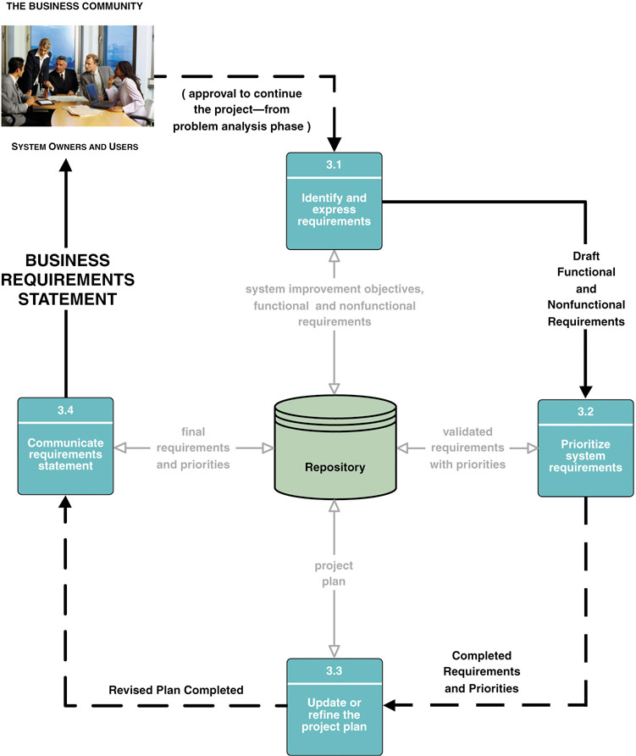
5.5 Requirements Analysis Phase Tasks
5-<number>
Notes:
Teaching Notes
Some of the tasks are completed in parallel.

Slide 37
Key Terms of
Requirements Analysis Phase
  Functional requirement – a description of activities and services a system must provide.
    inputs, outputs, processes, stored data
  Nonfunctional requirement – a description of other features, characteristics, and constraints that define a satisfactory system.
    Performance, ease of learning and use, budgets, deadlines, documentation, security, internal auditing controls
5-<number>
Notes:
Teaching Notes
It is not that functional requirements are mandatory and nonfunctional requirements are optional. The list of example nonfunctional requirements includes mandatory items.
The difference is that functional requirements describe functions that the system must perform. Nonfunctional requirements are not functions to be done but qualities that the system must have if it is to be successful.

Slide 38
非功能需求定义了对系统提供的服务或功能的约束，包括时间约束、空间约束、开发过程约束及应遵循的标准等。
  性能要求：要求系统能满足100个人同时使
  用，页面反应时间不能超过6秒；
  可靠性： 系统能7×24小时连续运行，要求
  能快速的部署，特别是在系统出
  现故障时，能够快速的切换到备
  用设备。
5-<number>

Slide 39
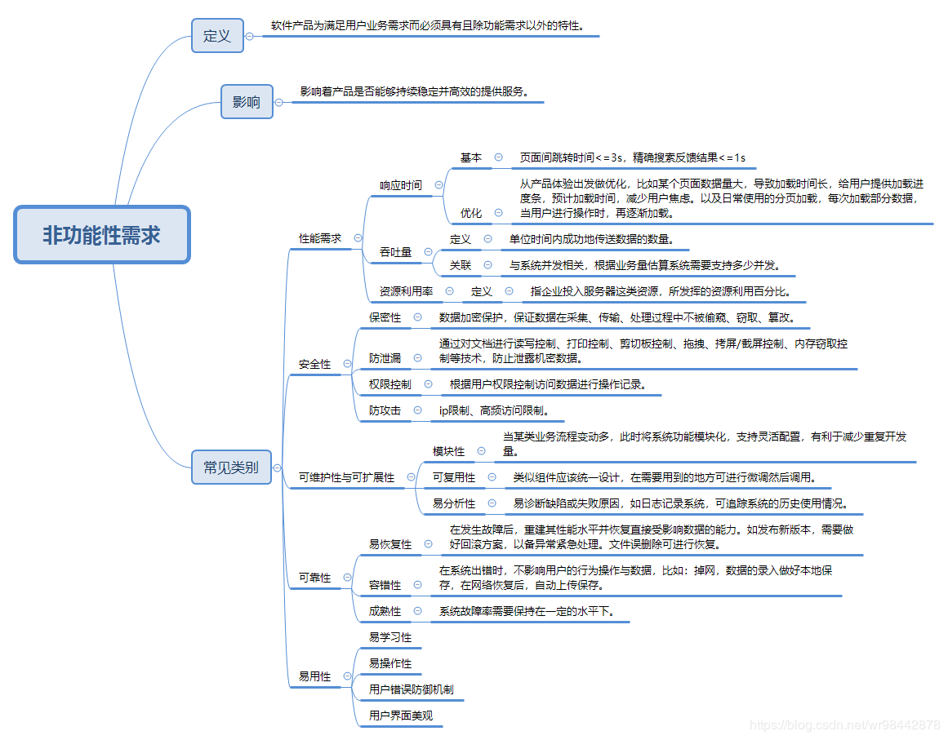
5-<number>

Slide 40
响应时间：
  在95％的情况下，一般时段响应时间不超过1.5秒，高峰时段不超过4秒。
  定位系统从点击到第一个界面显示出来所需要的时间不得超过300毫秒。
  在网络畅通时，电子地图刷新时间不超过10秒。
  在推荐配置环境下：登录响应时间在2秒内，刷新栏目响应时间在2秒内，刷新条目分页列表响应时间2秒内，打开信息条目响应时间1秒内，刷新部门、人员列表响应时间2秒内。
  在非高峰时间根据编号和名称特定条件进行搜索，可以在3秒内得到搜索结果。
5-<number>

Slide 41
业务量：
  每日最大成交数3000笔业务。
  平均交易并发数为20，最大交易并发数为50。
  估计用户数为1万人，每天登录用户数为3000左右.
  网络的带宽为100M带宽。
  系统可以同时满足10,000个用户请求，并为25,000个并发用户提供浏览功能。
5-<number>

Slide 42
系统容量需求描述：
  支持3万用户，支持GB级数据。
  数据库表行数不超过100万行，数据库最大容量不超过1000GB，磁盘空间至少需要40G以上。
资源使用率：CPU占用率<=50%,内存占用率<=50%
易用性需求描述：
  在引入该产品的3个月内，60％的用户应该可以在45秒内用它来完成转账的任务，失败率控制在万分之一以内。
  60％的用户在第一次看见该产品的5秒内，就会意识到这是**银行的网银。
  80%的用户在接受一个2小时的系统介绍培训后，可以在5分钟之内成功预订房间。
5-<number>

Slide 43
安全需求：
  用户在经过身份认证后，只能访问其权限范围内的数据，只能进行其权限范围内的操作。
  不同的用户具有不同的身份和权限，要确保数据的机密性和完整性。
  提供运行日志管理及安全审计功能，可追踪系统的历史使用情况。能经受来自互联网的一般性恶意攻击。如病毒（包括木马）攻击、口令猜测攻击、黑客入侵等。至少99%的攻击需要在10秒内检测到。
5-<number>

Slide 44
可靠性需求：
  对输入有提示，数据有检查，防止数据异常。
  系统健壮性强，应该能处理系统运行过程中出现的各种异常情况，如：人为操作错误、输入非法数据、硬件设备失败等，系统应该能正确的处理，恰当的回避。因软件系统的失效而造成不能完成业务的概率要小于5‰。要求系统7x24小时运行，全年持续运行故障停运时间累计不能超过10小时。系统缺陷率每1,000小时最多发生1次故障。在1,000,000次交易中，最多出现1次需要重新启动系统的情况。
5-<number>

Slide 45
兼容性需求：
  系统应支持IOS，Android , windows操作系统;系统应支持Oracle, DB2 数据库系统;最多只有5%的系统实现需要具体到特定的操作系统。替换关系数据库系统的平均时间不超过2小时，并且保证没有数据丢失。
数据保密需求：
  网络传递数据应经过加密。需要保证数据在采集、传输和处理过程中不被偷窥、窃取、篡改。业务数据需要在存储时进行加密，确保不可破解。
5-<number>

Slide 46
可维护性需求：
  从接到修改请求后，对于普通修改应在1~2天内完成；对于评估后为重大需求或设计修改应在1周内完成。90%的BUG修改时间不超过1个工作日，其他不超过2个工作日。代码的复杂度（圈）必须在10以内。任何对象的任何方法都不允许超过200行代码。安装新版本必须保持所有的数据库内容和所有个人设置不变。产品必须提供可跟踪任何数据库字段的工具。
5-<number>

Slide 47
例：
如何输入有关航班、乘客及订票信息。
输入什么信息要出现在机票和报告中。
输出如何计算乘机费用。
计算什么信息必须存储在旅行社和其他人访问的数据库中。
数据存储这个系统应该设计成可以处理常旅客计划。
这个系统在任何时候都必须是可用的。一周中只允许有2分钟宕机时间。
功能性
功能性
功能性
功能性
非功能性：可扩展性
非功能性：可靠性
5-<number>

Slide 48
Key Terms of Requirements Analysis Phase (cont.)
  Use case – a business event for which the system must provide a defined response. Use cases evolved out of object-oriented analysis; however, their use has become common in many other methodologies for systems analysis and design.
5-<number>
Notes:
No additional notes.

Slide 49
Key Terms of Requirements Analysis Phase (cont.)
Timeboxing – a technique that delivers information systems functionality and requirements through versioning.
  The development team selects the smallest subset of the system that, if fully implemented, will return immediate value to the systems owners and users.
  That subset is developed, ideally with a time frame of six to nine months or less.
  Subsequently, value-added versions of the system are developed in similar time frames.
  A mandatory requirement is one that must be fulfilled by the minimal system, version 1.0
  A desirable requirement is one that is not absolutely essential to version 1.0. It may be essential to the vision of a future version.
5-<number>
Notes:
No additional notes

Slide 50
5.6 Process of Requirements
Discovery (6.2)
Problem discovery and analysis
Requirements discovery
Documenting and analyzing requirements
Requirements management
5-<number>
Notes:
Teaching notes
The process of requirements discovery consists of four activities.

Slide 51
5.7 Fact Finding (6.3 自学)
Sampling of existing documentation, forms, and databases.
Research and site visits.
Observation of the work environment.
Questionnaires.
Interviews.
Prototyping.
Joint requirements planning (JRP).
5-<number>
Notes:
Teaching Notes
Stress that fact-finding is a technique that is used across the entire development cycle but it is extremely critical in the requirements analysis phase.
Be sure to discuss the role of ethics during the fact-finding activity.

Slide 52
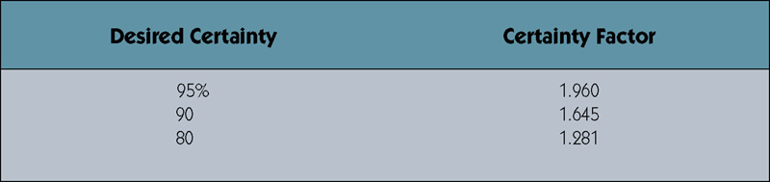
Determining Sample Size for Forms
P151
Sample Size = 0.25 x (Certainty factor/Acceptable error) ²
Sample Size = 0.25(1.645/0.10) ² = 68
Sample Size =0.10(1 – 0.10)(1.645/0.10)² = 25
Or if analyst knows 1 in 10 varies from norm.
p(1-p)
P:差异发票的比率
Certainty factor from certainty table. 10% acceptable error.
5-<number>
Notes:
Teaching Notes
Two versions of the sampling formula are provided in the textbook. The first uses a heuristic (.25) to calculate the sample size and the second replaces the (.25) with p(1-p) to reflect the knowledge of errors in the sample population. Review each with students and calculate various sample sizes using different levels of certainty.

Slide 53
Sampling Techniques
Randomization(随机) – a sampling technique
characterized by having no predetermined
pattern or plan for selecting sample data.
Stratification(分层) – a systematic sampling technique that attempts to reduce the variance (方差)of the estimates by spreading out the sampling—for example, choosing documents or records by formula—and by avoiding very high or low estimates.
5-<number>
Notes:
Teaching Notes
For randomization you just randomly choose the number of sample items based on the sample size calculated.
For computerized files, stratification sampling can be executed by writing a simple program. For instance, suppose invoices were stored in a database that had a volume of approximately 250,000. If the required sample size was 25, a program could be written that prints every 10,000th record (=250,000/25).

