Slide 1
Chapter 7
Use Case Model
7-<number>

Slide 2
Objectives
Describe the benefits of use-case modeling.
Define actors and use cases and be able to identify them from context diagrams and other sources.
Describe the relationships that can appear on a use-case model diagram.
Describe how to construct a use-case model diagram.
Describe the various sections of a use-case narrative and be able to prepare one.
Define the purpose of the use-case ranking and priority matrix and the use-case dependency diagram.
7-<number>
Notes:
Chapter 7 objectives.

Slide 3
7.1 An Introduction to Use-Case
Modeling
One of the primary challenges is the ability to elicit the correct and necessary system requirements from the stakeholders and specify them in a manner understandable to them so those requirements can be verified and validated.（证实和验证）
The hardest single part of building a software system is deciding precisely what to build. No other part of the conceptual work is a difficult as establishing the detailed technical requirements, including all the interfaces to people, to machines, and to other software systems. No other work so cripples the resulting system if done wrong. No other part is more difficult to rectify later. Fred Brooks
7-<number>

Slide 4
User-Centered Development and Use-Case Modeling
User-centered development – a process of systems development based on understanding the needs of the stakeholders and the reasons why the system should be developed.
Use-case modeling – the process of modeling a system’s functions in terms of business events, who initiated the events, and how the system responds to those events.
  Use-case modeling has roots in object-oriented modeling.
  Gaining popularity in non-object development environments because of its usefulness in communicating with users.
  Compliments traditional modeling tools.
7-<number>

Slide 5
Benefits of Use-Case Modeling
Provides tool for capturing functional requirements.
Assists in decomposing system into manageable pieces.
Provides means of communicating with users/stakeholders concerning system functionality in language they understand.
Provides means of identifying, assigning, tracking, controlling, and management system development activities.
Provides aid in estimating project scope, effort, and schedule.
7-<number>
Notes:
Teaching Notes
Using use-case modeling encourages user involvement.
By the same token, for use cases to be successful participation by the user is imperative.

Slide 6
Benefits of Use-Case Modeling (continued)
Aids in defining test plans and test cases.
Provides baseline for user documentation.
Provides tool for requirements traceability.
Provides starting point for identification of data objects or entities.
Provides specifications for designing user and system interfaces.
Provides means of defining database access requirements.
Provides framework for driving the system development project.
7-<number>
Notes:
Teaching Notes
Using use-case modeling encourages user involvement.
By the same token, for use cases to be successful participation by the user is imperative.

Slide 7
7.2 System Concepts for
Use-Case Modeling
Use case – a behaviorally related sequence of steps both automated and manual, for the purpose of completing a single business task.
  Description of system functions from the perspective of external users in terminology they understand.
Use-case diagram – a diagram that depicts the interactions between the system and external systems and users.
  graphically describes who will use the system and in what ways the user expects to interact with the system.
Use-case narrative – a textual description of the business event and how the user will interact with the system to accomplish the task.
7-<number>

Slide 8
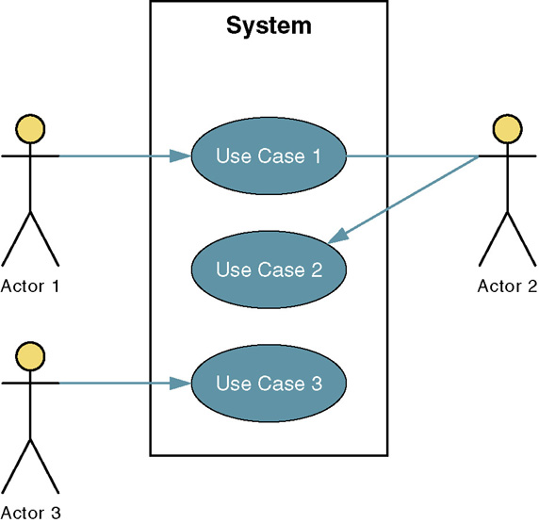
Sample Use-Case Model Diagram
7-<number>
Notes:
Teaching Notes
Definitions for these symbols are on the next slide.

Slide 9
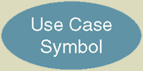
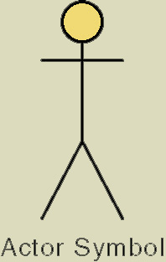
7.2.1 Basic Use-Case Symbols
Use case – subset of the overall system functionality
  Represented by a horizontal ellipse with name
  of use case above, below, or inside the ellipse.
Actor – anyone or anything that needs to interact with the system to exchange information.
  human, organization, another information system,
  external device, even time.
Temporal event – a system event triggered by time.
  The actor is time.
7-<number>
Notes:
Teaching Notes
Use cases are the results of deconstructing the scope of system functionality into many smaller statements of system functionality.
Use cases describe the system functions from the perspective of external users and in the manner and terminology in which they understand.
An actor initiates system activity, a use case, for the purpose of completing some business task. An actor represents a role fulfilled by a user interacting with the system and is not meant to portray a single individual or job title.
Have students provide examples of temporal events (nightly download, monthly billing, etc.).

Slide 10
Four Types of Actors
Primary business actor
  The stakeholder that primarily benefits from the execution of the use case.
  e.g. the employee receiving the paycheck
Primary system actor
  The stakeholder that directly interfaces with the system to initiate or trigger the business or system event.
  e.g. the bank teller entering deposit information
External server actor
  The stakeholder that responds to a request from the use case.
  e.g. the credit bureau authorizing a credit card charge
External receiver actor
  The stakeholder that is not the primary actor but receives something of value from the use case.
  e.g. the warehouse receiving a packing slip
7-<number>

Slide 11
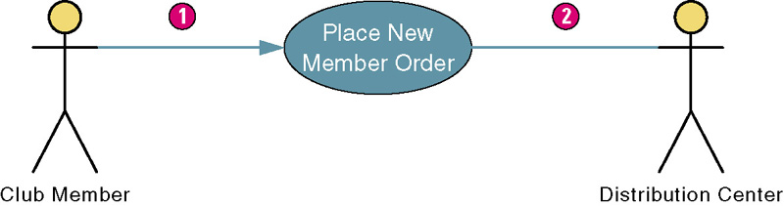
Use Case Association Relationship
Association – a relationship between an actor and a use case in which an interaction occurs between them.
  Association modeled as a solid line connecting the actor and the use case.
  Association with an arrowhead touching the use case indicates that the use case was initiated by the actor. (1)
  Association lacking arrowhead indicates a receiver actor. (2)
  Associations may be bidirectional or unidirectional.
7-<number>
Notes:
Teaching Notes
Most of the use case diagrams in this chapter shown only the primary system actor. This one also shows the external receiver actor. Use cases can be drawn to show some or all actors.

Slide 12

例： ATM机系统
查询
缴费
取款
转账
7-<number>

Slide 13
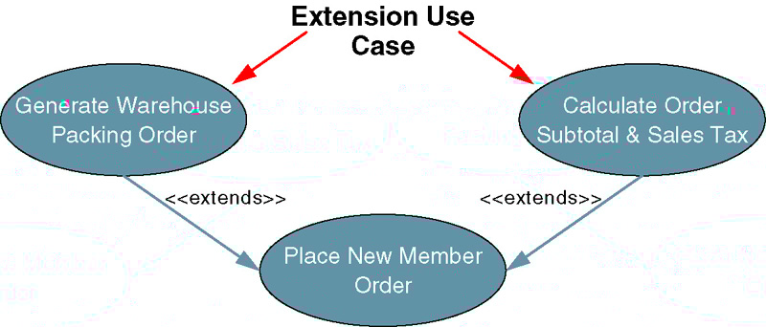
Use Case Extends Relationship
Extension use case –use case consisting of steps extracted from another use case to simplify the original.
  Extends the functionality of the original use case.
  Extends relationship represented as arrow beginning at the extension use case and pointing to use case it is extending.
  Labeled <<extends>>.
7-<number>
Notes:
Teaching Notes
An extension use case is employed to simplify another use case. An extension use case may have an extends relationship to one or more other use cases.

Slide 14
可以出于以下几个目的使用扩展用例：
表明用例的某一部分是可选（或可能可选）的系统行为。这样，可以将模型中的可选行为和必选行为分开。
可以在基本用例中的扩展点处插入的行为段（以及插入的顺序）将取决于在执行基本用例时与参与者进行的交互。
表明只在特定条件（有时是例外条件）下才执行分支流，如触发警报。
7-<number>

Slide 15
例: 对于电话业务，可以在基本通话(Call)业务上扩展出一些增值业务如：呼叫等待(Call Waiting)和呼叫转移(Call Transfer)。
Call
<<extends>>
<<extends>>
customer
Call Waiting
Call Transfer
7-<number>

Slide 16
还书
《extends》
《extends》
《extends》
赔偿遗失书
罚款超期书
赔偿损坏书
7-<number>

Slide 17
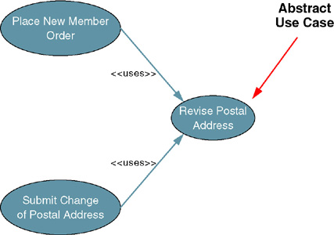
Use Case Uses Relationship
Abstract use case (使用，包含）– use case that reduces redundancy in two or more other use cases by combining common steps found in both.
包含关系意味着基用例显式地在其指定位置将另一个用例包含进来，使其成为自己的行为的一部分。在具备包含关系的两个用例中，被包含的那个用例不能单独存在，它只能以实例的形式存在于包含它的用例之中。
7-<number>
Notes:
Teaching Notes
If your students have programming experience you can compare abstract use cases to programming code that is placed in public functions or classes. An abstract use case has a uses relationship to two or more other use cases.

Slide 18
Use Case Uses Relationship
包含关系典型的应用就是复用。将程序的某一段算法封装成一个子过程，然后再从主程序中调用这一子过程。
网络申购定期定额基金
<<uses>>
电子邮件交易通知
网络申购单笔基金
<<uses>>
7-<number>

Slide 19

例：银行ATM机
查询
《includes》
缴费
身份验证
打印回执
《extends》
客户
取款
转账
7-<number>
Notes:
No additional notes.

Slide 20
Use Case Relationship generalization
当多个用例共同拥有一种类似的结构和行为时，可以将他们的共性抽象成为父用例，其他的用例作为泛化关系的子用例。
子用例从父用例处继承行为和属性，还可以添加行为或覆盖、改变已继承的行为。
在用例的泛化关系中，子用例是父用例的一种特殊形式，它继承了父用例的所有结构、行为、关系。其中三角箭头指向父用例。在任何使用基用例的地方都可以用子用例来代替。
本地注册
用户注册
网上注册
扩展侧重表示扩展用例的触发不定性
泛化侧重表示子用例间的互斥性，父用例通常是抽象的。
7-<number>

Slide 21
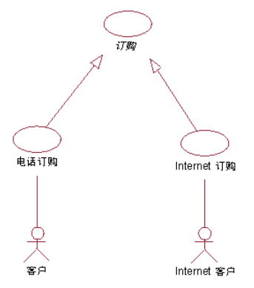
Use Case Relationship generalization
在订单管理系统中，“电话订购”和“Internet 订购”两个用例在结构和行为上存在很多的共同点。
而一般用例“订购”是根据结构和公有行为的定义来定义的。虽然抽象用例“订购”本身无须完整，但是它提供了一个大体的、通过子用例进行完善的行为框架。
7-<number>

Slide 22
泛化表示类似于术语“继承”或“多态”。
UML中的Use Case泛化过程是将不同Use Case之间的可合并部分抽象成独立的父Use Case，并将不可合并部分单独成各自的子Use Case；
包含以及扩展过程与泛化过程类似，但三者对用例关系的优化侧重点是不同的：
-- 泛化侧重表示子用例间的互斥性；
-- 包含侧重表示被包含用例对Actor提供服务的间接性
-- 扩展侧重表示扩展用例的触发不定性；
7-<number>

Slide 23
现有两个用例UC1和UC2.其中UC2是一个完整的用例,可被实例化,而UC1需要UC2中的事件流才可被实例化,且UC1指定了UC2的精确位置,则UC1和UC2间的关系是___。
UML用例图展示了各类actor与系统所提供的用例之间的连接。在银行储蓄管理信息系统中，不属于外部actor的是___。
A. 存折 B. 银行工作人员
C. 储蓄客户 D. 数据库
7-<number>

Slide 24
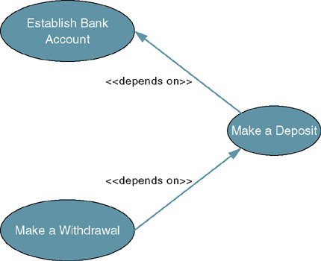
Use Case Depends On Relationship
Depends On – use case relationship that specifies which other use cases must be performed before the current use case.
  Can help determine
  sequence in which
  use cases need to
  be developed.
  Depicted as arrow
  beginning at one
  use case and
  pointing to use case
  it depends on.
  Labeled
  <<depends on>>.
7-<number>
Notes:
Teaching Notes
Identifying use case dependencies is discussed at the end of the chapter. It is useful when using build cycles to build the system in successive versions.

Slide 25
Use Case Inheritance Relationship
Inheritance – a use case relationship in which the common behavior of two actors initiating the same use case is extrapolated and assigned to a new abstract actor to reduce redundancy.
  Other actors can inherit the interactions of the abstract actor.
  Depicted as an arrow beginning at one
  actor and pointing to the abstract actor whose
  interactions the first actor inherits.
7-<number>
Notes:
Teaching Notes
Inheritance is depicted on the next slide.

Slide 26
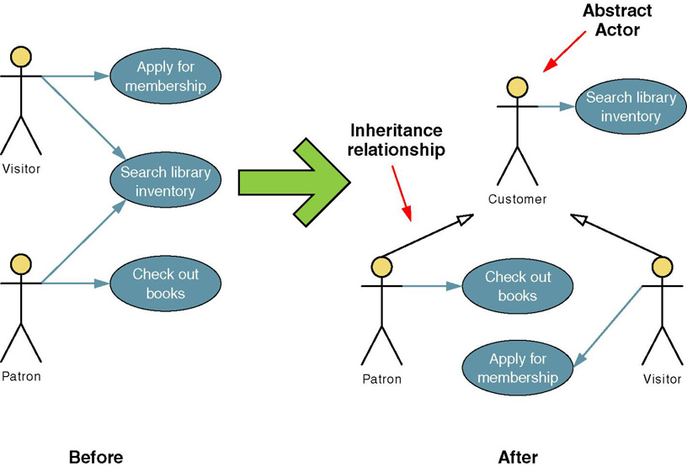
Use Case Inheritance Relationship
资助人
7-<number>
Notes:
Teaching Notes
Walk through the Before and After of this figure.
Students should understand that though we have added an actor, we have decreased the interactions we have to model.

Slide 27
class customer{
……
void searchlibraryinventory (){
…….
}
}
class patron extends customer{ …….
checkoutbooks() {
} }
class visitor extends customer{…….
applyformembership() {
}
7-<number>

Slide 28
例：棋牌馆管理系统
1. 客户通过Internet预订座位，在“预订座位” 的执行过程中，将“检查座位信息”，如果没有空闲的座位或满意的座位，可以选择进入等候队列（“处理等候队列”） 。
2. 总台服务员在客户到棋牌馆时，启动“安排座位” ，在执行过程中，将 “检查座位信息”。
3. 当客户要离开棋牌馆时，总台服务员将 “处理结账” ，并且定义了两种“收款”方式 ，一个是“处理现金结账”，另一个是“处理银行卡结账”，而后一个用例将通过与外部系统“银联POS系统”交互来完成。
7-<number>

Slide 29
预定座位
《extends》
处理等侯队列
客户
《Includes》
安排座位
检查座位信息
《Includes》
职员
总台服务员
处理现金结账
处理结账
处理银行结账
银行系统
7-<number>

Slide 30
获取用例的步骤
⑴找出系统外部的参与者和外部系统，确定系统的边界和范围。
⑵确定每一个参与者所期望的系统行为
⑶把这些系统行为命名为用例
⑷使用关联、包含、扩展等关系处理系统行为的公共或变更部分
⑸编制每一个用例的脚本
⑹绘制用例图
⑺区分基本事件流和异常情况的事件流，如有需要可以把表示异常情况的事件流作为单独的用例来处理
⑻细化用例图，解决用例间的重复与冲突。
7-<number>

Slide 31
7.3 The Process of Requirements
Use-Case Modeling
Objective is to elicit and analyze enough requirements information to prepare a model that:
  Communicates what is required from a user perspective.
  Is free of specific details about how system will be implemented.
Steps
  Identify business actors.
  Identify business use cases.
  Construct use-case model diagram.
  Documents business requirements use-case narratives.
7-<number>

Slide 32
Step 1: identify Business Actors
When looking for actors, ask the following questions:
  Who or what provides inputs to the system?
  Who or what receives outputs from the system?
  Are interfaces required to other systems?
  Are there events that are automatically triggered at a predetermined time?
  Who will maintain information in the system?
Actors should be named with a noun or noun phrase
7-<number>

Slide 33
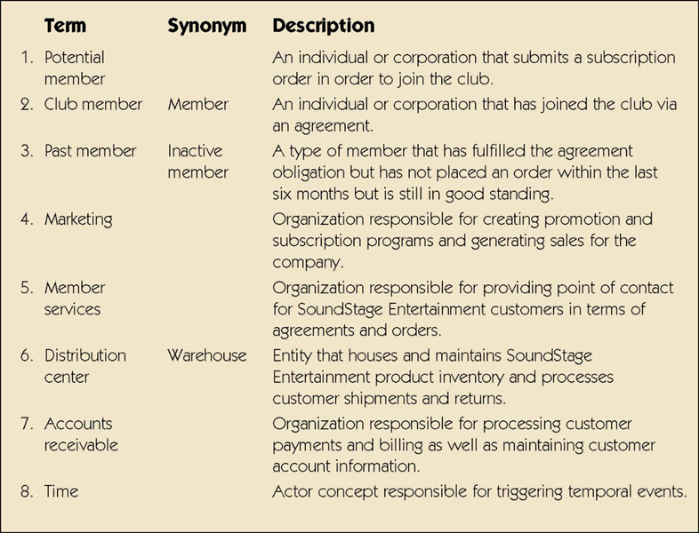
Sample List of Actors
7-<number>
Notes:
Teaching Notes
The can be called an actor glossary.

Slide 34
Step 2: Identify Business Requirements Use Cases
Business Requirements Use Case - a use case created during requirements analysis to capture the interactions between a user and the system free of technology and implementation details.
  During requirements analysis, strive to identify and document only the most critical, complex, and important use cases, often called essential use cases.(基本用例)
7-<number>
Notes:
No additional notes.

Slide 35
Step 2: Identify Business Requirements Use Cases (cont.)
When looking for use cases, ask the following questions:
  What are the main tasks of the actor?
  What information does the actor need form the system?
  What information does the actor provide to the system?
  Does the system need to inform the actor of any changes or events that have occurred?
  Does the actor need to inform the system of any changes or events that have occurred?
7-<number>
Notes:
No additional notes.

Slide 36
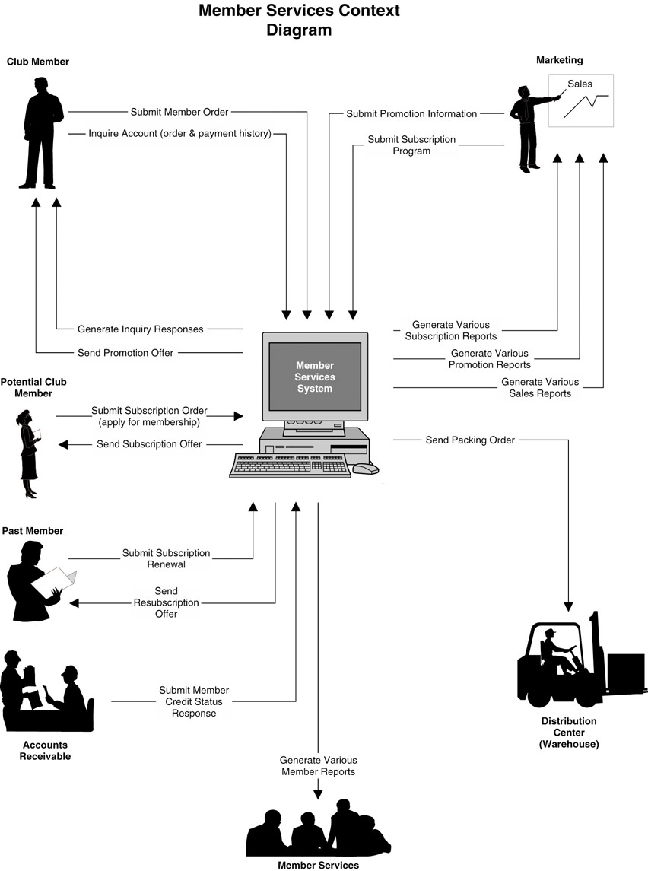
Sample Context Diagram
7-<number>

Slide 37
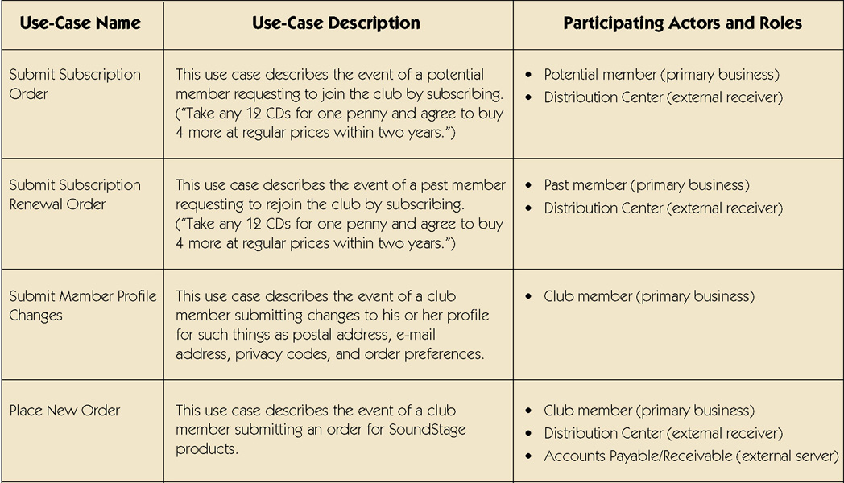
Sample Use-Case Glossary
7-<number>
continued
Notes:
No additional notes

Slide 38
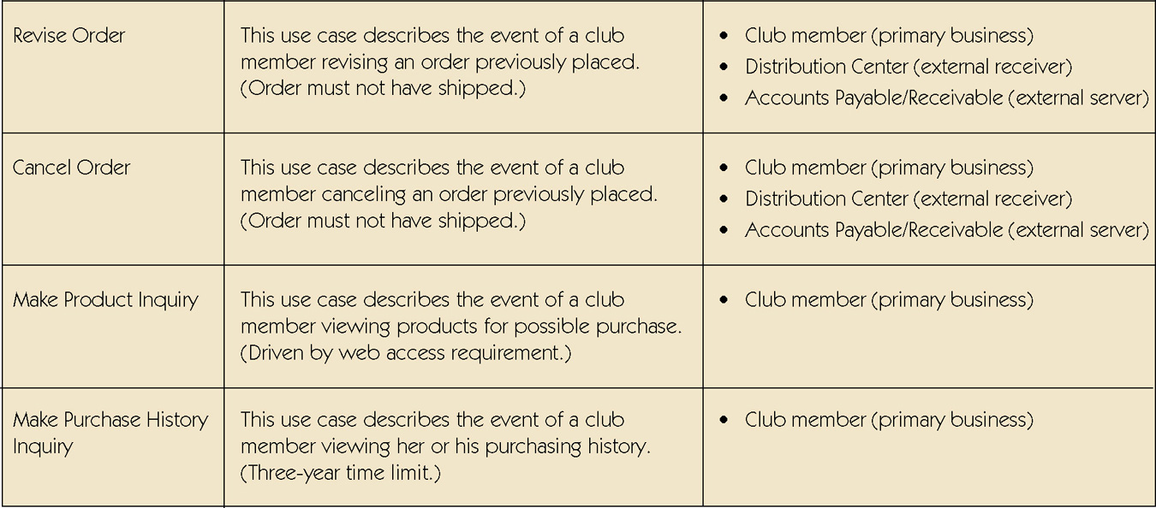
Sample Use-Case Glossary (cont.)
7-<number>
continued
Notes:
No additional notes

Slide 39
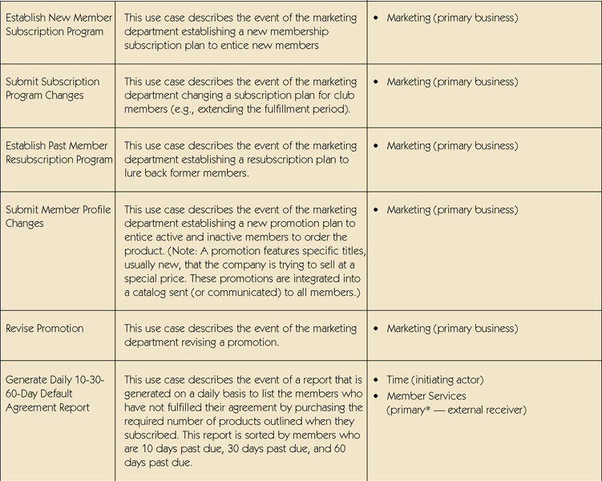
Sample Use-Case Glossary (cont.)
7-<number>
Notes:
No additional notes

Slide 40
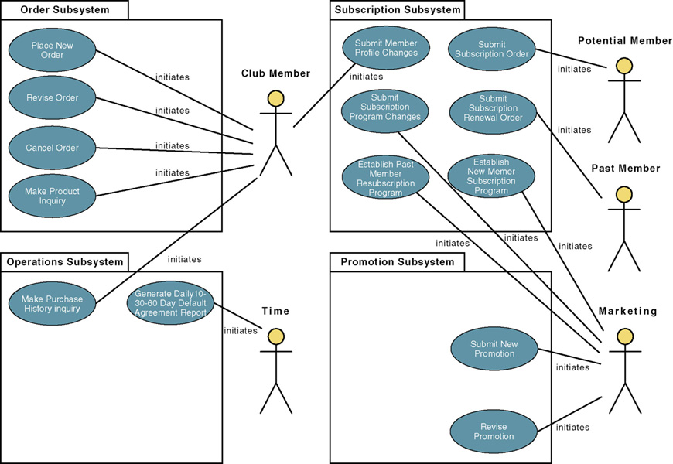
Step 3: Construct Use-Case
Model Diagram
7-<number>
Notes:
Teaching Notes
Note that the use cases have been grouped into business sub-systems. This is key to defining your development strategy – which use cases will be developed first and by whom.

Slide 41
Step 4: Document Business Requirements Use-Case Narratives
Document first at high level to quickly obtain an understanding of the events and magnitude of the system.
Then expand to a fully-documented business requirement narrative.
  Include the use case’s typical course of events and its alternate courses.
7-<number>
Notes:
No additional notes.

Slide 42
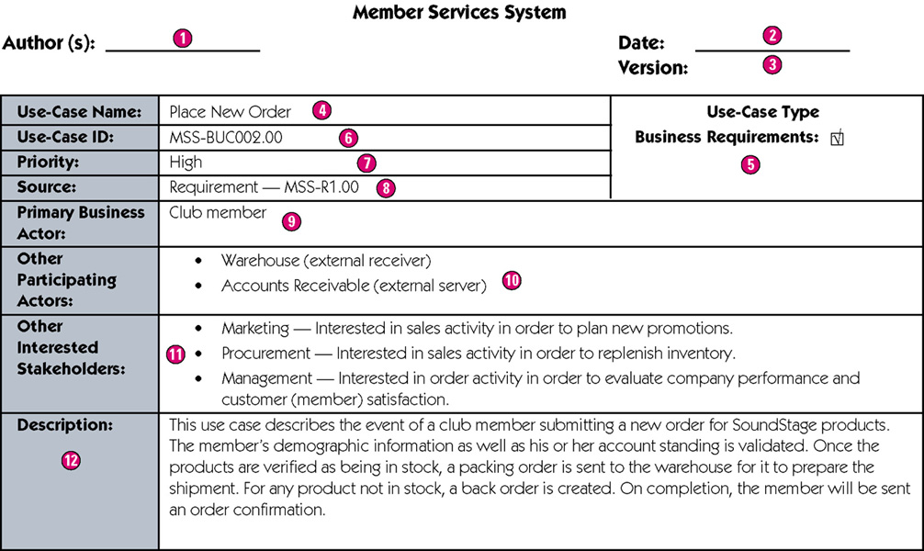
Sample High-Level Version of a Use-Case
Narrative
7-<number>

Slide 43
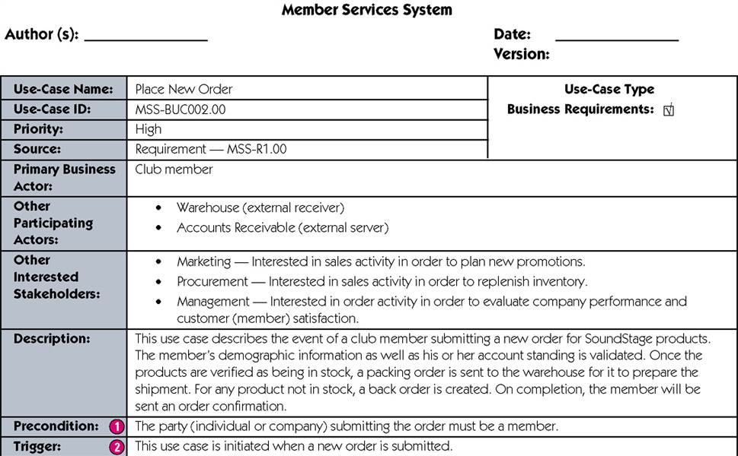
Sample Expanded Version of a Use-Case
Narrative
7-<number>
continued
Notes:
Teaching Notes
Precondition – A constraint on the state of the system before the use case can be executed.
Trigger – The event that initiates the use case.

Slide 44
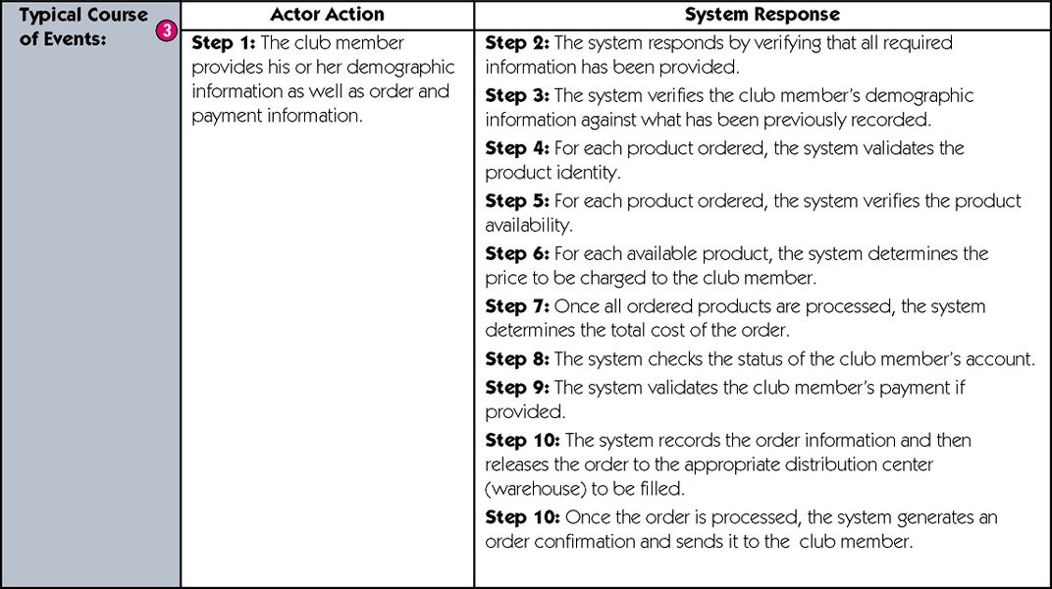
Sample Expanded Version of a Use-Case Narrative (cont)
7-<number>
continued
Notes:
Teaching Notes
Typical course of events – The normal sequence of activities performed by the actor(s) and the system to satisfy the goal of the use case.

Slide 45
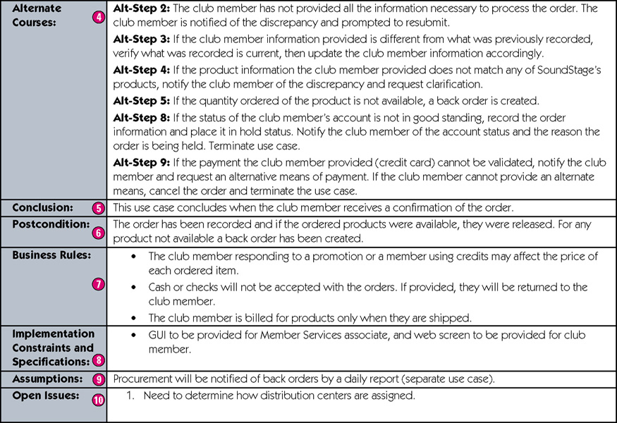
Sample Expanded Version of a Use-Case Narrative (cont)
7-<number>
concluded
Notes:
Teaching Notes
Alternate courses – The behaviors of the use case if an exception or variation to the typical course occurs.
Conclusion – When the use case successfully ends.
Postcondition – A constraint on the state of the system after the use case has successfully executed.
Business rules – Policies and procedures of the business that the system must abide by.
Implementation constraints and specifications – Any nonfunctional requirements that may impact the realization of the use case.
Assumptions – Assumptions made by the author.
Open issues – Issues that need to be resolved before the use case can be finalized.

Slide 46
Use-Case Ranking and Priority Matrix
In most projects, the most important use cases are developed first.
  Use-case ranking and priority matrix – a tool used to evaluate use cases and determine their priority.
  Evaluates use cases on 1-5 scale against six criteria.
    Significant impact on the architectural design.
    Easy to implement but contains significant functionality.
    Includes risky, time-critical, or complex functions.
    Involves significant research or new or risky technology.
    Includes primary business functions.
    Will increase revenue or decrease costs.
7-<number>
Notes:
Teaching Notes
A sample matrix is shown on the next slide.

Slide 47
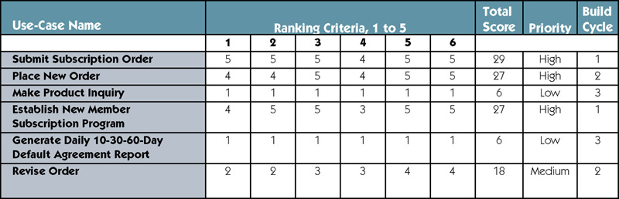
Sample Use-Case Ranking and Priority Matrix
7-<number>
Notes:
Teaching Notes
The ranking criteria are explained on the previous slide.

Slide 48
Use-Case Dependency Diagram
Use-case dependency diagram – graphical depiction of the dependencies among use cases.
  Provides the following benefits:
    Graphical depiction of the system’s events and their states enhances understanding of system functionality.
    Helps identify missing use cases.
    Helps facilitate project management by depicting which use cases are more critical.
7-<number>
Notes:
Teaching Notes
A sample dependency diagram is shown on the next slide.

Slide 49
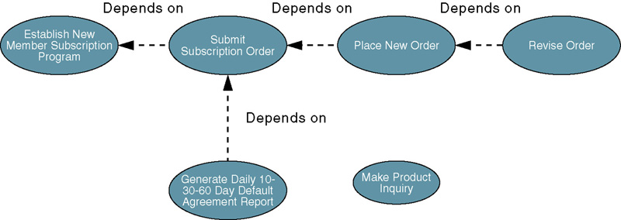
Sample Use-Case
Dependency Diagram
7-<number>
Notes:
No additional notes.

