Slide 1
8.1 Data Modeling
Data modeling – a technique for organizing and documenting a system’s data. Sometimes called database modeling.
Entity relationship diagram (ERD) – a data model utilizing several notations to depict data in terms of the entities and relationships described by that data.
8-<number>
Notes:
No additional notes

Slide 2
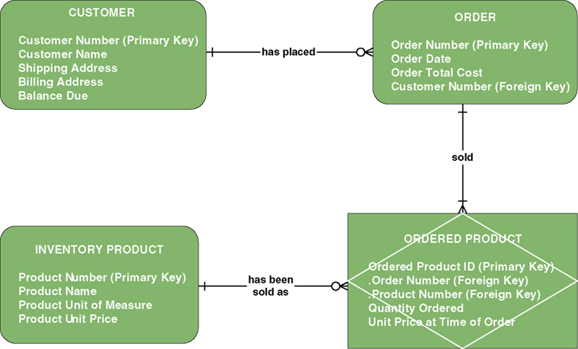
Sample Entity Relationship Diagram (ERD)
8-<number>
Notes:
Teaching Notes
Be sure to explain that this is merely an example – there are numerous data modeling notations. While they may differ in appearance (symbology) the knowledge that data models are intended to convey the same.

Slide 3

8.2 Data Modeling Concepts: Entity
Entity – a class of persons, places, objects, events, or concepts about which we need to capture and store data.
  Named by a singular noun
Persons: agency, contractor, customer,
department, division, employee,
instructor, student, supplier.
Places: sales region, building, room,
branch office, campus.
Objects: book, machine, part, product, raw material, software license, software package, tool, vehicle model, vehicle.
Events: application, award, cancellation, class, flight, invoice, order, registration, renewal, requisition, reservation, sale, trip.
Concepts: account, block of time, bond, course, fund, qualification, stock.
8-<number>
Notes:
Teaching Notes:
Prompt the students for additional examples. Have them classify their example(s).
Obtain a data model from a source other than the textbook. Ask the students to classify the entities.

Slide 4
Data Modeling Concepts: Entity
Entity instance – a single occurrence of an entity.
entity
Student ID | Last Name | First Name
2144 | Arnold | Betty
3122 | Taylor | John
3843 | Simmons | Lisa
9844 | Macy | Bill
2837 | Leath | Heather
2293 | Wrench | Tim
instances
8-<number>
Notes:
Teaching Notes
Substitute the name(s) of one or more of your students.
Be sure to explain that these are “instances” and that instances do NOT appear in the names of entity symbols.

Slide 5
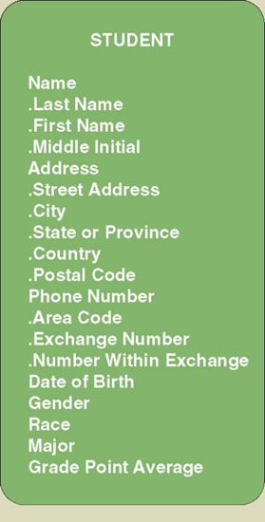
Data Modeling Concepts: Attributes
Attribute – a descriptive property or characteristic of an entity. Synonyms include element, property, and field.
  Just as a physical student can have attributes, such as hair color, height, etc., data entity has data attributes
Compound attribute – an attribute that consists of other attributes. Synonyms in different data modeling languages are numerous: concatenated attribute, composite attribute, and data structure.
8-<number>
Notes:
Teaching Notes:
Go back to the slide showing the sample ERD (Figure 8-1). Pick an entity and ask the students to list attributes that they feel describe those entities.
Show the students a form. Ask the students to identify the attributes. Be sure that the students recognize what items appearing on the form are truly attributes and those that are simply headings or preprinted items. Also, often students accidentally identify attribute values as attributes. For example, they may say that an item that appears as a check box is an attribute when in fact it may be the value of an attribute (ie. Male and female are values, whereas GENDER is the real attribute).

Slide 6
Data Modeling Concepts: Data Type
Data type – a property of an attribute that identifies what type of data can be stored in that attribute.
Representative Logical Data Types for Attributes
Data Type | Logical Business Meaning
NUMBER | Any number, real or integer.
TEXT | A string of characters, inclusive of numbers. When numbers are included in a TEXT attribute, it means that we do not expect to perform arithmetic or comparisons with those numbers.
MEMO | Same as TEXT but of an indeterminate size. Some business systems require the ability to attach potentially lengthy notes to a give database record.
DATE | Any date in any format.
TIME | Any time in any format.
YES/NO | An attribute that can assume only one of these two values.
VALUE SET | A finite set of values. In most cases, a coding scheme would be established (e.g., FR=Freshman, SO=Sophomore, JR=Junior, SR=Senior).
IMAGE | Any picture or image.
8-<number>
Notes:
Teaching Notes
These are generic data types. If your students have taken a database class they would be familiar with the data types specific to that database.

Slide 7
Data Modeling Concepts: Domains
Domain – a property of an attribute that defines what values an attribute can legitimately take on.
Representative Logical Domains for Logical Data Types
Data Type | Domain | Examples
NUMBER | For integers, specify the range. For real numbers, specify the range and precision. | {10-99} {1.000-799.999}
TEXT | Maximum size of attribute. Actual values usually infinite; however, users may specify certain narrative restrictions. | Text(30)
DATE | Variation on the MMDDYYYY format. | MMDDYYYY MMYYYY
TIME | For AM/PM times: HHMMT For military (24-hour times): HHMM | HHMMT HHMM
YES/NO | {YES, NO} | {YES, NO} {ON, OFF}
VALUE SET | {value#1, value#2,…value#n} {table of codes and meanings} | {M=Male F=Female}
8-<number>
Notes:
No additional notes

Slide 8
Data Modeling Concepts:
Default Value
Default value – the value that will be recorded if a value is not specified by the user.
Permissible Default Values for Attributes
Default Value | Interpretation | Examples
A legal value from the domain | For an instance of the attribute, if the user does not specify a value, then use this value. | 0 1.00
NONE or NULL | For an instance of the attribute, if the user does not specify a value, then leave it blank. | NONE NULL
Required or NOT NULL | For an instance of the attribute, require that the user enter a legal value from the domain. (This is used when no value in the domain is common enough to be a default but some value must be entered.) | REQUIRED NOT NULL
8-<number>
Notes:
No additional notes

Slide 9
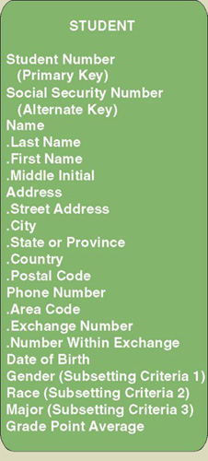
Data Modeling Concepts: Identification
Key – an attribute, or a group of attributes, that assumes a unique value for each entity instance. It is sometimes called an identifier.
  Concatenated key - group of attributes that uniquely identifies an instance. Synonyms: composite key, compound key.
  Candidate key – one of a number of keys that may serve as the primary key. Synonym: candidate identifier.
  Primary key – a candidate key used to uniquely identify a single entity instance.
  Alternate key – a candidate key not selected to become the primary key. Synonym: secondary key.
8-<number>
Notes:
Teaching Notes
Students can generally relate to the following example. Suppose you are working for an hourly wage. The employer has some method of tracking the hours you work. Whether that involves a time clock, an identification badge that it scanned, or a log book, the system records a certain number of hours and some employee identifier that says those hours are yours. Without that identifier, come pay day the employer would not know whose hours were whose. The employer might pay someone else for the hours you worked. That’s how important a primary key or identifier is.

Slide 10
Data Modeling Concepts:
Subsetting Criteria
  Subsetting criteria – an attribute(s) whose finite values divide all entity instances into useful subsets. Sometimes called an inversion entry.
8-<number>
Notes:
No additional notes

Slide 11

Data Modeling Concepts: Relationships
Relationship – a natural business association that exists between one or more entities.
  The relationship may represent an event that links the entities or merely a logical affinity(关系) that exists between the entities.
8-<number>

Slide 12
Data Modeling Concepts: Cardinality(基数)
Cardinality – the minimum and maximum number of occurrences of one entity that may be related to a single occurrence of the other entity.
  Because all relationships are bidirectional, cardinality must be defined in both directions for every relationship.
bidirectional
8-<number>
Notes:
Teaching Notes
Ask the students to read (or write) declarative sentences to reflect the bidirectional meaning of the relationship between student and curriculum.

Slide 13
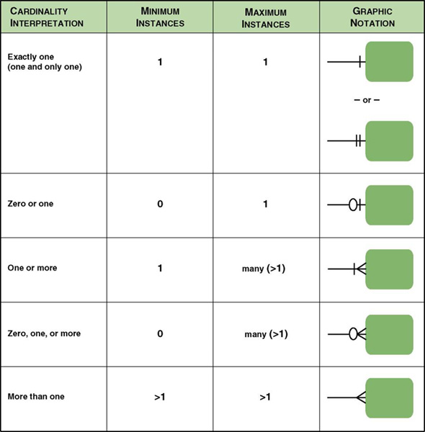
Cardinality Notations
8-<number>

Slide 14
Data Modeling Concepts: Degree(度数)
Degree – the number of entities that participate in the relationship.
  A relationship between two entities is called a binary relationship.
  A relationship between three entities is called a 3-ary or ternary relationship.
  A relationship between different instances of the same entity is called a recursive (递归)relationship.
8-<number>

Slide 15

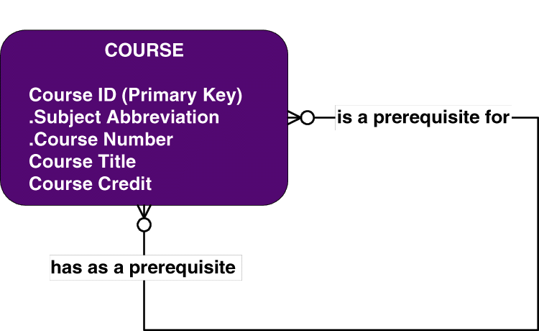
8-<number>

Slide 16
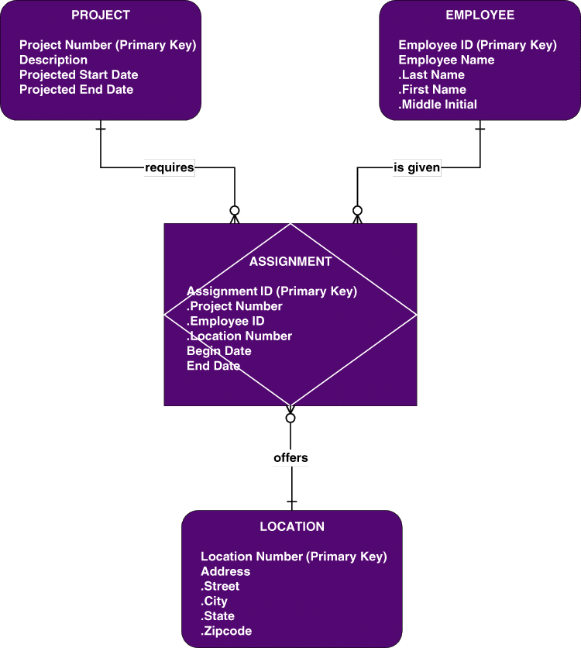
Data Modeling Concepts: Degree
Relationships may exist between more than two entities and are called
N-ary relationships.
The example ERD depicts a ternary relationship.
8-<number>
Notes:
Teaching Notes
The example also depicts an associative entity for the first time…as explained on the next slide.

Slide 17
Data Modeling Concepts: Degree
Associative entity – an entity that inherits its primary key from more than one other entity (called parents).
Each part of that concatenated (串联）key(复合键) points to one and only one instance of each of the connecting entities.
Associative Entity
8-<number>
Notes:
No additional notes

Slide 18
Data Modeling Concepts:
Foreign Keys
Foreign key – a primary key of an entity that is used in another entity to identify instances of a relationship.
  A foreign key is a primary key of one entity that is contributed to (duplicated in) another entity to identify instances of a relationship.
  A foreign key always matches the primary key in the another entity
  A foreign key may or may not be unique (generally not)
  The entity with the foreign key is called the child.
  The entity with the matching primary key is called the parent.
8-<number>
Notes:
Teaching Notes
Foreign keys are what make a relational database relational.

Slide 19
Data Modeling Concepts:
Parent and Child Entities
Parent entity - a data entity that contributes one or more attributes to another entity, called the child. In a one-to-many relationship the parent is the entity on the "one" side.
Child entity - a data entity that derives one or more attributes from another entity, called the parent. In a one-to-many relationship the child is the entity on the "many" side.
8-<number>
Notes:
Teaching Notes
These concepts are illustrated on the next slide.

Slide 20
Data Modeling Concepts:
Foreign Keys
Primary Key
Student ID | Last Name | First Name | Dorm
2144 | Arnold | Betty | Smith
3122 | Taylor | John | Jones
3843 | Simmons | Lisa | Smith
9844 | Macy | Bill
2837 | Leath | Heather | Smith
2293 | Wrench | Tim | Jones
Primary Key
Foreign Key
Duplicated from primary key of Dorm entity
(not unique in Student entity)
Dorm | Residence Director
Smith | Andrea Fernandez
Jones | Daniel Abidjan
8-<number>
Notes:
Teaching Notes
Have students identity which is the parent entity (Major) and which is the child (Student).
Additional examples should be given to test the student’s ability to recognize the parent entity.
We suggest you also provide an example of a one-to-one relationship!

Slide 21
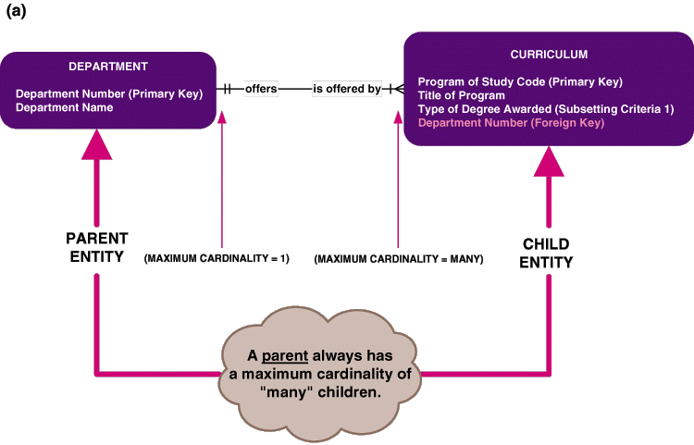
Data Modeling Concepts: Nonidentifying Relationships(非确定性关系) 不共享主键
Nonidentifying relationship – relationship where each participating entity has its own independent primary key
  Primary key attributes are not shared.
  The entities are called strong entities
Strong entity
Strong entity
8-<number>
Notes:
No additional notes.

Slide 22
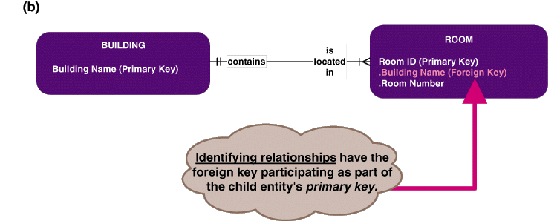
Data Modeling Concepts:
Identifying Relationships(确定性关系)
Identifying relationship – relationship in which the parent entity’ key is also part of the primary key of the child entity.
  The child entity is called a weak entity.
weak entity
弱实体具有引用强实体主键的外键
8-<number>
Notes:
No additional notes.

Slide 23
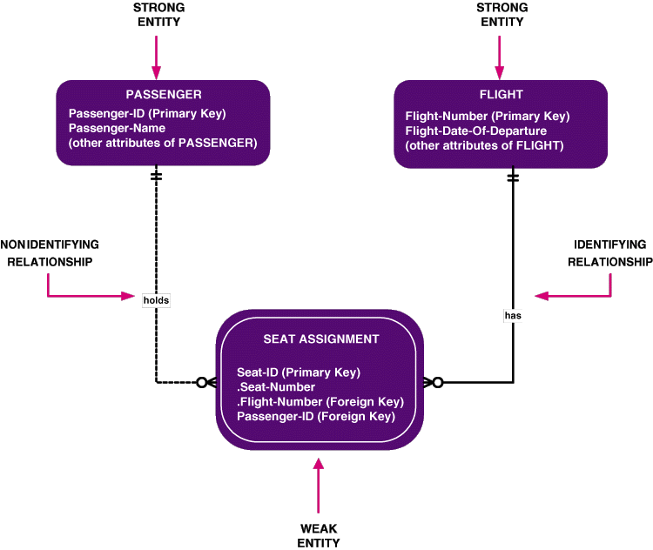
弱实体的作用：
避免数据冗余以及由此带来的不一致性
反映了一个实体对其它实体依赖的逻辑结构
弱实体可随其强实体的删除而自动删除
8-<number>
Notes:
.

Slide 24
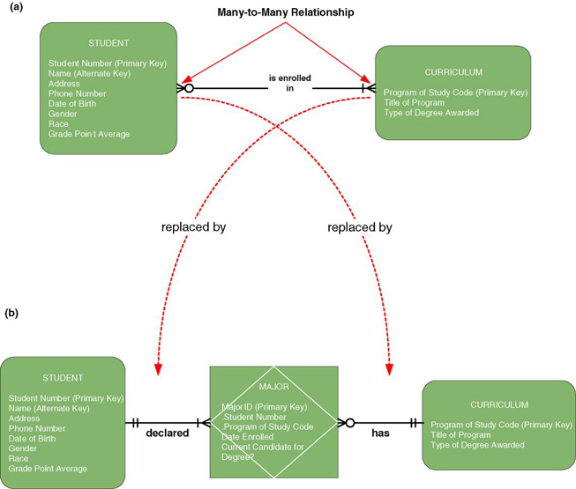
Data Modeling Concepts: Nonspecific Relationships(非特定性关系,多对多)
Nonspecific relationship – relationship where many instances of an entity are associated with many instances of another entity. Also called many-to-many relationship.
Nonspecific relationships must
be resolved, generally by introducing an associative entity.
parent
parent
8-<number>
Notes:
Teaching Notes
You may need to refer to the earlier slide that defines an associative entity
In the bottom diagram we see that a student can declare multiple majors and that a curriculum can offer multiple majors.
Note that for associative entities the cardinality from child to parent is always one and only one. An instance of MAJOR must correspond to one and only one STUDENT and to one and only one CURRICULUM.

Slide 25
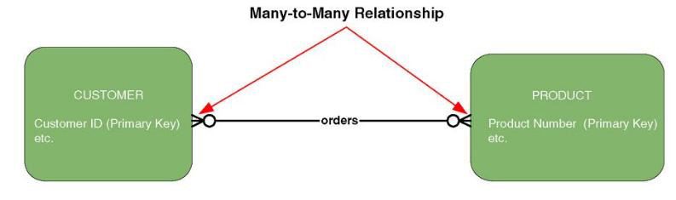
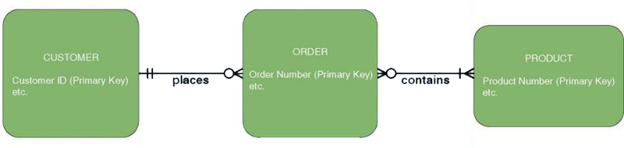
Resolving Nonspecific Relationships
The verb or verb phrase of a many-to-many relationship sometimes suggests other entities.
8-<number>
Notes:
Teaching Notes
Part (c) of Figure 8-9 is on the next slide

Slide 26
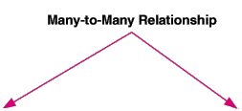
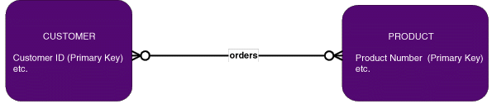
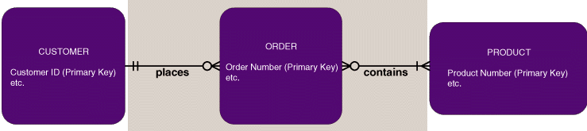
Resolving Nonspecific Relationships
?
8-<number>

Slide 27
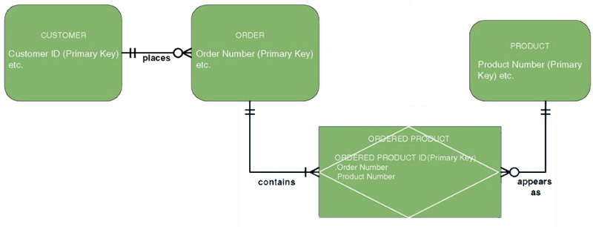
Many-to-many relationships can be resolved with an associative entity.
8-<number>
Notes:
No additional notes

Slide 28
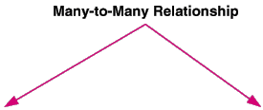
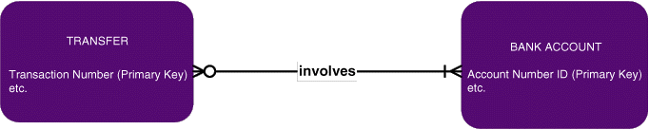
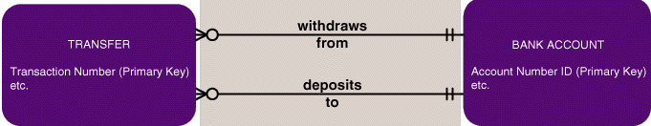
Resolving Nonspecific Relationships
While the above relationship is a many-to-many, the many on the BANK ACCOUNT side is a known maximum of "2." This suggests that the relationship may actually represent multiple relationships... In this case two separate relationships.
引入独立关系
8-<number>

Slide 29
Data Modeling Concepts: Generalization
Generalization – a concept wherein the attributes that are common to several types of an entity are grouped into their own entity.
Supertype – an entity whose instances store attributes that are common to one or more entity subtypes.
Subtype – an entity whose instances may inherit common attributes from its entity supertype
  And then add other attributes unique to the subtype.
8-<number>
Notes:
Teaching Notes:
If students have already studied object-oriented modeling, they will be familiar with generalization from that.
Ask the students to identify a generalization example. What are some common attributes? What are some unique attributes associated with the subtype(s)?
One common example is EMPLOYEE (supertype) with HOURLY EMPLOYEE (subtype) and SALARY EMPLOYEE (subtype).

Slide 30
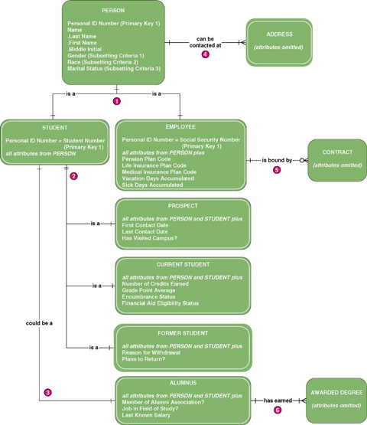
Generalization Hierarchy
8-<number>
Notes:
Teaching Notes
Generalization can be multiple levels deep.

Slide 31
Process of Logical Data Modeling
Strategic Data Modeling
  Many organizations select IS development projects based on strategic plans.
    Includes vision and architecture for information systems
    Identifies and prioritizes develop projects
    Includes enterprise data model as starting point for projects
Data Modeling during Systems Analysis
  Data model for a single information system is called an application data model.
8-<number>
Notes:
Teaching Notes
Data modeling may be performed during various types of projects and in multiple phases of projects.
Data models are progressive and should be considered a living document that will change in response to changing business needs.

Slide 32
Logical Model Development Stages
Context Data model
  Includes only entities and relationships
  To establish project scope
Key-based data model
  Eliminate nonspecific relationships
  Add associative entities
  Include primary and alternate keys
  Precise cardinalities
Fully attributed data model
  All remaining attributes
  Subsetting criteria
Normalized data model
Metadata - data about data.
8-<number>
Notes:
Teaching Notes
These are the steps that are followed in the case studies that accompany the text

Slide 33
JRP and Interview Questions for Data Modeling
Purpose | Candidate Questions (see textbook for a more complete list)
Discover system entities | What are the subjects of the business?
Discover entity keys | What unique characteristic (or characteristics) distinguishes an instance of each subject from other instances of the same subject?
Discover entity subsetting criteria | Are there any characteristics of a subject that divide all instances of the subject into useful subsets?
Discover attributes and domains | What characteristics describe each subject?
Discover security and control needs | Are there any restrictions on who can see or use the data?
Discover data timing needs | How often does the data change?
Discover generalization hierarchies | Are all instances of each subject the same?
Discover relationships? | What events occur that imply associations between subjects?
Discover cardinalities | Is each business activity or event handled the same way, or are there special circumstances?
8-<number>
Notes:
Teaching Notes
Regardless of whether you use JRP, interviewing, or any other approach for information gathering, these are good questions to ask.
Ask students to suggest other questions they could ask. It will help them and you make sure they understand the concepts and their real-world application.
Students can ask themselves these questions as they walk though data modeling for class assignments.

Slide 34
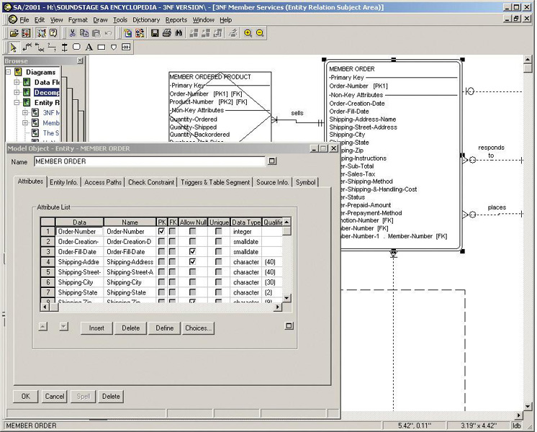
Automated Tools for Data Modeling
8-<number>
Notes:
Teaching Notes
You could substitute a screen shot from the modeling tool you use in your class. If your classroom has computer projection capabilities, you could demo the modeling tool.

Slide 35
Entity Discovery
In interviews or JRP sessions, pay attention to key words (i.e. "we need to keep track of ...").
In interviews or JRP sessions, ask users to identify things about which they would like to capture, store, and produce information.
Study existing forms, files, and reports.
Scan use case narratives for nouns.
Some CASE tools can reverse engineer existing files and databases.
8-<number>

Slide 36
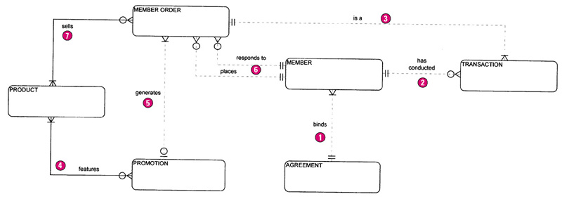
The Context Data Model
8-<number>
Notes:
Teaching Notes
The purpose of this slide is not just to show what a context data model looks like. Take the time to walk through the entities and relationships using information from the textbook as a guide.

Slide 37
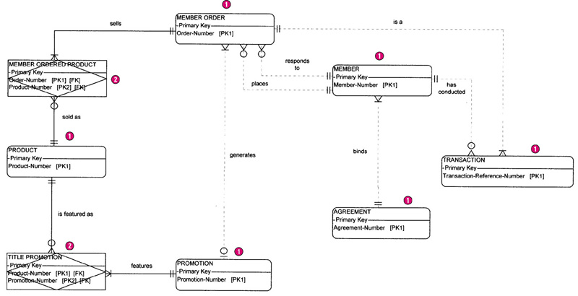
The Key-based Data Model
8-<number>
Notes:
Teaching Notes
Depending on your room conditions, you may want to break this diagram into two or more parts and resize each to insure readability.
Discuss the issues regarding keys and codes from the textbook

Slide 38
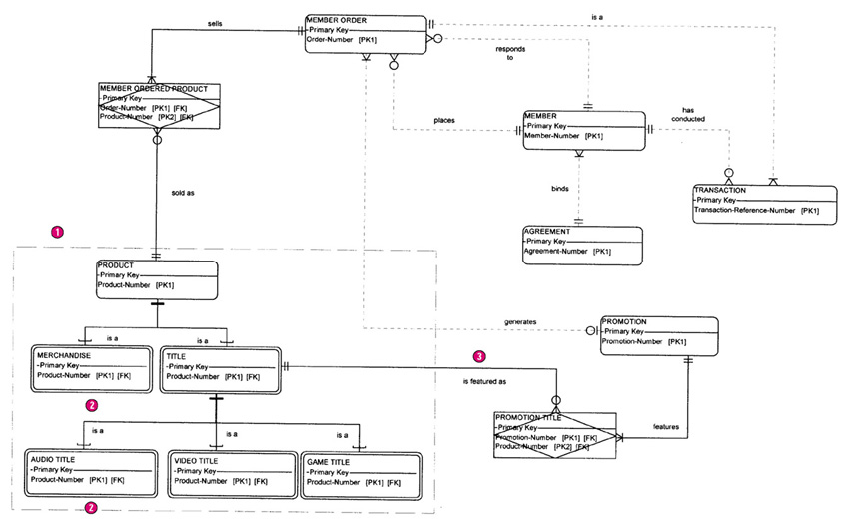
The Key-based Data Model with Generalization
8-<number>
Notes:
Teaching Notes
Depending on your room conditions, you may want to break this diagram into two or more parts and resize each to insure readability.
Discuss the need for the generalization.

Slide 39
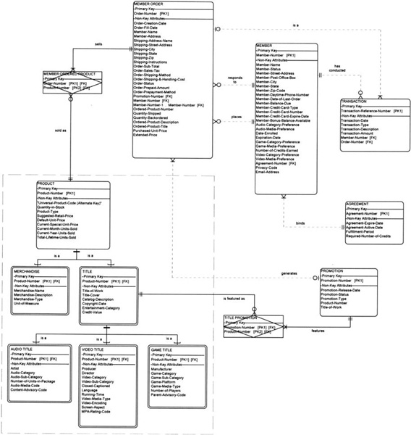
The Fully-Attributed Data Model
8-<number>
Notes:
Teaching Notes
Depending on your room conditions, you may want to break this diagram into two or more parts and resize each to insure readability.
Discuss attribute naming conventions, attribute discovery from forms, and other attribute issues. Use the information in the textbook as a guide.

Slide 40
What is a Good Data Model?
A good data model is simple.
  Data attributes that describe any given entity should describe only that entity.
  Each attribute of an entity instance can have only one value.
A good data model is essentially nonredundant.
  Each data attribute, other than foreign keys, describes at most one entity.
  Look for the same attribute recorded more than once under different names.
A good data model should be flexible and adaptable to future needs.
8-<number>
Notes:
No additional notes.

Slide 41
Data Analysis & Normalization
Data analysis – a technique used to improve a data model for implementation as a database.
  Goal is a simple, nonredundant, flexible, and adaptable database.
Normalization – a data analysis technique that organizes data into groups to form nonredundant, stable, flexible, and adaptive entities.
Notes:
No additional notes

Slide 42
Normalization: 1NF, 2NF, 3NF
First normal form (1NF) – entity whose attributes have no more than one value for a single instance of that entity
  Any attributes that can have multiple values actually describe a separate entity, possibly an entity and relationship.
Second normal form (2NF) – entity whose nonprimary-key attributes are dependent on the full primary key.
  Any nonkey attributes dependent on only part of the primary key should be moved to entity where that partial key is the full key. May require creating a new entity and relationship on the model.
Third normal form (3NF) – entity whose nonprimary-key attributes are not dependent on any other non-primary key attributes.
  Any nonkey attributes that are dependent on other nonkey attributes must be moved or deleted. Again, new entities and relationships may have to be added to the data model.
8-<number>
Notes:
No additional notes

Slide 43
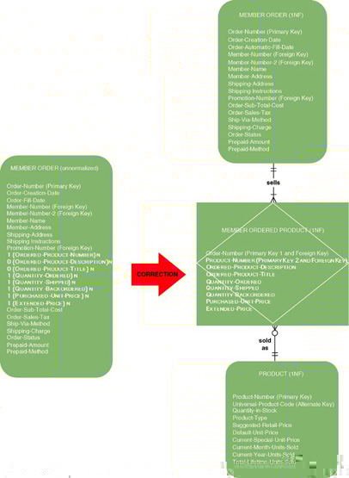
First Normal Form Example 1
8-<number>
Notes:
Teaching Notes
The repeating attributes are moved to a separate entity that has a one-to-many relationship to the original entity.

Slide 44
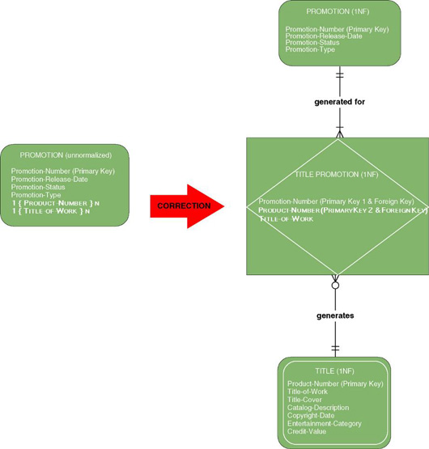
First Normal Form Example 2
8-<number>
Notes:
Teaching Notes
The repeating attributes are moved to a separate entity that has a one-to-many relationship to the original entity.

Slide 45
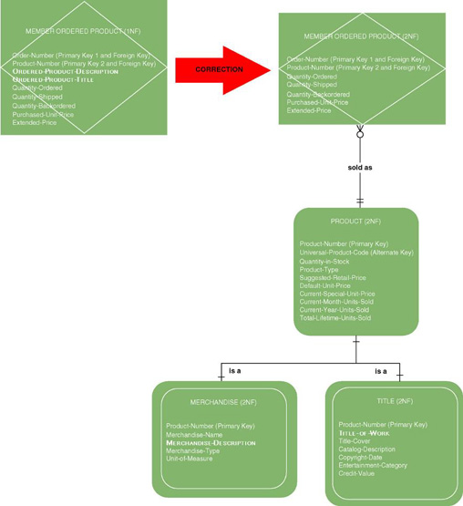
Second Normal Form Example 1
8-<number>
Notes:
Teaching Notes
The attributes ordered-product-description and ordered-product-title do not describe the primary key (order-number) of Member Ordered Product. They describe Merchandise and Title instead.

Slide 46
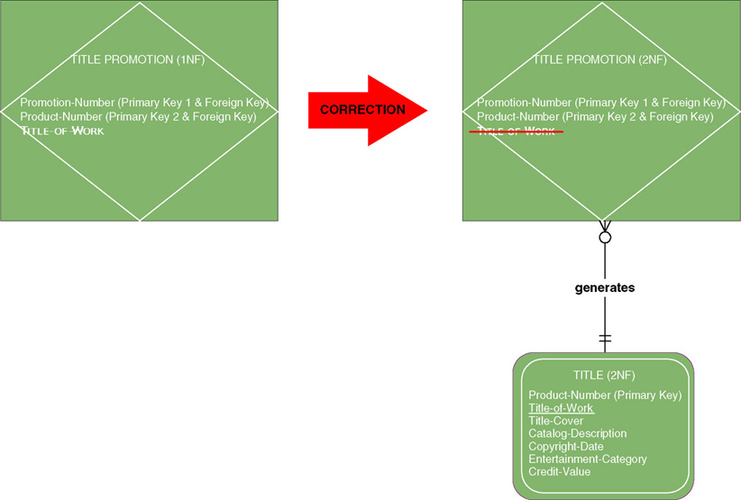
Second Normal Form Example 2
8-<number>
Notes:
Teaching Notes
This could be a good time to bring out the old saw, “The key, the whole key, and nothing but the key.”

Slide 47
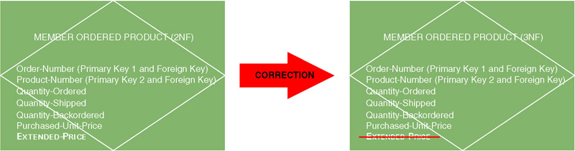
Third Normal Form Example 1
Derived attribute – an attribute whose value can be calculated from other attributes or derived from the values of other attributes.
8-<number>
Notes:
Teaching Notes
Some students also might see Purchased-Unit-Price as a derived attribute since it can be derived from Suggested-Retail-Price of the PRODUCT entity. This is a useful concept to discuss in class.
The reason why Purchased-Unit-Price must exist in MEMBER ORDERED PRODUCT is that while it can initially be derived from the PRODUCT entity, one would not be able to derive it at a later time if there were a price change. So these two attributes have subtly different definitions. One is the current price, which may change. The other is the price use for that particular order, which should not change.

Slide 48
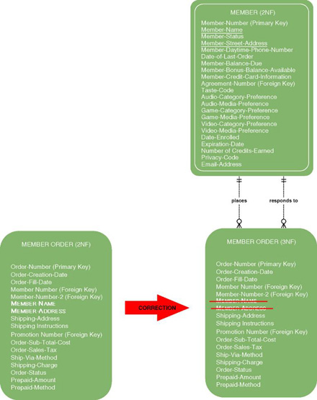
Third Normal Form Example 2
Transitive dependency – when the value of a nonkey attribute is dependent on the value of another nonkey attribute other than by derivation.
8-<number>
Notes:
Teaching Notes
Member Name and Member Address are dependent on Member Number, which is a foreign key to the Member entity. So they are moved to the Member entity.

Slide 49
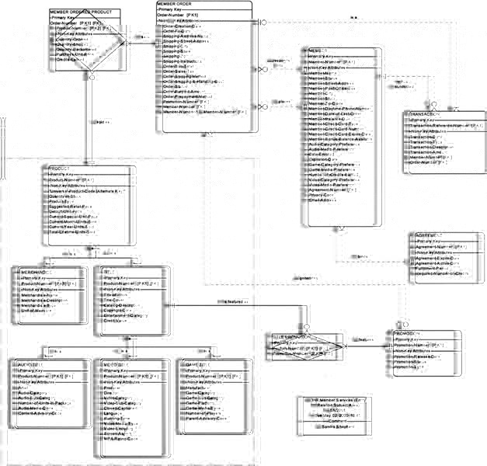
SoundStage 3NF Data Model
8-<number>
Notes:
Teaching Notes
Edit this slide as needed to ensure readability or refer students to the textbox.

Slide 50
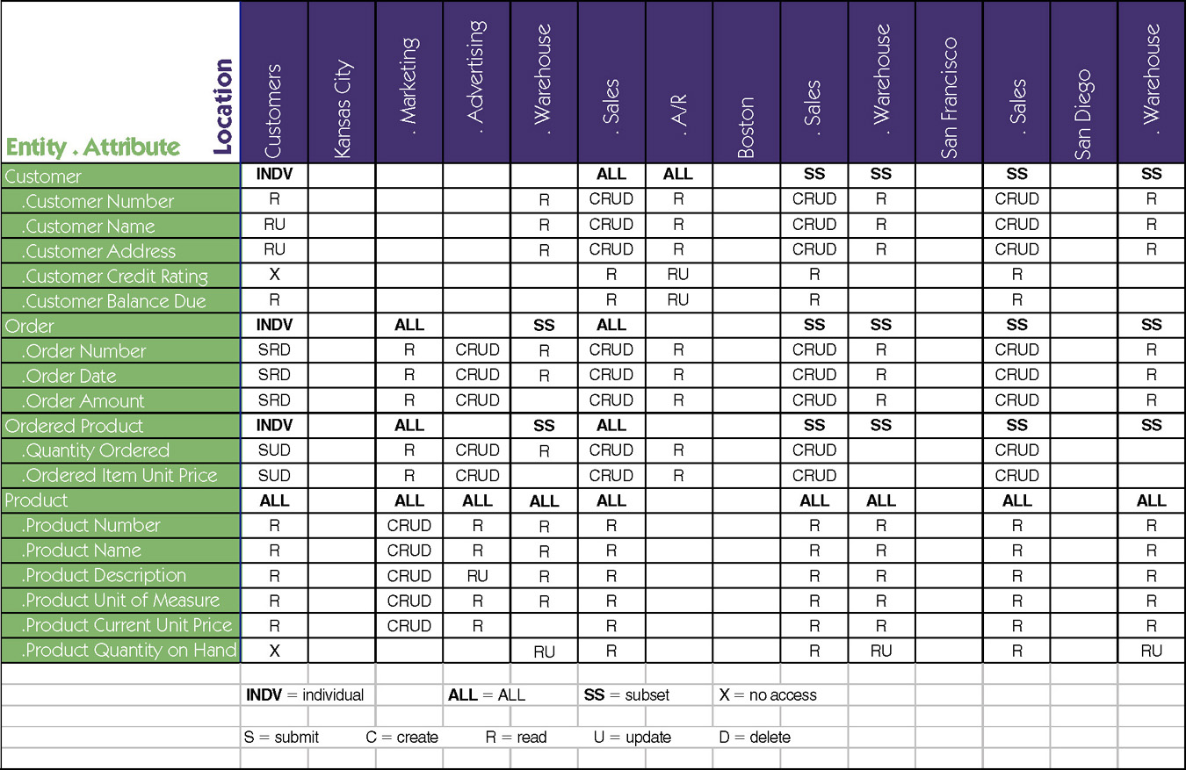
Data-to-Location-CRUD Matrix
8-<number>
Notes:
No additional notes

