Slide 1
Chapter 9
Process Modeling
9-<number>

Slide 2
Objectives
Draw event diagrams and merge them into a system diagram.
Draw primitive data flow diagrams and describe the elementary data flows in terms of data structures and procedural logic.
Synchronize(同步) data and process models using a CRUD matrix.
Notes:
Chapter 9 objectives.

Slide 3
9.1Process Modeling and DFDs
Process modeling – a technique used to organize and document the structure and flow of data through a system’s processes.
Data flow diagram (DFD) – a process model used to depict the flow of data through a system and the work or processing performed by the system. Synonyms are bubble chart, transformation graph, and process model.
  The DFD has also become a popular tool for business process redesign.
9-<number>

Slide 4
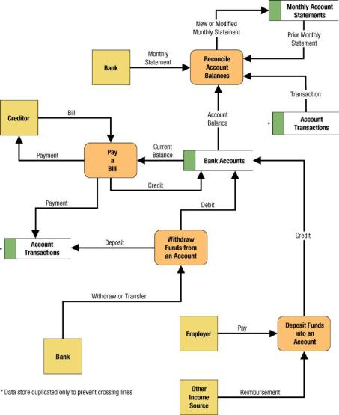
Simple Data Flow Diagram
9-<number>

Slide 5


9.2 External Agents
External agent – an outside person, unit, system, or organization that interacts with a system. Also called an external entity.
  External agents define the “boundary” or
  scope of a system being modeled.
  As scope changes, external agents can
  become processes, and vice versa.
  Almost always one of the following:
    Office, department, division.
    An external organization or agency.
    Another business or another
    information system.
    One of system’s end-users or managers
  Named with descriptive, singular noun
Gane and Sarson shape
DeMarco/Yourdon shape
9-<number>

Slide 6


Data Stores
Data store – stored data intended for later use. Synonyms are file and database.
  Frequently implemented as a file or database.
  A data store is “data at rest” compared to a data flow that is “data in motion.”
  Almost always one of the following:
    Persons (or groups of persons)
    Places
    Objects
    Events (about which data is captured)
    Concepts (about which data is important)
  Data stores depicted on a DFD store
  all instances of data entities
  (depicted on an ERD)
  Named with plural noun
Gane and Sarson shape
9-<number>
DeMarco/Yourdon shape

Slide 7
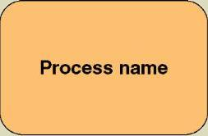
Process Concepts
Process – work performed by a system in response to incoming data flows or conditions. A synonym is transform(转换）.
  All information systems include
  processes - usually many of them
  Processes respond to business
  events and conditions and transform
  data into useful information
  Modeling processes helps us to understand the interactions with the system's environment, other systems, and other processes.
  Named with a strong action verb followed by object clause describing what the work is performed on/for .
Gane and Sarson shape
9-<number>
Notes:
No additional notes.

Slide 8
Data Flows & Control Flows
Data flow – data that is input to or output from a process.
  A data flow is data in motion
  A data flow may also be used to represent the creation, reading, deletion, or updating of data in a file or database (called a data store).
Composite data flow – a data flow that consists of other data flows.
Data flow name
9-<number>

Slide 9
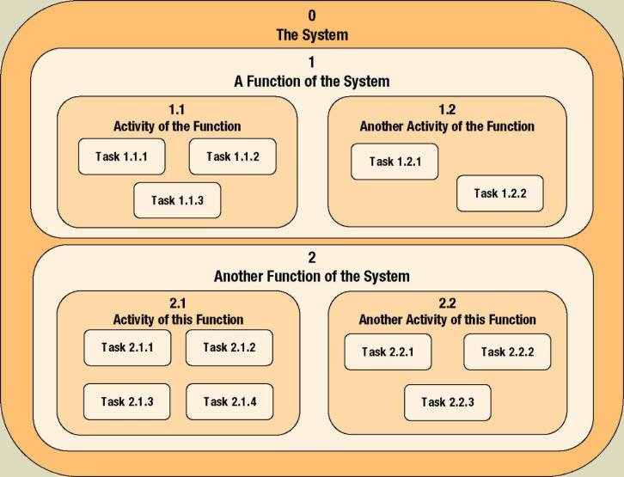
Process Decomposition
Decomposition – the act of breaking a system into sub-components. Each level of abstraction reveals more or less detail.
9-<number>
Notes:
No additional notes

Slide 10
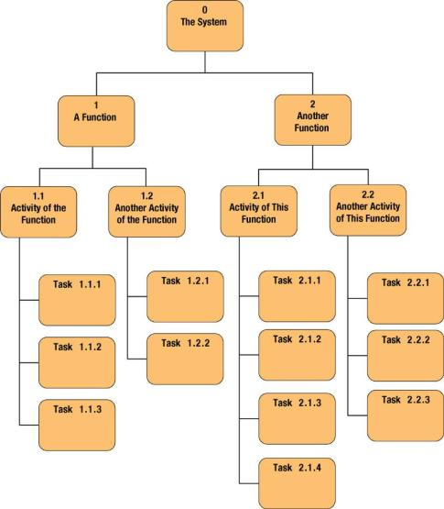
Decomposition Diagrams
Decomposition diagram – a tool used to depict the decomposition of a system. Also called hierarchy chart.
9-<number>

Slide 11
Types of Logical Processes
Function – a set of related and ongoing activities of a business.
  A function has no start or end. Eg. Order management
Event – a logical unit of work that must be completed as a whole. Sometimes called a transaction.
  Triggered by a discrete input and is completed when process has responded with appropriate outputs.
  Functions consist of processes that respond to events.
eg. process order
Elementary process – a discrete, detailed activity or task required to complete the response to an event. Also called a primitive process.
  The lowest level of detail depicted in a process model.
  Eg. Calculate order cost
9-<number>
Notes:
No additional notes

Slide 12
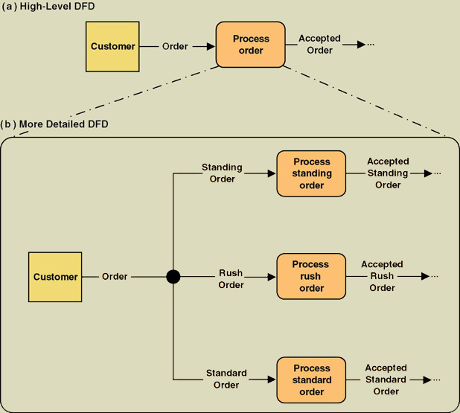
Composite and Elementary
Data Flows
Composite flow
Elementary flows
Junction indicates that any given order is an instance of only one of the order types.
9-<number>
Notes:
No additional notes

Slide 13
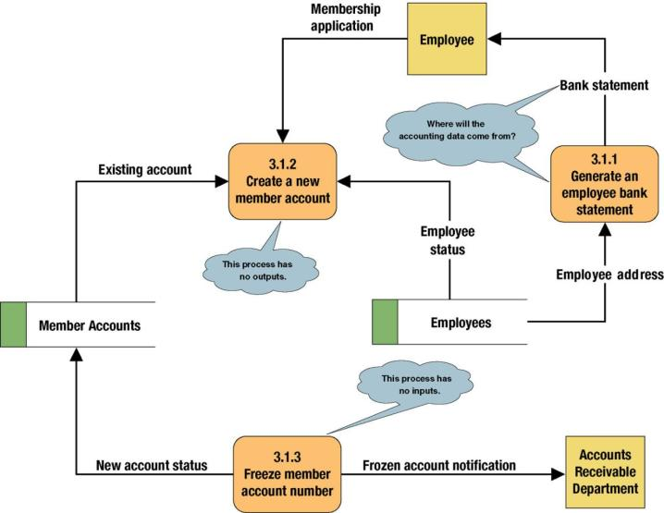
Common Process Errors on DFDs
black hole
Gray hole
9-<number>

Slide 14
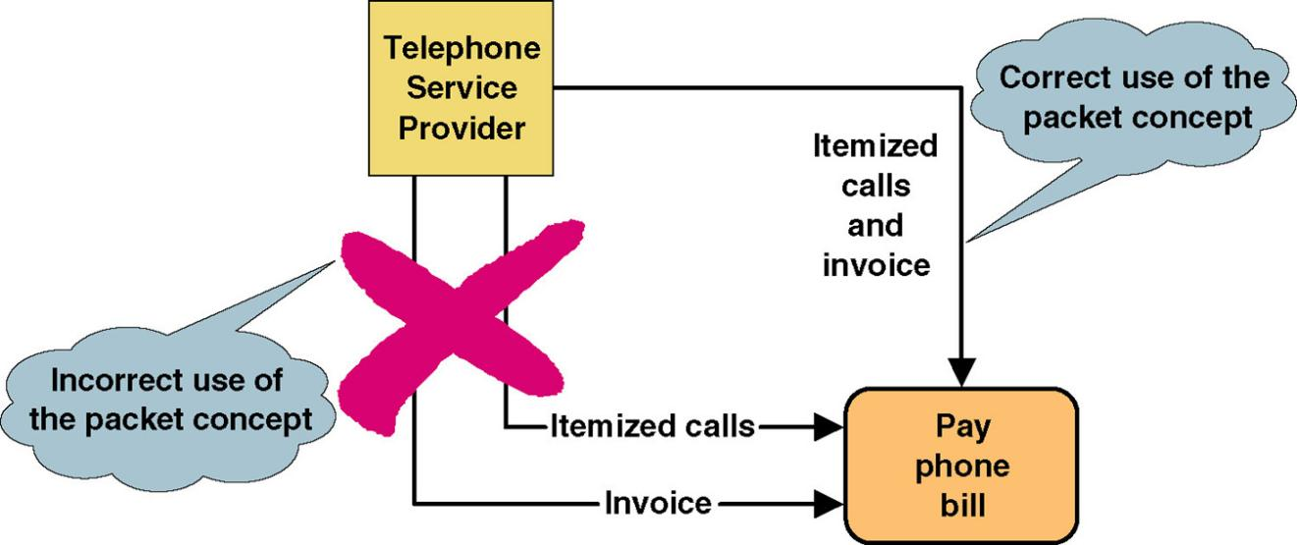
Data Flow Packet Concept(报文)
Data that should travel together should be shown as a single data flow, no matter how many physical documents might be included.
9-<number>

Slide 15
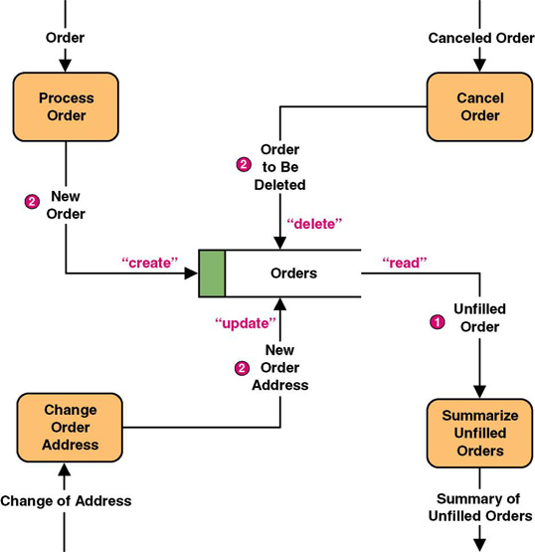
Data Flows to and from Data Stores
9-<number>
Notes:
Teaching Notes
Some DFD methodologies suggest that data flows to and from data stores not be named. We think this confuses the end-users when they try to read the diagrams. Also, we believe that it is easier to have DFD errors of omission if the rules state that some flows are named while others are not.
Some DFD notations actually use the CRUD letters only to name flows to and from data stores. We consider this an acceptable alternative. CRUD is a useful acronym from the database world to remember the basic data flows as they relate to data stores: Create, Read, Update (or change), and Delete.

Slide 16
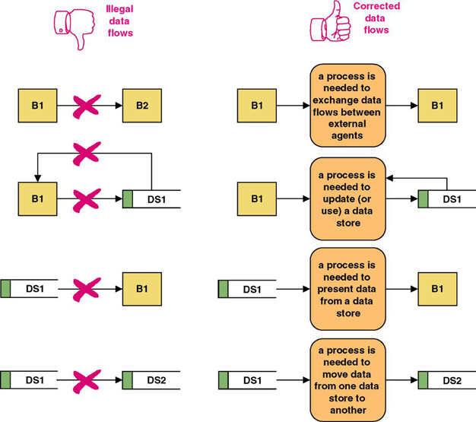
Rules for Data Flows
A data flow should never go unnamed.
In logical modeling, data flow names should describe the data flow without describing the implementation
All data flows must begin and/or end at a process.
9-<number>
Notes:
No additional notes.

Slide 17
Data Conservation数据流的守恒
Data conservation – the practice of ensuring that a data flow contains only data needed by the receiving process.
  Sometimes called starving the processes.
  Must precisely define the data composition of each data flow, expressed in the form of data structures.
9-<number>
Notes:
No additional notes.

Slide 18
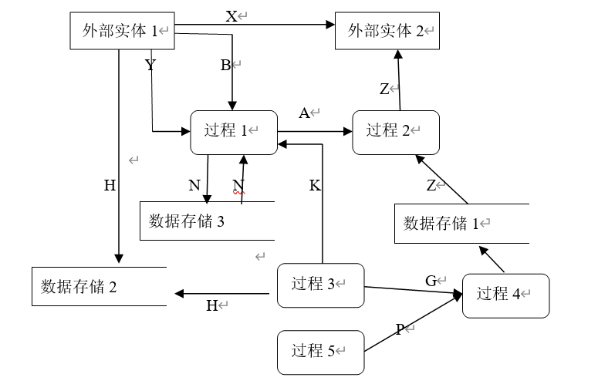
9-<number>

Slide 19
Data Structures
Data attribute – the smallest piece of data that has meaning to the users and the business.
Data structure – a specific arrangement of data attributes that defines an instance of a data flow.
The data attributes that comprise a data flow are organized into data structures.
Data flows can be described in terms of the following types of data structures:
  A sequence or group of data attributes that occur one after another.
  The selection of one or more attributes from a set of attributes.
  The repetition of one or more attributes.
9-<number>
Notes:
Conversion Notes
Many structured analysis books do not specifically use the term data structure, but the relational algebraic notation is very common in both books and CASE tools.
Some books refer to data attributes as data elements. Some also call them data fields, but some would argue that field is a very technical-, implementation-, or physical-oriented term (that is not consistent with our emphasis on logical DFDs).

Slide 20
Data Structure for a Data Flow
DATA STRUCTURE
ORDER=
ORDER NUMBER +
ORDER DATE+
[ PERSONAL CUSTOMER NUMBER,
CORPORATE ACCOUNT NUMBER]+
SHIPPING ADDRESS=ADDRESS+
(BILLING ADDRESS=ADDRESS)+
1 {PRODUCT NUMBER+
PRODUCT DESCRIPTION+
QUANTITY ORDERED+
PRODUCT PRICE+
PRODUCT PRICE SOURCE+
EXTENDED PRICE } N+
SUM OF EXTENDED PRICES+
PREPAID AMOUNT+
(CREDIT CARD NUMBER+EXPIRATION DATE)
(QUOTE NUMBER)
ADDRESS=
(POST OFFICE BOX NUMBER)+
STREET ADDRESS+
CITY+
[STATE, MUNICIPALITY]+
(COUNTRY)+
POSTAL CODE
ENGLISH ENTERPRETATION
An instance of ORDER consists of:
ORDER NUMBER and
ORDER DATE and
Either PERSONAL CUSTOMER NUMBER
or CORPORATE ACCOUNT NUMBER
and SHIPPING ADDRESS (which is equivalent to ADDRESS)
and optionally: BILLING ADDRESS (which is equivalent to ADDRESS)
and one or more instances of:
PRODUCT NUMBER and
PRODUCT DESCRIPTION and
QUANTITY ORDERED and
PRODUCT PRICE and
PRODUCT PRICE SOURCE and
EXTENDED PRICE
and SUM OF EXTENDED PRICES and
PREPAID AMOUNT and
optionally: both CREDIT CARD NUMBER and EXPIRATION DATE
An instance of ADDRESS consists of:
optionally: POST OFFICE BOX NUMBER and
STREET ADDRESS and
CITY and
Either STATE or MUNICIPALITY
and optionally: COUNTRY
and POSTAL CODE
9-<number>
Notes:
Teaching Notes
Bring several “physical” business forms to class. Transform one form into its relational algebraic data structure. Then, divide students into teams and ask them to perform the same exercise on a form and present their solutions to the class.

Slide 21
Data Structure Constructs
Data Structure | Format by Example (relevant portion is boldfaced | English Interpretation (relevant portion is boldfaced)
Sequence of Attributes - The sequence data structure indicates one or more attributes that may (or must) be included in a data flow. | WAGE AND TAX STATEMENT= TAXPAYER IDENTIFICATION NUMBER+ TAXPAYER NAME+ TAXPAYER ADDRESS+ WAGES, TIPS, AND COMPENSATION+ FEDERAL TAX WITHHELD+… | An instance of WAGE AND TAX STATEMENTS consists of: TAXPAYER IDENTIFICATION NUMBER and TAXPAYER NAME and TAXPAYER ADDRESS and WAGES, TIPS AND COMPENSATION and FEDERAL TAX WITHHELD and…
Selection of Attributes - The selection data structure allows you to show situations where different sets of attributes describe different instances of the data flow. | ORDER= [PERSONAL CUSTOMER NUMBER, CORPORATE ACCOUNT NUMBER]+ ORDER DATE+… | An instance or ORDER consists of: Either PERSONAL CUSTOMER NUMBER or CORPORATE ACCOUNT NUMBER; and ORDER DATE and…
9-<number>
Notes:
Teaching Notes
Point out that the same basic structures of sequence, selection, and iteration—that we applied to procedures using Structured English—are being applied here to describe data structures.
We have never found any form or file structure that could not be described using this notation!

Slide 22
Data Structure Constructs (continued)
Data Structure | Format by Example (relevant portion is boldfaced | English Interpretation (relevant portion is boldfaced)
Repetition of Attributes - The repetition data structure is used to set off a data attribute or group of data attributes that may (or must) repeat themselves a specific number of time for a single instance of the data flow. The minimum number of repetitions is usually zero or one. The maximum number of repetitions may be specified as “n” meaning “many” where the actual number of instances varies for each instance of the data flow. | POLICY NUMBER+ POLICYHOLDER NAME+ POLICY HOLDER ADDRESS+ 0 {DEPENDENT NAME+ DEPENDENT’S RELATIONSHIP} N+ 1 {EXPENSE DESCRIPTION+ SERVICE PROVIDER+ EXPENSE AMOUNT} N | An instance of CLAIM consists of: POLICY NUMBER and POLICYHOLDER NAME and POLICYHOLDER ADDRESS and zero or more instance of: DEPENDENT NAME and DEPENDENT’S RELATIONSHIP and one or more instances of: EXPENSE DESCRIPTION and SERVICE PROVIDER and EXPENSE ACCOUNT
9-<number>
Notes:
Teaching Notes
Point out that the same basic structures of sequence, selection, and iteration—that we applied to procedures using Structured English—are being applied here to describe data structures.
We have never found any form or file structure that could not be described using this notation!

Slide 23
Data Structure Constructs (concluded)
Data Structure | Format by Example (relevant portion is boldfaced | English Interpretation (relevant portion is boldfaced)
Optional Attributes - The optional notation indicates that an attribute, or group of attributes in a sequence or selection date structure may not be included in all instances of a data flow. Note: For the repetition data structure, a minimum of “zero” is the same as making the entire repeating group “optional.” | CLAIM= POLICY NUMBER+ POLICYHOLDER NAME+ POLICYHOLDER ADDRESS+ ( SPOUSE NAME+ DATE OF BIRTH)+… | An instance of CLAIM consists of: POLICY NUMBER and POLICYHOLDER NAME and POLICYHOLDER ADDRESS and optionally, SPOUSE NAME and DATE OF BIRTH and…
Reusable Attributes - For groups of attributes that are contained in many data flows, it is desirable to create a separate data structure that can be reused in other data structures. | DATE= MONTH+ DAY+ YEAR+ | Then, the reusable structures can be included in other data flow structures as follows: ORDER=ORDER NUMBER…+DATE INVOICE=INVOICE NUMBER…+DATE PAYMENT=CUSTOMER NUMBER…+DATE
9-<number>
Notes:
Teaching Notes
Point out that the same basic structures of sequence, selection, and iteration—that we applied to procedures using Structured English—are being applied here to describe data structures.
We have never found any form or file structure that could not be described using this notation!

Slide 24
Data Types and Domains
Data attributes should be defined by data types and domains.
Data type - a class of data that be stored in an attribute.
  Character, integers, real numbers, dates, pictures, etc.
Domain – the legitimate values for an attribute.
9-<number>
Notes:
Teaching Notes
The same concepts with the same names were used in chapter 8.

Slide 25
Diverging and Converging
Data Flows
Diverging data flow （分支数据流）– a data flow that splits into multiple data flows.
  Indicates data that starts out naturally as one flow, but is routed to different destinations.
  Also useful to indicate multiple copies of the same output going to different destinations.
Converging data flow （合并数据流）– the merger of multiple data flows into a single packet.
  Indicates data from multiple sources that can (must) come together as a single packet for subsequent processing.
9-<number>
Notes:
No additional notes.

Slide 26
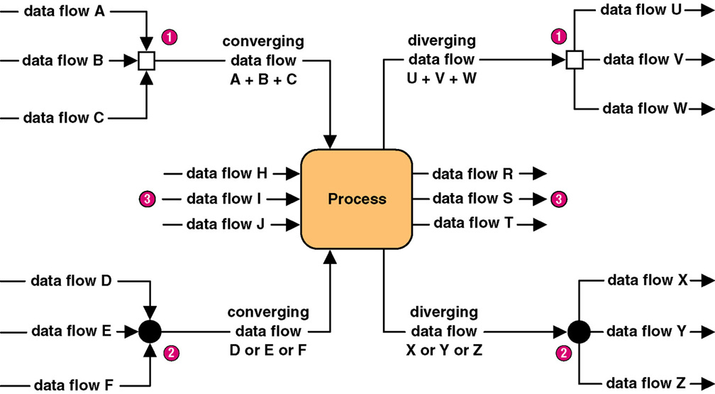
Diverging and Converging
Data Flows
9-<number>
Notes:
Teaching Notes
Different CASE tools use different notations to illustrate converging and diverging data flows. In fact, some CASE tools do not even support this concept.

Slide 27
Modern Structured Analysis
(More Commonly Practiced)
Draw context DFD to establish initial project scope.
Draw functional decomposition diagram to partition the system into subsystems.
Create event-response or use-case list for the system to define events for which the system must have a response.
Draw an event DFD for each event.
Merge event DFDs into a system diagram (or, for larger systems, subsystem diagrams).
Draw detailed, primitive DFDs for the more complex event.
Document data flows and processes in data dictionary.
9-<number>
Notes:
Teaching Notes
Although this process may not be as familiar to some adopters as the top-down, fully leveled, classical “physical-logical-logical-physical” approach in the 1976 DeMarco methodology, this is the more contemporary approach and is taught in our book. The original approach is rarely, if ever, practiced because it is so labor intensive and time consuming.

Slide 28
9.4 Context Data Flow Diagram
Context data flow diagram - a process model used to document the scope for a system. Also called the environmental model.
  Think of the system as a "black box."
  Ask users what business transactions the system must respond to. These are inputs, and the sources are external agents.
  Ask users what responses must be produced by the system. These are outputs, and the destinations are external agents.
  Identify any external data stores, if any.
  Draw a context diagram.
9-<number>
Notes:
Teaching Notes
This may be review from chapter 5.

Slide 29
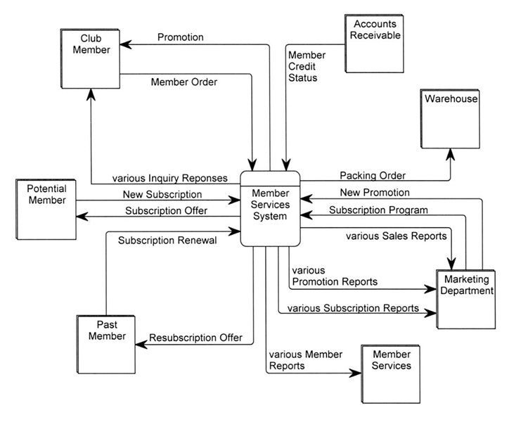
SoundStage Context DFD
9-<number>
Notes:
Teaching Notes
Emphasize that a context DFD does not have to show every net data flow. For most systems, that would overwhelm the reader. Trivial or less common flows can be omitted until later diagrams, and composite data flows can be created to combine multiple flows. As a result, and in the strictest sense, not all primitive data flows may “balance” up to the context DFD, but we sacrifice that balancing to improve readability and validation. All data flows on the context DFD will balance down to the lower-level DFDs (although composite data flows will be replaced by their separate component data flows).

Slide 30
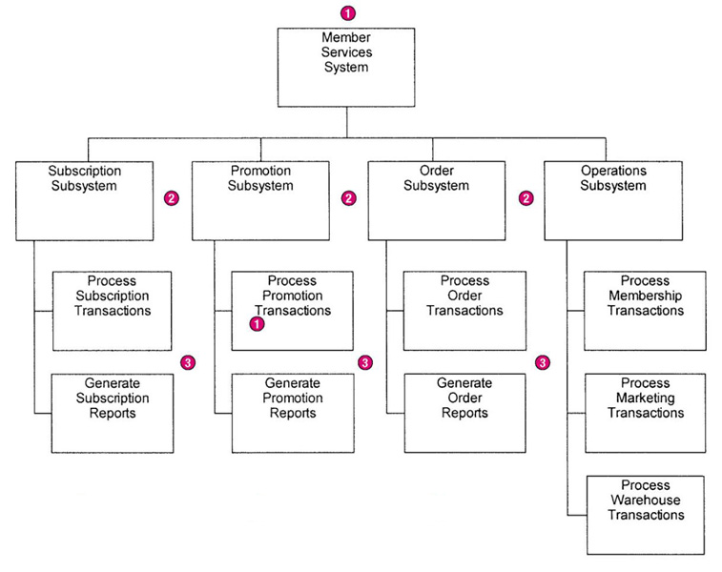
SoundStage Functional
Decomposition Diagram
9-<number>
Notes:
No additional notes.

Slide 31
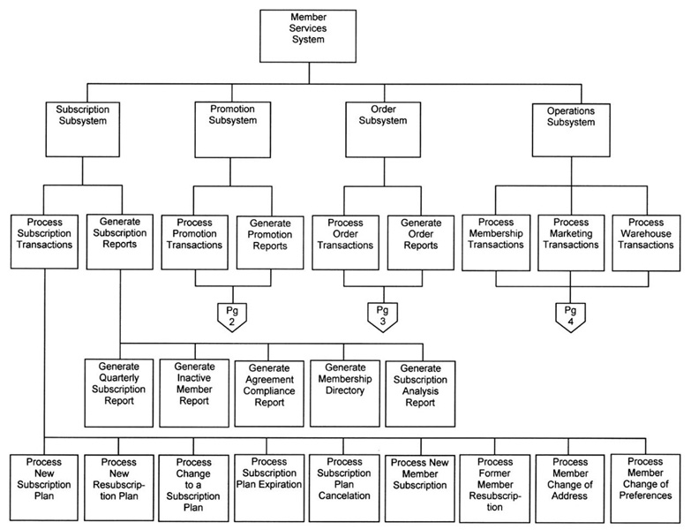
SoundStage Partial Event
Decomposition Diagram(事件分解图)
9-<number>
Notes:
Teaching Notes
Most event decomposition diagrams will require multiple pages (or one very large plotter-style page) because most systems are required to respond to many events (possibly dozens or hundreds).

Slide 32
Event Diagrams(事件图)
Event diagram – data flow diagram that depicts the context for a single event.
  One diagram for each event process
  Depicts
    Inputs from external agents
    Outputs to external agents
    Data stores from which records must be "read." Data flows should be added and named to reflect the data that is read.
    Data stores in which records must be created, deleted, or updated. Data flows should be named to reflect the update.
对数据存储的常规维护
9-<number>
Notes:
No additional notes.

Slide 33
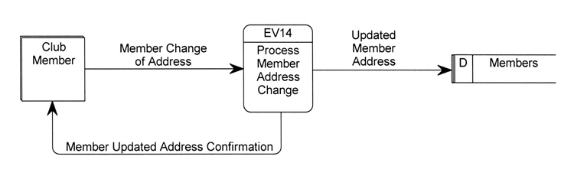
Simple Event Diagram
一个事件中可以有多个过程（3个以内），大多数事件过程不直接互相沟通，它们通过共享的数据存储进行沟通。
9-<number>
Notes:
No additional notes.

Slide 34
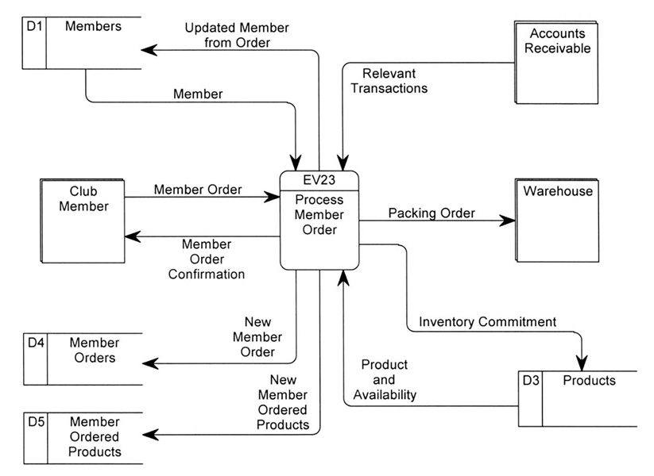
Event Diagram (more complex)
9-<number>
Notes:
No additional notes.

Slide 35
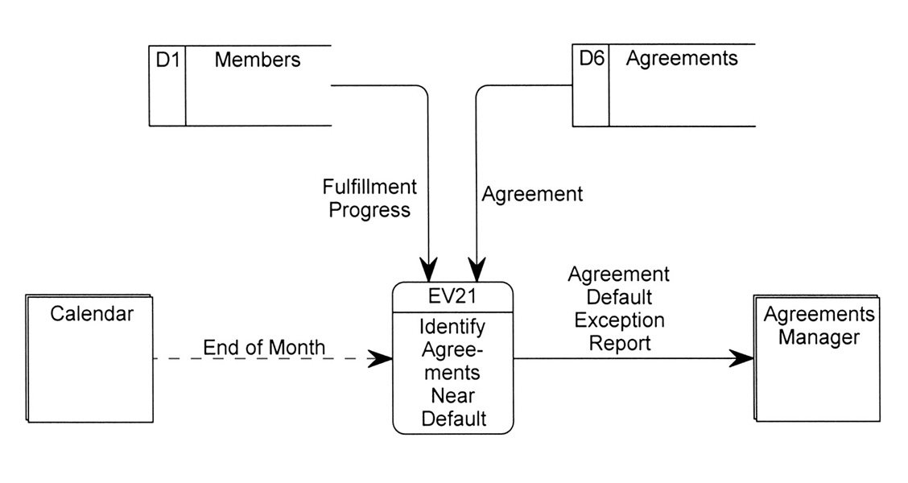
Temporal Event Diagram
9-<number>
Notes:
No additional notes.

Slide 36
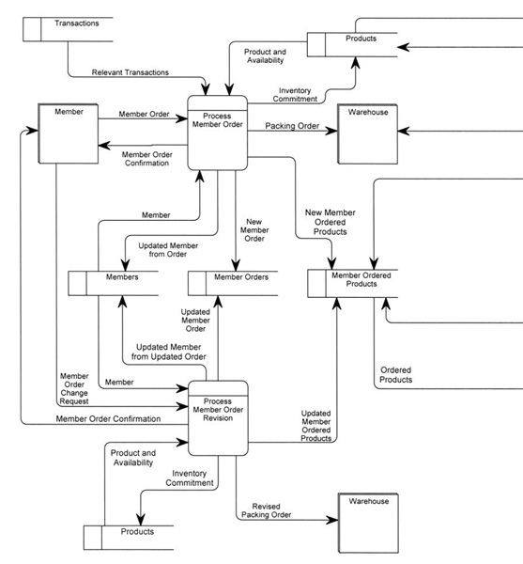
System DFD系统图
P244
9-<number>
Notes:
Teaching Notes
Most system DFDs will not fit on one or two pages—too many event processes. Instead they must be illustrated in a series of system diagrams that correspond to the structure originally depicted in the functional decomposition diagram.

Slide 37
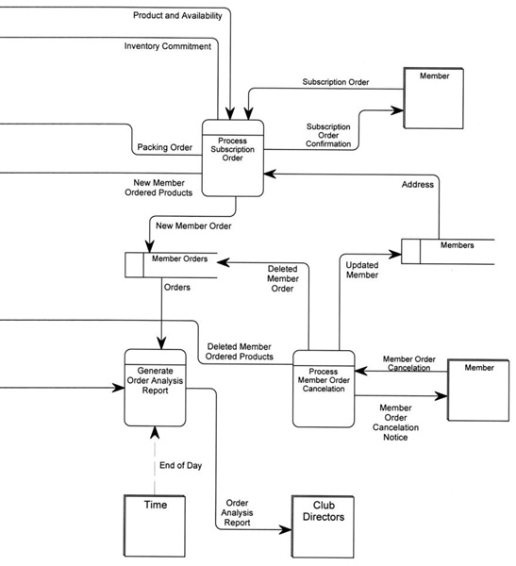
System DFD (concluded)
9-<number>
Notes:
No additional notes.

Slide 38
Balancing
Balancing - a concept that requires that data flow diagrams at different levels of detail reflect consistency and completeness
  Quality assurance technique
  Requires that if you explode a process to another DFD to reveal more detail, you must include the same data flows and data stores
9-<number>
Notes:
Teaching Notes
Discuss balancing with the class, the concept that requires that data flow diagrams at different levels of detail reflect consistency and completeness.

Slide 39
Primitive Diagrams(基本图)
Some (not necessarily all) event processes may be exploded into primitive diagrams to reveal more detail.
  Complex business transaction processes
  Process decomposed into multiple elementary processes
  Each elementary process is cohesive - it does only one thing
  Flow similar to computer program structure
9-<number>
Notes:
Teaching Notes
It is important to recognize that not all events require a primitive DFD to be drawn. This is especially true of most report-writing and inquiry response event processes. Drawing detailed DFDs for such processes is usually little more than “busy work.”

Slide 40
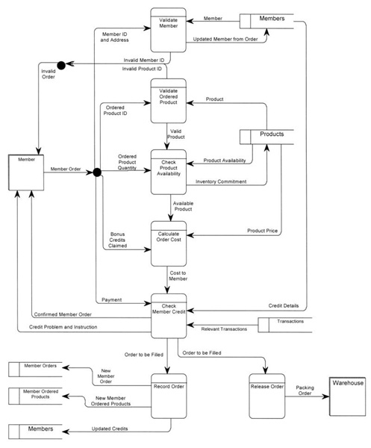
Primitive DFD
(see book for more readable copy)
9-<number>
Notes:
No additional notes.

Slide 41
Context diagram: 图 9-15
System diagran：图922
Event diagram： 图9-19， 图9-20
Primitive diagram: 图9-23
Consist of a DFD.
9-<number>

Slide 42
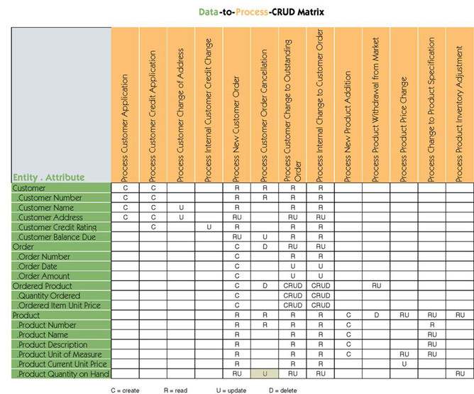
9.5 Data & Process Model Synchronization CRUD Matrix
9-<number>
Notes:
No additional notes.

Slide 43
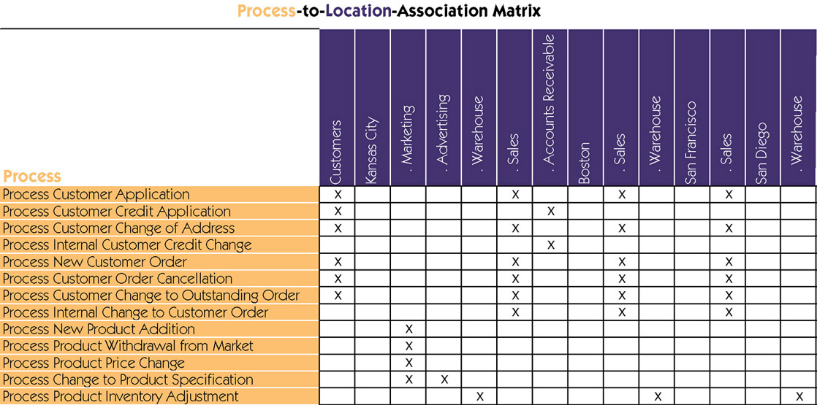
Process Distribution
Central / local implementation
9-<number>
Notes:
No additional notes.

