Slide 1
U-Net
Computer Vision, Convolutional Networks, Transformers & U-Nets

Slide 2
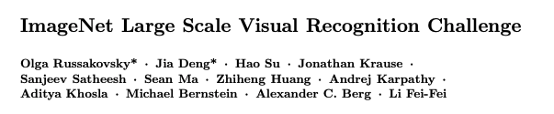
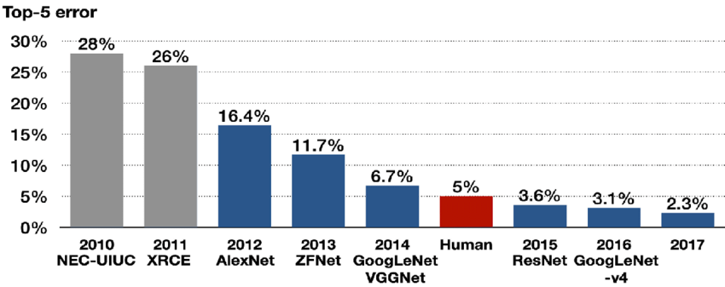
ImageNet
1MM+ Labeled Images
In 1000 Categories
Including Object
Detection
CNN
Deep Learning
Regime
ILSVRC
Contest
Feature Engineering
Regime

Slide 3
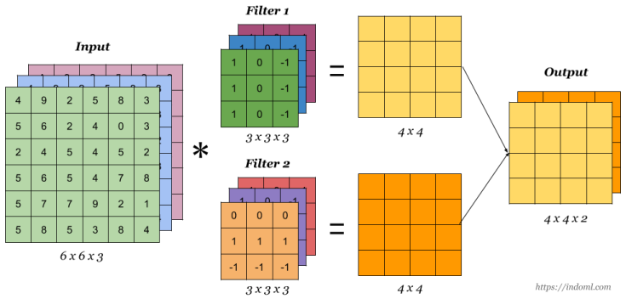
Convolution Operation - Filter
1. Slide Filter
Over Image
Black & White = 1 Channel Filter
RGD = 3 Channel Filter
3. Add
& Store
Result
2. Element-Wise
Multiply Filter

Slide 4
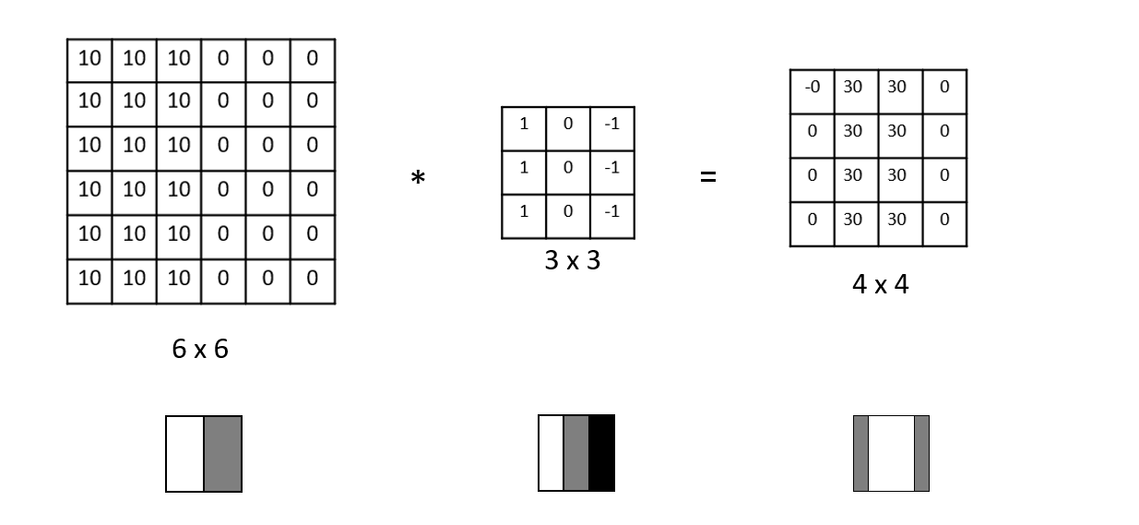
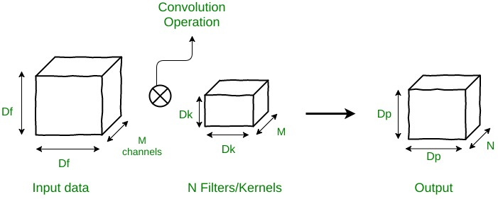
Convolution – Filters are Feature Detectors
Many
Types of Detectors
Edge Detector
In RGB – 3 Filters
Red Edge, Blue Edge, Green Edge

Slide 5
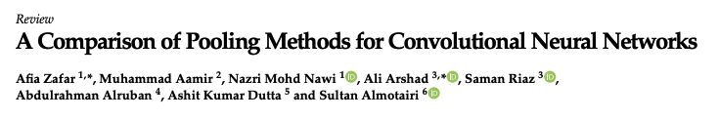
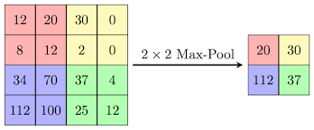
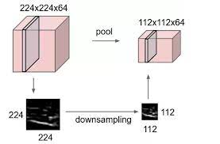
Max Pooling
Hinton
It is surprising that pooling works as well as it does
because it is a form of aggressive subsampling,
which can cause a significant loss of information.
He suggests that the success of pooling may allow the network to learn hierarchical representations,
with each layer focusing on different levels of abstraction.
Additionally, pooling helps to reduce the dimensionality of the data, which can improve computational efficiency and reduce overfitting.
Pooling
Reduces Image
Many Types of Pooling
Beyond Max & Average

Slide 6
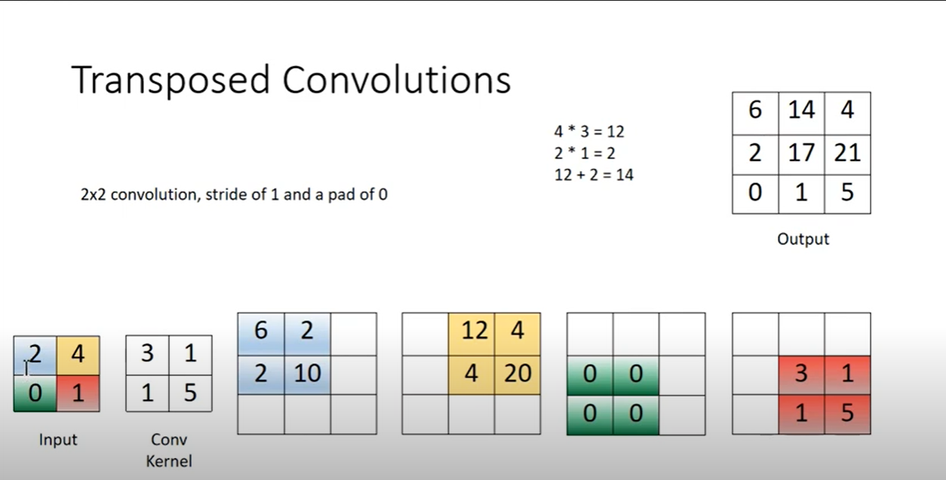
Transposed Convolutions
Addition
Reverse the Convolution
Operation
Element-wise
Projection

Slide 7
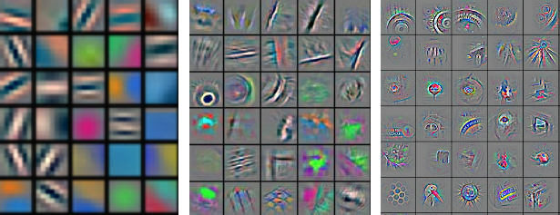
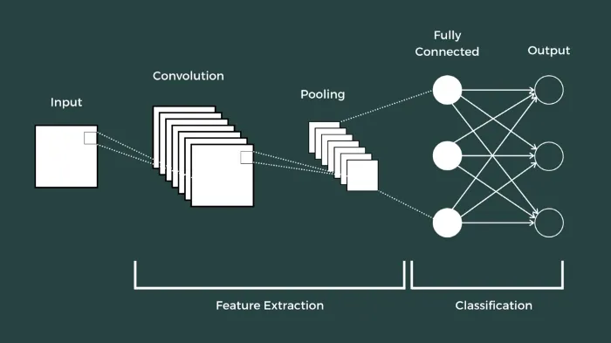
Convolutional Neural Networks
Convolution Layers
Act as Feature Detectors
Convolution Layers
Learn More Complex Patterns
As the Network Goes Deeper

Slide 8
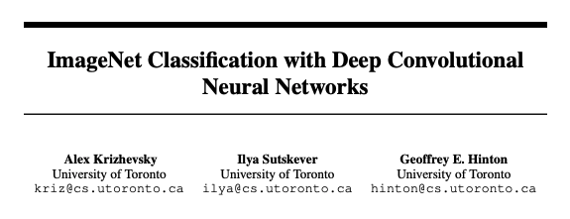
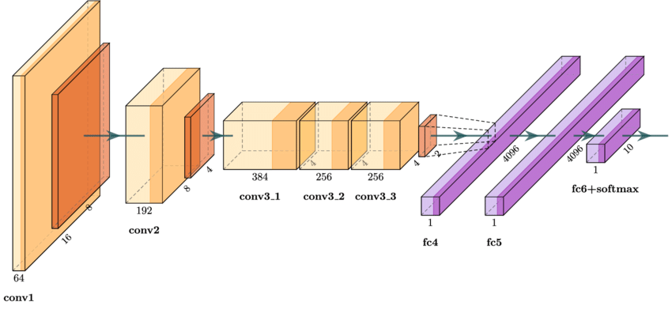
AlexNet
Data
Augmentation
One of Largest CNNs
At that Time
DropOut
Use ReLU
Trained 5-6 Days
On 2 3GB GPUs
Waiting for Bigger GPUs
and Larger Datasets
Trounced ImageNet 2012
15.3% Top 5 vs 26.2%

Slide 9
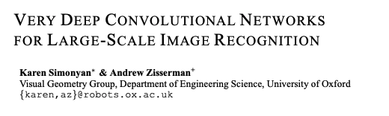
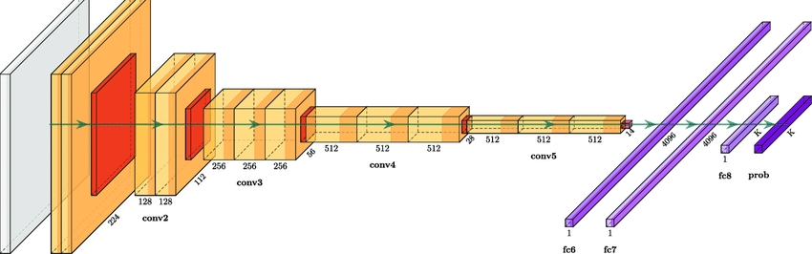
VGG
Deeper
Network
16-19 Layers
Generalizes
Well & Weights
Contributed
Smaller Filters
3x3

Slide 10
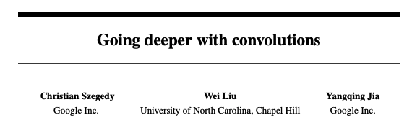
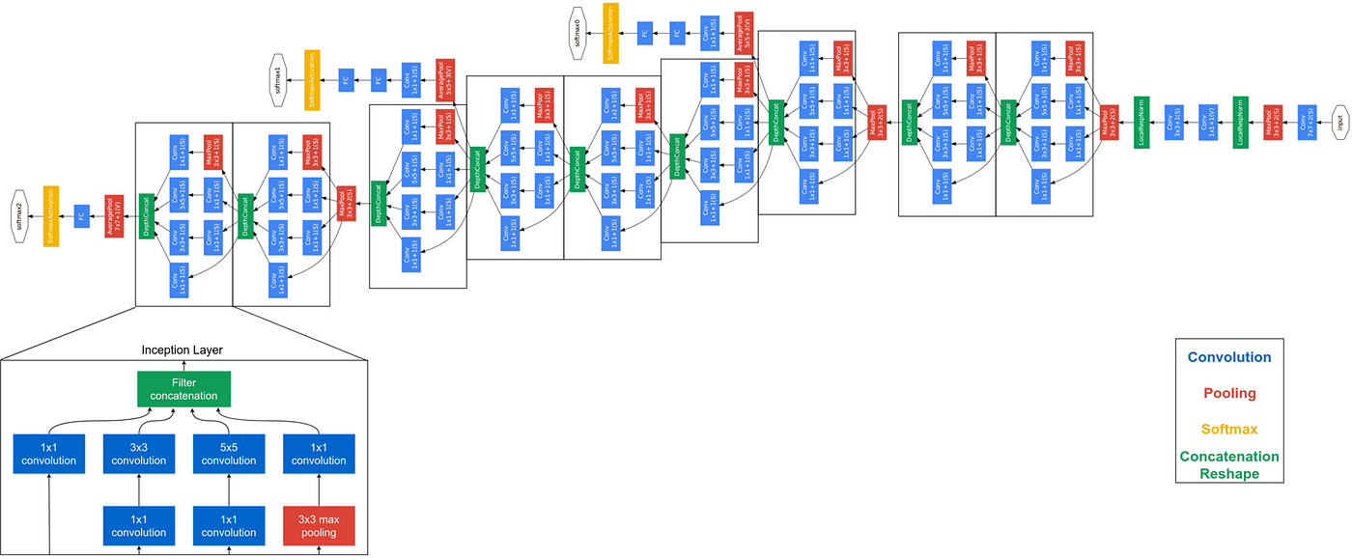
GoogLeNet
SOTA
2014 ImageNet
…
2016 ImageNet
22 Layers Deep
Inception allowed net to go deeper and wider
with a constant compute budget
Paper Uses
Inception Blocks

Slide 11
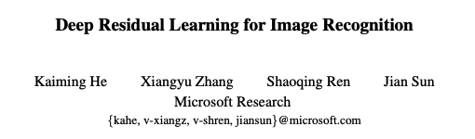
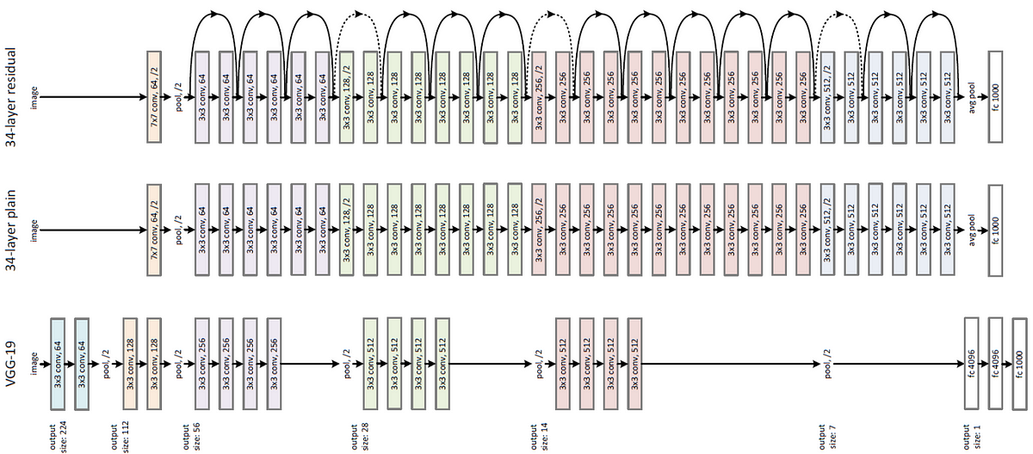
ResNet
152-Layer Variant –
Achieved Human Level Performance

Slide 12
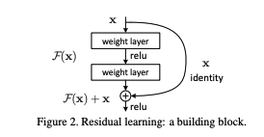
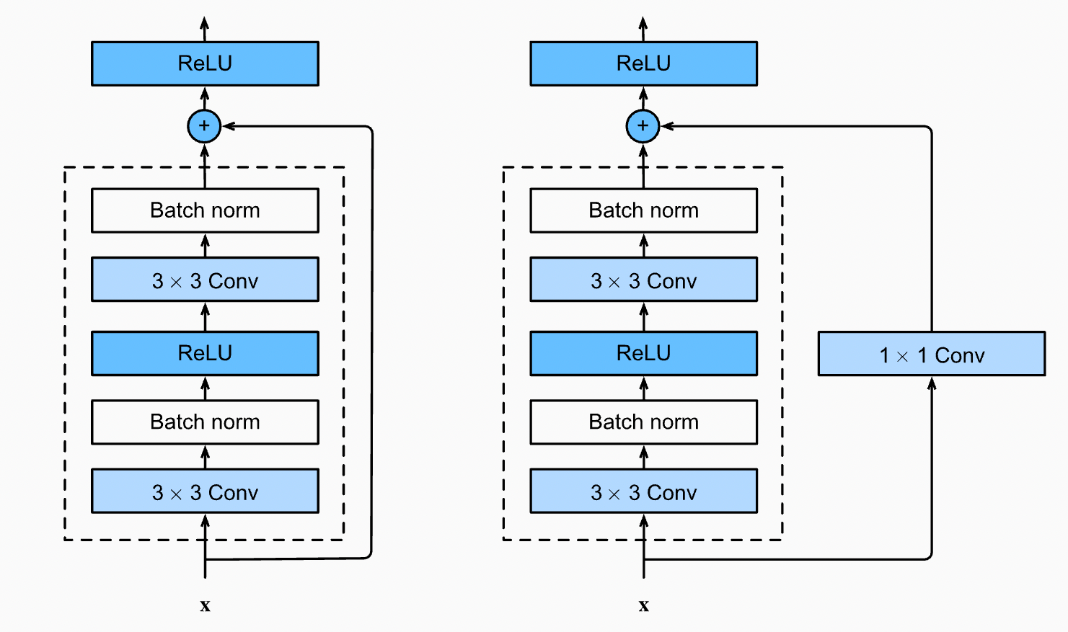
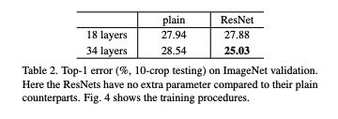
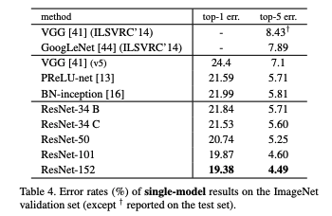
ResNet
Deeper Networks
Perform Better
Deeper Networks
Degrade in Back Prop
Shortcut
Connections
Stack
Residual Blocks
For the Win

Slide 13
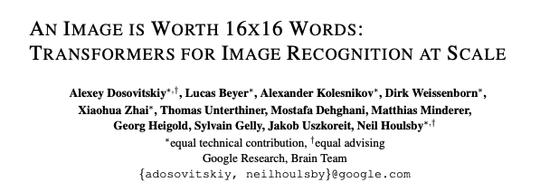
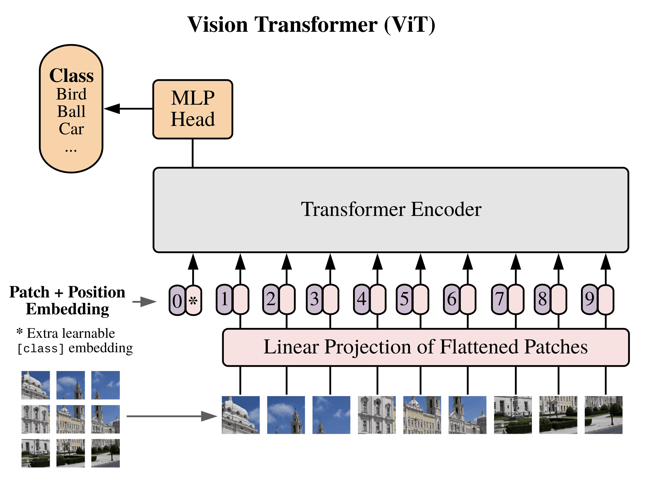
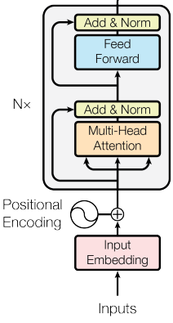
ViT – Vision Transformer
Lacks Inductive Biases
Of CNN (Equivariance & Locality)
Overcome
With Scale

Slide 14
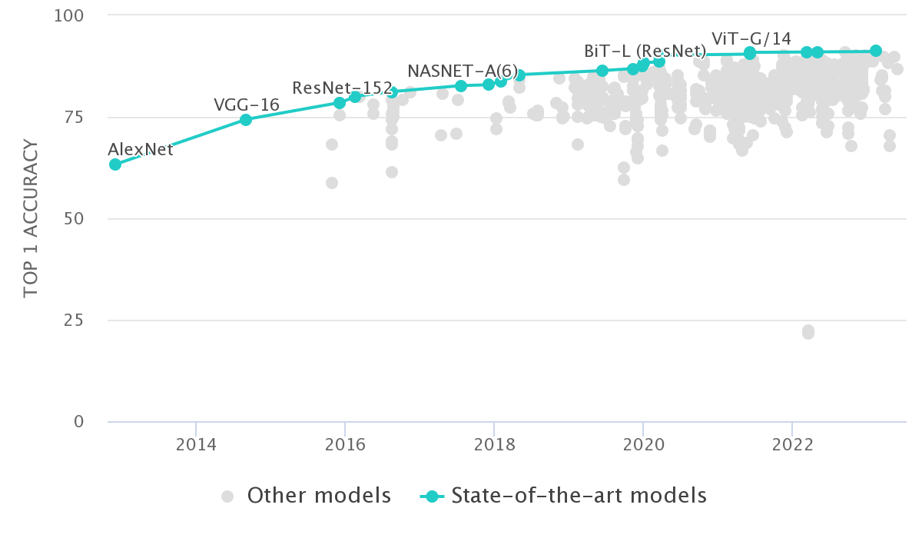
Top Models

Slide 15
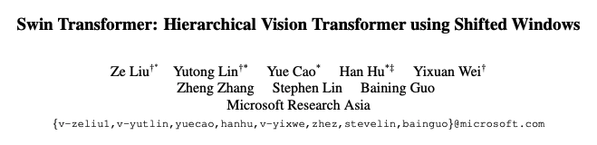
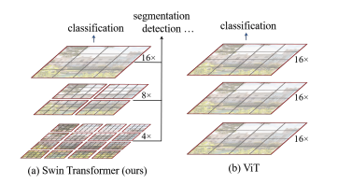
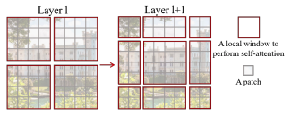
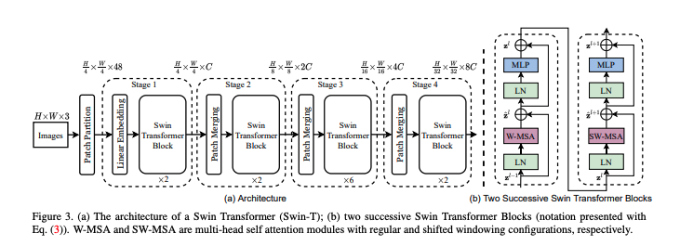
SWIN Transformer
Hierarchical
Better
Local & Global
Shifting Windows
Better Long Range
Dependencies
Pre-Train
On Large Datasets
Patches
Partitioning
(Into Multiple Tokens)
Patches
Merging
Combine for Larger
Context Capture

Slide 16
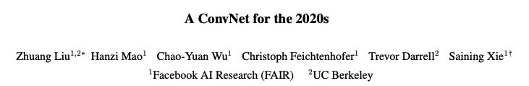
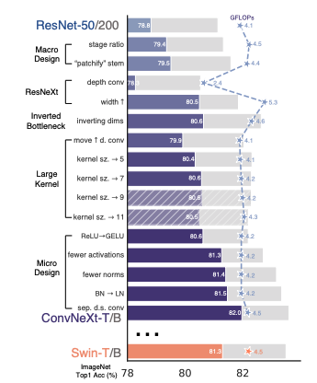
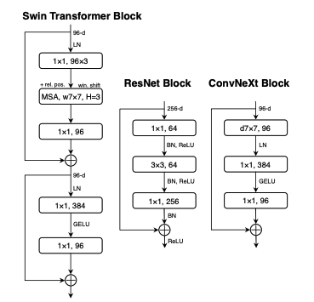
ConvNets 2020s

Slide 17
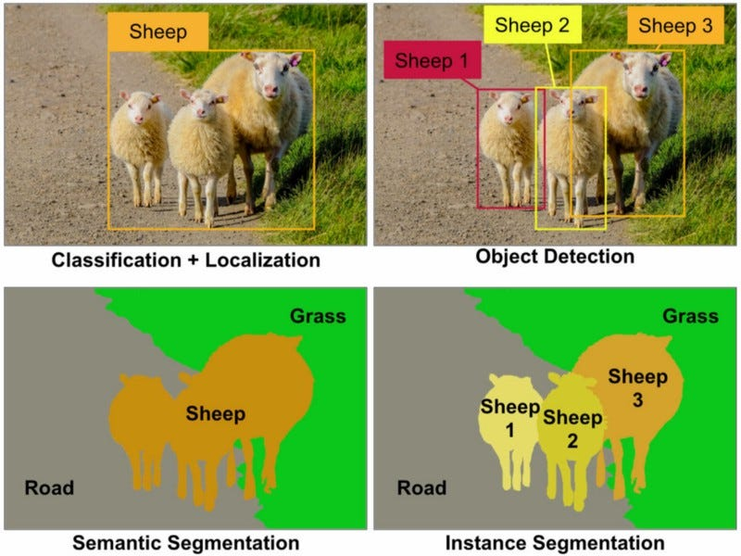
Classification vs Segmentation
Detection
Classification +
Bounding Box
Prediction
Algorithms & Innovation
R-CNN, Fast R-CNN, Faster R-CNN, YOLO
Segmentation =
Classification
Of Each Pixel

Slide 18
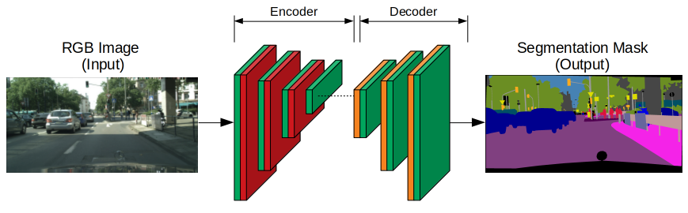

Segmentation Encoder – Decoder
How to keep Precision?
Measuring Loss?
Hinton
It is surprising that pooling works as well as it does
because it is a form of aggressive subsampling,
which can cause a significant loss of information.

Slide 19
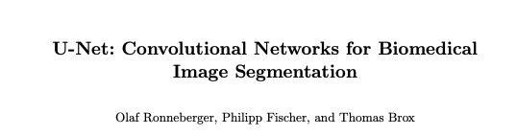
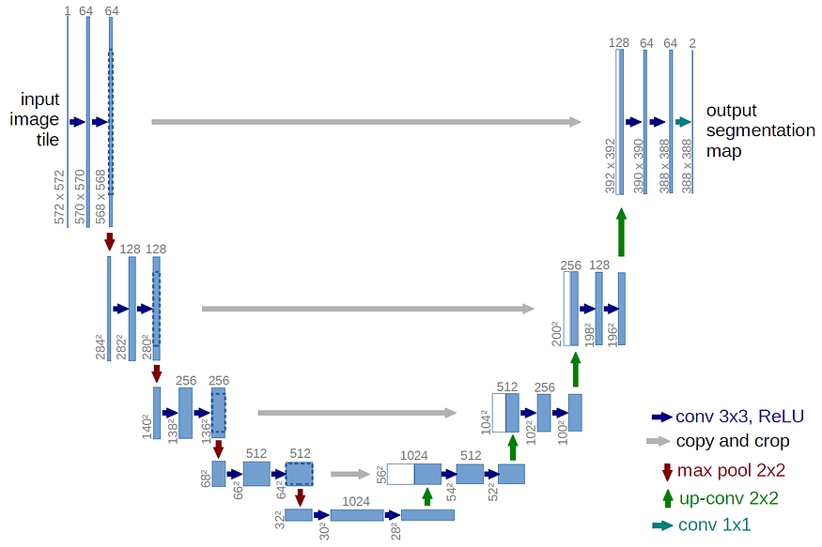
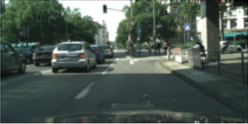
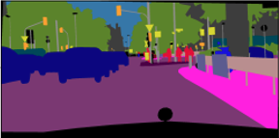
U-Net
Skip Connections
Feature
Detection
Pixel
Space
Conv 2D
Pixel Accuracy
Max Pool
Bottleneck

Slide 20
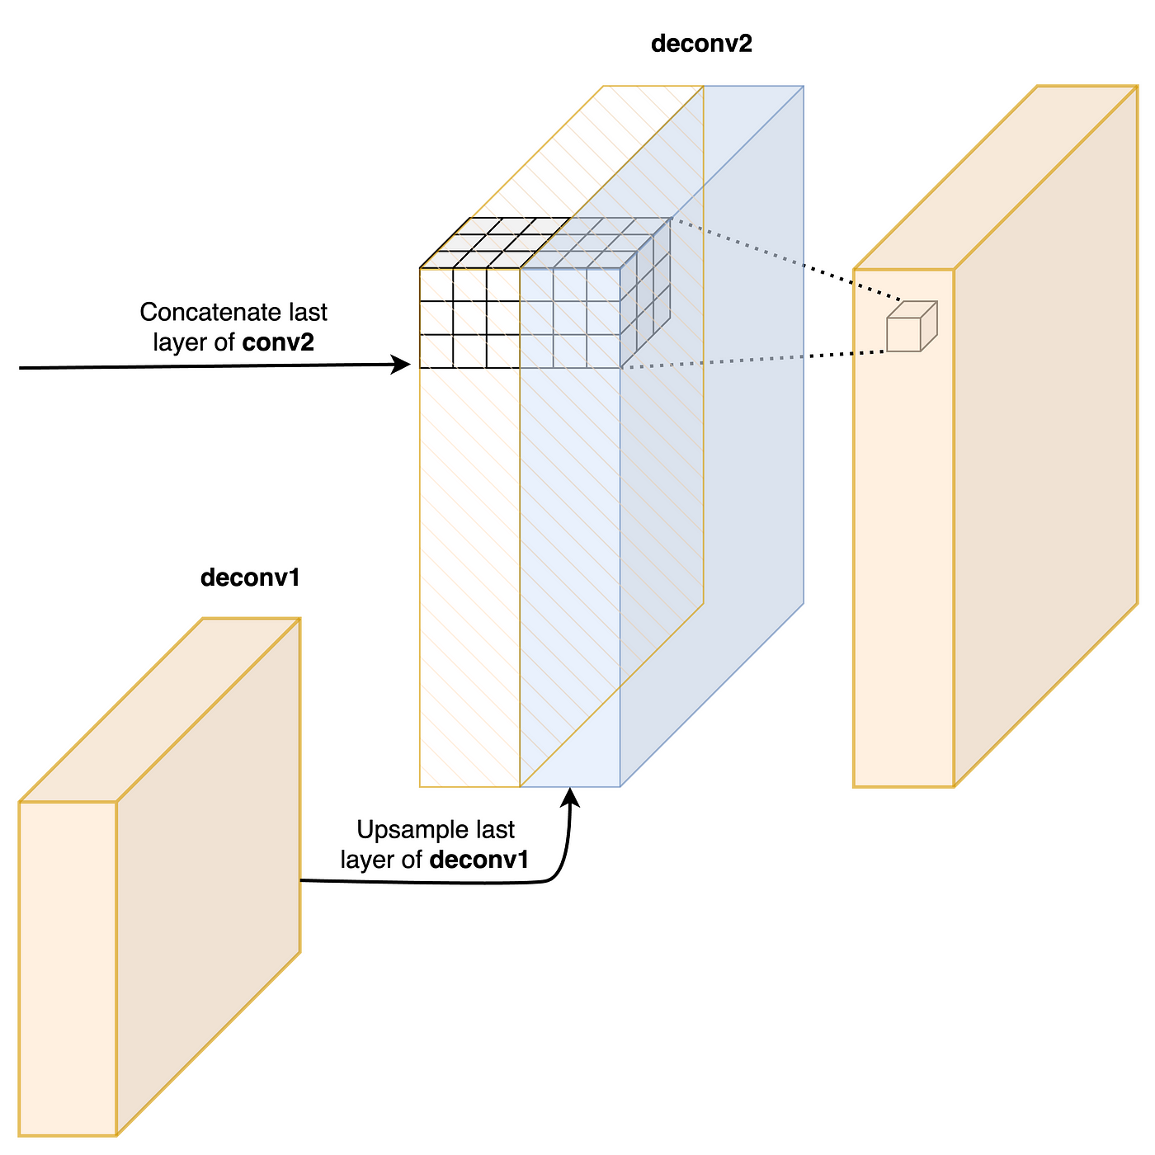
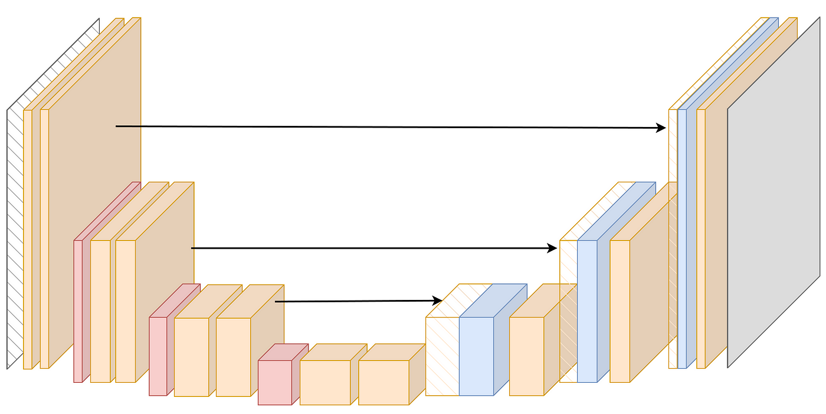
U-Net - Intuitions
Proposed Improvements / Papers
U-Net++ (Nesting)
Attention U-Net
U-Net with Residual Connections
Skip Connections
Keeps spatial information
As we down / up sample
Feature detectors
Encoder
Moves to Latent Space
Feature Detect
Pretty Efficient
Doesn’t require large
Datasets

