Slide 1
JavaScript History
Created in May 1995 by Brendan Eich
ECMAScript 2 ---1998
ECMAScript 3 ---1999
ECMAScript 5 ---2009
ECMAScript 6 ---2015
ECMAScript 7
https://github.com/tc39/ecma262
https://developer.mozilla.org/en-US/

Slide 2
JS data types: By Val, By Ref
Primary data types: Number, String, Null, Boolean, undefined
Referenced Type: Array, Function, Object

Slide 3
Front end build tools
Installation and help do work

Slide 4
ES6 features in React
Arrow function
const and let (no hoisting)
Function default value
Object.assign()
Destructuring and Spread operator
Import, Export, Class
Backtick, especially in Angular
*remove global object definition
**demo some important code related to immutable application such as spread operation, destructure, deep copy of Object(Babel REPL)
React Syntax ---JSX (Babel REPL)

Slide 5
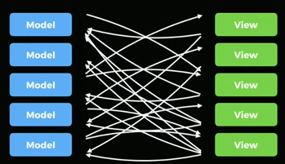
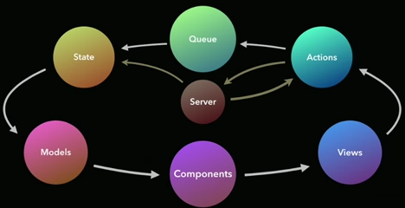
React App Architecture
MVC left with lots of challenge things not resolved
Immutable App Architecture

Slide 6
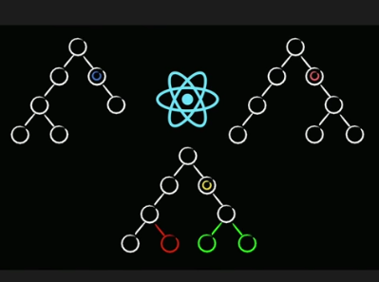
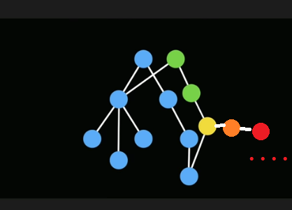
React – Immutable Application
* Lee Byron presentation on “Immutable User Interface”
**Demo elements is being copied many many……

Slide 7
React App Architecture Implementation
Facebook provide Flux solution:
Most Popular Solutions:
MobX observable: state is mutable
Redux functional: state is immutable

Slide 8
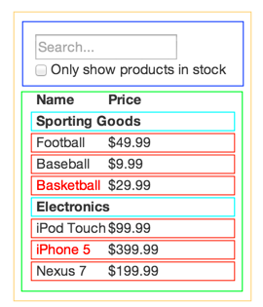
React Introduction--Component
https://facebook.github.io/react/docs/thinking-in-react.html

Slide 9
React Introduction—Key concepts
Key concept: View is the output of State
Essence: Using JS function to create the GUI
Important features: components(this.props, this.state, this. refs), virtual DOM, immutable app architecture
Life Cycle: componentWillMount(), componentDidMount()*, componentWillUpdate()*, componentDidUpdate(), componentWillUnmount(), componentWillReceiveProps()
JSX, Babel transpiler
* NEVER, NEVER USE setState()

Slide 10
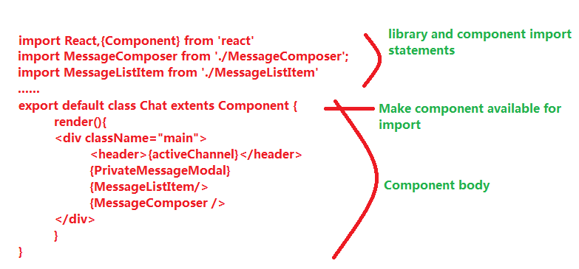
React Component

Slide 11
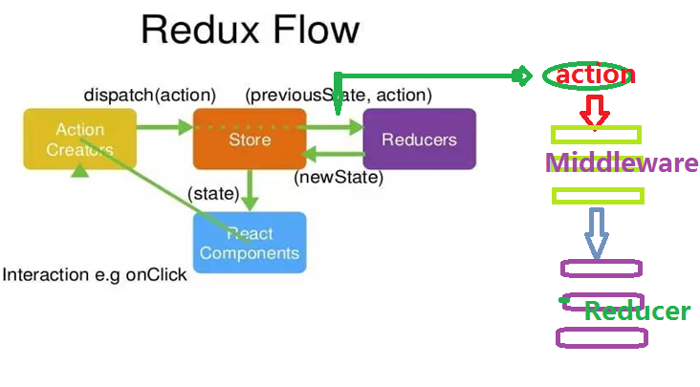
Redux---State Container
Don’t need Redux if your app is simple, no users’ interaction, no server interaction
Web app is about state, view and state one to one relationship, all states in store object.
const store=createStore(reducer)

Slide 12
Redux---State Container
View: 1:1 with state
Action: carry the data
Reducer : pure function, only for calculate state
Middleware: the place for add functions, example: applyMiddleware(thunk, promise, logger); thunk middleware make store.dispatch can accept function as parameter

Slide 13
React-Redux Introduction
Component separate into 2 parts: UI—a pure UI, container – data and logic
connect(): create container from UI,
const TodoList=connect(
mapStateToProps,
mapDispatchToProps
)(ToDoList)
Provider: help pass state object to UI
<Provider store={store}>
<App/>
</Provider>
React-Router
const Root = ({ store }) => (
<Provider store={store}>
<Router>
<Route path="/" component={App} />
</Router>
</Provider>
);

Slide 14
React Project Demo
We are going to learn a pretty solid example to demo: React-Redux-SocketIO project--- An open source ChatRoom project using MongoDB as database:
https://github.com/raineroviir/react-redux-socketio-chat
Project Overview and folder structure
Send/Create message process
Receive/Dispatch message process

Slide 15
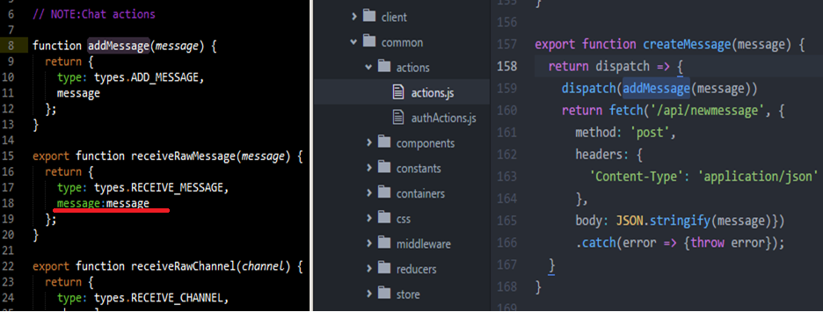
CreateMessage I
src/…/ actions/actions.js

Slide 16
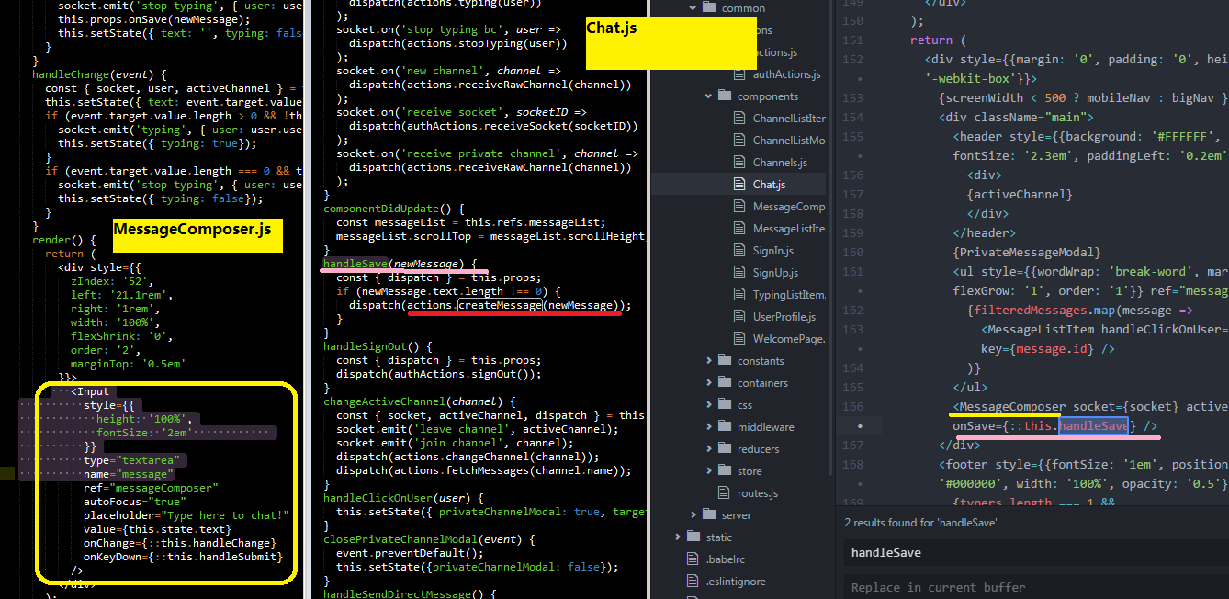
CreateMessage II
src/…/ components/Chats.js, MessageComposer.js

Slide 17
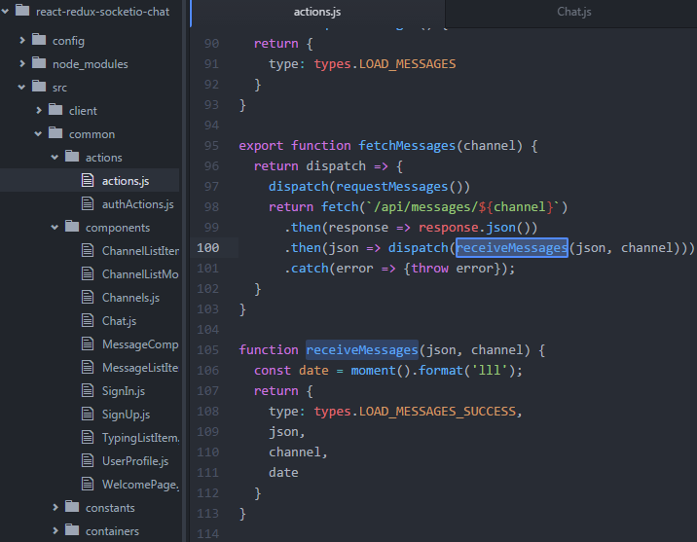
Receive Message I
src/…/ actions/actions.js

Slide 18
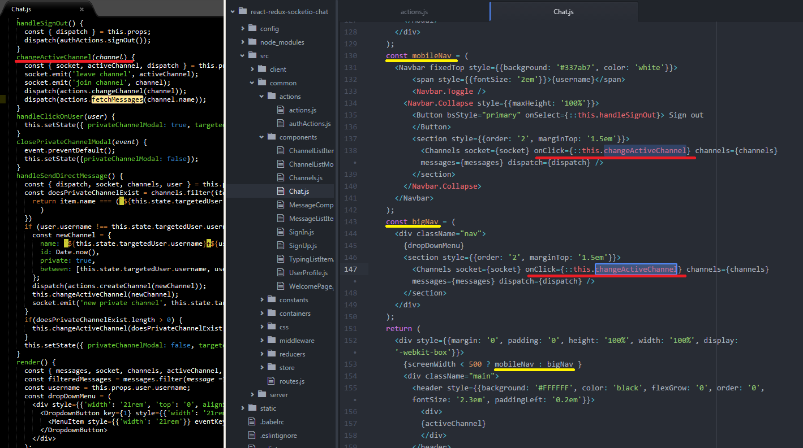
Receive Message II

Slide 19
Action-Middleware-Reducer (use receive message as an example, slide 11)
///ACTION:
function receiveMessages(json, channel){ }
export function fetchMessages(channel) { } <--- isomorphic-fetch
http://localhost:3000/api/messages/Lobby
///Reducer:
LOAD_MESSAGES_SUCCESS
///Middleware
promiseMiddleware
message_routes.js: http://localhost:3000/api/channels; http://localhost:3000/api/messages/Lobby
////Store
configureStore.dev.js: export configureStore
../src/client/index.js <--- entry point; root element named: “react”
Once “store” get new data, through “Provider”, it will update GUI by “state”

Slide 20
How to start React Project
Method I
npm install -g create-react-app
create-react-app name_of_project
cd name_of_project
npm start
Method II
Using a start boilerplate Projection
https://github.com/StephenGrider/ReduxSimpleStarter

Slide 21
Q & A
?

