Slide 1

Housing Price Analysis
Zhengyu Li, Naikang Zhao, Tianwei Zhang,
Chaoyang Yu, Ziying Huang

Slide 2
Team Introduction
1
2
3
Ziying Huang
Zhengyu Li
Naikang Zhao
4
5
Tianwei Zhang
Chaoyang Yu
Ziying Huang

Slide 3
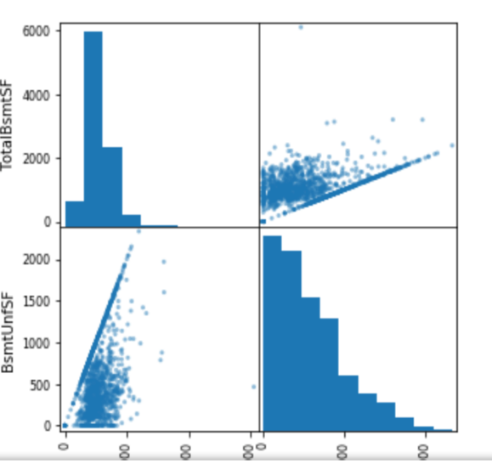
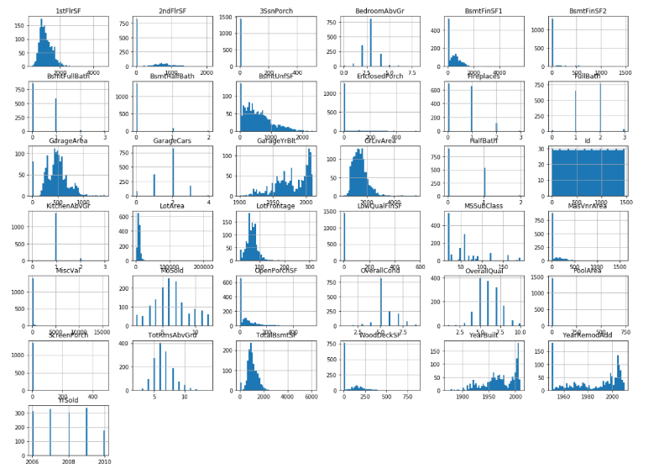
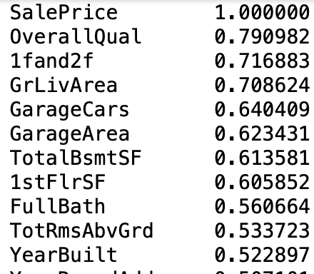
Description of Data
LTV_appreciation=
(LTV_time-LTV_orig_time)/LTV_orig_time
Data Viewing
Removing Correlation
Histogram
Scatterplot
Train
Data
Variable Selection
Missing Variables
Correlation
Median
Categorical Variables
Transformation for Algorithm
OneHotEncoder
Pipelines
Zhengyu Li

Slide 4



Model
Linear Regression, Decision Tree and Random Forest
MSE&RMSE,MAPE
Cross Validation Method
RMSE Score: Mean and Std
Test Promising Model& Predict
Process and Run Test Data
Naikang Zhao

Slide 5
Metrics
 | MAPE | RMSE
Linear Regression | 0.0781 | 20505.68
Ridge Regression | 0.0858 | 22971.24
Lasso Regression | 0.0782 | 20511.98
Decision Tree |  | 0
Random Forest | 0.1188 | 29146.75
Cross-Validation for Linear Regression |  | 33555.46
Cross-Validation for Decision Tree |  | 43241.88
Cross-Validation for Random Forest |  | 30824.69
Tianwei Zhang

Slide 6
Future Work
Data Transformation
Still have a lot to explore with data
How to deal with categorical variables
Model
Still could improve the model selection
Could improve metrics
Chaoyang Yu

Slide 7
Thanks !

