Slide 1

Housing Price Analysis
Zhengyu Li, Naikang Zhao, Tianwei Zhang,
Chaoyang Yu, Ziying Huang

Slide 2
Team Introduction
1
2
3
Ziying Huang
Naikang Zhao
Zhengyu Li
4
5
Tianwei Zhang
Chaoyang Yu
Ziying Huang

Slide 3
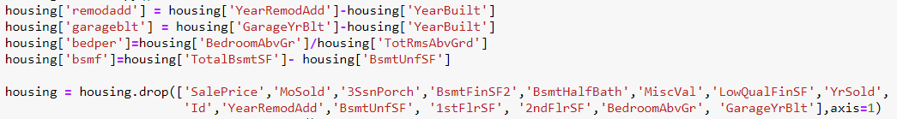
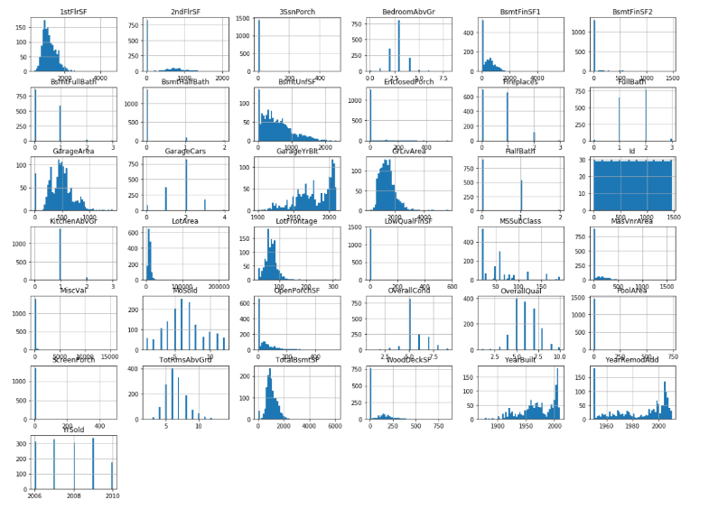
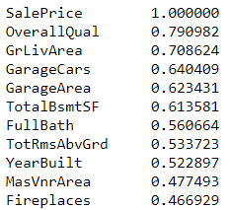
Description of Data
LTV_appreciation=
(LTV_time-LTV_orig_time)/LTV_orig_time
Data Viewing
Variable Selection
Numerical &Categorical
Numerical
Train
Data
Correlation Viewing
Missing Variables
Correlation
Median
Categorical Variables
Transformation for Algorithm
OneHotEncoder
Pipelines
Naikang Zhao

Slide 4

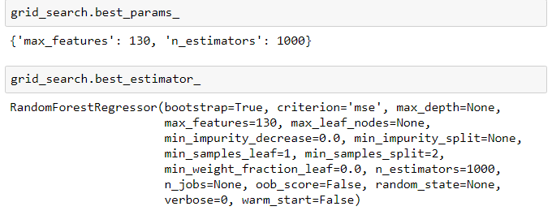


Model
Linear Regression (Simple, Lasso and Ridge), Decision Tree and Random Forest
Criterion: MAPE
Grid Search Method
Validation and Prediction
Using Test Data
Zhengyu Li

Slide 5
Metrics
 | MAPE for Training | MAPE for Test
Random Forest (Grid Search) | 0.036 | 0.096
Linear Regression | 0.078 | 0.111
Decision Tree | 0 | 0.144
Lasso Regression | 0.078 | 0.109
Ridge Regression | 0.086 | 0.102
Random forest model has a better performance than others.
The mean absolute percentage error is 0.096.
Tianwei Zhang

Slide 6
Future Work
Still have a lot to explore with data
How to deal with categorical variables
Data Transformation
Model
Still could improve the model selection
Could improve metrics
Chaoyang Yu

Slide 7
Thanks !

