Slide 1
Bandwidth-efficient Live Video Analytics for Drones via Edge Computing
2018 Third ACM/IEEE Symposium on Edge Computing
Notes:
2b331a9e-077f-40be-b75c-21e6a745a7dd

Slide 2
INTRODUCTION
01
Notes:
33793d8b-addd-44af-aac1-4db8275dd9b8

Slide 3
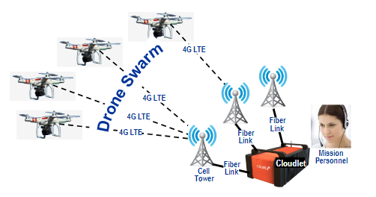
INTRODUCTION
In this paper, we show how edge computing can greatly reduce the per-drone bandwidth demand for video analytics, without compromising the timeliness or accuracy of results.
Notes:
33793d8b-addd-44af-aac1-4db8275dd9b8

Slide 4
INTRODUCTION
Contributions
A bandwidth-efficient architecture
Four different strategies to reduce total transmission：
EarlyDiscard, Just-in-Time-Learning, Reachback and Context-Aware
Notes:
33793d8b-addd-44af-aac1-4db8275dd9b8

Slide 5
VIDEO PROCESSING ON SMALL DRONES
02
Notes:
bba190d2-40de-4a4c-9bbc-320eb6c9cc13

Slide 6
VIDEO PROCESSING ON SMALL DRONES
A. Payload and Drone Size
B. Result Latency, Offloading & Scalability
Notes:
e2059bf4-0e3a-4364-8c0d-22aa6aa52355

Slide 7
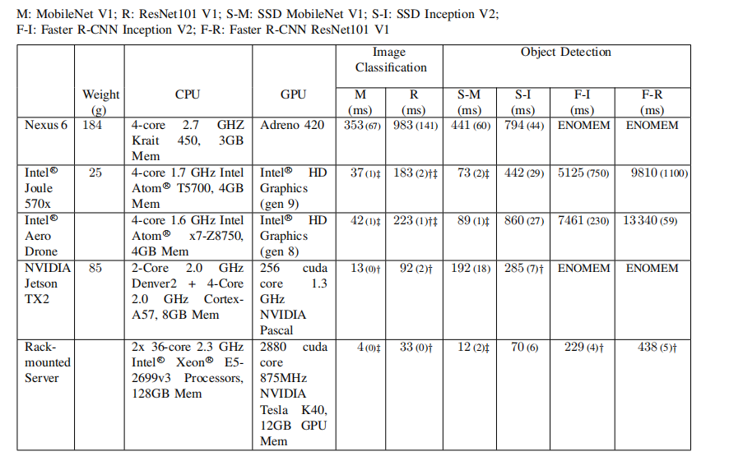
Notes:
e2059bf4-0e3a-4364-8c0d-22aa6aa52355

Slide 8
VIDEO PROCESSING ON SMALL DRONES
Result latency is the delay between first capture of a video
frame in which a particular result (e.g., image of a survivor)
and report of its discovery to mission personnel after video processing
At that point, the data can be uploaded from the drone to
the cloud and processed there.
A different approach is to offload video processing during flight over a wireless link to an edge computing node called a cloudlet. With this approach, even a small drone can leverage the substantial processing capability of a ground-located cloudlet, without concern for its weight, size, heat dissipation, or energy usage.
Notes:
e2059bf4-0e3a-4364-8c0d-22aa6aa52355

Slide 9
VIDEO PROCESSING ON SMALL DRONES
Scalability
For example, a pipeline that has virtually no false positives or false negatives in detecting survivors will consume less supervisory human attention than a mediocre pipeline. That will allow one person to confidently supervise a large swarm that rapidly covers a large search area.
Notes:
e2059bf4-0e3a-4364-8c0d-22aa6aa52355

Slide 10
SYSTEM ARCHITECTURE
03
Notes:
bba190d2-40de-4a4c-9bbc-320eb6c9cc13

Slide 11
SYSTEM ARCHITECTURE
Notes:
e2059bf4-0e3a-4364-8c0d-22aa6aa52355

Slide 12
SYSTEM ARCHITECTURE
Reducing Bandwidth Demand
EARLYDISCARD: Use limited processing on the drone to avoid transmitting “uninteresting” video frames.
• JUST-IN-TIME-LEARNING (JITL): Use real-time machine learning on the early part of an input video stream to adapt and improve drone processing on the later part of the video stream.
• REACHBACK: Compensate for over-zealous filtering on the drone by having the cloudlet reach back and re-quest suppressed video segments from drone storage to discover false negatives.
• CONTEXTAWARE: Exploit unique opportunities for op-timization that are only possible because of specific attributes of the current mission and video stream.
Notes:
e2059bf4-0e3a-4364-8c0d-22aa6aa52355

Slide 13
SYSTEM ARCHITECTURE
Key Performance Indicators
Precision and recall, which are the classic measures of
computer vision accuracy, are also important.
recall——False negatives（miss events）
Precision——false positives（wrong events）
Notes:
e2059bf4-0e3a-4364-8c0d-22aa6aa52355

Slide 14
DUMBDRONE STRATEGY
04
Notes:
bba190d2-40de-4a4c-9bbc-320eb6c9cc13

Slide 15
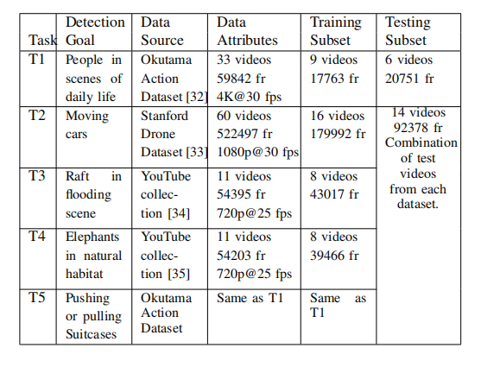
DUMBDRONE STRATEGY
Notes:
e2059bf4-0e3a-4364-8c0d-22aa6aa52355

Slide 16
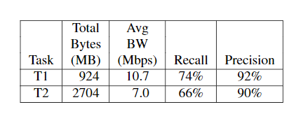
DUMBDRONE STRATEGY
We use the well-labeled dataset to train and evaluate Faster-RCNN with ResNet 101
As shown earlier in Figure 3, the accuracy of this algorithm comes at the price of very high resource demand. This can only be met today by server-class hardware that is available in a cloudlet. Even on a cloudlet, the figure of 438 milliseconds of processing time per frame indicates that only a rate of two frames per second is achievable.
Note that the results in Figure 3 were based on 1080p frames, while tasks T1 and T5 use the higher resolution of 4K. This will further increase demand on cloudlet resources.
Notes:
e2059bf4-0e3a-4364-8c0d-22aa6aa52355

Slide 17
EARLYDISCARD STRATEGY
05
Notes:
bba190d2-40de-4a4c-9bbc-320eb6c9cc13

Slide 18
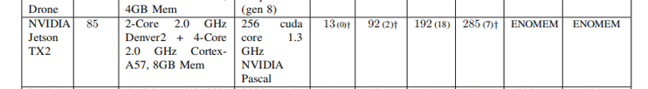
EARLYDISCARD STRATEGY
early discard only requires image classification: it is not necessary to know exactly where in the frame a relevant object occurs. This suggests that MobileNet would be a good choice as a weak detector. Its speed of 13 ms per frame on Jetson yields more than 75 fps. We therefore use MobileNet on the drone for early discard in our experiments.
Notes:
e2059bf4-0e3a-4364-8c0d-22aa6aa52355

Slide 19
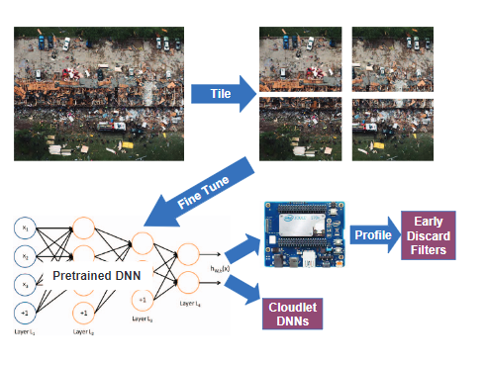
EARLYDISCARD STRATEGY
we tile high resolution frames into multiple sub-frames and then perform recognition on the sub-frames.
The price paid for tiling is increased computational demand. For example, tiling a frame into four sub-frames results in four times the classification workload.
Notes:
e2059bf4-0e3a-4364-8c0d-22aa6aa52355

Slide 20
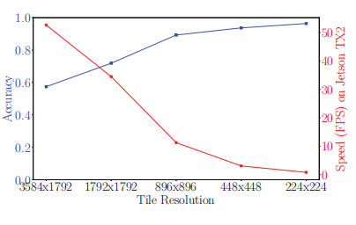
EARLYDISCARD STRATEGY
The choice of an operating point will need to strike a balance between the speed and accuracy. In the rest of the paper, we use two tiles per frame by default.
T1 of Figure 4
Notes:
e2059bf4-0e3a-4364-8c0d-22aa6aa52355

Slide 21
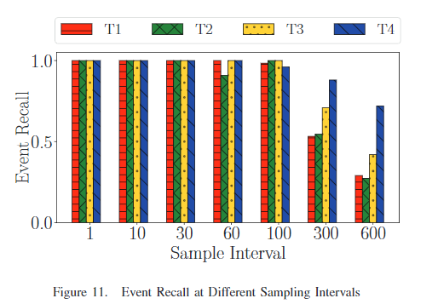
EARLYDISCARD STRATEGY
This suggests that simply restricting the number of transmitted frames by sampling may help reduce bandwidth consumption.
However, if the events just a few frames long, then this method would be less effective, as sampling may lead to many missed events (false negatives).
Notes:
e2059bf4-0e3a-4364-8c0d-22aa6aa52355

Slide 22
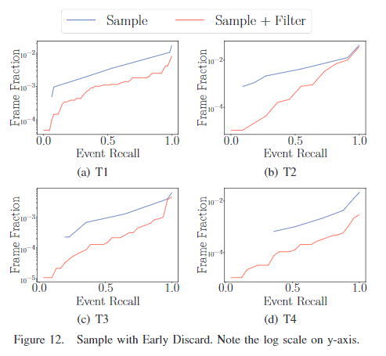
EARLYDISCARD STRATEGY
This shows that for the same recall, we can reduce the bandwidth consumed by another factor of 5 on average over sampling alone.
Furthermore, more processing time is available per processed frame, allowing more sophisticated algorithms to be employed, or to allow smaller tiles to be used, improving accuracy of early discard.
Notes:
e2059bf4-0e3a-4364-8c0d-22aa6aa52355

Slide 23
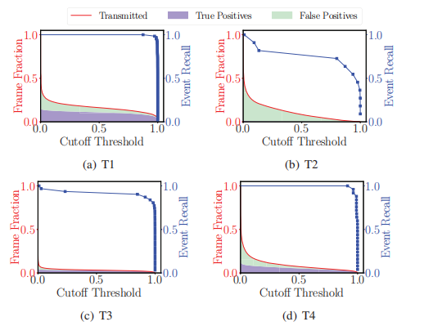
EARLYDISCARD STRATEGY
MobileNet DNN filter detect all the events for T1 and T4 even at a high cutoff threshold. Achieving high recall on T2 and T3 (on the order of 0.95 or better) requires setting
a low cutoff threshold.
Notes:
e2059bf4-0e3a-4364-8c0d-22aa6aa52355

Slide 24
JUST-IN-TIME-LEARNING STRATEGY
06
Notes:
bba190d2-40de-4a4c-9bbc-320eb6c9cc13

Slide 25
JUST-IN-TIME-LEARNING STRATEGY
Just-in-time-learning (JITL) reduce transmitted false positives from the drone, and therefore reduce wasted bandwidth.
Specifically, when a frame is reported as positive by Ear-lyDiscard, it is then passed through a JITL filter. If the JITL filter reports negative, the frame is regarded as a false positive and will not be sent.
so this approach can only serve to improve precision, but not recall.
Notes:
e2059bf4-0e3a-4364-8c0d-22aa6aa52355

Slide 26
JUST-IN-TIME-LEARNING STRATEGY
we use a linear support vector ma-chine (SVM) [41] as the JITL filter. Linear SVM has several advantages: 1) short training time in the order of seconds; 2) fast inference; 3) only requires a few training examples; 3) small in size to transmit, usually on the order of 50KB in our experiments.
The input features to the JITL SVM filter are the image features extracted by the EarlyDiscard DNN filter.
Notes:
e2059bf4-0e3a-4364-8c0d-22aa6aa52355

Slide 27
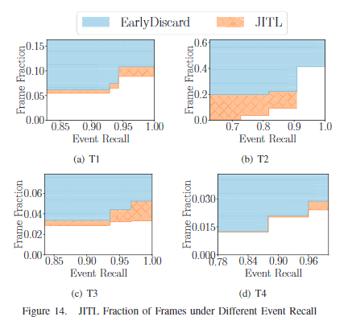
JUST-IN-TIME-LEARNING STRATEGY
at the highest event recall, JITL filters out more than 15% of remaining frames. This shows that JITL is effective at reducing the false positives thus improving the precision of the drone filter.
Notes:
e2059bf4-0e3a-4364-8c0d-22aa6aa52355

Slide 28
REACHBACK STRATEGY
07
Notes:
bba190d2-40de-4a4c-9bbc-320eb6c9cc13

Slide 29
REACHBACK STRATEGY
The essence of the reachback strategy is to allow the cloudlet to fetch additional frames from the drone storage when needed to complete analysis.
This mechanism is particularly useful in the context of activity detection, where a consecutive set of frames are needed to accurately identify the actions in the scene, e.g., whether an elephant is flapping its ears.
Notes:
e2059bf4-0e3a-4364-8c0d-22aa6aa52355

Slide 30
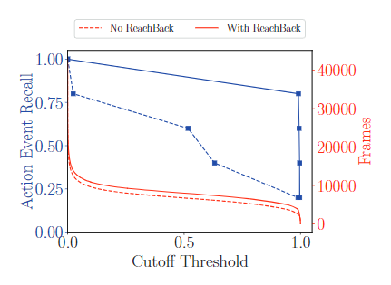
REACHBACK STRATEGY
The blue lines indicate action event recall, based on the accuracy model where the action is detected if at least 80% of the event frames are seen. The red lines show number of frames transmitted. As we can see, with just a marginal increase in bandwidth, event recall can be greatly improved with reachback for all early discard cut-off thresholds.
Notes:
e2059bf4-0e3a-4364-8c0d-22aa6aa52355

Slide 31
CONTEXT-AWARE STRATEGY
08
Notes:
bba190d2-40de-4a4c-9bbc-320eb6c9cc13

Slide 32
CONTEXT-AWARE STRATEGY
The essence of this approach is to leverage unique at-tributes of the current mission to improve the speed and accuracy of video processing on the drone.
Notes:
e2059bf4-0e3a-4364-8c0d-22aa6aa52355

Slide 33
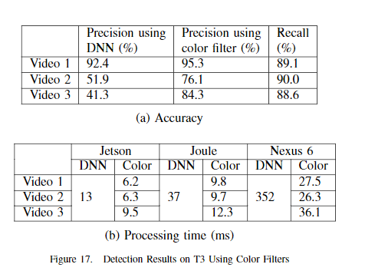
CONTEXT-AWARE STRATEGY
we apply it using a simple color filter for T3. In each raft search video, we randomly pick a frame that contains a raft and obtain the color of the most distinctive region of the raft. Using the hue, saturation, and value (HSV) color space attributes of this region, we apply a color filter to all the other frames of the video
Notes:
e2059bf4-0e3a-4364-8c0d-22aa6aa52355

Slide 34
CONCLUSION
09
Notes:
bba190d2-40de-4a4c-9bbc-320eb6c9cc13

Slide 35
CONTEXT-AWARE STRATEGY
In this paper, we address several difficult mobile comput-ing challenges that arise in performing real-time video ana-lytics on small autonomous drones. These challenges lie at the intersection of wireless bandwidth, processing capacity, result accuracy, and timeliness of results.
We explore an early discard strategy to selectively send the most interest-ing frames and reduce precious bandwidth between the drone and a ground-based cloudlet. We propose additional strategies including just-in-time learning, reachback, and context-based filtering to further improve bandwidth efficiency.
Notes:
e2059bf4-0e3a-4364-8c0d-22aa6aa52355

