Slide 1
Scaling Deep Reinforcement Learning to Enable Datacenter-Scale
Automatic Traffic Optimization
Li Chen, Justinas Lingys, Kai Chen, Feng Liu (SAIC)
SING Group, HKUST

Slide 2
Scaling Deep Reinforcement Learning to Enable Datacenter-Scale
AuTO
Li Chen, Justinas Lingys, Kai Chen, Feng Liu (SAIC)
SING Group, HKUST

Slide 3
DevOps Engineers:
Analysis, Design, Implementation
Expected Turn-around Time:
At least Weeks
Deploy monitoring system
Collect enough data
Traffic Stat Collection
Traffic Optimization Policies
Data analysis
App. Layer knowledge
Design heuristics
Run simulations
Optimize param. setting.

Slide 4
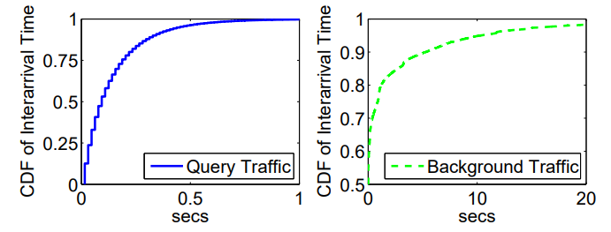
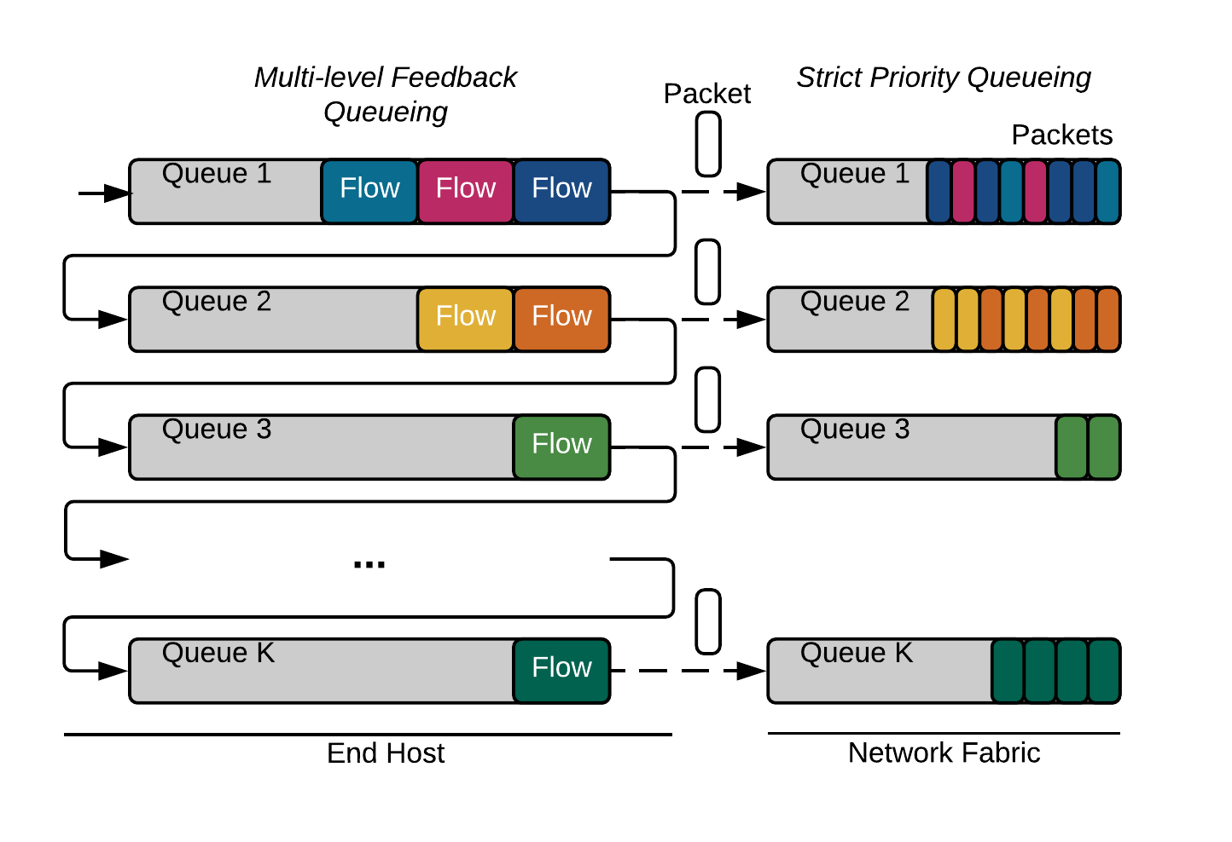
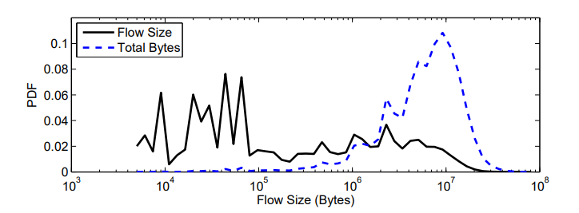
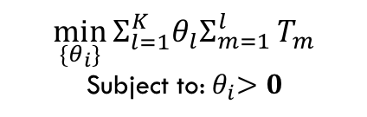
PIAS - An Example
Bai, Wei, et al. "Information-Agnostic Flow Scheduling for Commodity Data Centers." NSDI. 2015.
Traffic Stat Collection
DevOps Engineers:
Analysis, Design, Implementation
Traffic Optimization Policies
Design and Impl. MLFQ
$$\min_{\{θ_{i}\}}{Σ_{l=1}^{K}θ_{l}Σ_{m=1}^{l}}T_{m}$$
Subject to:${ θ}_{i}>0$
Traffic Characteristics from large production datacenters (& papers)
Benson, Theophilus, Aditya Akella, and David A. Maltz. "Network traffic characteristics of data centers in the wild." Proceedings of the 10th ACM SIGCOMM conference on Internet measurement. ACM, 2010.
Kandula, Srikanth, et al. "The nature of data center traffic: measurements & analysis." Proceedings of the 9th ACM SIGCOMM conference on Internet measurement. ACM, 2009.
Greenberg, Albert, et al. "VL2: a scalable and flexible data center network." ACM SIGCOMM computer communication review. Vol. 39. No. 4. ACM, 2009.
Alizadeh, Mohammad, et al. "Data center tcp (dctcp)." ACM SIGCOMM computer communication review 41.4 (2011): 63-74.
Formulation & soln. for MLFQ thresholds
Turn-around Time:
~6 Months

Slide 5
PIAS - Problems
Traffic Stat Collection
DevOps Engineers:
Analysis, Design, Implementation
Traffic Optimization Policies
Data staleness
Design and Impl. MLFQ
Param.-Env. Mismatch
$$\min_{\{θ_{i}\}}{Σ_{l=1}^{K}θ_{l}Σ_{m=1}^{l}}T_{m}$$
Subject to:${ θ}_{i}>0$
-40%
Traffic Characteristics from large production datacenters (& papers)
Formulation & soln. for MLFQ thresholds
Turn-around Time:
~6 Months
Long Turn-around Time:
~6 Months

Slide 6
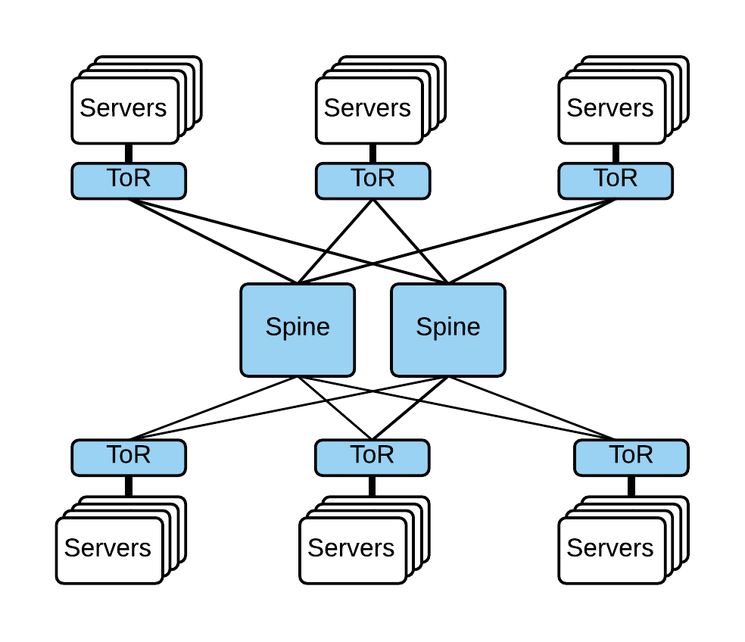
Datacenter-scale Traffic Optimizations (TO)
Dynamic control of network traffic at flow-level to achieve performance objectives.
Main goal is to minimize flow completion time.
Very large-scale online decision problem.
>10⁴ servers*
>10³ concurrent flows per second per server*
Web
Big Data
Cache
DB
*Singh, Arjun, et al. "Jupiter rising: A decade of clos topologies and centralized control in google's datacenter network." ACM SIGCOMM Computer Communication Review. Vol. 45. No. 4. ACM, 2015.
*Roy, Arjun, et al. "Inside the social network's (datacenter) network." ACM SIGCOMM Computer Communication Review. Vol. 45. No. 4. ACM, 2015.
A Simple Datacenter Network

Slide 7

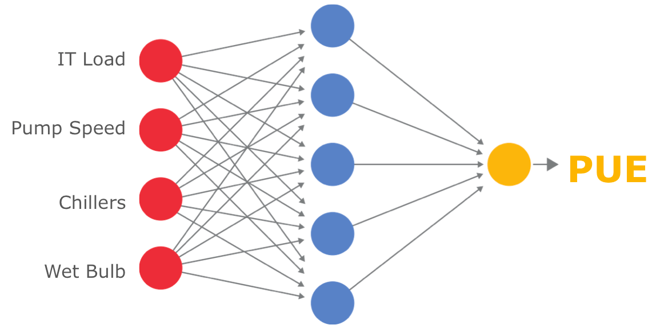
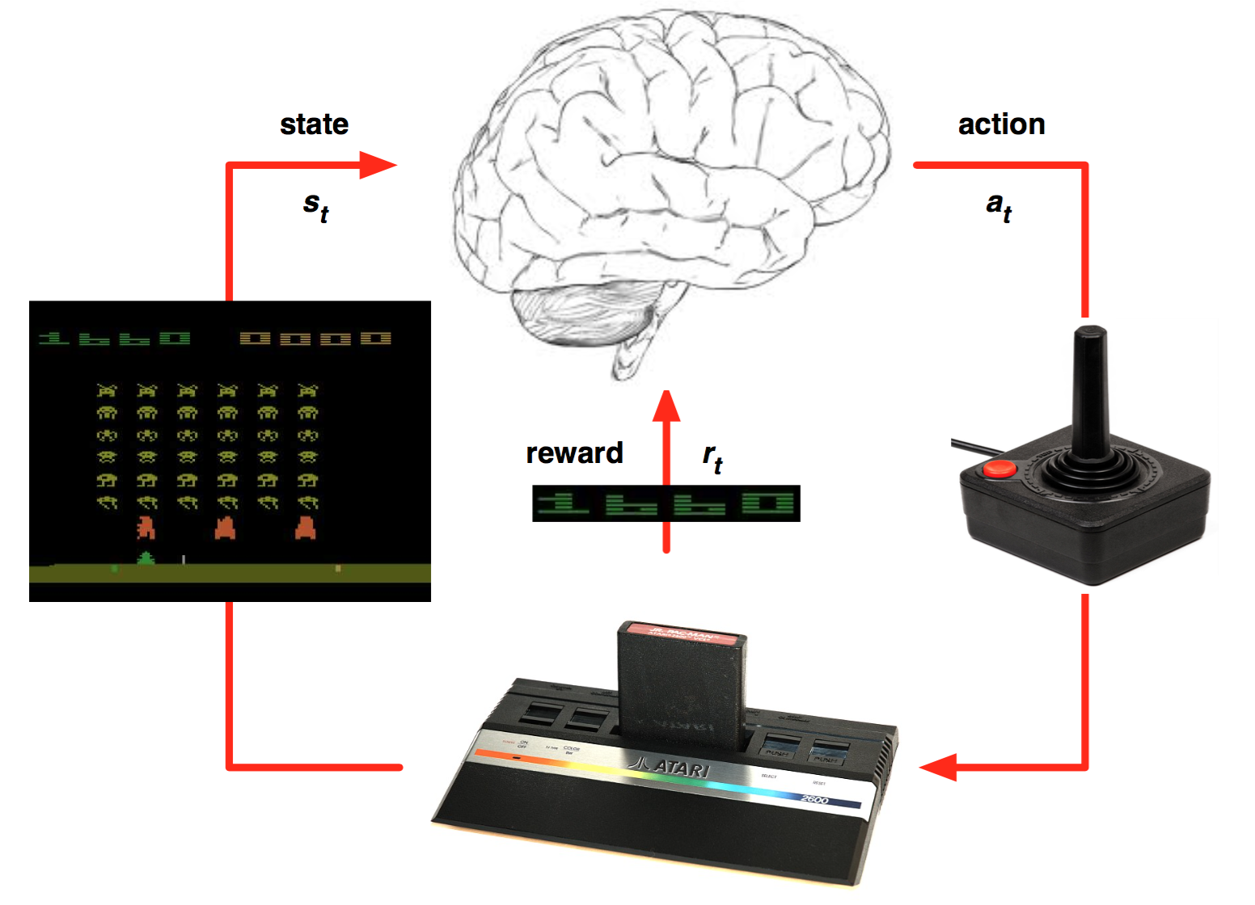

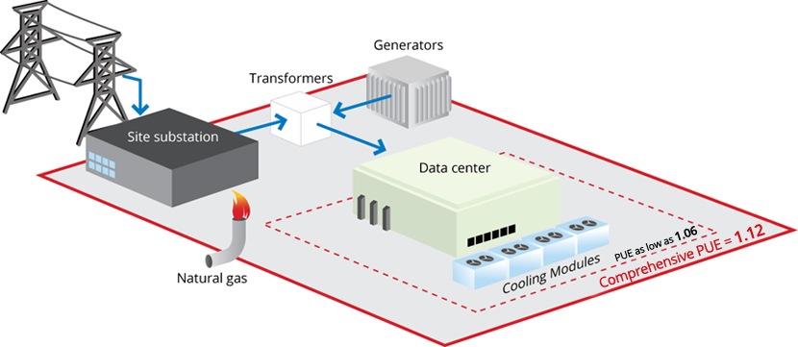
AI for the Job
Reinforcement Learning: Learning the optimal mapping from situations to actions.
Sequential decision making.
Many recent success stories of deep reinforcement learning (DRL):
Playing Go, datacenter power management, playing Atari games, …

Slide 8
AI for the Job
Reinforcement Learning: Learning the optimal mapping from situations to actions.
Sequential decision making.
Many recent success stories of deep reinforcement learning (DRL):
Playing Go, datacenter power management, playing Atari games, …
Reinforcement Learning
Deep Learning
RL
DL
Deep models allow reinforcement learning algorithms to solve complex control problems end-to-end!

Slide 9
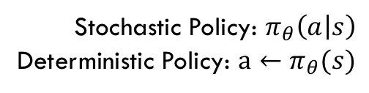
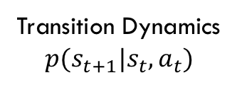
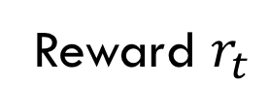
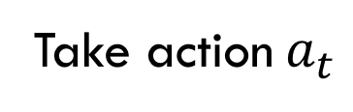

Reinforcement Learning Model
In each time step t…
Reward $r_{t}$
Agent
DCN Environment
Take action$a_{t}$
Stochastic Policy: $π_{θ}\left(a | s\right)$
Deterministic Policy: $a←π_{θ}(s)$
Transition Dynamics
$$p(s_{t+1}|s_{t},a_{t})$$
Observe state $s_{t}$
In each time step t, RL agent collects the states, generates an action for each active flow, and updates the policy based on reward.
Goal: maximize the expected discounted future reward $Σ_{i=t}^{T}{γ^{i−t}r}_{t}$

Slide 10

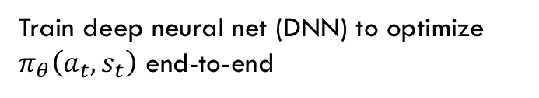
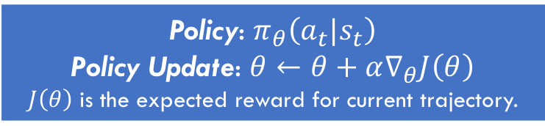
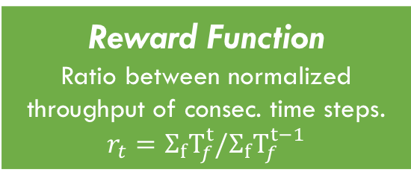
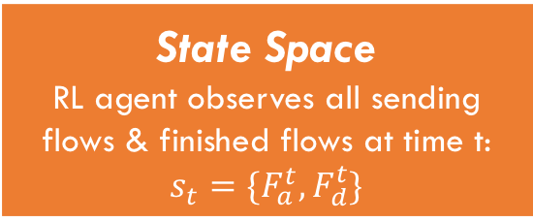
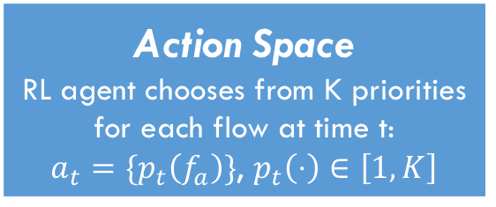
DRL Formulation for Flow Scheduling
We assume the network is running priority queuing for all flows in all switches, and well load-balanced.
Flow Scheduling → Ordering flows using priorities.
Policy gradient (PG) algorithm.
In each time step t, RL agent collects the states, generates an action for each active flow, and updates the policy based on reward.
State Space
RL agent observes all sending flows & finished flows at time t:
$$s_{t}=\{F_{a}^{t},F_{d}^{t}\}$$
Action Space
RL agent chooses from K priorities for each flow at time t:
$a_{t}=\{p_{t}\left(f_{a}\right)\}$, $p_{t}\left(⋅\right)∈\left[1,K\right]$
Reward Function
Ratio between normalized throughput of consec. time steps.
$$r_{t}=Σ_{f}T_{f}^{t}/Σ_{f}T_{f}^{t−1}$$
Time step t
Policy: $π_{θ}\left(a_{t}|s_{t}\right)$
Policy Update: $θ←θ+α∇_{θ}J\left(θ\right)$
$J\left(θ\right)$ is the expected reward for current trajectory.
Train deep neural net (DNN) to optimize $π_{θ}\left(a_{t},s_{t}\right)$ end-to-end
$$∇_{θ}J(θ)≈Σ_{i}(Σ_{t}∇_{θ}logπ_{θ}\left(a_{t}^{i} | s_{t}^{i}\right))(Σ_{t}r\left(s_{t}^{i},a_{t}^{i}\right))$$

Slide 11
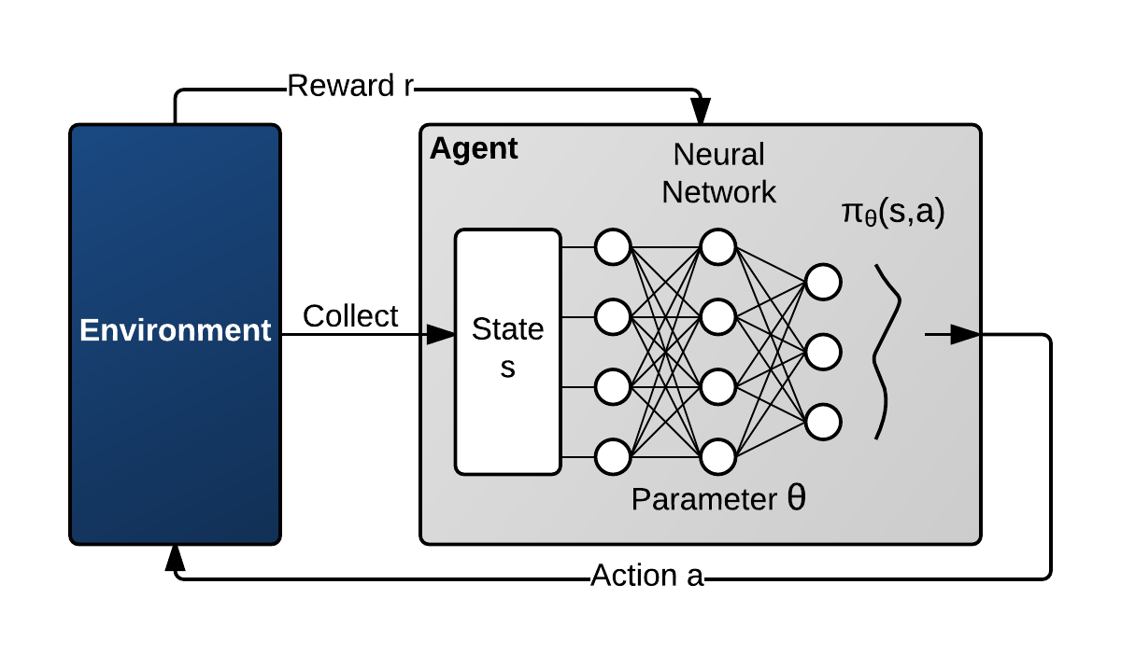
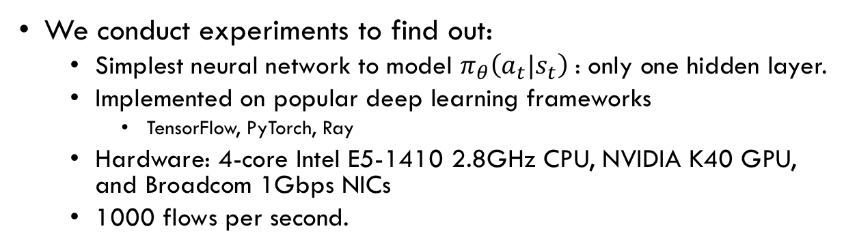
Deep RL for DC-scale TO?
We conduct experiments to find out:
Simplest neural network to model $π_{θ}\left(a_{t}|s_{t}\right)$: only one hidden layer.
Implemented on popular deep learning frameworks
TensorFlow, PyTorch, Ray
Hardware: 4-core Intel E5-1410 2.8GHz CPU, NVIDIA K40 GPU, and Broadcom 1Gbps NICs
1000 flows per second.
The processing delays are more than 60ms.
Any flow within 7.5MB would’ve finished on a 1Gbps link.
A 7.5MB flow is larger than 95.13% of all flows in production data centers*.
* Alizadeh, Mohammad, et al. "Data center tcp (dctcp)." ACM SIGCOMM computer communication review. Vol. 40. No. 4. ACM, 2010.
Too Slow!
Most of the DRL actions are useless: Short flows are already gone when the actions arrive.

Slide 12
How to Scale DRL for Datacenter-Scale TO?
Go back to well-known datacenter traffic characteristics*
* Alizadeh, Mohammad, et al. "Data center tcp (dctcp)." ACM SIGCOMM computer communication review. Vol. 40. No. 4. ACM, 2010.
Short flows comes and go quickly (inter-arrival time < 1s)
Long flows appear less frequently
Most flows are short flows.
Most bytes (traffic) come from long flows. Long flows are more impactful.

Slide 13
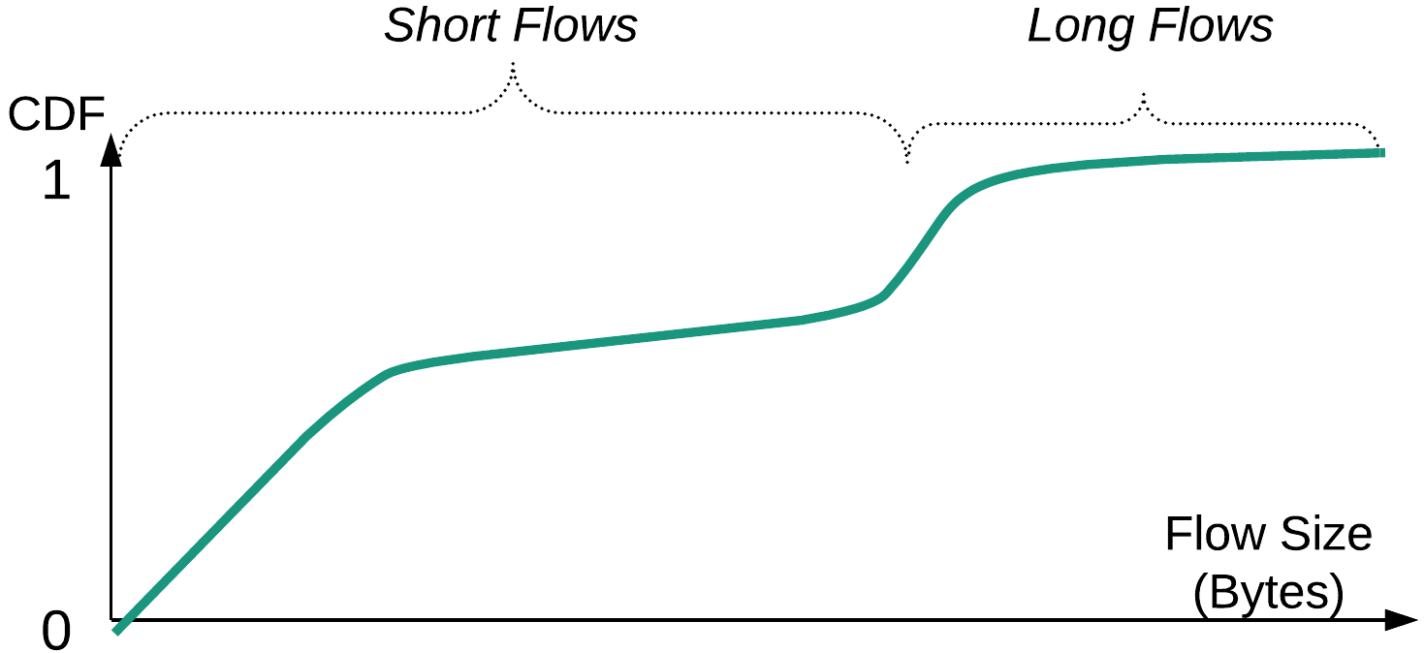
AuTO Design
Most Flows
Must handle at End-hosts
Most Bytes
Tolerant of DRL delays
Process Centrally
How to separate short flows and long flows?
How to choose an short flow scheduling mechanism that …
reduces FCT with information available at end-hosts?
is tolerant of DRL latencies?
How to keep up with global traffic dynamics at end-hosts?
Challenges

Slide 14
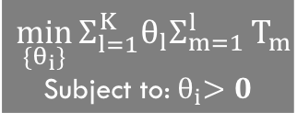
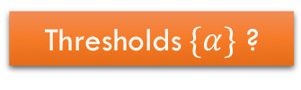


Lessons from PIAS: MLFQ Addresses 3 Challenges
PIAS approximates SJF (reduces FCT) without knowing flow size with MLFQ.
MLFQ separates short and long flows naturally.
Threshold computation &update is parallel to flow scheduling, thus is tolerant of DRL processing delay.
Threshold update is generated centrally with global information → can adapt to traffic dynamics flows.
Send packets tagged with the highest priority until$α_{1}$bytes sent.
Highest Priority
2nd Highest Priority
…
Lowest Priority
Send packets tagged with 2nd highest priority until$α_{2}$bytes sent.
Thresholds$\{α\}$ ?
$$\min_{\{θ_{i}\}}{Σ_{l=1}^{K}θ_{l}Σ_{m=1}^{l}}T_{m}$$
Subject to:${ θ}_{i}>0$
Flow-level movement on MLFQ
Send packets tagged with the lowest priority.
Notes:
Send packets tagged with the highest priority until 𝛼_1 bytes sent.
Send packets tagged with the 2nd highest priority until 𝛼_2 bytes sent.
Send packets tagged with the lowest priority.
Highest Priority
2nd Highest Priority
…
Lowest Priority

Slide 15

Taking DRL Off the Path
Time scale: hours/days/weeks
DevOps Engineers:
High Level Directives
Management Plane
Reduce FCT
Traffic Stat Collection
Deep Reinforcement Learning
Traffic Optimization Policies
Central System
Time scale: seconds
Control Plane
Peripheral System
(End-host)
Parameter Setting
Short flows: MLFQ Thresholds
Long flows: route, priority…
Data Plane
Flow-level traffic statistics
Packets
Monitoring
Module
Enforcement
Module
Flow Table
Packets
Time scale: sub-milliseconds

Slide 16
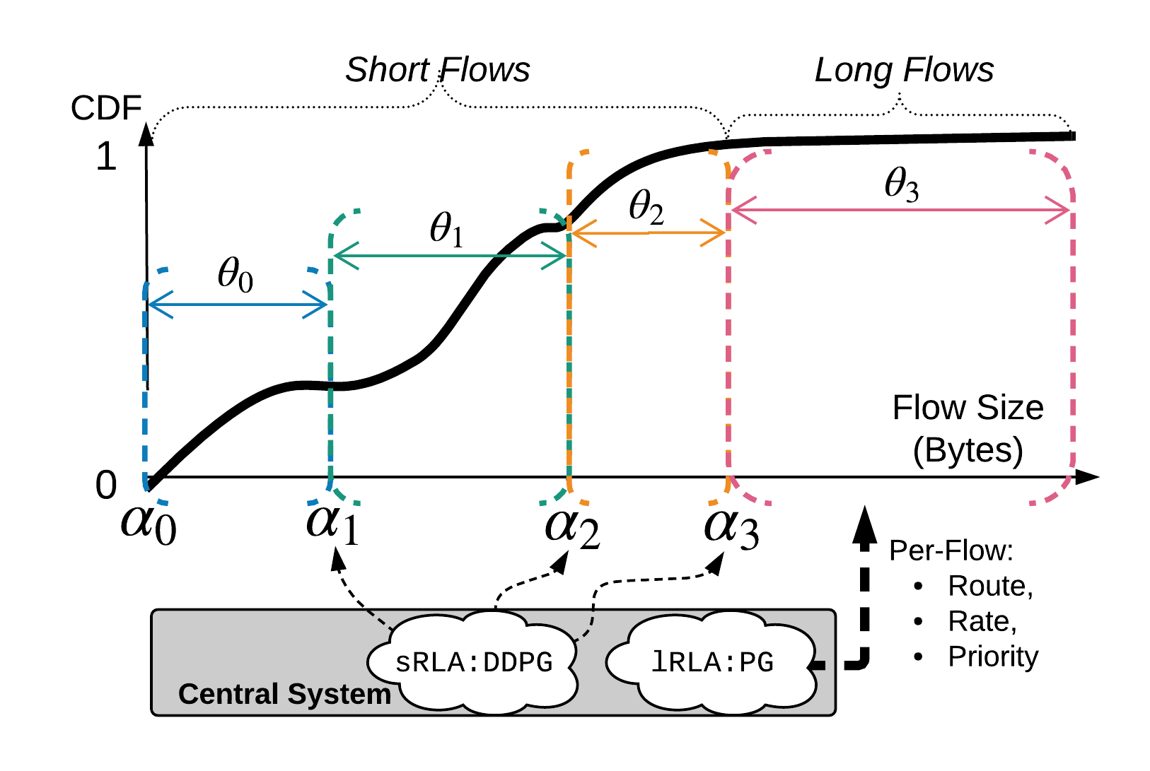
Example: AuTO with 4 Queues
Short Flow RL Agent
Long Flow RL Agent

Slide 17
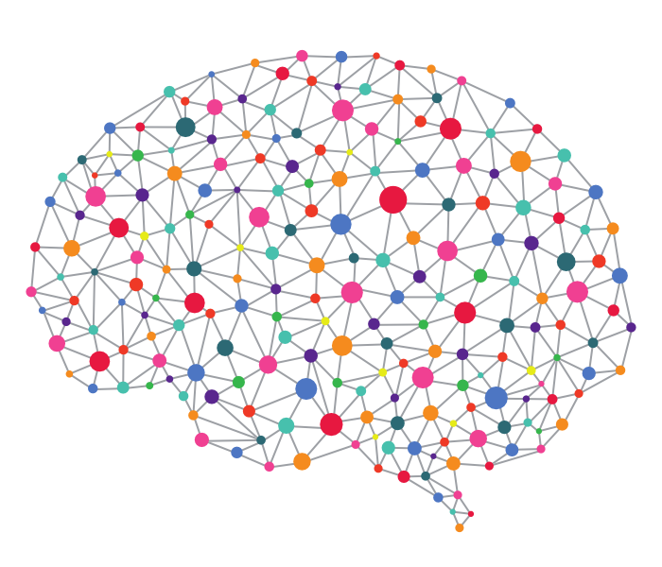

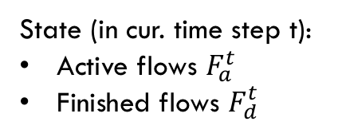
Peripheral System at End-hosts
Operations for short flows
Enforcement Module:
Runs MLFQ, Tags packets DSCP field according to its flow’s queue
Network Fabric
Packet Tagging
Tagged packets
Packets
NETFILTER
LOCAL_OUT hook
Intercepts all out-going packets.
insert_if_not_exist(flow)
get(flow)
Thresholds: $\{α\}$
set(flow)
Monitoring Module:
Reports flow information to Central System
Flow Table
<5-tuple, byte-sent, timing-info>
Central System
DDPG
State (in cur. time step t):
Active flows $F_{a}^{t}$
Finished flows $F_{d}^{t}$

Slide 18
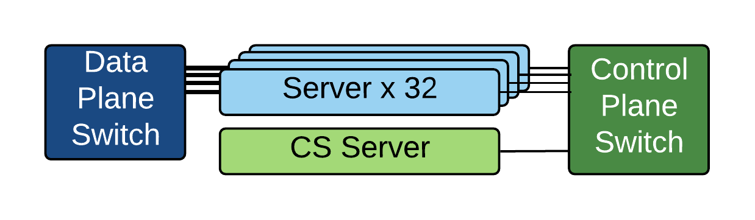
Evaluation Setting
32-server testbed:
Dell PowerEdge R320.
Separate control plane and data plane switch.
4 priority queues.
CS server hosts the DRL agents.
Use flow generators to produce traffic based on realistic workloads.
Web Search workload: mixture of short and long flows
Data Mining workload: mostly short flows
Comparison targets: heuristics with fixed thresholds:
Quantized Shortest Job First (QSJF)
Quantized Least Attained Service (QLAS)

Slide 19
AuTO Performance
vs Heuristics with fixed parameters
Dynamic Scenario:
Traffic characteristics change temporally (every hour): flow size distribution, load percentages, server groups.
Flow Completion Time (us) (Lower is better)
p99 Flow Completion Time (us) (Lower is better)
When their parameters mismatches the environment, performance of fixed-parameter heuristics suffer greatly.
AuTO can learn and adapt to time-varying traffic.
In the 8th hour, AuTO achieves 8.71% reduction in average FCT vs. QSJF.

Slide 20
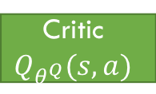
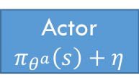
Scaling DRL for Short Flows (sRLA)
Deep Deterministic Policy Gradient: an off-policy algorithm
sRLA
{Thresholds}
An off-policy learner learns the value of the optimal policy independently of the agent's actions.
Actor’s policy is deterministic (with added noise).
2 hidden fully-connected layers
Critic’s DNN (action-value estimator) is updated in parallel to action-taking.
Critic’s training does not impact response delay.
Action a
>
Actor
$$π_{θ^{a}}\left(s\right)+η$$
DCN
Environment
>
State s
Error
Critic
$$Q_{θ^{Q}}(s,a)$$
Reward r
sRLA can respond to an update within 10ms on average.
Send back a set of thresholds for each update.
DNN inference overhead + Query queueing delay
Number of short flows does not impact DRL processing in Central System due to MLFQ.

Slide 21
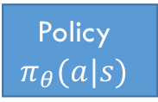
Scaling DRL for Long Flows (lRLA)
Policy gradient: an on-policy algorithm
{<Priority, Route_id>}
Action a
lRLA
Policy DNN generates action given state.
No need to do rate-limiting ← work conservation.
Policy DNN is updated with reward signals.
Number of long flows does impact DRL processing in Central System.
>
DCN
Environment
Policy
$$π_{θ}(a|s)$$
>
State s, Reward r
(#active flow, #fin. flow)
Scaling #active long flows from 11 → 1000 per server per time step (10 second)
Average latency: 36.2ms → 81.8ms
Future improvements of lRLA:
…can be made off-policy.
…can make training & action-taking asynchronous.
…can use compute capacity to adjust last threshold of MLFQ.

Slide 22
Summary
To reduce turn-around time, we attempt to use DRL for automatic traffic optimizations in datacenters.
Moving humans out of the loop.
Experiments show that the processing latency of current DRL systems is the major obstacle to traffic optimizations at the scale of current datacenters.
Moving DRL out of the critical path.
AuTO scales DRL by exploiting known datacenter traffic characteristics.
MLFQ to separate short & long flows.
Short flows are handled at end-host locally with DRL-optimized thresholds using DDPG.
Long flows are processed centrally by another DRL algorithm, PG.
A first step towards automating datacenter traffic optimizations.

