Slide 1
Evaluation of Generative Models

Slide 2
Reference
Lucas Theis, Aäron van den Oord, Matthias Bethge, “A note on the evaluation of generative models”, arXiv preprint, 2015

Slide 3

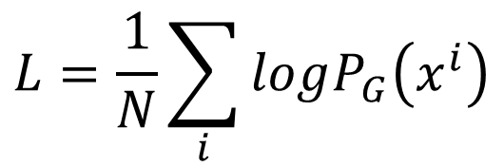

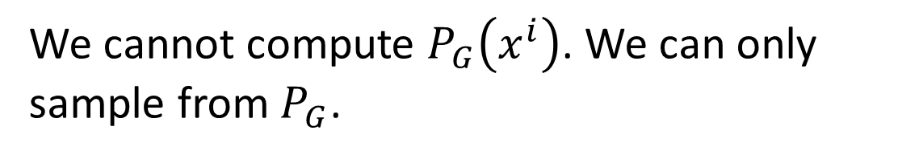
Likelihood
: real data (not observed during training)
: generated data
Prior
Distribution
Generator
P_{G}
$$x^{i}$$
$$L=\frac{1}{N}\sum_{i}{logP_{G}\left(x^{i}\right)}$$
Log Likelihood:
We cannot compute $P_{G}\left(x^{i}\right)$. We can only sample from $P_{G}$.

Slide 4
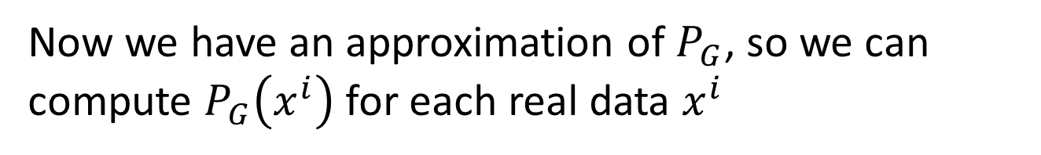
Likelihood - Kernel Density Estimation
https://stats.stackexchange.com/questions/244012/can-you-explain-parzen-window-kernel-density-estimation-in-laymans-terms/244023
Estimate the distribution of P_{G}(x) from sampling
Generator
P_{G}
Each sample is the mean of a Gaussian with the same covariance.
Now we have an approximation of $P_{G}$, so we can compute $P_{G}\left(x^{i}\right)$ for each real data $x^{i}$
Then we can compute the likelihood.
Notes:
A common way is the use the bandwidth that minimises the optimality criterion

Slide 5
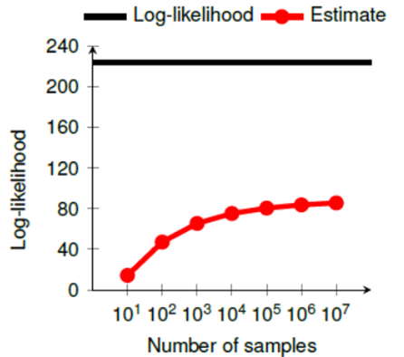
Likelihood - Kernel Density Estimation
https://arxiv.org/pdf/1511.01844.pdf
How many samples?
Weird results?
Model | Likelihood
DBN | 138
GAN | 225
True Distribution | 243
K-means | 313
?

Slide 6







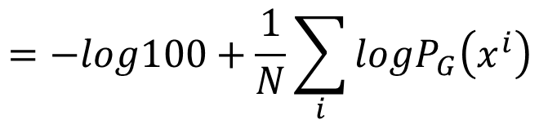
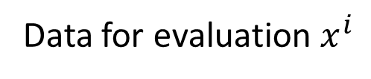
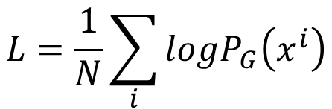

Likelihood v.s. Quality
Low likelihood, high quality?
High likelihood, low quality?
Considering a model generating good images (small variance)
Generator
P_{G}
$$P_{G}\left(x^{i}\right)=0$$
Generated data
Data for evaluation $x^{i}$
X 0.99
X 0.01
G1
G2
$$L=\frac{1}{N}\sum_{i}{logP_{G}\left(x^{i}\right)}$$
$$=−log100+\frac{1}{N}\sum_{i}{logP_{G}\left(x^{i}\right)}$$
100
4.6

Slide 7





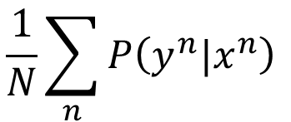




Evaluate by Other Networks
Well-trained CNN
$$x$$
$$P\left(y|x\right)$$
Lower entropy means higher visual quality
$$x^{1}$$
CNN
$$P\left(y^{1}|x^{1}\right)$$
$$\frac{1}{N}\sum_{n}{P\left(y^{n}|x^{n}\right) }$$
$$x^{2}$$
CNN
$$P\left(y^{2}|x^{2}\right)$$
$$x^{3}$$
CNN
Higher entropy means higher variety
$$P\left(y^{3}|x^{3}\right)$$
……

Slide 8
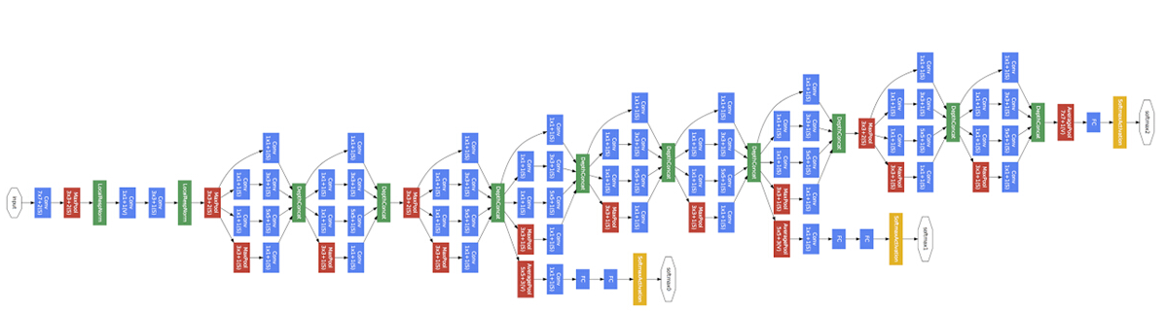
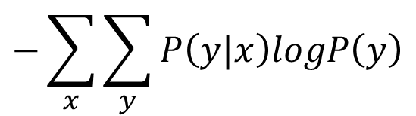
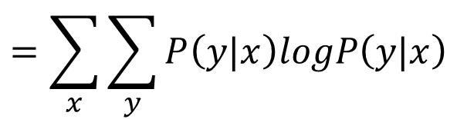
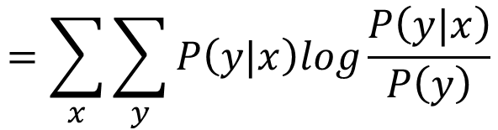
Evaluate by Other Networks - Inception Score
Tim Salimans, Ian Goodfellow, Wojciech Zaremba, Vicki Cheung, Alec Radford, Xi Chen, “Improved Techniques for Training GANs”, arXiv prepring, 2016
$$=\sum_{x}{\sum_{y}{P\left(y|x\right)log\frac{P\left(y|x\right)}{P\left(y\right)}}}$$
$$=\sum_{x}{\sum_{y}{P\left(y|x\right)logP\left(y|x\right)}}$$
Negative entropy
$$−\sum_{x}{\sum_{y}{P\left(y|x\right)logP\left(y\right)}}$$
Cross entropy

Slide 9
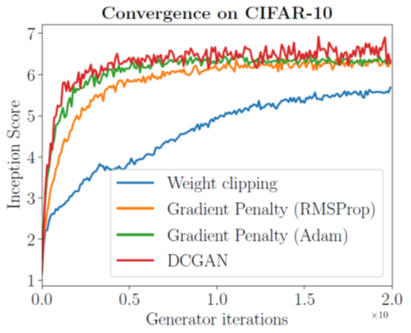
Evaluate by Other Networks - Inception Score
Improved W-GAN

Slide 10
K-Nearest Neighbor
https://arxiv.org/pdf/1511.01844.pdf
Using k-nearest neighbor to check whether the generator generates new objects
Notes:
reverse

Slide 11
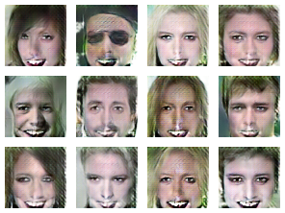
Mode Collapse
https://devblogs.nvidia.com/parallelforall/photo-editing-generative-adversarial-networks-2/

Slide 12

Missing Mode
https://arxiv.org/pdf/1612.02136.pdf
Missing anything?
Discriminator always knows it is real with high confidence

