Slide 1
MLDS - HW0
MNIST - Number Recognition

Slide 2
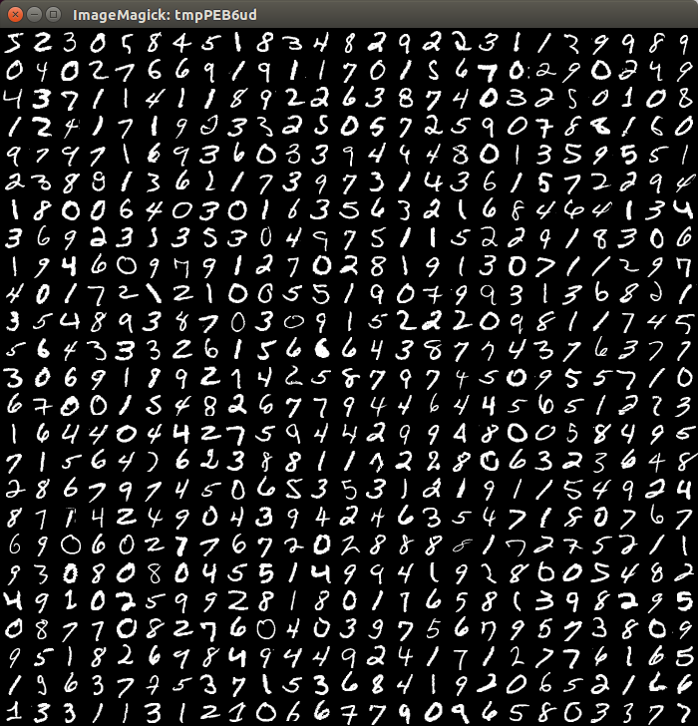
MNIST

Slide 3
DATA
training data (image+label)
60000 data
http://yann.lecun.com/exdb/mnist/
testing data (image)
10000 data
https://mega.nz/#!WlI31LzI!Z6HAOnVIa-AOqQcDMPRKLldZ7Q7nXhsUycT7GY7IND4
different from the original testing data file

Slide 4
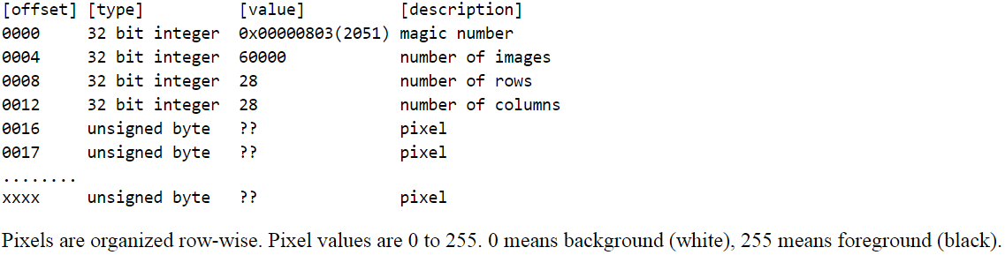
data format - image
ignore first 16 bytes
784 bytes for each image (28*28, row-wise) - 0~255
60000 images
same format in testing image file (10000 data)

Slide 5
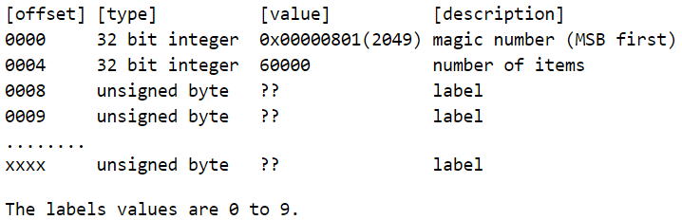
data format - label
ignore first 8 bytes
60000 bytes for 60000 int - 0~9

Slide 6
Method
any Model
any programming language
Tensorflow

Slide 7
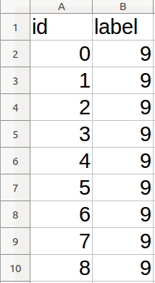
answer file
csv file
[id, label]
id : from 0~9999
label : from 0~9

Slide 8
kaggle in class
https://inclass.kaggle.com/c/hw0-mnist
deadline: 12 p.m. 2/26 (Sun)
99% in public testing set
use your student number as Team Name
relative lectures in description

Slide 9
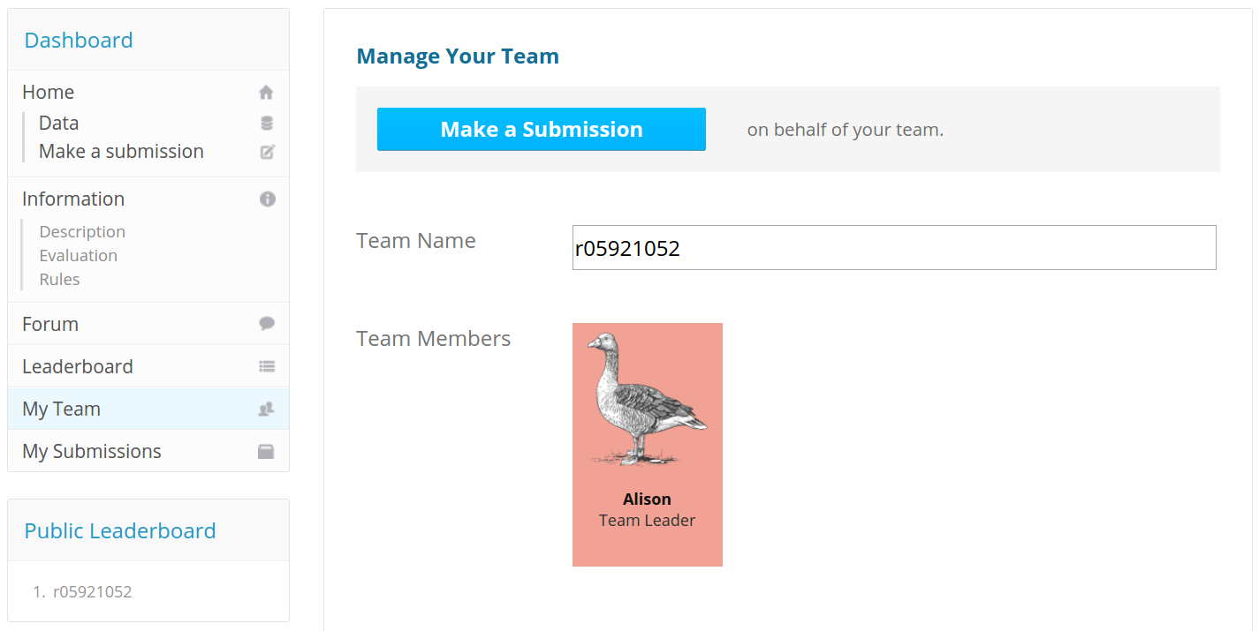

Slide 10
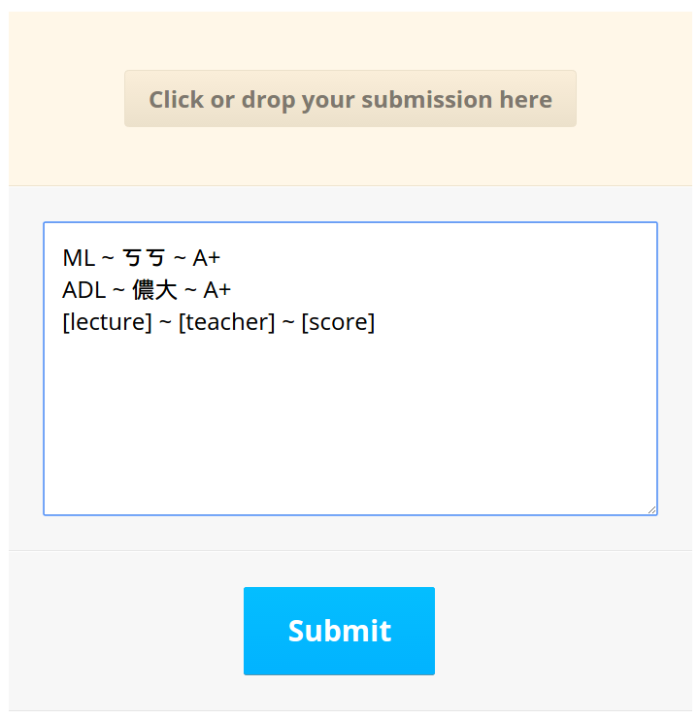
every submission

Slide 11
TA Email
mldsntu2017@gmail.com

