Slide 1
MLDS 2017 Spring
HW1 - Language Model
mldsntu2017@gmail.com

Slide 2
Outline
Introduction - The Microsoft Sentence Completion Challenge
How to solve this task
Output layer issue and the solutions
How to use NCE in tensorflow
How to reach the baseline
Submission

Slide 3
The Microsoft Research Sentence Completion Challenge
The task is to complete the sentence with multiple choices given the contextual information
Each sentence contains a underline indicating the missing word in the real-world literature
Testing data source: Sherlock Holmes novels by Sir Arthur Conan Doyle
Accuracy as evaluation metric

Slide 4
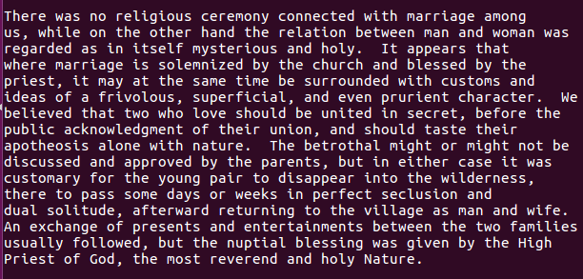
The Microsoft Research Sentence Completion Challenge
example of training data:

Slide 5
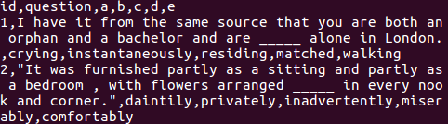
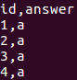
The Microsoft Research Sentence Completion Challenge
example of testing data:
output format:

Slide 6
How To Solve This Task
Testing data: Today is ________ hot. (a) very (b) was
method1:
P(“very”)
P(“was”)
(Don’t care)
(Don’t care)
(Start)
“Today”
“is”

Slide 7
How To Solve This Task
0.3
Testing data: Today is ________ hot. (a) very (b) was
method2: Assume the answer is (a) very
0.1
P(“very”)
P(“hot”)
(Don’t care)
(Don’t care)
(Start)
“Today”
“is”
“very”

Slide 8
How To Solve This Task
0.03
0.00016
Testing data: Today is ________ hot. (a) very (b) was
method2: Assume the answer is (b) was
0.002
0.08
P(“was”)
P(“hot”)
(Don’t care)
(Don’t care)
(Start)
“Today”
“is”
“was”

Slide 9
Output Layer Issue
output layer dimension = |vocabulary| ----> super high computing cost
softmax
If target is A
increase
A
P(A)
1
decrease
0
B
P(B)
C
P(C)
decrease
0
decrease
D
P(D)
0
decrease
0
E
P(E)
Hidden Layer
Output Layer

Slide 10
Sampling Method - Noise Contrastive Estimation
Noise Contrastive Estimation (NCE)
Randomly sample some words to suppress the probability
softmax
If target is A
increase
A
P(A)
1
B
P(B)
0
C
P(C)
decrease
0
D
P(D)
0
decrease
0
E
P(E)
Hidden Layer
Output Layer

Slide 11
Sampling Method - Noise Contrastive Estimation
Noise Contrastive Estimation (NCE)
Randomly sample some words to suppress the probability
softmax
If target is A
increase
A
P(A)
1
B
P(B)
(Don’t care)
0
C
P(C)
decrease
0
D
P(D)
(Don’t care)
0
decrease
0
E
P(E)
Hidden Layer
Output Layer

Slide 12
Sampling Method - Noise Contrastive Estimation
Noise Contrastive Estimation (NCE)
Randomly sample some words to suppress the probability
Only part of the weights would be updated
softmax
If target is A
increase
A
P(A)
1
B
P(B)
(Don’t care)
0
C
P(C)
decrease
0
D
P(D)
(Don’t care)
0
decrease
0
E
P(E)
Hidden Layer
Output Layer

Slide 13
Softmax-based Method - Hierarchical Softmax
Hierarchical Softmax
word
Word | Class
A | 1
B | 1
C | 1
D | 2
E | 2
A
Pw(A)
B
Pw(B)
C
Pw(C)
D
Pw(D)
E
Pw(E)
P(A) = Pw(A) x Pc(1)
…….
P(D) = Pw(D) x Pc(2)
…...
Hidden Layer
class
1
Pc(1)
2
Pc(2)
Output Layer

Slide 14
Softmax-based Method - Hierarchical Softmax
If target is A, A belongs to class 1
Hierarchical Softmax
determine class first
word
A
Pw(A)
B
Pw(B)
C
Pw(C)
D
Pw(D)
E
Pw(E)
Hidden Layer
class
1
Pc(1)
increase
2
Pc(2)
decrease
Output Layer

Slide 15
Softmax-based Method - Hierarchical Softmax
If target is A, A belongs to class 1
Hierarchical Softmax
determine class first
word
A
Pw(A)
increase
B
Pw(B)
decrease
C
Pw(C)
decrease
D
Pw(D)
E
Pw(E)
Hidden Layer
class
1
Pc(1)
increase
2
Pc(2)
decrease
Output Layer

Slide 16
Softmax-based Method - Hierarchical Softmax
If target is A, A belongs to class 1
Hierarchical Softmax
determine the class first
word
A
Pw(A)
increase
B
Pw(B)
decrease
C
Pw(C)
decrease
D
Don’t care
Pw(D)
E
Pw(E)
Hidden Layer
class
1
Pc(1)
increase
2
Pc(2)
decrease
Output Layer

Slide 17
Softmax-based Method - Hierarchical Softmax
balanced binary tree
if |vocabulary| = 10000, cost from 10000 to 13.3
Machine Learning and
Hidden Layer
machine
learning
and
having
deep
it
structured
OOV

Slide 18
Softmax-based Method - Hierarchical Softmax
balanced binary tree
if |vocabulary| = 10000, cost from 10000 to 13.3
Machine Learning and
Hidden Layer
machine
learning
and
having
deep
it
structured
OOV

Slide 19
Softmax-based Method - Hierarchical Softmax
p ( “having” | context ) = ( 1 - p ( branch right at node 1 | context ) ) x p ( branch right at node 2 | context ) x p ( branch right at node 3 | context )
1
Machine Learning and
2
Hidden Layer
3
machine
learning
and
having
deep
it
structured
OOV

Slide 20
Softmax-based Method - Hierarchical Softmax
p ( “having” | context ) = ( 1 - sigmoid( b1 + v1・ h(x) ) ) x sigmoid( b2 + v2・ h(x) ) x sigmoid( b3 + v3・ h(x) )
V
1
Machine Learning and
2
Hidden Layer
3
machine
learning
and
having
deep
it
structured
OOV

Slide 21
Softmax-based Method - Hierarchical Softmax
How to define the word hierarchy?
randomly generated tree
existing linguistic resources, ex: WordNet
hierarchical clustering

Slide 22
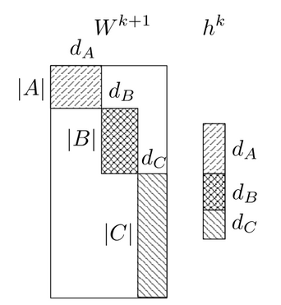
Softmax-based Method - Differentiated Softmax
As many words will only require comparatively few parameters, the complexity of computing the softmax is reduced, which speeds up training. In contrast to H-Softmax, this speed-up persists during testing.

Slide 23
Softmax-based Method - CNN-softmax
Char CNN
C
A
T
LSTM
Char CNN
T
H
E

Slide 24
Output Layer Issue - Note
some techniques can only apply in training
choose a technique regarding your computing resource
out of memory / too slow

Slide 25
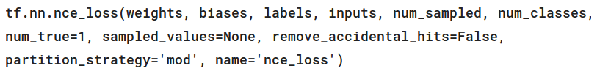
How to use NCE in tensorflow
Returns:
A batch_size 1-D tensor of per-example NCE losses.
Be careful to the shape of weights and labels
https://www.tensorflow.org/api_docs/python/tf/nn/nce_loss

Slide 26
How to reach the baseline?
Method 1
BasicLSTM with hidden state dimension 256
Standard softmax
AdamOptimizer
12000 words
2 epochs
Training time = 76 mins, by using TITAN X
Accuracy = 0.3317

Slide 27
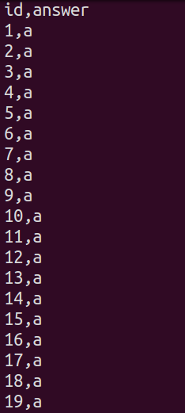
Submission on Kaggle
[Kaggle link] will be published a few days later
Data: https://goo.gl/9jIYDd
Deadline: 3/25(Sat.) 23:59:59 (UTC+8)
Number of submissions per day : 5 Refresh at 8:00:00 (UTC+8) every day
You need to choose two submissions before deadline

Slide 28
Submission on Github
Only Python with Tensorflow r1.0 (TAs will run your code in Tensorflow-only environment).
Deadline: 3/26(Sun.) 23:59:59 (UTC+8)
MLDS2017/hw1 should contain all the things you use. Ex. run.sh, model, report.pdf, pre-trained word embedding, etc. If some files are too big, upload to your cloud and write a script to download them. Remember to call the download script in run.sh.
Usage: bash run.sh [path to testing data] [output path]

Slide 29
Submission on Github
You must create two branches master and best.
master stores the model by using only RNN (external data is not allowed except for pre-trained word embeddings)
best stores your best model. If your best model is the same as your baseline model, just copy all files in master to this branch.
The format is mentioned in the previous slide.
You have to specify the best performance you achieved by using only RNN in the experiment part of your report.

Slide 30
Grading Policy (20%)
Report (10%)
Code (6%)
You have to use RNN and your model should output in 10 minutes
Baseline (2%+2%)
Bonus
First place (10%)
Second place (5%)
Third place (3%) You have to present how you beat other teams to get your bonus at 3/31.

Slide 31
What report should cover?
Environment (1%)
Ex. OS, CPU, GPU, Memory, libraries you used and version, etc.
Model description (3%)
How do you improve your performance (3%)
Experiment settings and results (2%)
Ex. Epochs, training time, hyperparameters, etc.
Team division (1%)
No more than 3 pages
Please written in Chinese (unless you don’t know how to type Chinese)

Slide 32
Other Policy
Incompatible format will not be graded.
Late policy: 30% off per day late afterwards. [Delay form will be announced afterwards]
You must register Kaggle using NTU account.
Remember to fill the group form, and add MLDS2017TA as github collaborator.
No plagiarism is allowed.
Use the given data only, except for pre-trained word embedding (you should specify the source in your report).

Slide 33
For Tensorflow tutorial
Install python3 shell on your laptop [demo]
Install Tensorflow r1.0
Download dataset
Install CUDA

