Slide 1
Demo 1: word2vec
dataset: https://drive.google.com/open?id=0B27ghKdkaWv-amZDQWtQRElsUDA
word2vec.py: https://drive.google.com/open?id=0B27ghKdkaWv-ZGlSMjdHSUlPdFU

Slide 2
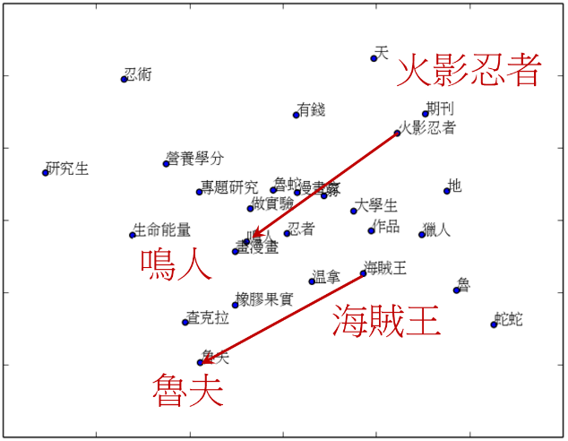
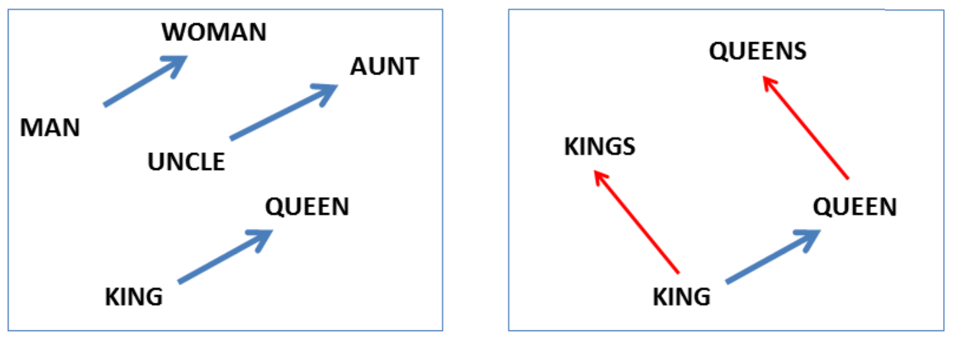
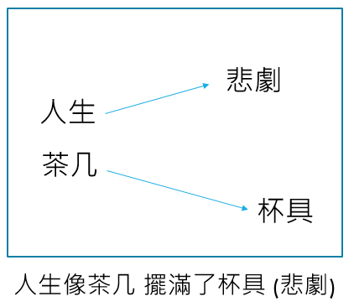
What is word2vec?
vec(woman) - vec(man) ≈ vec(queen) - vec(king)
人生=
0.5 0.7 -0.8 0.3 -0.4

Slide 3
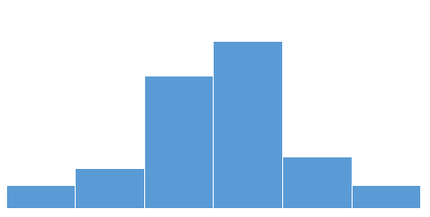
Distributional Hypothesis in linguistics:
‘a word is characterized by the company it keeps’.
Firth, J.R. (1957). A synopsis of linguistic theory 1930-1955
Suppose we read the word “cat”. What is the probability P(w|cat) that we’ll read the word w nearby?
word embedding
“cat” = P(·|cat)
W fur fish meow car

Slide 4
How to train?
w0
context
Input: the quick brown fox jumped over the lazy dog
window | w0 | context
1 | fox | {brown, jumped}
2 | jumped | {brown, fox, over, the}
Predict company context: P(context|w)

Slide 5
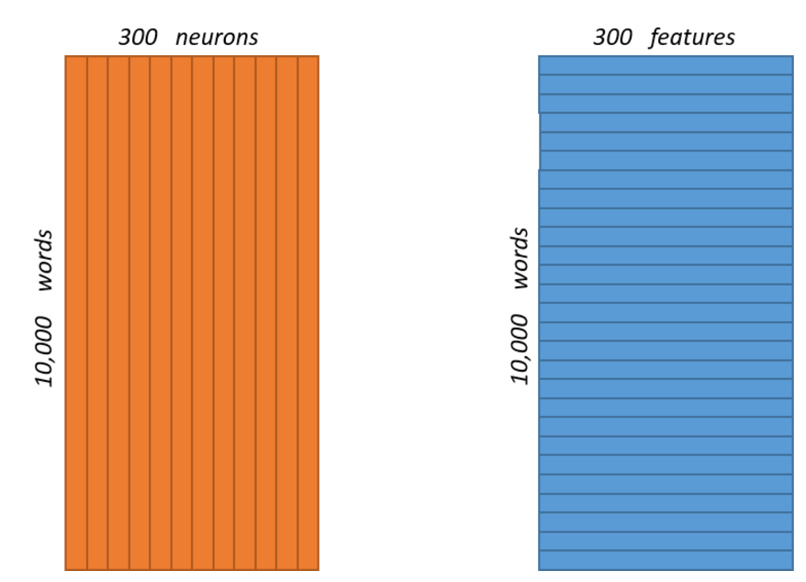
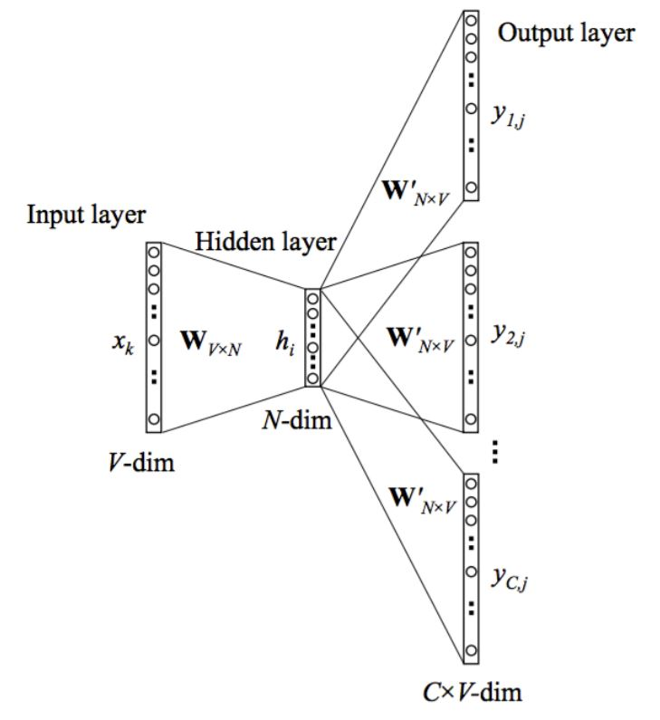
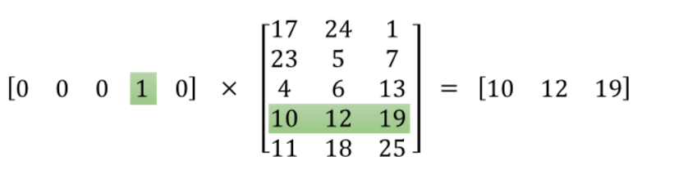
Skip-gram model
W
W’
cat
W

Slide 6
Tensorflow Review
Step 1: Download the data.
Step 2: Build the dictionary(word->int32).
Step 3: Function to generate a training batch.
Build dataset
Define graph
Variables
Inputs/labels
Loss
Optimizer
Run session
Initial variables
Define feed_dict
Session.run
Step 4: Build and train a skip-gram model.
Step 5: Begin training.

Slide 7
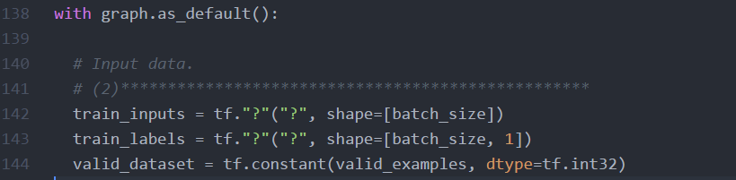
Exercise
共七題

Slide 8
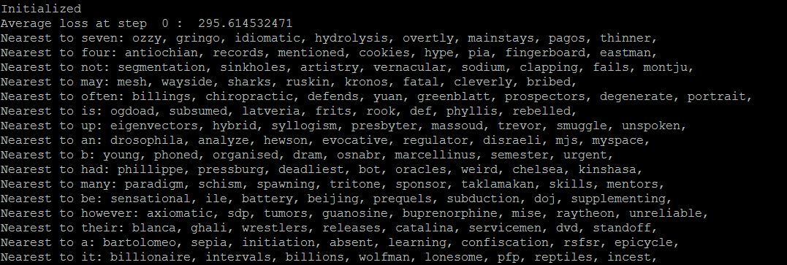
Run!
Before:
Loss = 295.61
Nearest to seven: ozzy, gringo, idiomatic, hydrolysis….

Slide 9
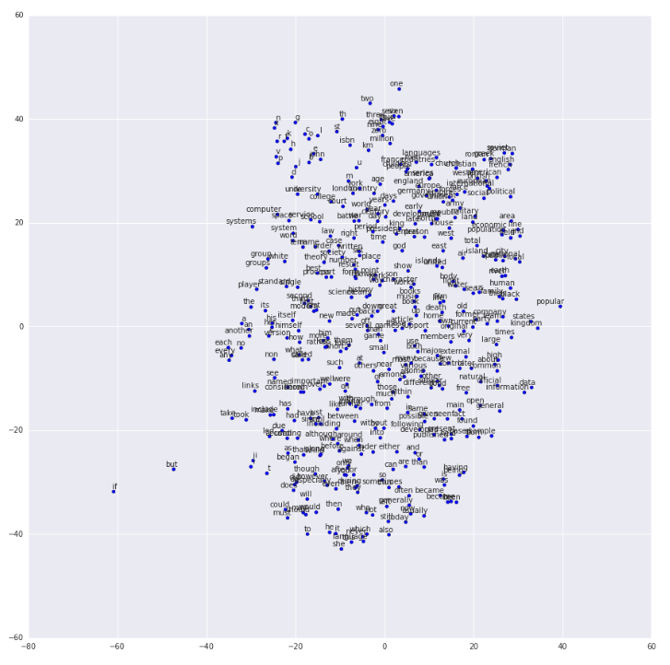
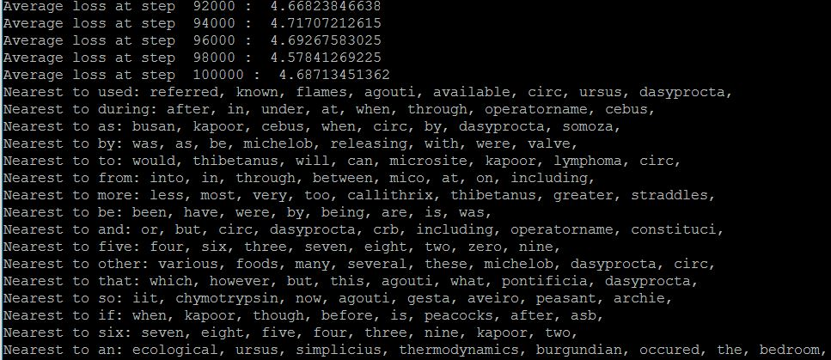
After:
Loss = 4.687
Nearest to five: four, six, three, seven, right, two, zero, nine

Slide 10
Ref
word2vec_answer.py: https://drive.google.com/open?id=0B27ghKdkaWv-c2lfSUZlM1dwS1k
Deep Learning, Ali Ghodsi, University of Waterloo https://uwaterloo.ca/data-science/sites/ca.data-science/files/uploads/files/word2vec.pdf
Tensorflow documentation, Vector Representations of Words https://www.tensorflow.org/tutorials/word2vec
Demo code modified from: https://www.tensorflow.org/code/tensorflow/examples/tutorials/word2vec/word2vec_basic.py
Word2Vec Tutorial - The Skip-Gram Model http://mccormickml.com/2016/04/19/word2vec-tutorial-the-skip-gram-model/
Word2Vec Tutorial Part I: The Skip- Gram Model

