Slide 1
Irony Blindspots
Can a model reliably detect ironic tweets?
Effects of cue removal and word clusters
Vis4AI · Phase I
AI group and non-AI group comparison
Cedric Hempe · Erik Ludescher · Braian Plaku · Lukas Steu

Slide 2
The problem · Can a model detect irony reliably?
“Great, another delayed train! 🙃 #sarcasm”
Does the prediction change if the context is modified?
H1
Remove hashtags and emojis; compare prediction changes.
H2
Find word and tweet clusters; compare model score patterns.
Both the AI and non-AI groups investigated both hypotheses.
CardiffNLP Twitter-RoBERTa irony · TweetEval test set · 784 tweets
2

Slide 3
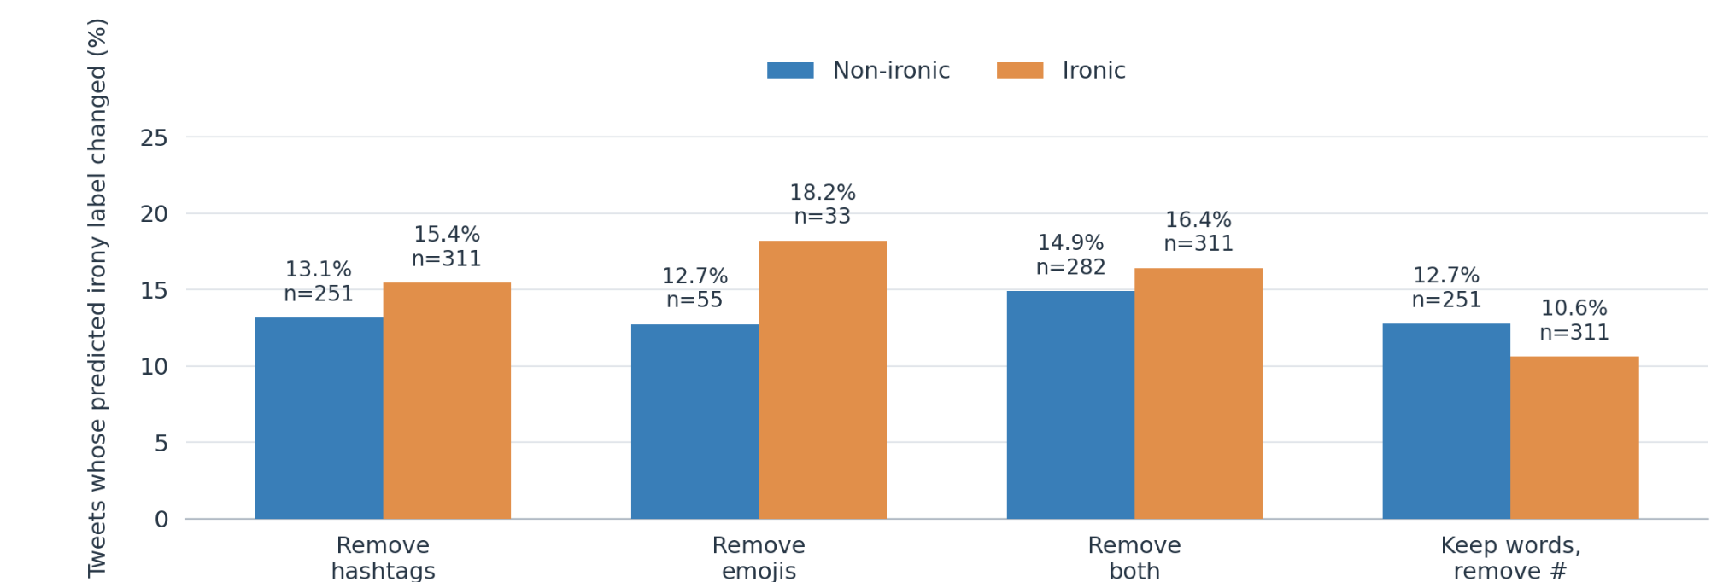
AI GROUP
H1 · How often does the label change?
Key takeaway: Removing both cues flips 14.9% of non-ironic and 16.4% of ironic tweets.
Affected tweets only · compared with each tweet’s original prediction
3

Slide 4
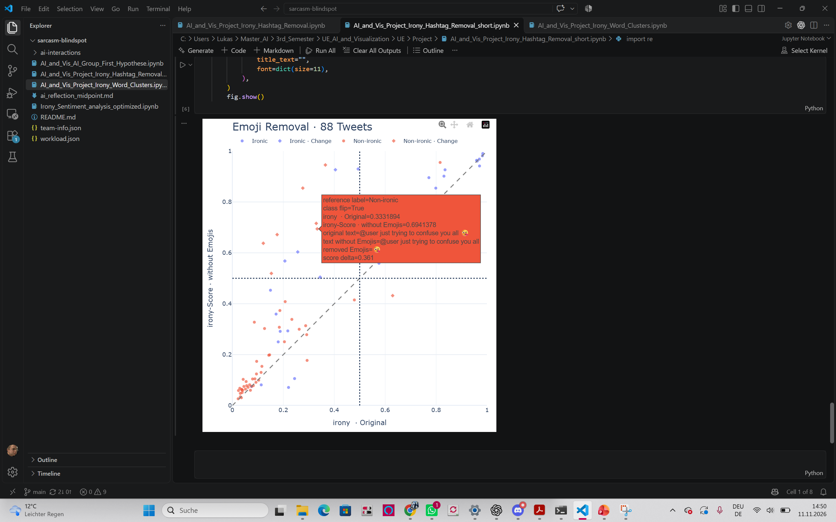
NON-AI GROUP
H1 · Emoji removal, tweet by tweet
Selected tweet
P(irony): 0.333 → 0.694
One emoji removal changes the label.
Non-AI scatter plot · 88 tweets containing emojis
5

Slide 5
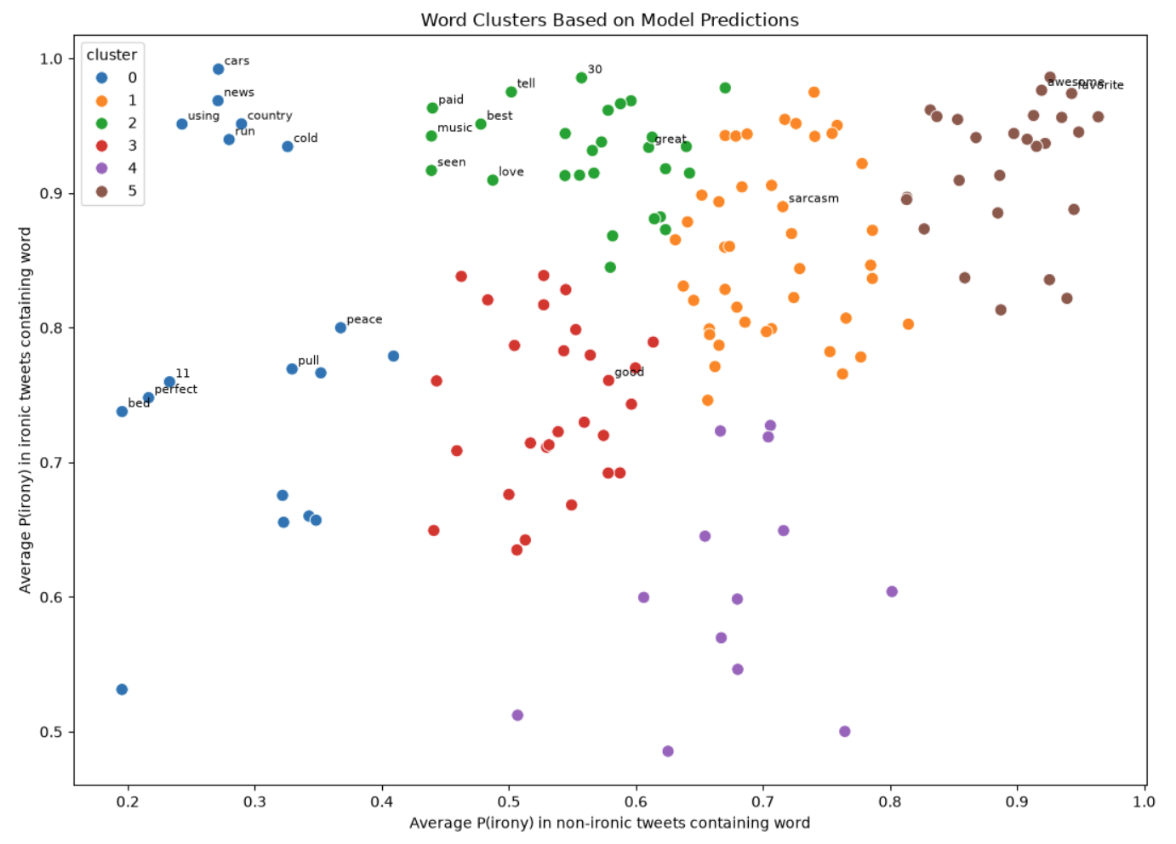
AI GROUP
H2 · Word clusters by prediction pattern
How to read the plot
Words close together have similar average irony scores.
Example clusters
Cluster 0: cars, cold, news
Cluster 1: irony, sarcasm, lol
Grouped by predictions, not by meaning.
Each dot = one word; colors group words with similar model scores
6

Slide 6
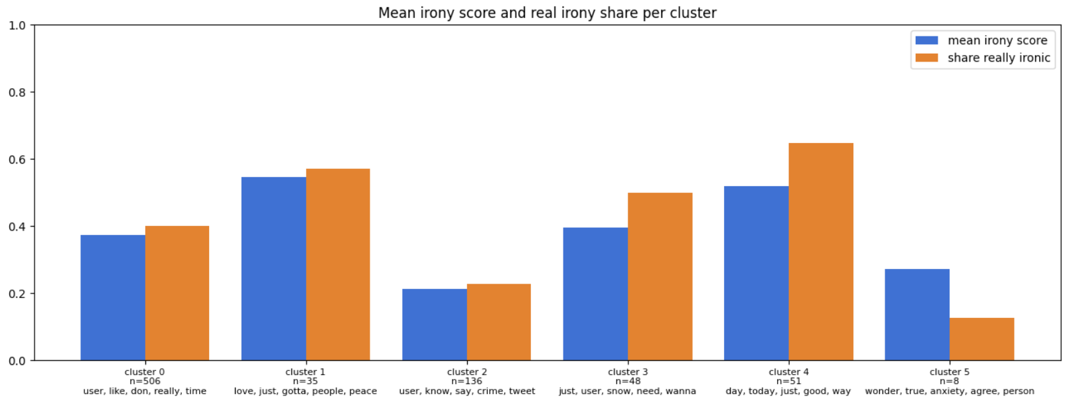
NON-AI GROUP
H2 · Model score vs. actual irony rate
Key takeaway: Clusters vary in score–label agreement; small groups are less reliable.
Non-AI tweet clusters · cluster sizes shown underneath the bars
7

Slide 7
Conclusion · What did we find out?
H1
Removing cues changes predictions — and increases false positives.
Example
One tweet: irony score 0.333 → 0.694 without its emoji.
H2
Clusters reveal similar prediction patterns, not necessarily similar meanings.
The model detects some irony, but remains sensitive to small input changes.
Next step: investigate the model with Integrated Gradients and UMAP
8

