Slide 1
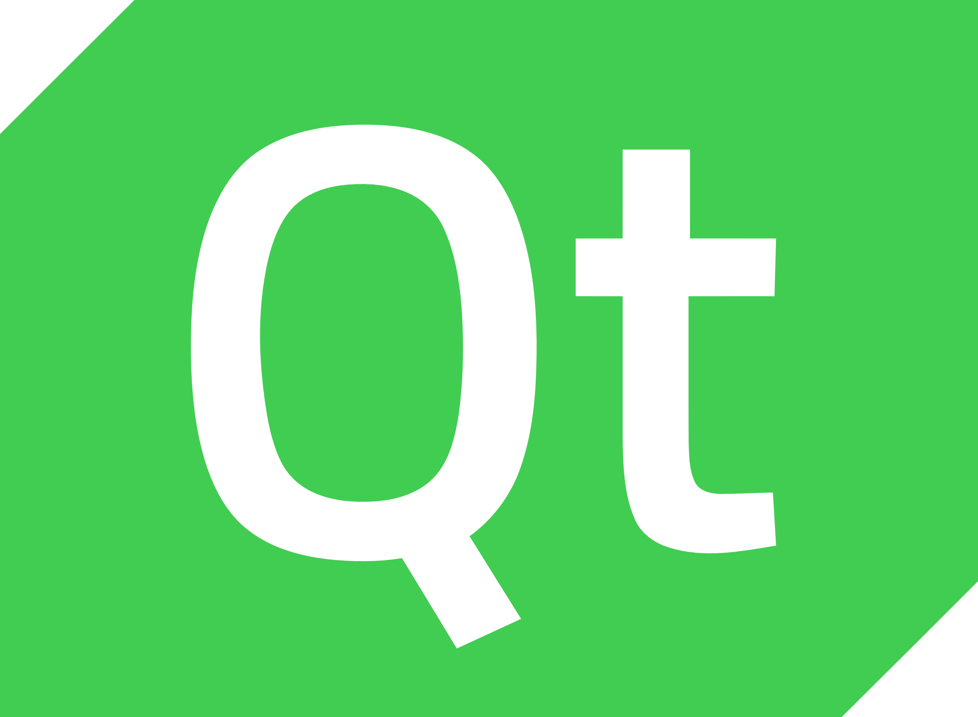
Intro to (Py)Qt5
How to get started with writing GUIs in Python: A crash course

Slide 2
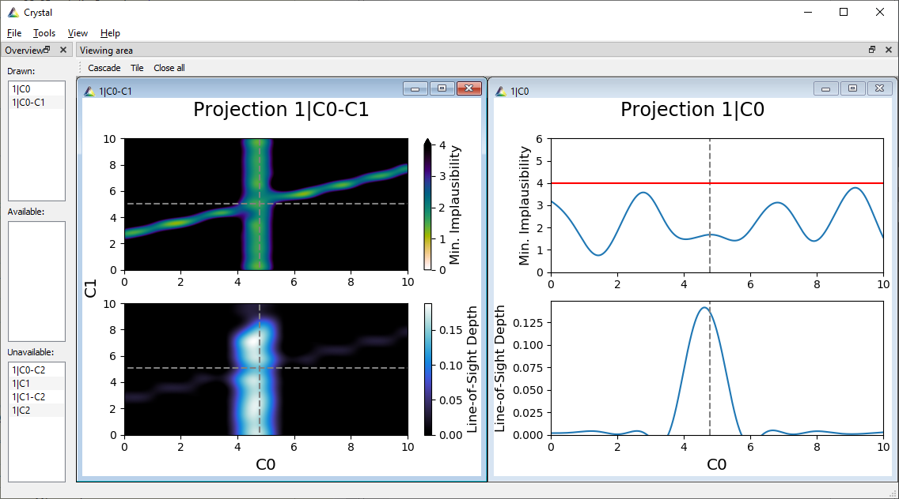
PRISM Projection GUI: Crystal

Slide 3
Tk vs. Qt5
Tk (TkInter)
Qt5 (PyQt5/PySide2)
Included in standard Python library;
Easy to learn;
Free for open-source/commercial use;
Fast;
No advanced widgets;
No reliable UI builder.
Requires installation;
Steep learning curve;
(L)GPLv3 license;
No Python-specific documentation;
Incredibly advanced, powerful and modular;
QtDesigner (and QtCreator for C++);
Signals/Slots!;
Very active community and lots of resources available;

Slide 4
Examples of apps using Qt5
RStudio;
Spyder;
Dropbox;
TexStudio/TexMaker;
Vim;
Adobe Photoshop;
Google Earth;
Mathematica;
Stellarium;
OBS;
VirtualBox;
Telegram;
Blackberry 10 OS;
And many more.

Slide 5
PyQt5 vs. PySide2
PyQt5
PySide2
Riverbank Computing;
Minor syntax/naming differences from Qt.
GPLv3 license;
Many tutorials online;
Receives updates against QT rapidly;
The Qt Company;
Basically no syntax/naming differences.
(L)GPLv3 license;
Few tutorials online;
Receives updates slowly;

Slide 6
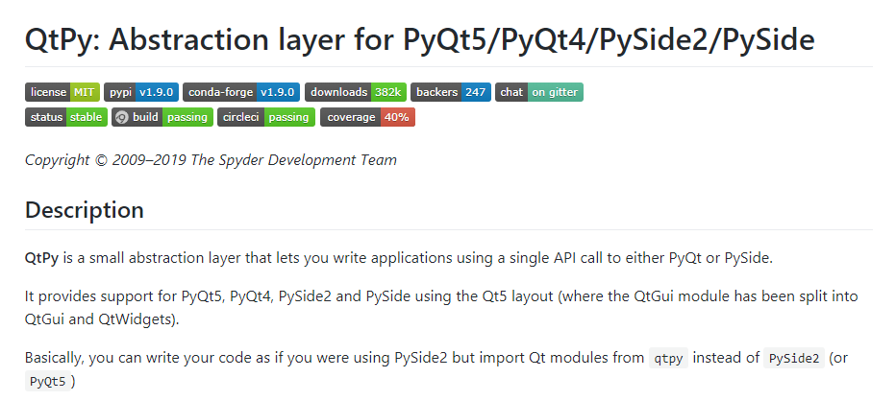
QtPy (Spyder Project)

Slide 7
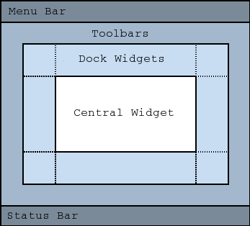
Getting started with QT: Main window

Slide 8
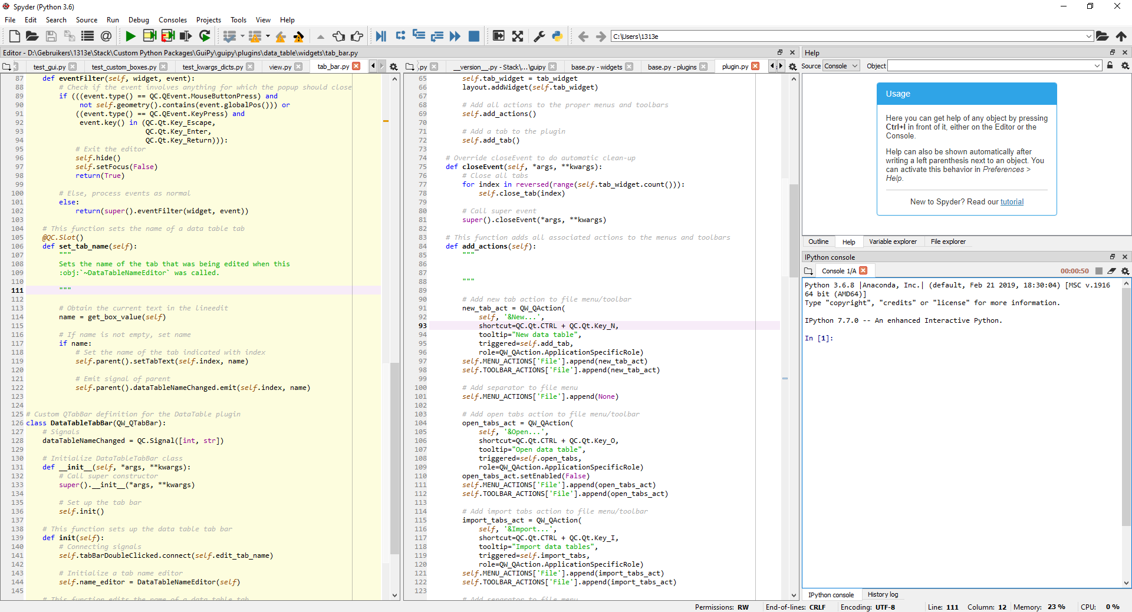
Python IDE: Spyder

Slide 9
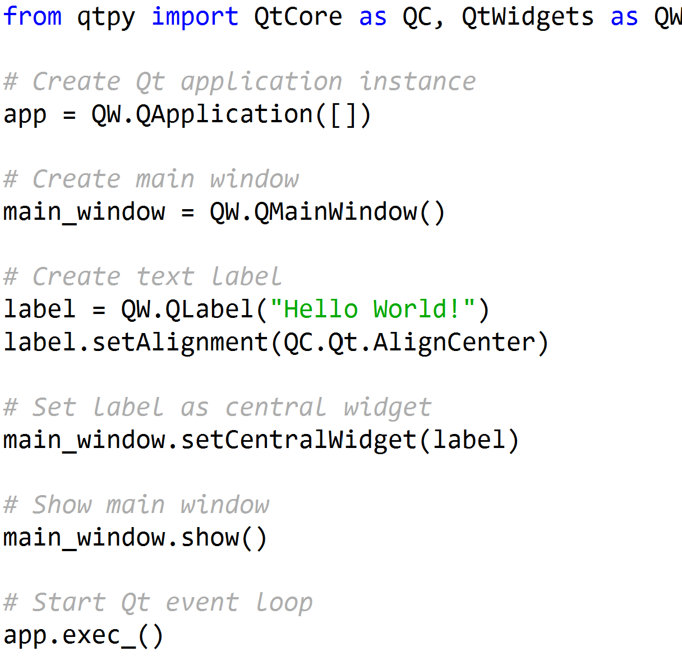
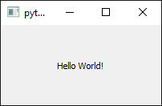
Getting started with Qt: An example

Slide 10

Widgets vs. Layouts
Widgets
Layouts
A user-interactable GUI element:
QLabel;
QMainWindow;
QComboBox;
QPushButton; etc.
Widgets can live on their own;
Widgets contain either no layout or a single layout.
Custom widgets are defined often.
A container for widgets/layouts:
QHBoxLayout;
QVBoxLayout;
QGridLayout;
QFormLayout.
Layouts must be set into a widget;
Layouts can contain an unlimited number of widgets and layouts;
Custom layouts are defined rarely.

Slide 11
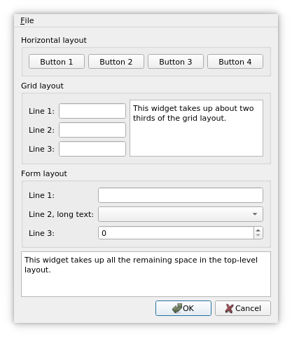
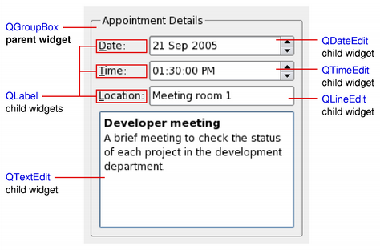
Widgets vs. Layouts
Widgets
Layouts
A user-interactable GUI element:
QLabel;
QMainWindow;
QComboBox;
QPushButton; etc.
Widgets can live on their own;
Widgets contain either no layout or a single layout.
Custom widgets are defined often.
A container for widgets/layouts:
QHBoxLayout;
QVBoxLayout;
QGridLayout;
QFormLayout.
Layouts must be set into a widget;
Layouts can contain an unlimited number of widgets and layouts;
Custom layouts are defined rarely.

Slide 12
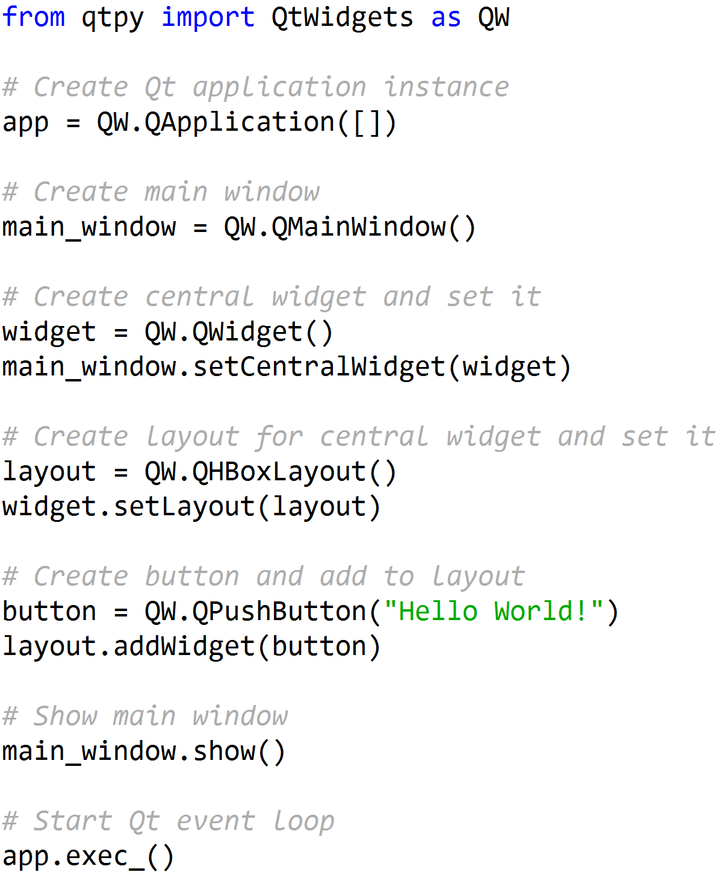
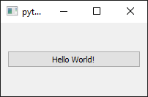
Getting started with Qt: Another example

Slide 13
Signals & Slots
Signals
Slots
Emitted when a specific event occurs:
A button is clicked;
A window closes;
A text line is edited;
A key is pressed;
A dialog is resized, etc.
Can provide specific arguments;
Can be connected to multiple slots;
Does not know if slots are connected.
Executed when a specific signal is emitted:
Clean-up memory when window closes;
Select all text when CTRL+A is pressed;
Recalculate layout when dialog is resized;
Update a database when a button is clicked, etc.
Can request specific arguments;
Can be connected to multiple signals;
Does not know if connected to a signal.

Slide 14
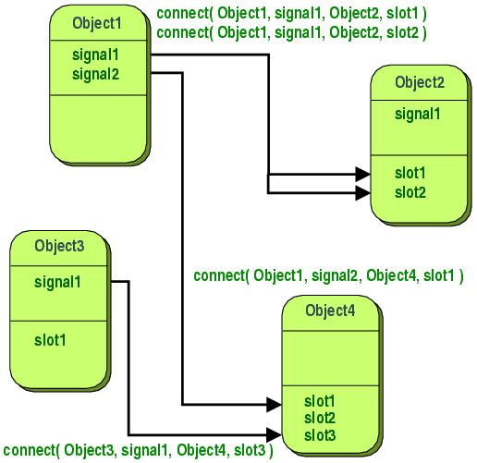
Signals & Slots
Signals
Slots
Emitted when a specific event occurs:
A button is clicked;
A window closes;
A text line is edited;
A key is pressed;
A dialog is resized, etc.
Can provide specific arguments;
Can be connected to multiple slots;
Does not know if slots are connected.
Executed when a specific signal is emitted:
Clean-up memory when window closes;
Select all text when CTRL+A is pressed;
Recalculate layout when dialog is resized;
Update a database when a button is clicked, etc.
Can request specific arguments;
Can be connected to multiple signals;
Does not know if connected to a signal.

Slide 15
QtDesigner

