Slide 1
An Introduction to SSH SSH Keys & SSH Config
Adam Batten
Cookies ‘n’ Code

Slide 2
Secure SHell (SSH)

Slide 3
Secure SHell (SSH)
SSH is a secure way to access another computer.

Slide 4
Secure SHell (SSH)
SSH is a secure way to access another computer.

Slide 5
Secure SHell (SSH)
SSH is a secure way to access another computer.

Slide 6
Secure SHell (SSH)
SSH is a secure way to access another computer.
This prompt interacts with Ozstar
This prompt interacts with my local machine

Slide 7
Why should I care about SSH Keys?

Slide 8
Why should I care about SSH Keys?
PASSWORDS ARE ANNOYING!

Slide 9
Why should I care about SSH Keys?
PASSWORDS ARE ANNOYING!
Remembering passwords
Typing your password everytime you SSH
Typing your password everytime you copy via SSH
Your password might not even be secure

Slide 10
Why should I care about SSH Keys?
PASSWORDS ARE ANNOYING!
Remembering passwords
Typing your password everytime you SSH
Typing your password everytime you copy via SSH
Your password might not even be secure
SSH Keys removes the need to enter passwords whilst still being secure

Slide 11
Why should I care about SSH Keys?
PASSWORDS ARE ANNOYING!
Remembering passwords
Typing your password everytime you SSH
Typing your password everytime you copy via SSH
Your password might not even be secure
SSH Keys removes the need to enter passwords whilst still being secure
Setting this up once will actually save you lots of time in the future.

Slide 12
Setting up SSH Keys for Ozstar

Slide 13
Setting up SSH Keys for Ozstar
Step 1: Generate a SSH key pair
ssh-keygen –t rsa

Slide 14
Setting up SSH Keys for Ozstar
Step 1: Generate a SSH key pair
ssh-keygen –t rsa
Step 2: Copy public key to Ozstar
ssh-copy-id user@ozstar.swin.edu.au
(You may need to install ssh-copy-id although most have it by default.)

Slide 15
How do SSH Keys work?

Slide 16
How do SSH Keys work?
Asymmetric cryptography

Slide 17
How do passwords work?
Hash Functions

Slide 18
How do passwords work?
Hash Functions
⟹ “One Way” Function

Slide 19
How do passwords work?
Hash Functions
⟹ “One Way” Function
badpassword1 ⟹ DFCD345452ED879e

Slide 20
How do passwords work?
Hash Functions
⟹ “One Way” Function
badpassword1 ⟹ DFCD345452ED879e
Example:
Square root a number 3 times remove the decimal point, 0’s and 8’s then use the first 5 numbers. 27164 24534 23796

Slide 21
How do passwords work?
Hash Functions
⟹ “One Way” Function
badpassword1 ⟹ DFCD345452ED879e
Example:
Square root a number 3 times remove the decimal point, 0’s and 8’s then use the first 5 numbers. 27164 24534 23796 3584 1313 4207

Slide 22
How do SSH Keys work?
Public
Private

Slide 23
How do SSH Keys work?
Public
These keys “undo” each other in a mathematical operation. Anything encrypted with one is decrypted with the other.
Private

Slide 24
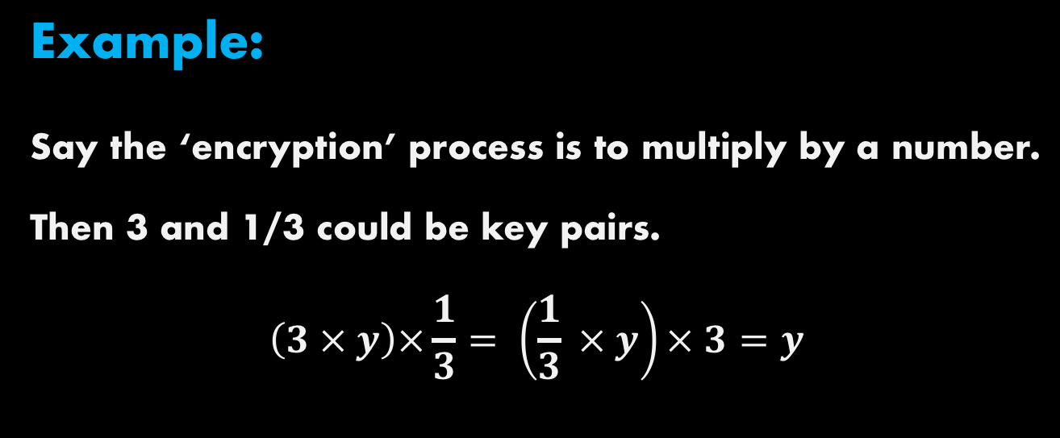
How do SSH Keys work?
Public
These keys “undo” each other in a mathematical operation. Anything encrypted with one is decrypted with the other.
Private
Example: Say the ‘encryption’ process is to multiply by a number. Then 3 and 1/3 could be key pairs. $$\left(3 × y\right)×\frac{1}{3}= \left(\frac{1}{3} × y\right)× 3=y$$

Slide 25
How do SSH Keys work?
YOU
OZSTAR

Slide 26
Step 1: Generate a SSH key pair
ssh-keygen –t rsa
YOU
OZSTAR

Slide 27
Setting up SSH Keys for Ozstar
Step 1: Generate a SSH key pair
ssh-keygen –t rsa
Step 2: Copy public key to Ozstar
ssh-copy-id user@ozstar.swin.edu.au
(You may need to install ssh-copy-id although most have it by default.)

Slide 28
Step 1: Generate a SSH key pair
ssh-keygen –t rsa
YOU
OZSTAR

Slide 29
Step 1: Generate a SSH key pair
ssh-keygen –t rsa
Step 2: Copy public key to Ozstar
ssh-copy-id user@ozstar.swin.edu.au
YOU
OZSTAR

Slide 30
Setting up SSH Keys for Ozstar
Step 1: Generate a SSH key pair
ssh-keygen –t rsa
Step 2: Copy public key to Ozstar
ssh-copy-id user@ozstar.swin.edu.au
(You may need to install ssh-copy-id although most have it by default.)

Slide 31
YOU
OZSTAR

Slide 32
Attempt to login to Ozstar
ssh user@ozstar.swin.edu.au
YOU
OZSTAR

Slide 33
Attempt to login to Ozstar
ssh user@ozstar.swin.edu.au
Bananas
YOU
OZSTAR

Slide 34
Attempt to login to Ozstar
ssh user@ozstar.swin.edu.au
Bananas
YOU
OZSTAR
Hash: 2114114119

Slide 35
Attempt to login to Ozstar
ssh user@ozstar.swin.edu.au
Bananas
YOU
OZSTAR
Encrypted: 13356
Hash: 2114114119

Slide 36
Attempt to login to Ozstar
ssh user@ozstar.swin.edu.au
Bananas
YOU
OZSTAR
Encrypted: 13356
Hash: 2114114119

Slide 37
Attempt to login to Ozstar
ssh user@ozstar.swin.edu.au
Bananas
YOU
OZSTAR
Encrypted: 13356
Hash: 2114114119

Slide 38
Attempt to login to Ozstar
ssh user@ozstar.swin.edu.au
Bananas
YOU
OZSTAR
Decrypted: Bananas
Hash: 2114114119

Slide 39
Attempt to login to Ozstar
ssh user@ozstar.swin.edu.au
Bananas
YOU
OZSTAR
Hash: 2114114119
Hash: 2114114119

Slide 40
Attempt to login to Ozstar
ssh user@ozstar.swin.edu.au
Bananas
YOU
OZSTAR
Hash: 2114114119
Hash: 2114114119

Slide 41
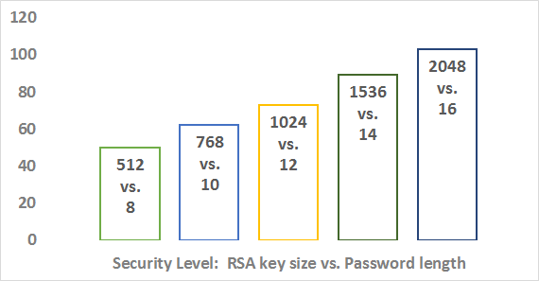
How strong are SSH keys?
Default
The default ssh key is as strong as a 16 character password.

Slide 42
How strong are SSH keys?
Default
The default ssh key is as strong as a 16 character password.
i.e.”safe” until around 2030

Slide 43
SSH Config

Slide 44
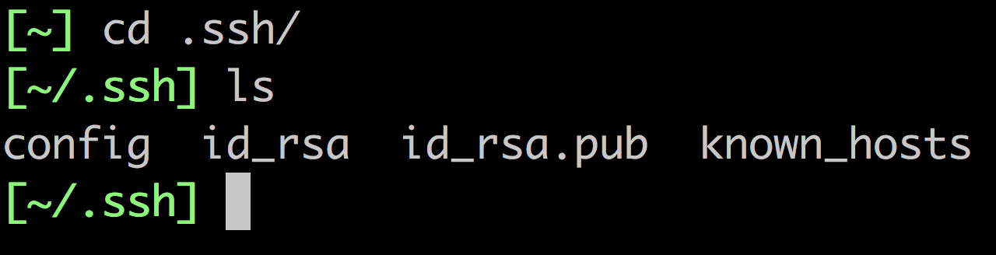
SSH Config

Slide 45
SSH Config
Inside your .ssh folder you should see 4 files: 1. config This is your ssh config file
2. id_rsa This is your private key (DO NOT SHARE THIS!) 3. id_rsa.pub This is your public key 4. known_hosts This is a list of known places you ssh

Slide 46
SSH Config
Your SSH config contains the settings for everything when you SSH into a remote server.
Host firsthost SSH_OPTION_1 custom_value
SSH_OPTION_2 custom_value
SSH_OPTION_3 custom_value
Host secondhost SSH_OPTION_1 custom_value
SSH_OPTION_2 custom_value
SSH_OPTION_3 custom_value

Slide 47
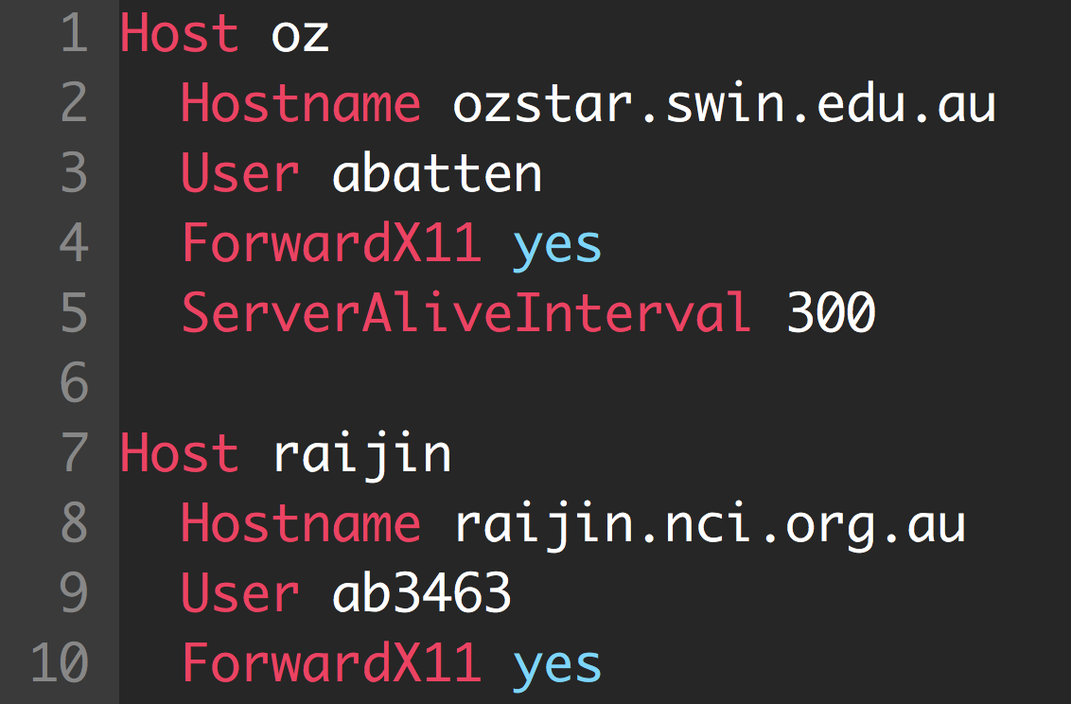
SSH Config

Slide 48
SSH Config
Name of the host

Slide 49
SSH Config
Name of the host
Host Location

Slide 50
SSH Config
Name of the host
Host Location
Your Username

Slide 51
SSH Config
Name of the host
Host Location
Your Username
Forward display from host to your computer

Slide 52
SSH Config
Without SSH Config

Slide 53

SSH Config
Without SSH Config
Using SSH Config

