Slide 1
Improving Your Life with mpi4py
Or
How I Learned to Stop Worrying and Love Parallelization
Jacob Seiler

Slide 2
Overview
What is MPI?
When should I use MPI?
Examples!

Slide 3
What is MPI?
MPI stands for Messenger Passing Interface.
Provides a standard design for passing messages across multiple processors.
Can be physically one machine (laptop) or separate discrete machines (supercomputer).
mpi4py provides bindings for using MPI in Python. Same underlying machinery but has a few extra perks (e.g., communicating arrays across processors).
Notes:
Can be physically one machine or in a supercomputer (separate discrete things).

Slide 4
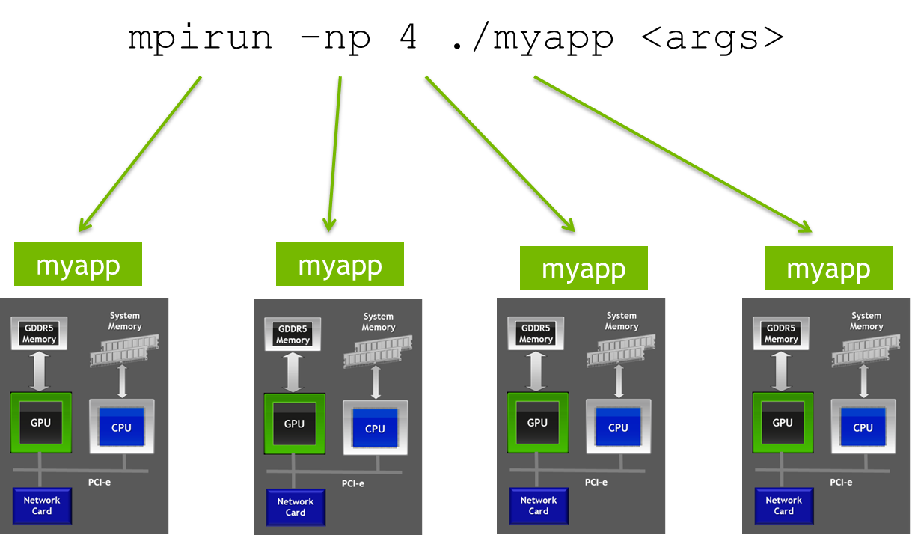
What is MPI?

Slide 5
When to use MPI?
Always.
When multiple, similar operations are being performed (look for “for” loops).
There are two broad classes of problems that can be solved with MPI:
Embarrassingly Parallel: In this case the operations are completely independent of each other. E.g., Running a program on 64 different initial conditions.
Communication Intensive: This class requires heavy communication between processors. E.g., N-body simulation where processors need to communicate their updated position at the end of each time step.

Slide 6
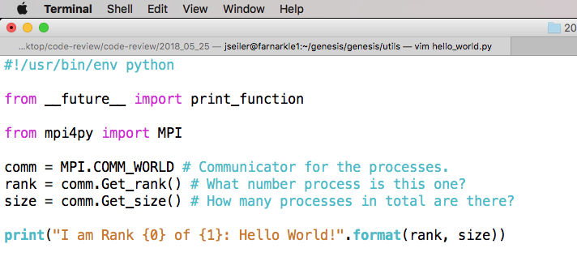
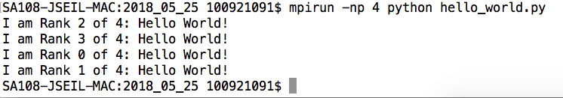
mpi4py: The Basics

Slide 7
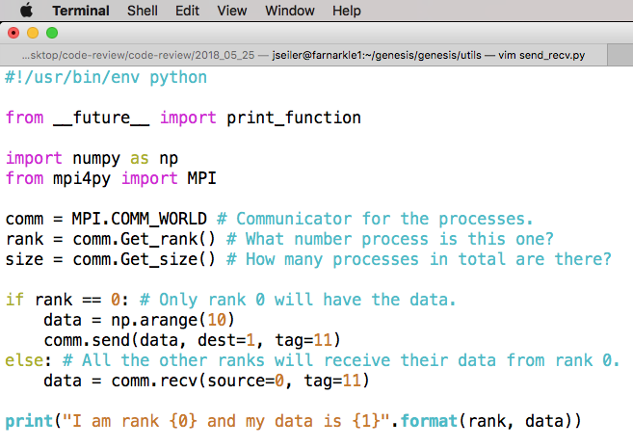

mpi4py: Send/Receive

Slide 8
Send/Receive
Be aware that ‘comm.send()’ and ‘comm.recv()’ are blocking communications. They will wait until the other process has received/sent the appropriate message.
This means that programs can hang as they wait for a message that will never come!
Test: See what happens when you change ‘tag=11’ to ‘tag=12’ for either ‘comm.send()’ or ‘comm.recv()’.

Slide 9
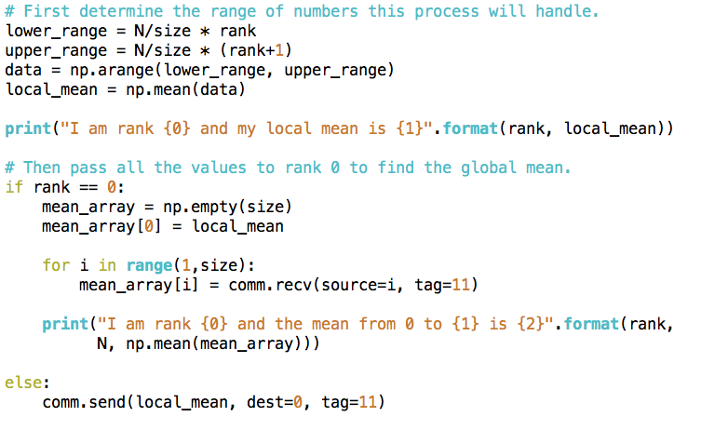
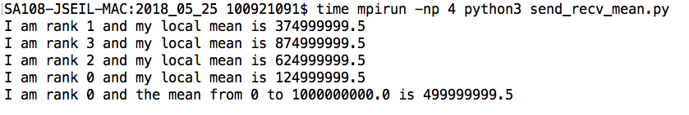
mpi4py: Send/Receive

Slide 10
mpi4py: Send/Receive
For N = 1e9:
Time on 1 Processor: 5.922s
Time on 4 Processors: 2.311s
If you did this for 1000 time steps, MPI would save you 1 hour!

Slide 11
Manually Send/Receive is tedious…
Manually managing all the send/receive calls can be tedious.
Can be dangerous if you have many communications; need to ensure all send/receives are being answered.
For collective operations (e.g., summing across processes) it’s much much easier…

Slide 12
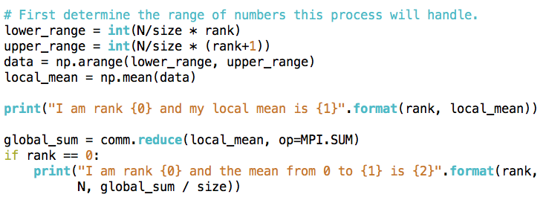
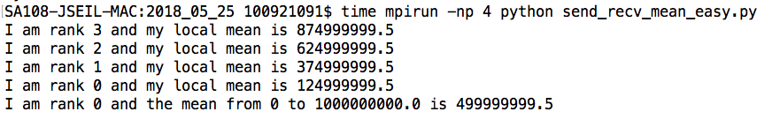
mpi4py: Send/Receive

Slide 13
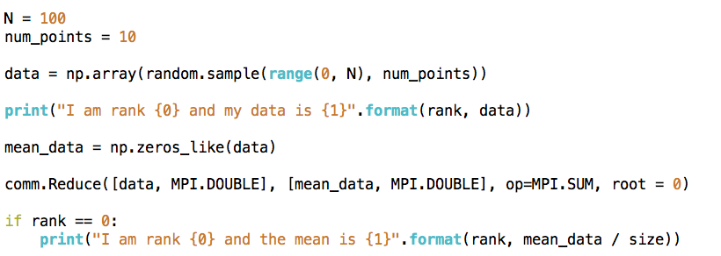
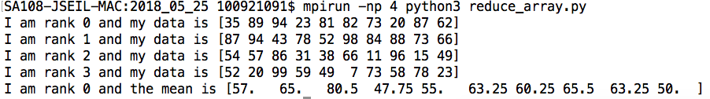
mpi4py: Send/Receive

Slide 14
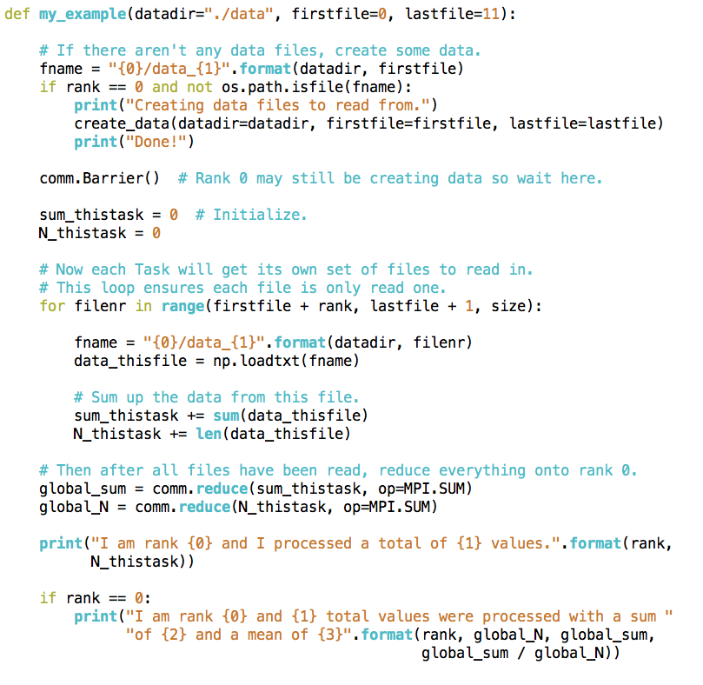
mpi4py: A more real example...

Slide 15
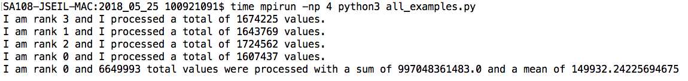
mpi4py: A more real example...

Slide 16
mpi4py: A more real example...
For N = ~6e6 data points across 12 files:
Time on 1 Processor: 24.869s
Time on 4 Processors: 7.555s

Slide 17
Summary
MPI can vastly speed your code up, allowing you to perform many operations simultaneously.
It’s critical to identify if your code can be parallelized, and the level of effort required (e.g., embarrassingly parallel vs intensive communication).
Give consideration to time spent parallelizing vs speedup. Some codes are only ever run once; could the time spent parallelizing be spent actually running the code?

Slide 18
Read the Docs!
http://mpi4py.scipy.org/docs/usrman/tutorial.html
Basically a summary of everything I showed!

